Slide 1
Electrosurgical leaflet modification to prevent coronary obstruction during transcatheter aortic valve replacement in failing native and bioprosthetic valves Results of the TELLTALE pivotal trial (NCT05666713)
Toby Rogers, Jaffar Khan, Roger Laham, Vasilis Babaliaros, Adam Greenbaum, Lowell Satler, Azeem Latib, Jeremy Rier, James Harvey, Brad Oldemeyer, Jamie McCabe, Jeremiah Depta, Jason Foerst, David Daniels, George Petrossian, Newell Robinson, William Chung, Isida Byku, Andrea Scotti, Justin Strote, Aaron Schelegle, Rim Halaby, Christopher Bruce, Xin Tian, Annette Stine, and Robert Lederman, on behalf of the TELLTALE investigators.

Slide 2
Toby Rogers, MD PhD
Consulting: Edwards Lifesciences, Medtronic, Boston Scientific, Abbott, Anteris, and Transmural Systems
Advisory board: Medtronic, Boston Scientific
Equity interest: Transmural Systems
Intellectual property: co-inventor on patents, assigned to NIH, for transcatheter electrosurgery devices.

Slide 3
Introduction
Coronary obstruction may occur during TAVR for native aortic stenosis or bioprosthetic valve failure
If coronary obstruction occurs, it is associated with high morbidity and mortality
Pre-TAVR computed tomography (CT) identifies patients at risk of coronary obstruction
Leaflet modification (BASILICA) using off-label guidewires and catheters has been shown to effectively prevent coronary obstruction in patients with high-risk anatomy

Slide 4
TELLTALE Trial Objective
To test the safety and effectiveness of the TELLTALE Leaflet Modification System to prevent coronary artery obstruction in high or prohibitive surgical risk patients undergoing TAVR for native aortic stenosis or bioprosthetic valve failure whose anatomy predicts high risk of coronary obstruction due to narrow sinus of Valsalva or sinus sequestration.

Slide 5
Clinical trial oversight
NHLBI Transmural Electrosurgery LeafLet Traversal And Laceration Evaluation (TELLTALE) Trial (NCT05666713)
Sponsor | National Heart, Lung, and Blood Institute (NHLBI)
CT Core Laboratory | National Heart, Lung, and Blood Institute (NHLBI)
Data Monitoring* | National Heart, Lung, and Blood Institute (NHLBI)
Independent Clinical Events Adjudication Committee (CEAC) | MedStar Health Research Institute
Data and Safety Monitoring Board (DSMB) | National Heart, Lung, and Blood Institute (NHLBI)
Funding | NIH Z01-HL006040
* 100% source data verification

Slide 6
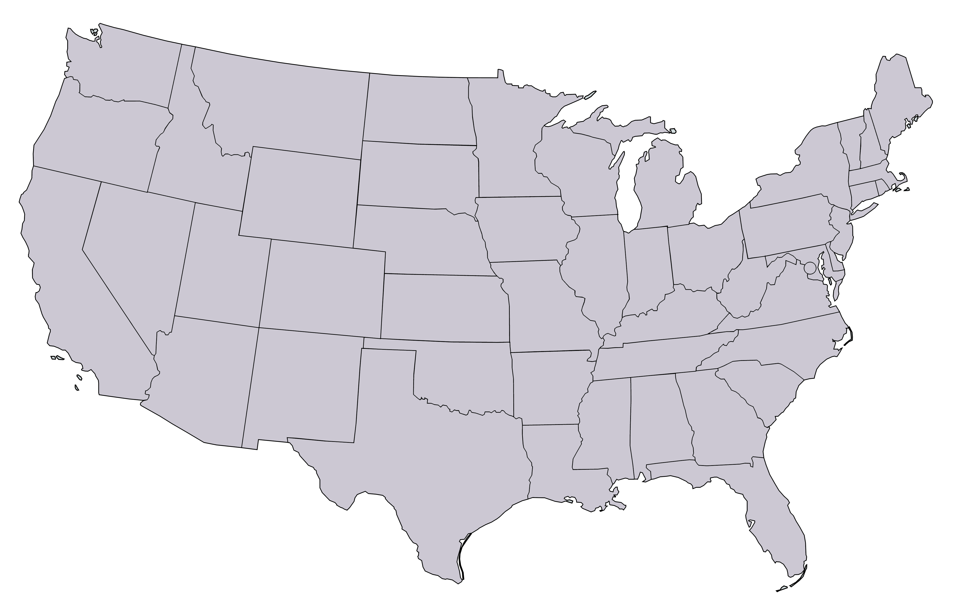
Enrolling centers
Jaffar Khan, George Petrossian & Newell Robinson St Francis Hospital and Heart Center - Roslyn, NY (n=20)
Roger Laham
Beth Israel Deaconess Medical Center - Boston, MA (n=14)
Adam Greenbaum, Vasilis Babaliaros & Isida Byku Emory University - Atlanta, GA (n=12)
Lowell Satler & Toby Rogers
MedStar Washington Hospital Center - Washington, DC (n=11)
Azeem Latib & Andrea Scotti
Montefiore Medical Center - Bronx, NY (n=9)
Bradley Oldemeyer & Justin Strote
University of Colorado Health - Fort Collins, CO (n=6)
James Harvey & Jeremy Rier
Wellspan York Hospital - York, PA (n=6)
Jeremiah Depta
Rochester Regional Health - Rochester, NY (n=4)
Jamie McCabe, Christine Chung, David Elison
University of Washington Heart Institute - Seattle, WA (n=4)
David Daniels
California Pacific Medical Center - San Francisco, CA (n=2)
Jason Foerst & Aaron Schelegle
Carilion Medical Center - Roanoke, VA (n=2)

Slide 7
Eligibility Criteria
Key Inclusion Criteria
High or prohibitive risk of surgical aortic valve replacement according to the local multidisciplinary heart team
Undergoing TAVR for bioprosthetic aortic valve failure or native aortic stenosis
High risk of coronary obstruction based on NHLBI Core lab analysis of CT, any of:
Risk is narrow Sinus of Valsalva: (a) Leaflet height is greater than coronary artery height, and (b) Virtual transcatheter valve-to-coronary (VTC) distance < 4mm
Risk is Sinus sequestration: (a) Leaflet height is greater than sinotubular junction, and (b) Virtual transcatheter valve-to-sinotubular-junction distance (VTSTJ) < 2mm at the affected Sinus
Key Exclusion Criteria
Requires doppio (two-leaflet) BASILICA*
Flail target leaflet at baseline
Excessive target aortic leaflet calcification (no basal calcium-free window or potentially obstructive calcific masses) on baseline CT
Requires non-femoral access
* Doppio BASILICA excluded per protocol because discordant first and second leaflet results would impact assessment of the primary efficacy endpoint.

Slide 8
Study design
High surgical risk subjects undergoing TAVR for native aortic stenosis or bioprosthetic valve failure (n=157)
High risk for coronary obstruction determined by NHLBI core laboratory CT analysis and multidisciplinary study eligibility committee (n=90)
TELLTALE BASILICA-TAVR for bioprosthetic valve failure (n=60)
TELLTALE BASILICA-TAVR for native aortic stenosis (n=30)
In hospital Primary Endpoints*
30-day and 90-day follow up
* Adjudicated by independent Clinical Events Adjudication Committee

Slide 9
Reasons for Exclusion
(n=67)
* Doppio BASILICA excluded per protocol because discordant first and second leaflet results would impact assessment of the primary efficacy endpoint.

Slide 10
Primary Efficacy Endpoint
Technical success, assessed upon exit from the cardiac catheterization laboratory, and defined as:
Successful electrosurgical leaflet traversal using the TELLTALE guidewire;
and successful electrosurgical leaflet laceration using the TELLTALE guidewire;
and successful retrieval of the TELLTALE guidewire system.

Slide 11
Primary Safety Endpoint
Inpatient safety, assessed upon hospital discharge and defined as a composite of freedom from:
Mortality (all-cause)
Stroke, (both disabling and non-disabling)
Acute coronary artery obstruction
Emergency cardiac surgery or reintervention related to the TELLTALE BASILICA procedure or device
BASILICA-related complications including coronary artery perforation, coronary artery dissection, aortic dissection, cardiac free wall perforation, or systemic embolization of a native or bioprosthetic leaflet.

Slide 12
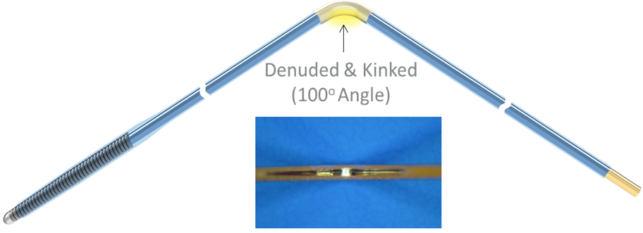
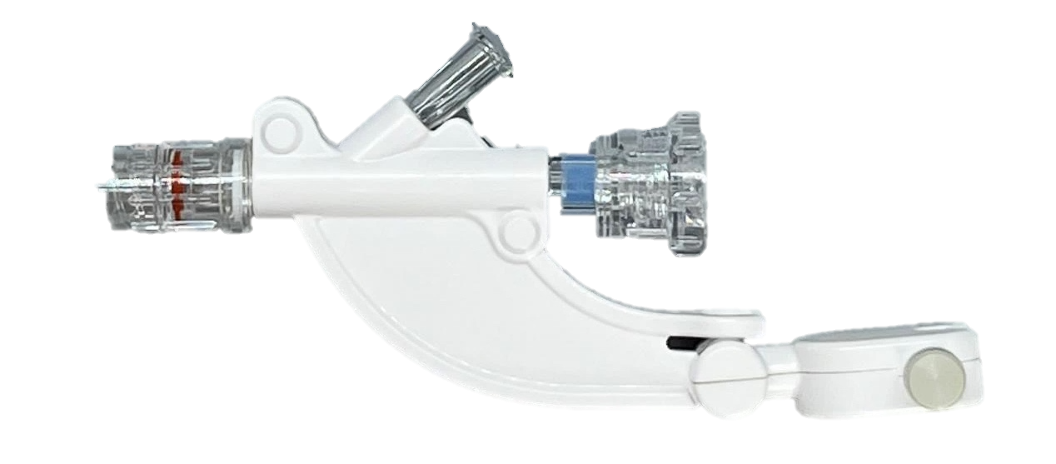
TELLTALE Leaflet Modification System
Kinker-denuder
Wire grippers
Notes:
0.14” so it is compatible with balloon or microcatheters, if you need them.
The whole guidewire is insulated, except for the very distal tip, used for leaflet traversal and the proximal end which is connected to the generator.
The center section has a flourscopic gold marker which is denuded and kinked by the user using this tool that we designed to reliably create the the Flying-V. The shiny gold section indicates the insulation has been removed on the inner curvature of the wire.
In addition, we provide Wire Grippers (also known as the groovy touhy) that clamps onto the guidewire to prevent slipping during Laceration

Slide 13
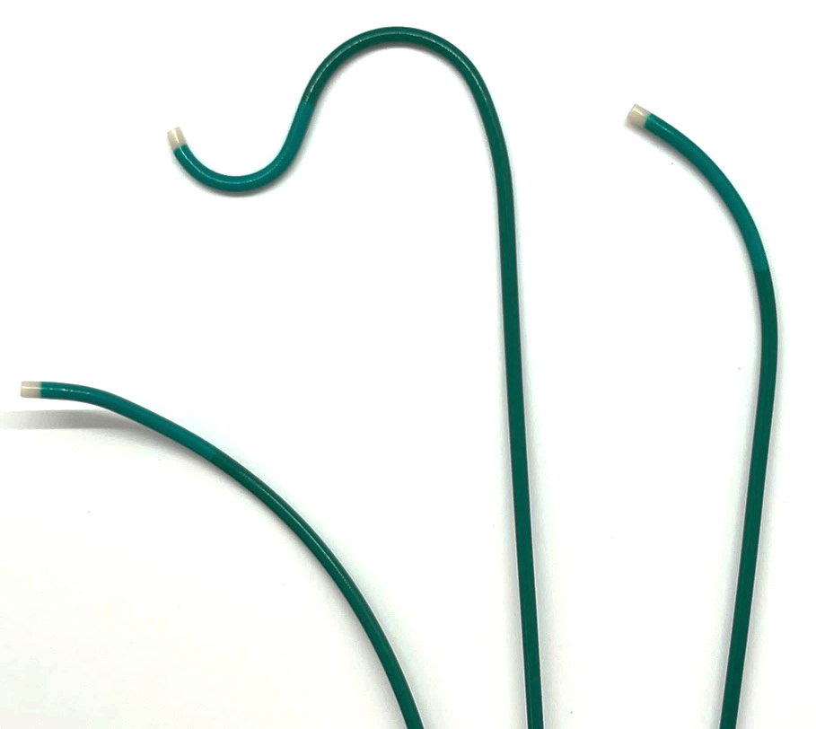
TELLTALE Pachyderm Catheters
Left Leaflet
Guide Catheter
Snare
Guide Catheter
Right Leaflet
3D Guide Catheter

Slide 14
TELLTALE native leaflet modification
Step 1 – catheter positioning
Step 2 – leaflet traversal

Slide 15
TELLTALE native leaflet modification
Step 3 – guidewire snaring
Step 4 – leaflet laceration

Slide 16
TELLTALE native leaflet modification
Aortogram after TAVR

Slide 17
Baseline characteristics
Characteristic | n=90
Age | 79 (75, 82)
Female | 59 (65.6%)
STS-PROM (%) | 4.2 (3.0, 6.6)
Diabetes mellitus | 31 (34.4%)
End-stage renal disease | 0 (0%)
Severe pulmonary disease | 10 (11.1%)
Home oxygen use | 5 (5.6%)
Cirrhosis | 22 (24.4%)
Permanent pacemaker | 10 (11.1%)
Characteristic | n=90
Hypertension | 75 (83.3%)
Coronary artery disease | 41 (45.6)
Percutaneous coronary intervention | 12 (13.3%)
Coronary artery bypass grafting | 25 (27.8%)
Myocardial infarction | 8 (8.9%)
Peripheral artery disease | 17 (18.9%)
Stroke | 14 (15.5%)
Transient ischemic attack | 8 (8.9%)
Atrial fibrillation
Paroxysmal | 20 (22.2%)
Persistent > 1 week or permanent | 7 (7.8%)

Slide 18
Aortic valve details
Characteristic | n=90
Target leaflet cusp
Left | 74 (82.2%)
Right | 16 (18.8%)
Prior surgical aortic valve implant
CE Magna family | 29/60 (48.3%)
Epic | 3/60 (5.0%)
Freestyle | 1/60 (1.7%)
Mitroflow | 3/60 (5.0%)
Mosaic | 3/60 (5.0%)
Trifecta | 20/60 (33.3%)
Characteristic | n=90
Years since aortic valve replacement | 10.0 (7.5, 14.0)
Type of aortic valve
Native | 30 (33.3%)
Stented, inner leaflet | 35 (43.3%)
Stented, outer leaflet | 23 (25.6%)
Stentless | 1 (1.1%)
TAVR* | 1 (1.1%)
Aortic valve failure mode
Aortic regurgitation | 10 (11.1%)
Aortic stenosis | 72 (80.0%)
Mixed | 8 (8.9%)
* n=1 Evolut

Slide 19
Computed tomography
Characteristic | n=90
Mechanism of coronary obstruction risk*
Coronary ostial obstruction | 56 (62.2%)
Sinus sequestration | 16 (18.8%)
Both | 18 (20.0%)
Sinotubular junction height (mm) | 13.7 (12.8, 15.5)
Leaflet height (mm) | 15.0 (13.6, 16.0)
Width of Sinus of Valsalva (mm) | 29.0 (27.3, 31.0)
Height of coronary ostium (mm) | 8.3 (6.3, 11.0)
VTC (Predicted virtual TAVR to coronary ostium distance, mm) | 3.4 (2.9, 3.8)
VTSTJ (Predicted virtual TAVR to sinotubular junction distance, mm) | 1.5 (0.8, 1.7)
* STJ height, VTC, and VTSTJ at target reflect predicted mechanisms of obstruction.

Slide 20
Procedural details
Characteristic | n=90
TAVR device implanted
Evolut FX/FX+ | 43 (47.8%)
Navitor | 3 (3.3%)
Sapien 3/Ultra/Resilia | 44 (48.9%)
TAVI device nominal diameter
20 | 8 (8.9%)
23 | 52 (57.8%)
26 | 25 (27.8%)
29 | 5 (5.6%)
Characteristic | n=90
Anesthesia or sedation strategy
General anesthesia | 65 (72.2%)
Moderate sedation | 25 (27.8%)
Cerebral embolic protection*
None | 13 (14.4%)
Sentinel only one filter deployed | 4 (4.4%)
Sentinel both filters deployed | 73 (81.1%)
Debris recovered (site reported) | 29/76 (38.2%)
* Optional per protocol

Slide 21
Procedural details
Characteristic | n=90
Procedure stages
Time from first guiding catheter to TELLTALE traversal (min)* | 20 (14, 28)
Time from TELLTALE traversal to laceration (min)* | 15 (11, 20)
Time from TELLTALE to TAVR (min) | 8 (5, 11)
Procedure time including TAVR, total (min) | 84 (67, 105)
Radiocontrast volume, total (mL) | 83 (50, 149)
Fluoroscopy time, total (min) | 37 (30, 47)
Bioprosthetic frame fracture (BVF) or remodeling attempted | 29 (32.5%)
Number of electrifications for traversal | 1 (1, 2)
Number of electrifications for laceration | 1 (1, 1)
Target leaflet avulsed by TELLTALE | 0 (0%)
* Time included cerebral embolic protection placement, valve preparation, recrossing aortic valve, etc.

Slide 22
Primary Efficacy Endpoint*
The primary Efficacy Endpoint was met in
100% of subjects
Technical success, assessed upon exit from the cardiac catheterization laboratory, and defined as:
Successful electrosurgical leaflet traversal using the TELLTALE guidewire;
and successful electrosurgical leaflet laceration using the TELLTALE guidewire;\
and successful retrieval of the TELLTALE system.

Slide 23
Primary Safety Endpoint*
The primary Safety Endpoint was met in
96% of subjects
Inpatient safety, assessed upon hospital discharge and defined as a composite of freedom from:
All-cause mortality
Stroke (disabling and non-disabling)
Acute coronary artery obstruction
Emergency cardiac surgery or reintervention related to the TELLTALE BASILICA procedure or device BASILICA-related complications including coronary artery perforation, coronary artery dissection, aortic dissection, cardiac free wall perforation, or systemic embolization of a native or bioprosthetic leaflet

Slide 24
Primary Safety Endpoint*
Characteristic | n=90
All-cause mortality | 0 (0%)
Stroke | 3 (3.3%)
Disabling | 1 (1.1%)
Non-disabling | 2 (2.2%)
Coronary obstruction* | 1 (1.1%)
Emergency cardiac surgery or reintervention related to the TELLTALE BASILICA procedure or device | 0 (0%)
BASILICA-related complications including coronary artery perforation, coronary artery dissection, aortic dissection, cardiac free wall perforation, or systemic embolization of a native or bioprosthetic leaflet | 0 (0%)
* n=1 subacute coronary obstruction attributed to Sapien commissural suture post landing randomly in front of BASILICA leaflet splay, returned to the cath lab and resolved with deployment of orthotopic stent

Slide 25
Stroke
Characteristic | Stroke #1 | Stroke #2 | Stroke #3
Native or bioprosthetic valve | Bioprosthetic | Native | Native
Timing of stroke post TAVR | Day 1 | Day 5 | Day 2
Disabling or non-disabling* | Non-disabling | Non-disabling | Disabling
Related to TELLTALE* | No | No | Unlikely
Related to TAVR* | Possibly | No | Possibly
Cerebral embolic protection with both filters in place throughout BASILICA and TAVR | No (no debris captured) | Yes (no debris captured) | Yes (no debris captured)
Bioprosthetic valve fracture performed | Yes | — | —
History of atrial fibrillation | No | Yes | Yes
Description | Sentinel removed after TELLTALE but before TAVR and BVF | Anticoagulation withheld | Posterior circulation stroke
* Adjudicated by independent Clinical Events Adjudication Committee

Slide 26
Complications
Characteristic | Inpatient n=90 | 30-day * n=88 (cumulative)
Any of the following | 8/90 (8.9%) | 10/88 (11.4%)
Mortality, all-cause | 0 (0%) | 0 (0%)
Stroke | 3 (3.3%) | 3 (3.4%)
Disabling | 1 (1.1%) | 1 (1.1%)
Non-disabling | 2 (2.2%) | 2 (2.3%)
Transient ischemic attack | 0 (0%) | 0 (0%)
Major or life-threatening vascular access complication | 3 (3.3%) | 4 (4.5%)
Major or life-threatening bleeding | 4 (4.4%) | 5 (5.7%)
Acute kidney injury stage 3 or 4 | 0 (0%) | 0 (0%)
Delayed coronary obstruction | 1 (1.1%) | 1 (1.1%)
New permanent pacemaker implantation | 4 (4.4%) | 5 (5.7%)
* Adjudicated by independent Clinical Events Adjudication Committee

Slide 27
Conclusions
The TELLTALE Leaflet Modification System enables TAVR without coronary obstruction in patients with high-risk anatomy
Effective electrosurgical leaflet traversal and laceration was achieved in all patients
The TELLTALE system is the only leaflet modification device for both native and bioprosthetic leaflets
The TELLTALE system has received FDA Breakthrough designation
The TELLTALE system (guidewire, pachyderm guiding catheters and accessories) make leaflet modification easy
The need for leaflet modification is predicted to grow substantially over the coming decade (in particular for TAVR-in-TAVR)

Slide 28
Acknowledgements
Enrolling centers
Emory University | Vasilis Babaliaros, Adam Greenbaum, Isida Byku, Gaetano Paone, Patrick Gleason, Elizabeth Charles, Kristie Pitts, Xu Wang, Steven Fair, Cherise Wilson, Olga Rivera
MedStar Washington Hospital Center | Lowell Satler, Toby Rogers, Ron Waksman, Erin Collins, Katherine Ellerd, Donya Barandeh
St Francis Hospital and Heart Center | Jaffar Khan, George Petrossian, Newell Robinson, William Chung, Lin Wang, Matt Henry, Joan Jennings, Patricia Krug, Linda Bongiovanni, Beth Schwartz, Elizabeth Haag, Kristin Pasquarello
Wellspan York Hospital | Jeremy Rier, James Harvey, Heather McKinney, Shannon Myers, Denise Grove
Rochester Regional Health | Jeremiah Depta, Jennifer LaLonde
University of Colorado Heath | Brad Oldemeyer, Justin Strote, Dulce Hayes, Adam Jaskowiak
California Pacific Medical Center | David Daniels, Christian Spies, Milena Ferreria, Olivia Lewman, Bonnie Chan
Montefiore Medical Center | Azeem Latib, Andrea Scotti, Kara Booth, Pan Phyu
Beth Israel Deaconess Medical Center | Roger Laham, Jenifer Kaufman, Jacob Luetje
Carilion Medical Center | Jason Foerst, Aaron Schelegle, Brittny O’Toole, Rebecca Butterworth, Kristina Cooper
University of Washington | Jamie McCabe, Christine Chung, David Elison, Ray Larsen, JoAnn Cho, Jennifer Schaeffer
Clinical trial oversight
Sponsor (NHLBI) | Robert Lederman, Christopher Bruce, Irina Kolosova, Xin Tian
Study Manager | Annette Stine
Data Monitor | Valeriy Matveev
CT Core Laboratory (NHLBI) | Rim Halaby
Clinical Events Adjudication Committee | Hector Garcia-Garcia, Eugene McFadden, Alexandre Kajita, Pablo Rubio, Gebremedhin Melaku
Manufacturer
Transmural Systems | Nasser Rafiee, Kathleen Pizzuti, Rany Busold, Stuart MacDonald, Morgan House, Eric Matthew, Koosha Rafiee, Mai Diep, BiWei MacDonald, Marybeth Gamber, Arman Rafiee, Eylem Kocaturk, Yongguang Zhou, Ozgur Kocaturk, Penny Smith, Monica Cohen, Nga Nguyen

