Slide 1
Impending Paradoxical Embolism
Mohinder Vindhyal M.D., M.Ed, Paul Ndunda M.D., Cyrus Munguti M.D., Venkata SubbaRao Boppana, MD.

Slide 2
Presenter: Mohinder Vindhyal, M.D., M.Ed.
I have no relevant financial relationships

Slide 3
Clinical Presentation
A 65-year-old obese female presented to the emergency department (ED) with shortness of breath.
PMH: DM type II, hypertension, dyslipidemia
Pt on examination was diaphoretic, tachycardic ( HR – 110-125bpm), tachypneic (RR-24-28/min) and hypoxemic O₂ Sats – 86-88% on RA).

Slide 4
Investigations
EKG revealed atrial fibrillation with RVR
Serum lab markers were significant for elevated Brain natriuretic peptide (2500) and troponin (1ng/mL).

Slide 5
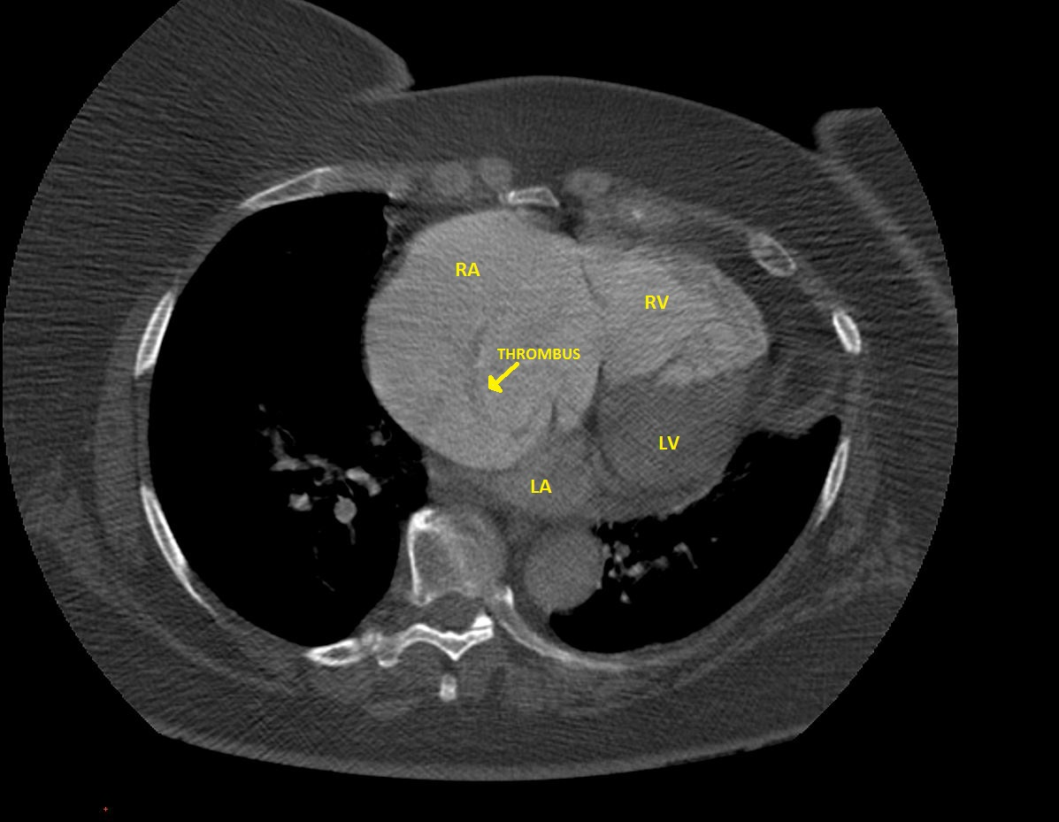
CT-Angiography(CTA)
CTA revealed main stem pulmonary embolism (PE) extending to both arteries along with a clot in right atrium (RA)

Slide 6
Clinical Course
The Pt was hemodynamically stable and was admitted for anticoagulation.

Slide 7
TTE
Demonstrated severe right ventricular ( RV) enlargement and dysfunction along with massive RA thrombus in transit to the left atrium (LA) through a patent foramen ovale (PFO).

Slide 8
TTE
Filling defect

Slide 9
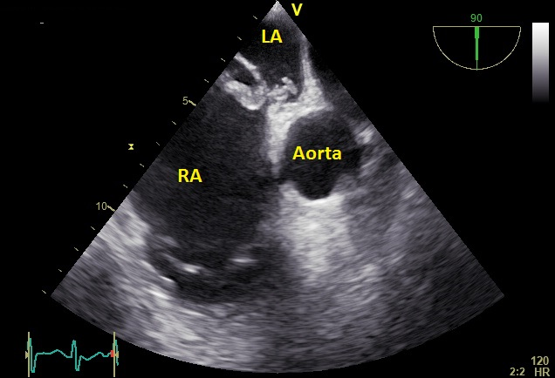
Transesophageal Echocardiogram (TEE)
Large echogenic mass of 8.5 cm in length in the RA extending through the PFO into the LA measuring 3.0 cm in length

Slide 10
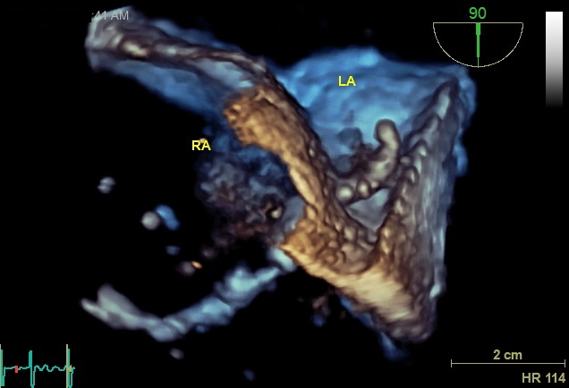
3D- Echo
Done to better understand the relationship of the clot with other cardiac structures.
Clot appeared free on either side of the atria with extension through PFO

Slide 11
3D-Echo

Slide 12
Hospital Clinical Course
Patient underwent surgical thrombectomy (ST) given her hemodynamic stability and high thrombotic burden.
Pt was started on anti-coagulation and remained on it due to high CHA₂DS₂VASC score from Atrial Fibrillation.

Slide 13
Clinical Course
Pt was discharged home after 3 days of being in the hospital.
Pt was continued on Anti-coagulation for Atrial Fibrillation
Pt was seen in the clinic after 2 weeks of being discharged and she remained symptom free.

Slide 14
Take Home Points
Clot in transit, also called as Impending Paradoxical Embolism (IPE) is rare when compared to right atrial thrombi associated with PE.
IPE has high mortality given the tendency for paradoxical embolism.
IPE has varied management options: Thrombolysis, anticoagulation or ST, none of them proven to have significant mortality benefit over each other.

