Slide 1
Ruptured Angiomyolipoma After Thrombolytic Therapy In High Risk Pulmonary Embolism
Saudi German Hospital Cairo Branch
Presented by Dr. Housam Hassan
Cardiology Registrar, Msc
Authors:
Housam Hassan (Msc), Mohamed Helmy (MD), Ahmed.E.Ragb (Msc), Mohamed.H.Abdelmaksoud (MD), Mahmoud.F. Elmeniesy (MD), Mahmoud Saraya (MD), Mostafa Abdelmonaem (MD), Tarek.K.Othman (MD), Mostafa Ibrahim (MD), Mohammed.A.Elmolla (MD), Amr.M.Salem (Msc), Amir.A.Abdelghany (Msc), Bassem.A.Abdelhalim (Msc), Ahmed Behiery (Msc), Ahmed.F.Tharwat (MD)

Slide 2
History:
A 68-year-old menopausal lady with a history osteoarthritic tibio-femoral and patella-femoral articulations presented to the emergency department with a complaint of dysuria and right flank pain, she was diagnosed with urinary tract infection.
During hospitalization, urine culture demonstrated Escherichia coli colony more than 100,000 cfu/mL. Complete blood picture showed leukocytosis of 19.5 cells/L, hemoglobin; 11.6g/dL, hematocrite; 37%, urea; 54mg/dL (Max44), serum creatinine; 1.5mg/dL, CRP; 4.6mg/dL (max0.5). Antibiotics and rehydration were initiated.

Slide 3
Examination
12 hours later, the patient complained from acute severe dyspnea associated with hemodynamic instability.
On examination her body temperature was 37.0°C, heart rate 117bpm, respiratory rate 38 breaths/min, blood pressure was 80/50, and oxygen saturation was 75%. Bilateral respiratory movements were identical. Breath sounds were diminished and no wheezes were heard. Regular heart rhythm, with prominent pulmonary component of cardiac second sound. Peripheral pulsations were not felt and reduced urine output recorded.

Slide 4
Investigations:
Arterial blood gas analysis showed: pH; 7.47, PaO2; 65 mm Hg, PaCO2; 29mm Hg, and HCO3; 28mmol/L (with 4 L/min flow rate of oxygen inhalation). Cardiac troponin I; 0.02ng/mL, CK-MB; 1.6ng/mL, D-dimer level; 238ng/mL(normal), procalcitonin; 0.2ng/ml.
Electrocardiography: revealed signs of RV strain, including inversion of T waves in leads V1–V3 and the classical Q wave in lead III.
Bedside echocardiography: revealed RV pressure overload characterized by dilated and hypokinetic RV. Color Doppler Ultrasound revealed moderate tricuspid regurgitation and severe pulmonary hypertension, pulmonary artery systolic pressure of 90mmHg and impaired right ventricular systolic function.
Lower limb venous duplex: showed subacute deep venous thrombosis in iliofemoral segment

Slide 5
Management of High risk pulmonary embolism:
Based on her initial diagnosis of high risk pulmonary embolism, she was transferred immediately to coronary care unit
she received intravenous thrombolytic therapy with recombinant tissue plasminogen activator (rt-PA, 100mg administered over 120 minutes) and an anticoagulant (Intravenous heparin continuous infusion with targeted partial thromboplastin time 50-70 seconds)
vasopressor (norepinephrine) and normal saline infusion were administered

Slide 6
Complication:
6 hours after thrombolytic therapy patient complained from acute left abdominal pain radiating to the back.
the patient became pale, heart rate 125bpm, blood pressure dropped to 90/60 and respiratory rate was 28 breaths per minute. Heparin infusion was held.
Hemoglobin dropped to 7.8gm/dL. Immediate resuscitation performed including transfusion of 4 packs of whole fresh blood, continuous saline infusion and reversal of transfused heparin using vitamin K agonist.
Pelvi-abdominal ultrasound: demonstrated the presence of angiomyolipoma measuring 5.0X5.9cm on the lower pole of the left kidney.
CT with contrast: revealed significant retroperitoneal hematoma due to ruptured angiomyolipoma and bilateral filling defects in both main pulmonary arteries (Figure 1, 2)

Slide 7
Management of Retroperitoneal Hematoma:
Inferior Vena Cava filter was implanted
Peripheral angiography demonstrated: two ruptured vessels feeding retroperitoneal hematoma; one of them was large and aneurysmatic
Selective arterial embolization for both feeding vessels using 3 vascular plugs was done in the same setting
Anticoagulation using heparin infusion resumed after 5 days (Targeting 1.5 times baseline partial thromboplastin time) with close follow up of hemoglobin, hematocrite, PTT, kidney function test and oxygen saturation.

Slide 8
Monitoring and follow up
3 days after thrombolytic therapy, hypoxemia remarkably improved, arterial blood gas analysis revealed pH; 7.40, PaO2; 81 mmHg, PaCO2; 38mmHg, (On room air). Her oxygen saturation was 92% maintained on room air.
Follow up CT abdomen and pelvis with IV contrast demonstrated stationary size of retroperitoneal hematoma (Figure7).
Follow up echocardiography revealed decreased RV diastolic dimensions with fair RV systolic function, pulmonary artery systolic pressure decreased to 55mmHg.
Upon discharge, she was prescribed antibiotic, paracetamol and non-vitamin K novel oral anticoagulant (Apixaban 5mg twice daily).

Slide 9
CT Abdomen and Pelvis with contrast
Figure (1) CT abdomen with contrast demonstrating a large heterogeneous left renal lower polar mass lesion of mixed soft tissue and fat density, measures about (5 x 5.6 x 4.5) cm in the maximum (AP, CC & TS) dimensions. The lesion shows ill-defined borders with surrounding ill-defined extensive collection of mixed blood and fluid density, filling the left perinephric space and left retroperitoneal space and extending down to the left iliac fossa, measuring about (10 x 10 x 28 ) cm in the maximum (CC, TS & AP)dimensions of about 60 HU (blood) denoting hematoma.

Slide 10
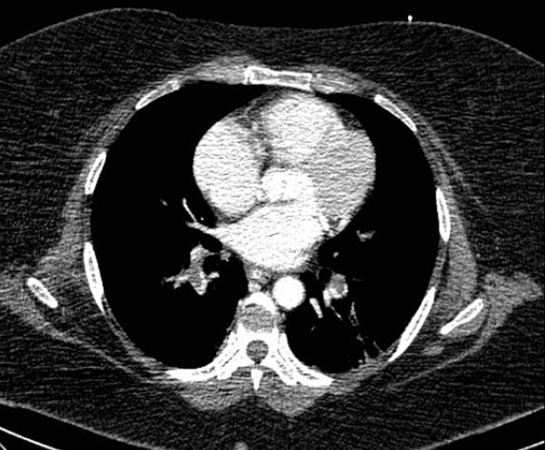
CT pulmonary angiography
Figure (2) CT pulmonary angiography reveals extensive bilateral pulmonary emboli

Slide 11
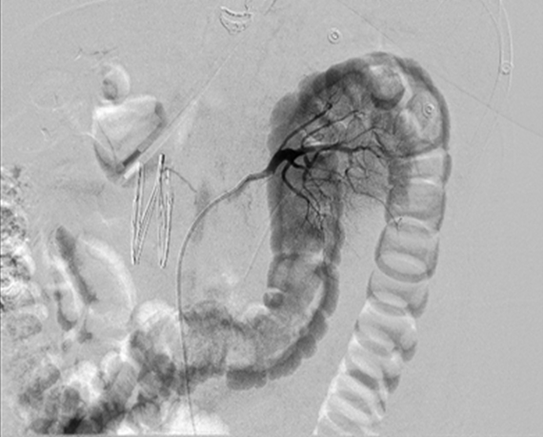
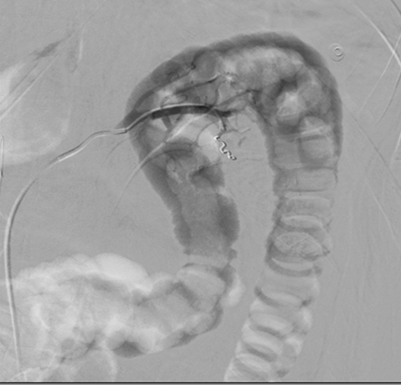
Inferior Vena Cava filter and peripheral angiography:
Figure (3) Showing selective angiography for angiomyolipoma feeding vessels after successful implantation of inferior vena cava filter in the same setting.
Figure (4) angiography showing successful selective embolization of feeding vessel using vascular plug

Slide 12
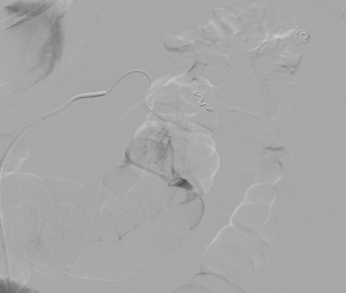
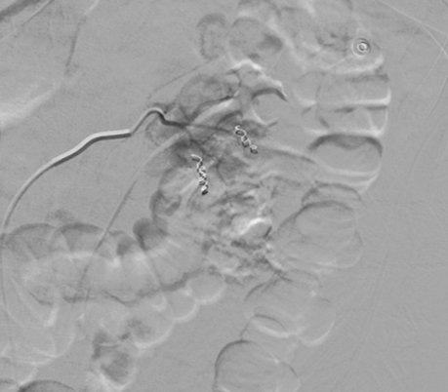
Selective Arterial Embolization
Figure (5) Selective angiography showing aneurysmatic dilatation of angiomyolipoma feeding vessel
Figure (6) Selective angiography showing successful embolization of angiomyolipoma feeding vessels using vascular plugs.

Slide 13
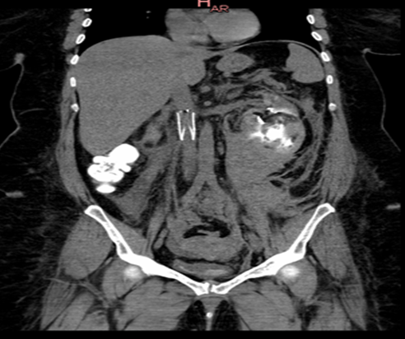
Follow up CT Abdomen and Pelvis
Figure (7) Follow up CT abdomen 24 hours later showing a stationary non-enhanced appearance of the previously noted ill-defined borders with surrounding illdefined extensive collection/hematoma of mixed blood and fluid density, filling the left perinephric space and left retroperitoneal space and extending down to the left iliac fossa with currently noted pelvic retro-peritoneal fluid collection/extension down to the pre-sacral level

Slide 14
Take Home Message
High clinical suspicion is the key in diagnosis of pulmonary embolism
Risk stratification and Early initiation of anticoagulation and thrombolytic therapy in high risk pulmonary embolism is crucial
Rapid detection of complication and resuscitation are cornerstone in improving morbidity and mortality
Effective communication between highly skilled physicians in well equipped facility may predict better outcome for high risk patients requiring early intervention
Selective arterial embolization is an effective treatment modality for management of retroperitoneal hematoma due to ruptured angiomyolipoma after thrombolytic therapy in high risk pulmonary embolism

Slide 15
Thank You

