Slide 1
Very Late BVS Thrombosis Due to Intraluminal Scaffold Dismantling
Gibran Nascif, MD
Instituto Nacional de Cardiologia - Rio de Janeiro, Brazil

Slide 2
Gibran Nascif, MD
Fellow of Interventional Cardiology on Instituto Nacional de Cardiologia. Rio de Janeiro - Brazil
I have no relevant financial relationships
I do not have conflit of interests

Slide 3
Case Report
A 45 year old male, underwent elective angioplasty with BVS of the proximal portion of his anterior descendent artery (LAD) in June 2016
The procedure was performed in outstanding conditions and guided by optical coherence tomography (OCT)
Remained asymptomatic about two years
On dual antiplatelet therapy (DAPT) throughout this period

Slide 4
Case Report
On July 2018 this patient was consulted on our emergency room with acute chest pain symptom after emotional stress
He was on use of: Aspirin, P2Y12 inhibitor, B-blocker, Statin
First EKG did not have significant alterations
BP: 135x85, Pulse: 90, regular rhythm. Normal S1 and S2
Resp: 18, normal lung auscultation

Slide 5
EKG

Slide 6
Case Report
After his first troponin revealed positive in combination with acute refractory chest pain sympton, a cardiac catheterization was performed.
The culprit artery was found to be the same LAD, at the spot of BVS implantation, with lumen obstruction of approximately 90%

Slide 7
Coronariography

Slide 8
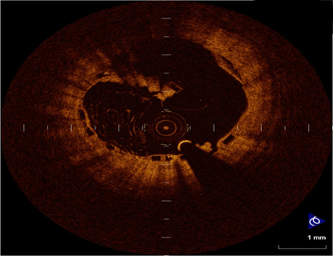
OCT
Acute thrombus formation
Intraluminal scaffold dismantling (ILDS)

Slide 9
What to do now?
The lesion was treated in the same procediment
A second generation DES was implanted and post dilated with non compliant ballon

Slide 10
Angioplasty

Slide 11
Angioplasty

Slide 12
Angioplasty

Slide 13
OCT after DES implant

Slide 14
Clinical Outcome
The patient was discharged symptom-free, with negative biomarkers and the same innocent pattern of EKG.
Patient is in use of DAPT
Remained asymptomatic in the follow up at 1 and 3 months

Slide 15
Thank you
gibran_bn@hotmail.com

