Slide 1
WF5143777-1

Slide 2
Background
Percutaneous Mechanical Aspiration
There has been a rise in right-sided infective endocarditis (RSIE) ~ 10% of endocarditis cases
Treatment options for persistent RSIE are limited, with antimicrobials being suboptimal and surgery having high rates of morbidity and mortality
Percutaneous mechanical aspiration emerged as an option to debulk the vegetations and help achieve infection control
WF5143777-2

Slide 3
Objective
To assess efficacy and safety outcomes of percutaneous mechanical aspiration in right-sided infective endocarditis
WF5143777-3

Slide 4
Methods
Design
Large Multicenter Longitudinal Registry
Follow up
In hospital, 6 weeks
Key Outcomes
Procedural Success: Reduction of vegetation size by 70% or ≤ 1 cm
Primary Efficacy Outcome: Culture Clearance
Primary Safety Outcome: Composite In-Hospital Death/New Pulmonary Embolism/Emergency Surgery
WF5143777-4

Slide 5
Study Flow Chart
January 2014-January 2024
Dataset locked for Analysis April, 1 2024
316 total patients who underwent PMA
31 patients who underwent left-sided PMA
19 sites across the USA
285 total patients who met inclusion criteria
29 pts insufficient data
256 total patients included in final analysis
WF5143777-5

Slide 6
Younger Patient Population
50% were IV Drug Users
Majority Bacterial IE (Staphylococcus Sp.)
Majority Persistent IE
WF5143777-6

Slide 7
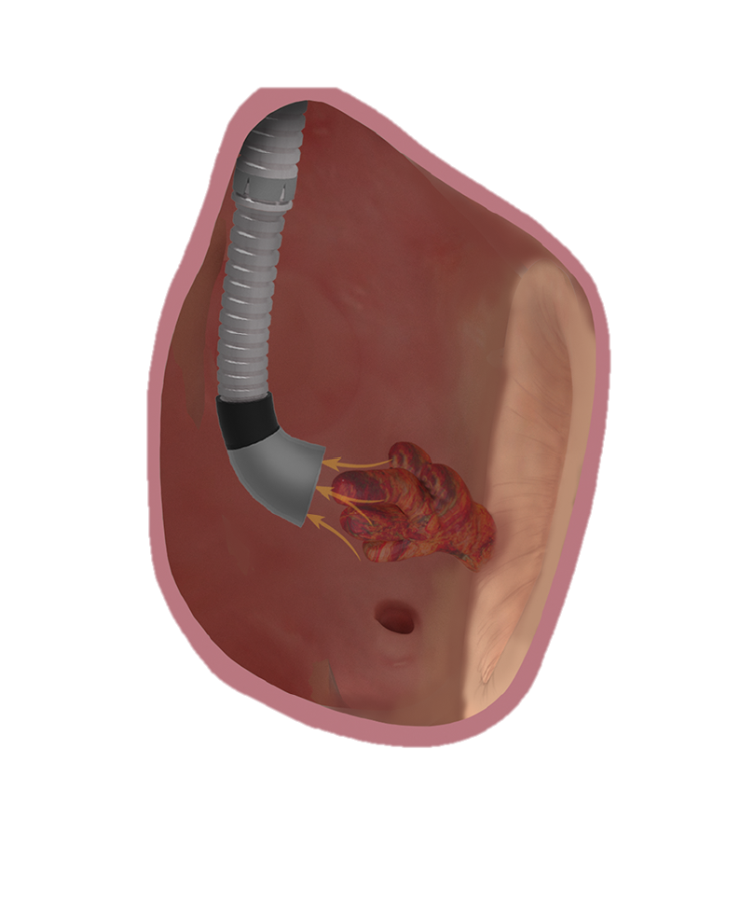
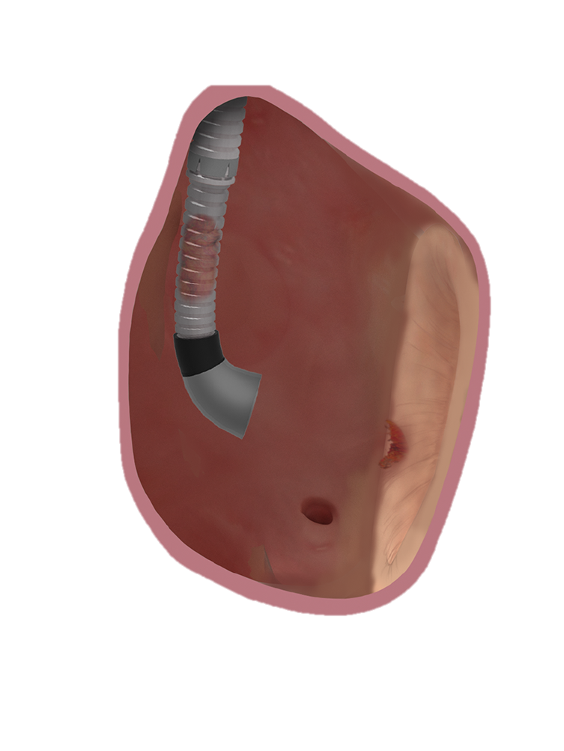
Key Endpoints
Culture Clearance
Death/New PE/Emergency Surgery
≥ 70% or ≤ 1 cm
Procedural Success
89.4%
Primary Efficacy Endpoint
92.4%
Primary Safety Endpoint
18%
WF5143777-7

Slide 8
Culture Clearance
P<0.001
Overall survival (%)
Culture clearance
No culture clearance
Time since procedure (weeks)
No. at risk
162 156 150 145 141 135 129
13 9 7 7 7 7 7
WF5143777-8

Slide 9
Conclusions
In patients with right-sided infective endocarditis, the majority of whom were refractory to medical therapy alone, PMA resulted in culture clearance
Culture clearance was associated with lower in-hospital mortality
Randomized trials are needed to confirm the clinical efficacy and safety of PMA in RSIE
WF5143777-9

