Slide 1






COMPARE-ABSORB
Prospective, single blind, multicenter randomized controlled trial comparing Absorb versus Xience in a high-risk patient and/or complex lesion population
Final 7-year results
Pieter C Smits, MD, PhD, FESC
On behalf of the COMPARE-ABSORB investigators

Slide 2

Potential conflicts of interest
Speaker's name: Pieter Smits
☑ I have the following potential conflicts of interest to report
Receipt of grants / research supports - Abbott
Receipt of grants / research supports - Sahajanand Medical Technologies (SMT)
Receipt of honoraria or consultation fees - Abbott
Receipt of honoraria or consultation fees - Sahajanand Medical Technologies (SMT)
Receipt of honoraria or consultation fees - MicroPort
Receipt of honoraria or consultation fees - Elixir Medical
Stock shareholder – CERC (minor shareholder)
europcr.com

Slide 3

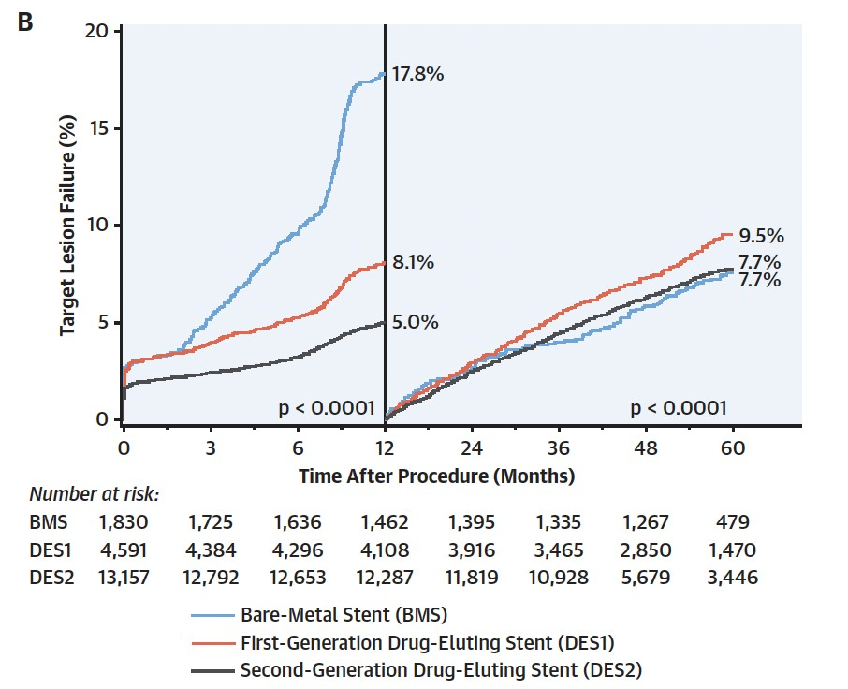
Why this study?
Meta-analysis (on patient level) 19 stent RCT’s
25.032 pts
Annual increase TLF 1.9%
for
BMS & 2e gen DES
A
Madhavan et al. JACC 2020;75:590-604

Slide 4
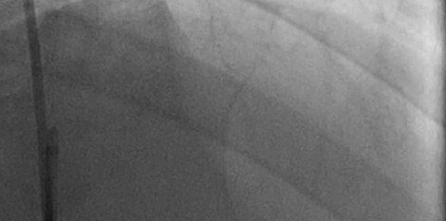
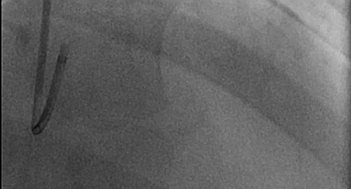
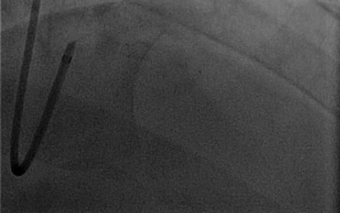
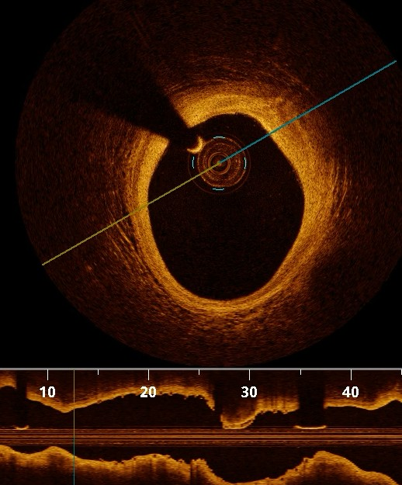

Post
Pre
3 yr FU
Example ABSORB B case 5 year FU

Slide 5
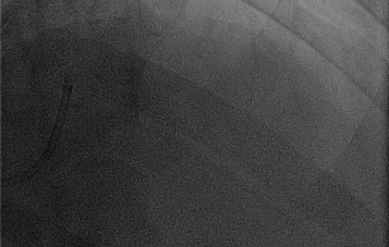
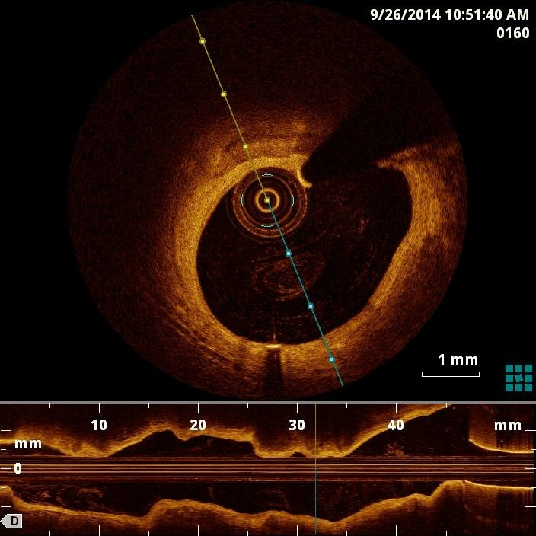
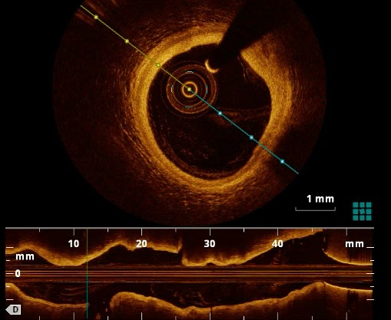
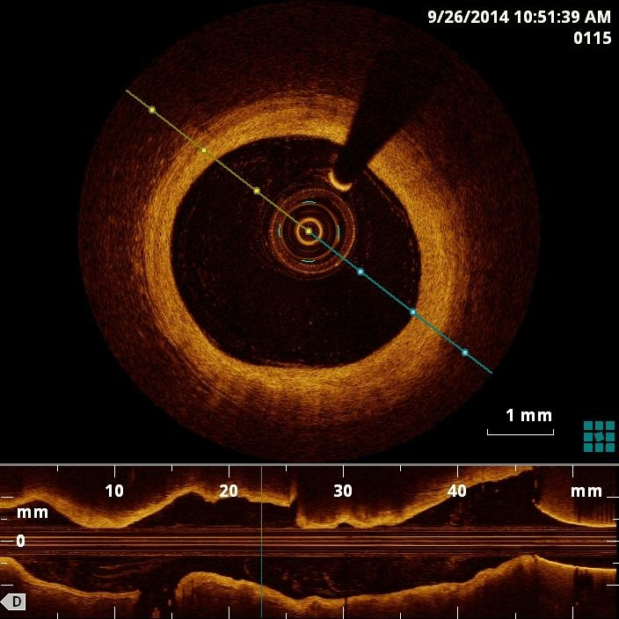
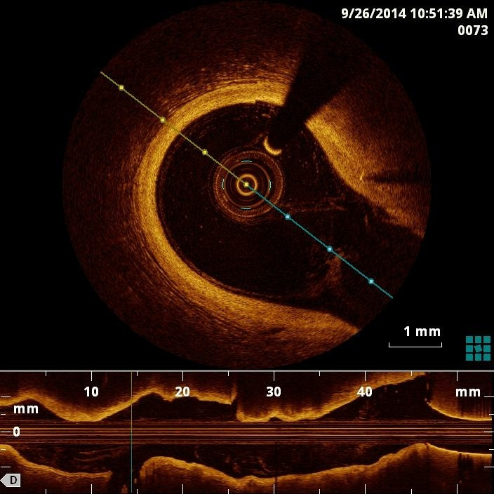
Example ABSORB B case 5 year FU
Proximal marker
Distal marker
….and nothing in between

Slide 6
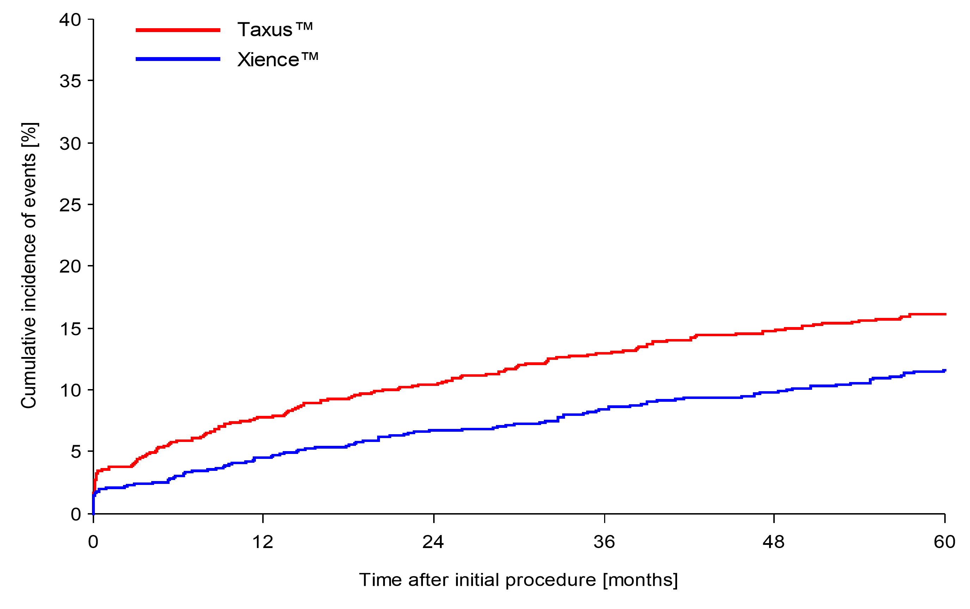

COMPARE - ABSORB Expectation
ABSORBTM expectation
We hypothesised that the use of BVS in a
In COMPARE-ABSORB a dedicated optimal implantation technique for BVS was mandated from the start
high-risk population for re-stenosis might
demonstrate better long-term outcomes
compared to metallic DES after full BVS
resorption
TLF rate
72
84

Slide 7




Trial design
Amended protocol April 2017
1Y
3Y 7Y
2nd analysis: Superiority in TLF between 3
and 7 years
1st analysis: Non-inferiority in TLF at 1Y
45 sites across Europe
ABSORB
Patients high risk for restenosis
DM and/or MVD
Complex lesion
  Long >28 mm
  Bifurcation
  CTO
  Small vessel
Emergent/ Elective PCI 2100 pts
R
Randomization after successful wiring first target lesion
Stratification for:
STEMI
DM
Xience
3rd analysis: Cumulative superiority in TLF at 7Y
Extended the follow-up from 5 to 7 years
Excluded target vessel ref. diam. < 2.5 mm
Excluded high risk bleeding patients
Recommendation on extension DAPT
Enrolment was stopped after 1670 pts (80%) because increase in MI and DT, however, non-inferiority @ 1-year on TLF was met
Smits et al. EuroIntervention 2020;16:645-653

Slide 8



7-Year Study Flow and Follow-up
Randomized 1:1 N=1670 (ITT)
Absorb N=848
Xience N=822
N = 25 no contact @ 7 yr N = 21 withdrew consent N = 69 died
N = 19 no contact @ 7 yr N = 19 withdrew consent N = 67 died
Absorb N=802
Xience N=784
7-Year Follow-up
94.6% FU Complete* (95.5% vital status complete)
95.4% FU Complete* (96.5% vital status complete)
* Complete clinical information available

Slide 9
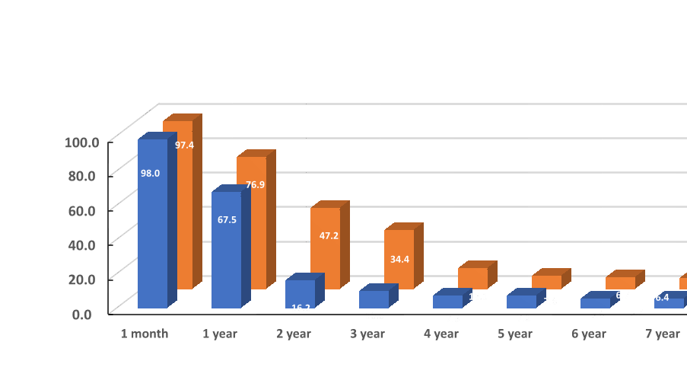
DAPT usage
%
Xience
Absorb
*
*
*
*
P=0.51
P<0.001
P<0.001
P<0.001
P=0.002
P=0.78
P=0.45
P=0.58

Slide 10
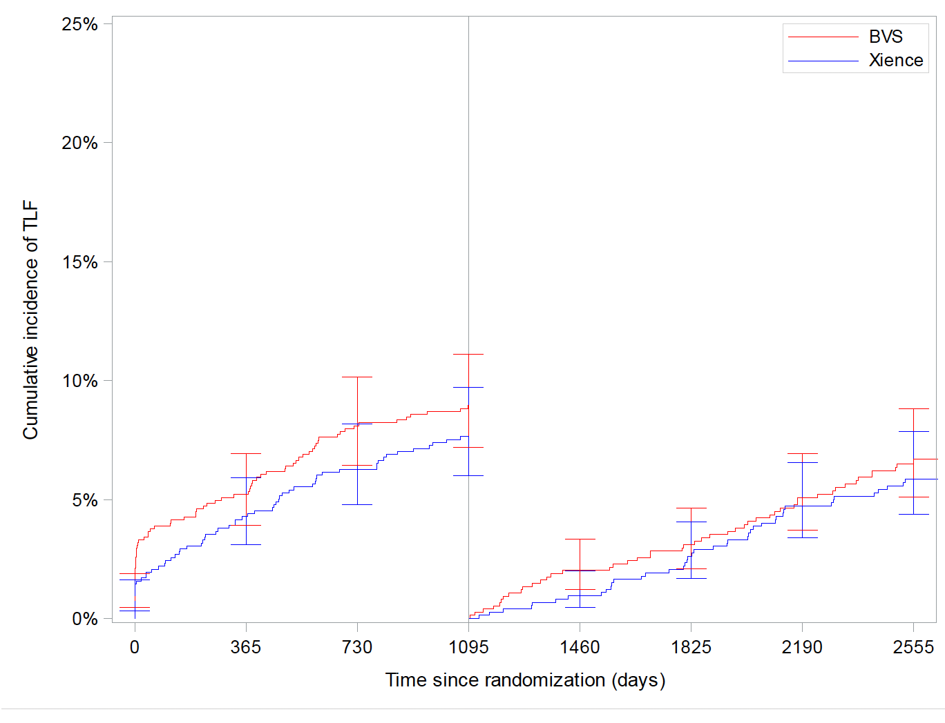
7-year results in Landmark analysis @ 3-year: TLF
^{P}Logrank^{= 0.32}
^{P}Logrank^{= 0.53}
HR (95%CI) = 1.19 (0.85-1.66)
P = 0.32
HR (95%CI) = 1.14 (0.76-1.77)
P = 0.53
9.0%
P_{non-inf} <0.001
6.7%
7.6%
5.9%

Slide 11
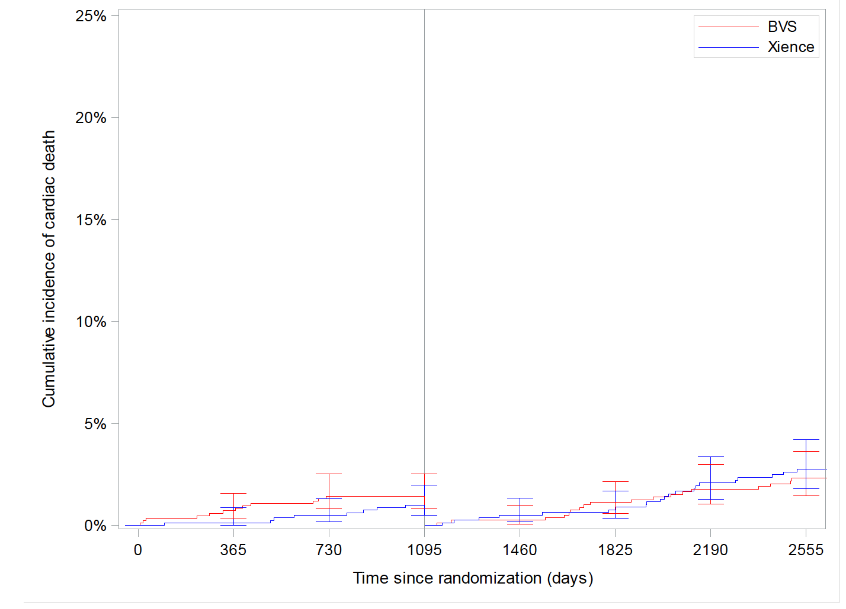
7-year results in Landmark analysis @ 3-year: C-Death
^{P}Logrank^{= 0.40}
^{P}Logrank^{= 0.58}
HR (95%CI) = 1.47 (0.60-3.59)
P = 0.40
HR (95%CI) = 0.84 (0.45-1.57)
P = 0.58
4 pts died of COVID
in BRS arm
4 pts died of COVID
in EES arm
2.8%
1.4%
2.3%
1.0%

Slide 12
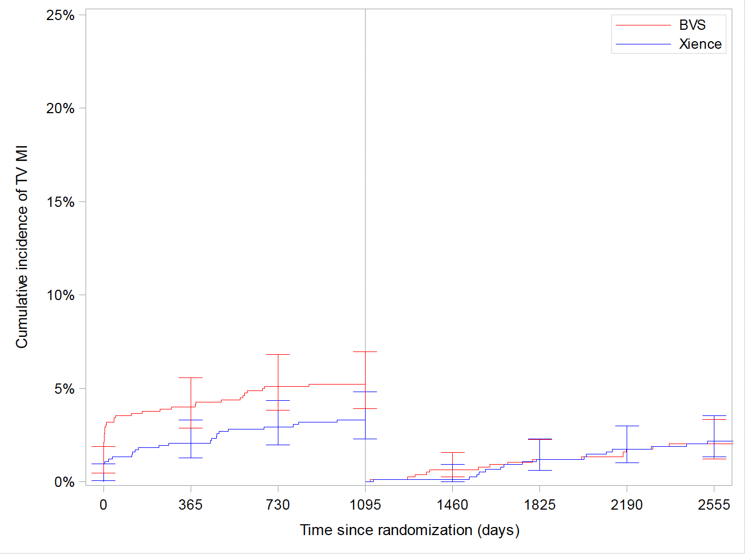
7-year results in Landmark analysis @ 3-year: TV-MI
P_{Logrank}= 0.0501
^{P}Logrank^{= 0.86}
HR (95%CI) = 1.61 (0.99-2.59)
P = 0.053
HR (95%CI) = 0.99 (0.46-1.40)
P = 0.86
5.2%
2.2%
2.0%
3.3%

Slide 13
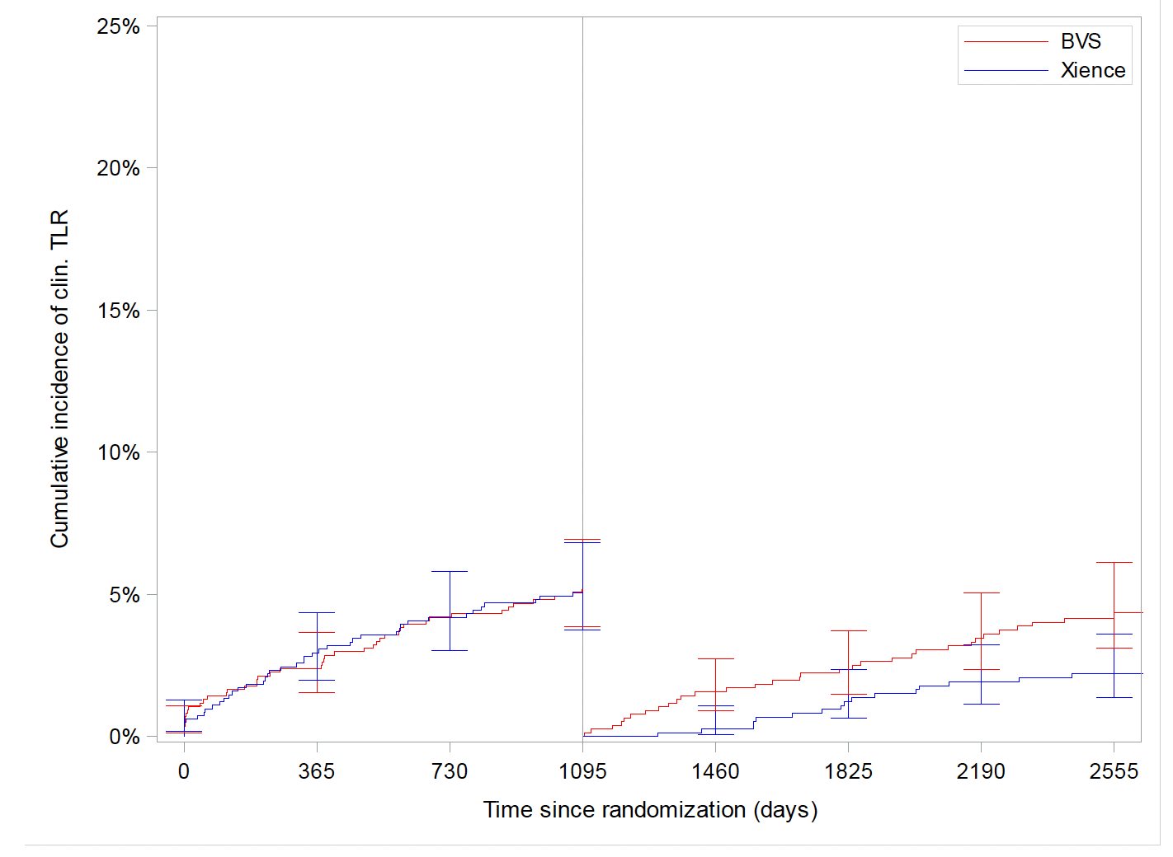
7-year results in Landmark analysis @ 3-year: CI-TLR
^{P}Logrank^{= 0.92}
^{P}Logrank^{= 0.02}
HR (95%CI) = 1.02 (0.67-1,57)
P = 0.92
HR (95%CI) = 1.97 (1.08-3.06)
P = 0.03
5.2%
4.4%
5.1%
2.2%

Slide 14
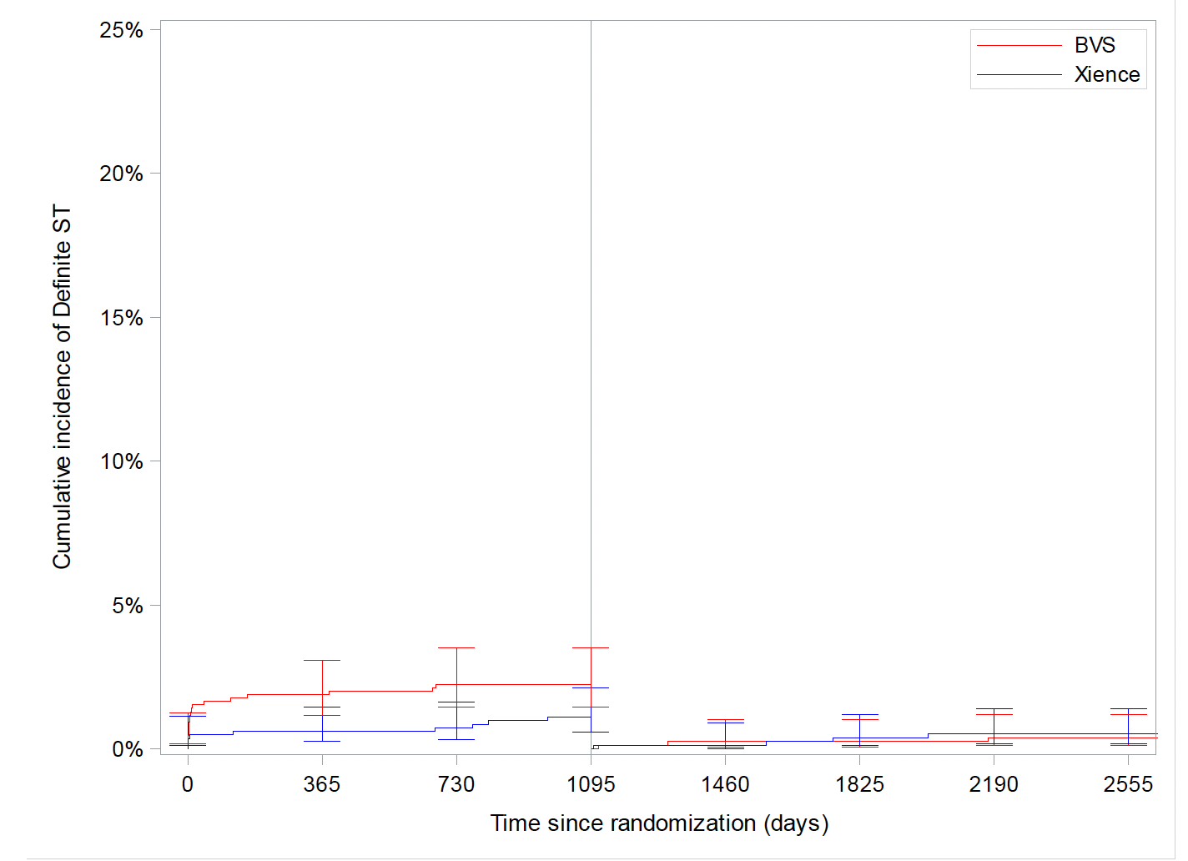
7-year results in Landmark analysis @ 3-year: Def. DT
^{P}Logrank^{= 0.07}
^{P}Logrank^{= 0.69}
HR (95%CI) = 2.06 (0.93-4.56)
P = 0.07
HR (95%CI) =0.741 (0.17-3.30)
P = 0.69
2.3%
0.5%
1.1%
0.4%

Slide 15
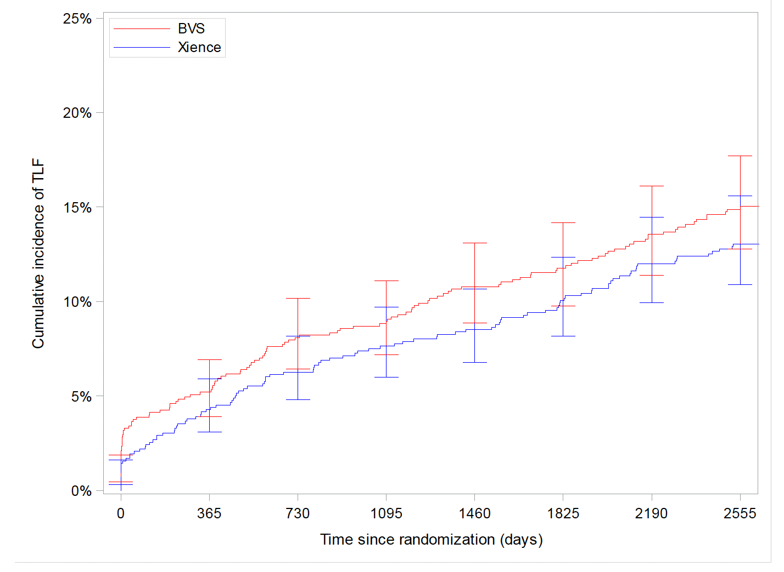
Kaplan-Meier-Plot Primary Endpoint: TLF (DoCE)
HR (95%CI) = 1.17 (0.90-1.52)
P = 0.24
15.1%
P_{non-inf} =0.009
9.0%
P_{non-inf} <0.001
5.2%
13.1%
7.6%
4.3%
^{P}Logrank^{= 0.24}

Slide 16
Summary
At 7-year follow-up, no benefit was observed with BVS in comparison to Xience DES, despite a dedicated implantation protocol and prolonged DAPT duration for BVS
After 30 days, the TLF event curves in time run parallel for both devices.
Significantly more target lesion revascularizations occurred within the BVS arm after a 3-year landmark analysis

Slide 17
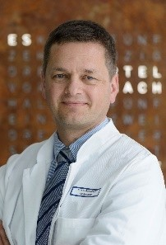
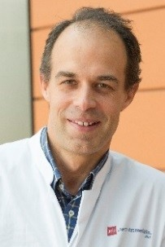

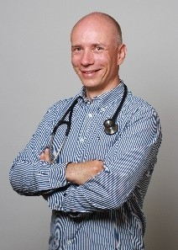
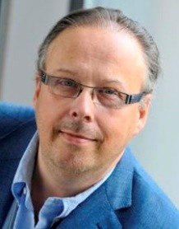

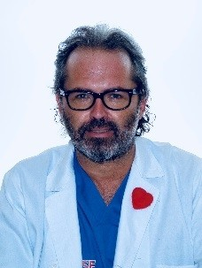
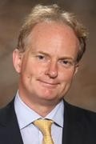

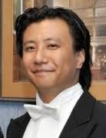
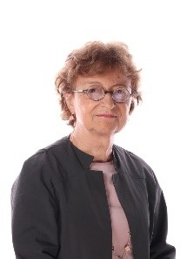
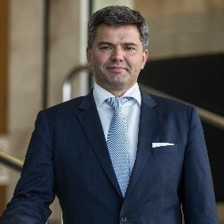
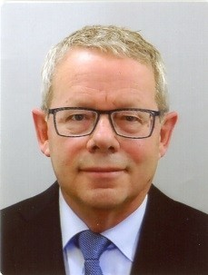
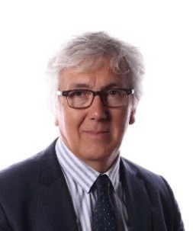
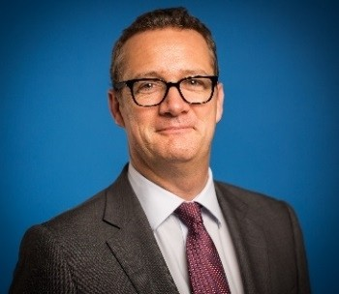
Steering Committee
Stephan ACHENBACH
Tommaso GORI
Emanuele BARBATO
Victor KOCKA
Bernard CHEVALIER
Guiseppe TARANTINI
Peter SMITS
Robert-Jan VAN GEUNS
Yoshi ONUMA
Marie-Claude MORICE
Dariusz DUDEK
Jan TIJSSEN
Javier ESCANED
Nick WEST

Slide 18



Trial Organisation
Grant giver : Abbott Vascular
Grant receiver and trial sponsor: Maasstad Hospital, Rotterdam
Trial conductor : CERIC, Geneva
CRO : CERC, Paris
Corelab and Statistics : Cardialyis, Rotterdam
DSMB : Stefan James, Eric Boersma, Michel Bertrand
Senior Consultant : Patrick Serruys
Lead Clinical Trial Managers: Ute Windhovel, Tatamo Rakotoary, Ria van Vliet

Slide 19

pcronline.com

Slide 20
Key features of COMPARE-ABSORB
Specific patient population, FU period and implantation technique
To study a patient population that is high risk for restenosis which potentially might benefit the most from resorbable scaffolds
Selection of specific patients and complex lesions not investigated in previous
RCT’s like: STEMI, acute non-STEMI, bifurcations and long lesions and CTO’s
Follow-up period at 7-year, several years after fully resorption of the scaffold and the only BVS trial with FU beyond 5 year.
PSP implantation technique from the start
  Mandatory pre-dilatation 1:1 balloon – artery ratio
  IVUS / OCT / QCA guidance for treatment target vessels < 2.75 mm highly recommended
  Mandatory high pressure (> 16 atm.) post-dilatation
  Usage off NC balloons up to 0.50 mm larger than the scaffold for post-dilatation highly recommended

