Slide 1
One-year Outcomes of ACURATE neo2 vs Approved TAVR Devices in All-risk Patients with Severe AS: the ACURATE IDE Trial
Michael Reardon, MD
Houston Methodist DeBakey Heart & Vascular Center Houston, TX
On behalf of the ACURATE IDE Investigators

Slide 2
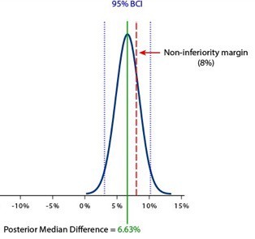
ACURATE IDE Trial Design & Primary Endpoint
Prospective, multicenter, randomized study N=1500 patients with symptomatic severe native aortic stenosis indicated for TAVR
Primary Endpoint:
Composite of all-cause mortality, stroke or rehospitalization† at 1 year
Posterior Median and 95% BCI |  | Non-Inferiority Test*
ACURATE neo2 | Control | Posterior Median Difference and 95% BCI | Non-inferiority Margin
16.16% [13.38%,19.07%] | 9.53% [7.47%,11.89%] | 6.63% [3.04%,10.20%] | 8.0%
Operators pre-specify valve type to be used if randomized to Control
1:1 Randomization
Upper bound of 95% BCI exceeds prespecified non-inferiority margin
Mixed Control
N=748
ACURATE neo2
N=752
Non-inferiority of ACURATE neo2 vs Control for the primary endpoint was not met
Evolut
N=244
SAPIEN
N=504
Follow-Up through 10y post-procedure
Note: Control devices include CoreValve Evolut R, Evolut PRO, Evolut PRO+, and Evolut FX and SAPIEN 3, SAPIEN 3 Ultra
† Hospitalization for valve-related symptoms or worsening congestive heart failure (NYHA class III or IV); per VARC-2 definition
* Posterior probability for non-inferiority was 77.9%, which is lower than the non-inferiority test threshold of 97.5%

Slide 3
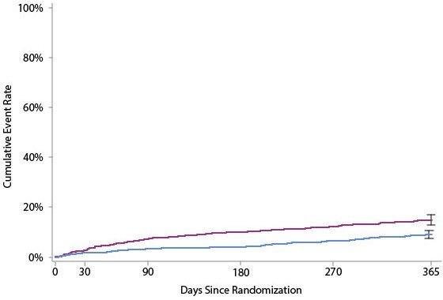
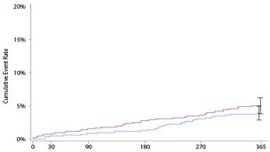
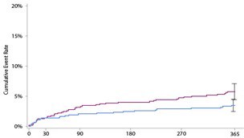
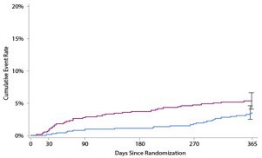
Kaplan-Meier Analysis through 1 Year
ITT Population (N=1500)
Death
Death, stroke, or rehospitalization†
∆1.1%
[-1.0%, 3.2%]
5.0%
3.9%
ACURATE neo2
Control
Stroke
∆2.3% [0.1%, 4.4%]
5.7%
3.4%
∆5.8% [2.4%, 9.1%]
14.8%
9.1%
Rehospitalization†
∆1.8%
[-0.4%, 3.9%]
5.3%
3.5%
No. at risk
ACURATE neo2 (N=752) | 752 | 733 | 711 | 676 | 651 | 617
Control (N=748) | 748 | 737 | 723 | 706 | 695 | 654
Note: Control devices include CoreValve Evolut R, Evolut PRO, Evolut PRO+, and Evolut FX and SAPIEN 3, SAPIEN 3 Ultra
† Hospitalization for valve-related symptoms or worsening congestive heart failure (NYHA class III or IV); per VARC-2 definition

Slide 4
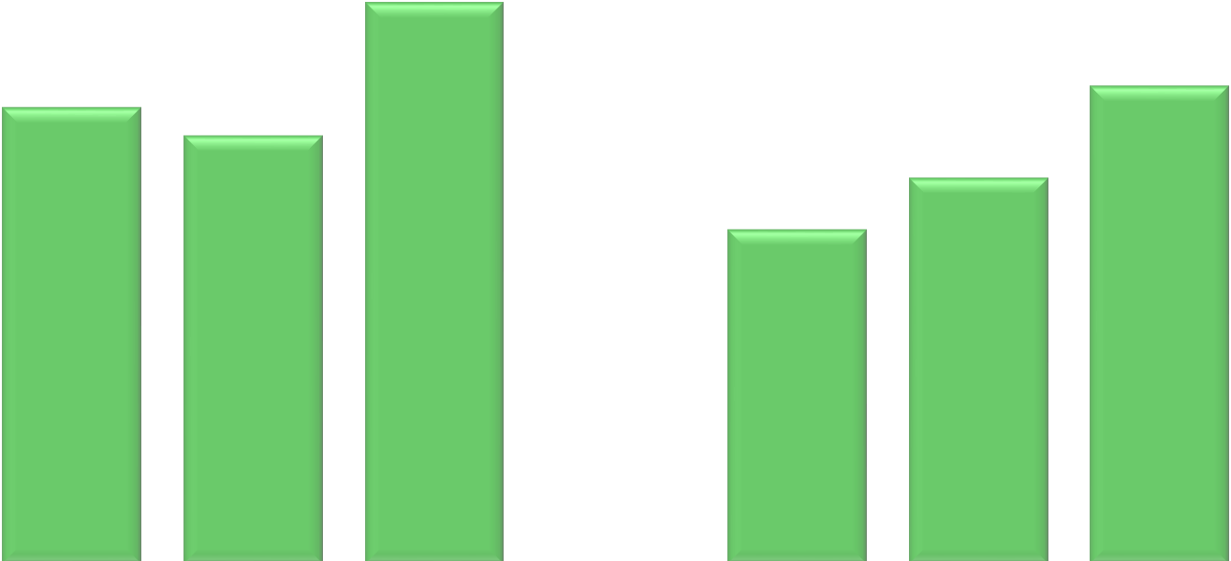
Echocardiography Outcomes
Mean Gradient Paravalvular Regurgitation
Severe Moderate Mild
None/Trace
ACURATE neo2 (n=752)
neo2
Ev olut (n=244) SAPIEN (n=504)
16.0
12.0
8.2
7.9
12.0
11.6
8.0
7.0
mmHg
11.4
9.0
7.7
Discharge
1 Year
8.0
4.0
0.1%
1.0%
0.8%
0.5%
3.2%
0.2%
6.7%
4.6%
Discharge 30 Days 1 Year
Doppler Velocity Index (DVI)
Discharge 1 Year
23.0%
28.0%
20.4%
0.0
40.7%
31.3%
0.8
93.3%
0.6
0.65
0.68
0.64
0.63
75.9%
71.2%
64.1%
79.3%
0.4
0.55
0.52
55.5%
0.2
0
ACURATE
neo2
n=721
Evolut
SAPIEN
ACURATE
neo2
n=616
Evolut
SAPIEN
ACURATE
neo2
n=676
Evolut SAPIEN
n=218 n=463
ACURATE Evolut SAPIEN
neo2
n=586 n=209 n=388
ACURATE
Evolut
SAPIEN
ACURATE
Evolut
SAPIEN
n=236
n=490
n=217
n=411
Note: Control devices include CoreValve Evolut R, Evolut PRO, Evolut PRO+, and Evolut FX and SAPIEN 3, SAPIEN 3 Ultra

Slide 5
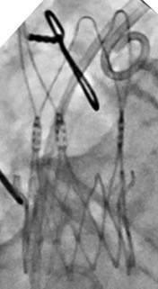
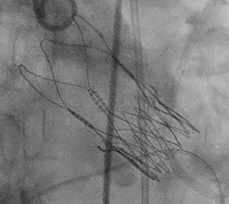
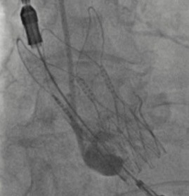
Retrospective Review
A post-hoc case review of ACURATE neo2 implantation evaluated proper valve frame expansion per angiographic imaging
Under-expansion can be identified by non-parallel commissure posts
Valve frame under-expansion was present in ~20% of ACURATE neo2 cases

Slide 6
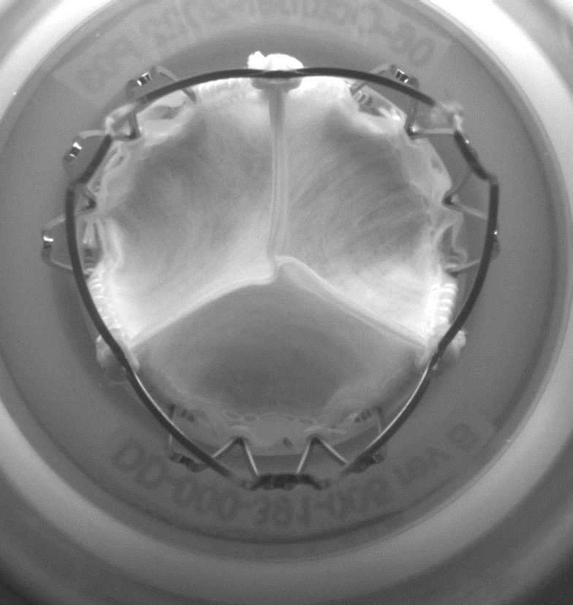
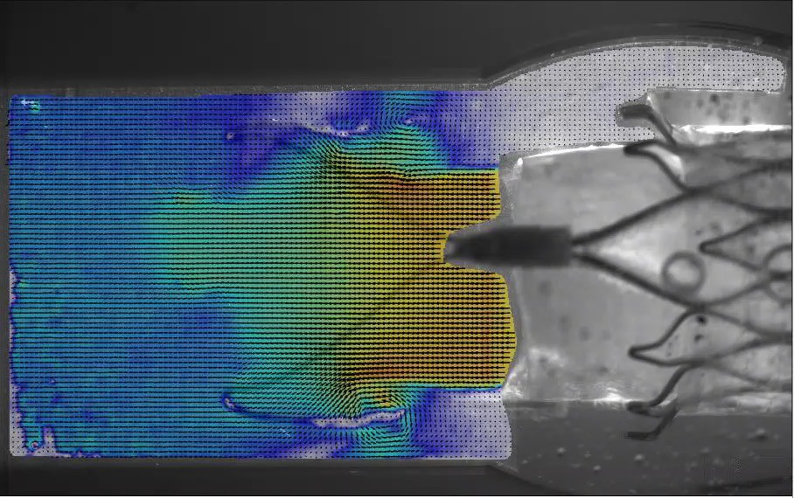
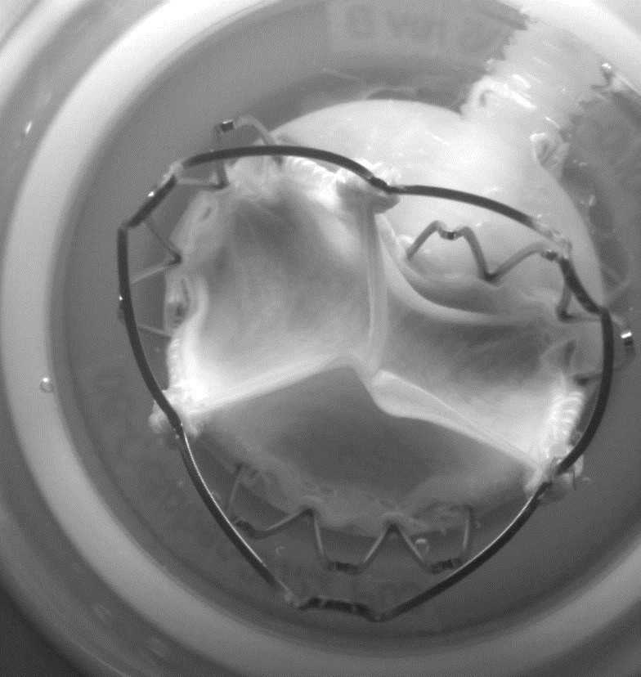
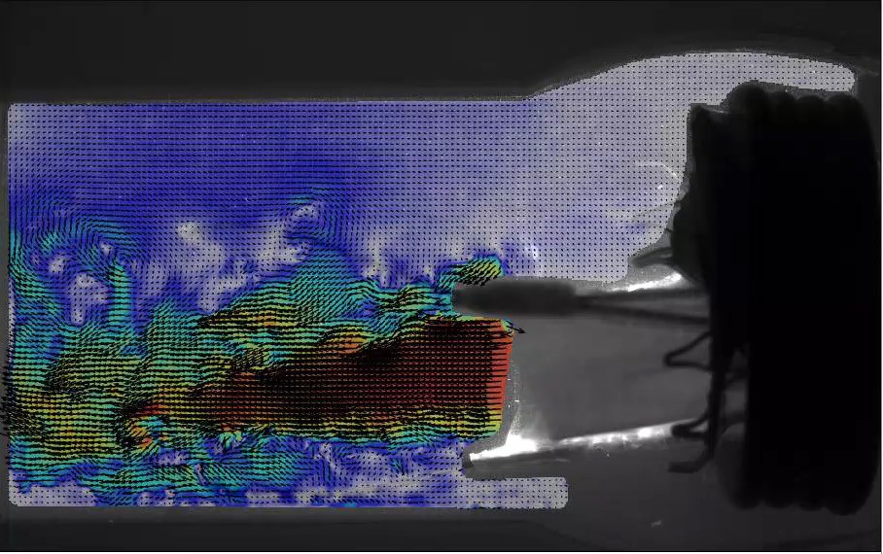
Bench Testing: Impact of Valve Frame Under-Expansion
Video Video
Expanded ACURATE neo2
Max Velocity 1.6 m/s
Laminar flow
Adequate washout
Video
Video
Under-Expanded ACURATE neo2
Max Velocity 3.1 m/s
Turbulent flow
Reduced washout

Slide 7
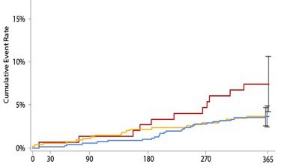
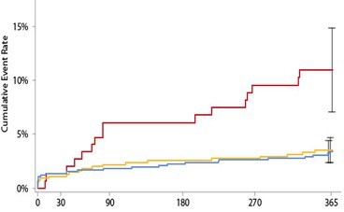
Post-Hoc Clinical Analysis: Valve Frame Expansion
 | ACURATE neo2
Time-to-Event Analysis through 1 Year Post- Procedure (N=703) | Expanded Valve Frame (N=553) | Under-Expanded Valve Frame (N=150) | P-value
Primary Endpoint: Death, stroke, or rehospitalization† | 12.4% (68) | 18.8% (28) | 0.050
Individual components
Death | 3.7% (20) | 7.4% (11) | 0.054
Stroke | 3.5% (19) | 11.0% (16) | <0.001
Rehospitalization† | 5.9% (32) | 2.7% (4) | 0.131
Valve frame under-expansion was associated with increased rates of death (2-fold) and stroke (3-fold)
Death
ACURATE neo2 Under-expanded ACURATE neo2 Expanded Control
Stroke
Death and stroke at 1 year are comparable for ACURATE neo2 Expanded and Control
11.0%
7.4%
3.7%
3.6%
3.5%
3.4%
Days since Procedure
Days since Procedure
† Hospitalization for valve-related symptoms or worsening congestive heart failure (NYHA class III or IV); per VARC-2 definition

Slide 8
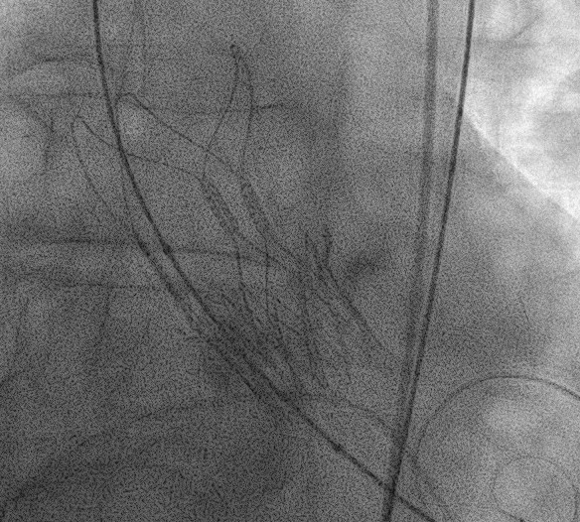
ACURATE IDE Trial Key Take-Aways
The largest head-to-head trial to evaluate TAVR with ACURATE neo2
Ability to compare ACURATE neo2 with commercially available devices was complicated by a challenging trial environment (trial-related and enrollment factors)
Under-expansion is easy to identify and correct during the procedure
Post-hoc analyses identified valve under-expansion as a potential factor contributing to clinical outcomes
Adverse impact of under-expansion not evident for early clinical outcomes, but became apparent at 1 year
Well-expanded ACURATE neo2 valves are comparable to Control for death and stroke at 1 year

