Slide 1





PCI in multivessel disease and STEMI-related cardiogenic shock:
A DanGer Shock substudy
Rasmus Paulin Beske, MD, PhD on behalf of Jasmine Melissa Marquard, MD, and
The DanGer-Shock investigators
Department of Cardiology, Risghospitalet Denmark

Slide 2

Potential conflicts of interest
Speaker's name: Rasmus Paulin Beske
☑ I have the following potential conflicts of interest to report
None
europcr.com

Slide 3
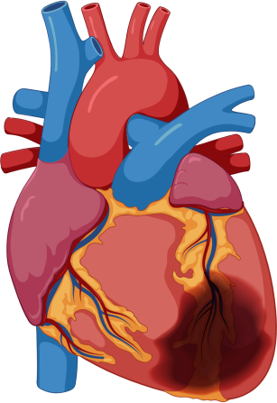
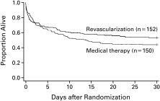
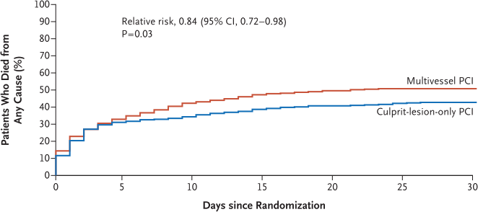
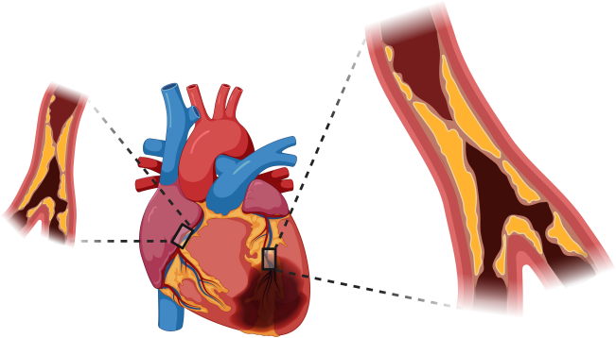







Why this study?
CULPRIT SHOCK
36% not STEMI – enough myocardium at risk?
54% resuscitated – modifiable cause of death?
34 % with lactate < 2.0 mmol/L – shock criteria?
Can the optimal PCI strategy still be debated in STEMI-related cardiogenic shock with multivessel disease?
10% of patients with _{SHOCK trial:}
^{STEMI develop} 12.8% absolute ^{cardiogenic shock.} mortality reduction
at 180 days
30-day mortality of
50%
^{80 % of AMI-CS} CULPRIT-SHOCK:
^{present with} 8.3 % absolute ^{multivessel} mortality increase
^{coronary artery} with multivessel ^{disease} PCI at 30 days
Helgestad O, et al.: Temporal trends in incidence and patient characteristics in cardiogenic shock following acute myocardial infarction from 2010 to 2017: a Danish cohort study. Eur J Heart Fail. 2019
Hochman J., et al.: Early revascularization in acute myocardial infarction complicated by cardiogenic shock. SHOCK Investigators. Should We Emergently Revascularize Occluded Coronaries for Cardiogenic Shock. NEJM 1999
Multivessel versus culprit lesion only percutaneous revascularization plus potential staged revascularization in patients with acute myocardial infarction complicated by cardiogenic shock: design and rationale of CULPRIT-SHOCK trial. Am Heart J 2016 Thiele H, et al.: Thiele H, et al.: PCI Strategies in Patients with Acute Myocardial Infarction and Cardiogenic Shock, NEJM 2017
europcr.com

Slide 4
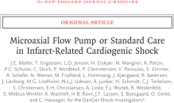



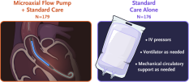



What did we study and how was it executed?
Multivessel coronary disease
Immediate multivessel PCI (n =103)
vs.
Culprit only PCI (n= 118)
DanGer Shock Trial:
355 patients with STEMI
Lactate ≥ 2.5 mmol
LVEF < 45 %
Not comatose
221 (62 %) with multivessel coronary disease
Visual stenosis ≥70% judged
by PCI operator
Excluded isolated left main artery culprit
Post-hoc explorative study of the association of PCI strategy with 180-day all-cause mortality
Møller, JE et al.: Microaxial Flow Pump or Standard Care in Infarct-Related Cardiogenic Shock, NEJM 2024
europcr.com

Slide 5




What are the essential results?
Patient characteristics
 |  | Culprit only PCI (n = 118) | Immediate multivessel PCI (n = 103)
 | Age, years | 69 (59, 76) | 68 (60, 76)
 | Male sex | 75 % | 82 %
 | Hypertension | 59 % | 56 %
 | Diabetes | 25 % | 28 %
 | Previous AMI | 21 % | 17 %
 | Cardiogenic shock
 | Resuscitated | 19 % | 15 %
 | MAP, mmHg | 61 (54 , 73) | 63 (54, 72)
 | LVEF, % | 25 (15, 30) | 25 (15, 30)
 | Lactate, mmol/L | 4.6 (3.4, 6.6) | 4.6 (3.5, 7.1)
 |  | Culprit only PCI | Immediate multivessel PCI
 | Symptom to balloon, minutes | 284 (147, 697) | 324 (152, 676)
 | Culprit artery
 | LAD | 52 % | 50 %
 | CX | 14 % | 14 %
 | RCA | 21 % | 20 %
 | Left main | 12 % | 15 %
 | No. of diseased vessels
 | 2 | 50 % | 42 %
 | 3 | 50 % | 58 %
Non culprit tre | Culprit only PCI ated / non culprit | Immediate multivessel PCI lesion
LAD | 0 / 50 | 37 / 57
CX | 0 / 55 | 52 / 59
RCA | 0 / 64 | 14 / 47
Left main | 0 / 6 | 12 / 11
Chronic total oc CTO SYNTAX score P Delta Delta Post – Pre PCI Randomization Impella CP | clusion treated 0 / 40 (Total) Syntax: P < 17 (9, 22) 47 % | / total no. 6 / 41 0.001 22 (14, 29) 52 %
re PCI 28 (22, 32) 29 (22, 34)
europcr.com

Slide 6
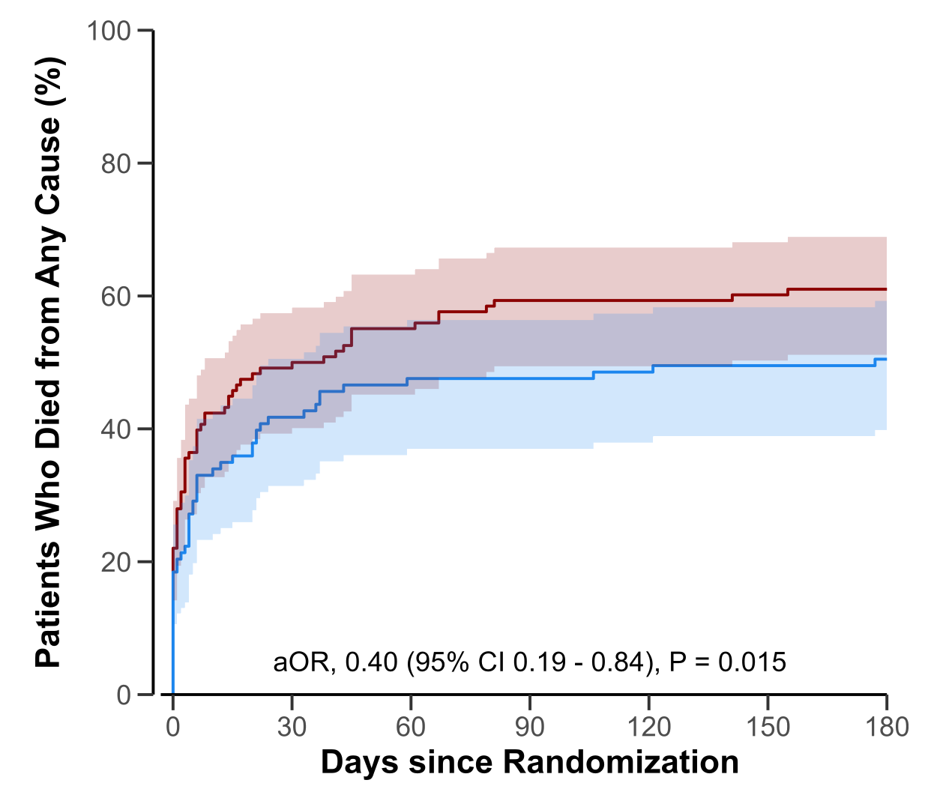
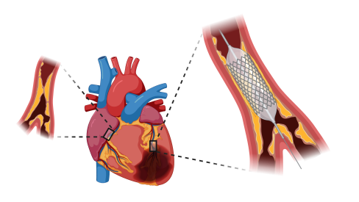



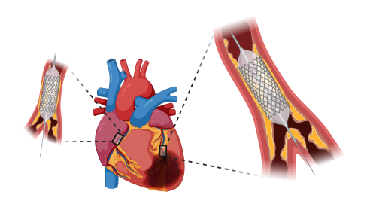


What are the essential results?
Primary outcome
Estimated effect
Step-wise adjustments
OR: 0.65 (0.38 – 1.11)
Crude estimate
Culprit-only PCI
Demographics
Age, sex, randomization
OR: 0.66 (0.37 – 1.20)
Coronary anatomy HxAMI, No. Diseased vessels, PrePCI SYNTAX, CTO
Immediate multivessel PCI
OR: 0.51 (0.27 – 0.95)
Clinical
Duration of symptoms, lactate, LVEF, pre/post CULPRIT SHOCK
OR: 0.40 (0.19 – 0.83)
europcr.com

Slide 7



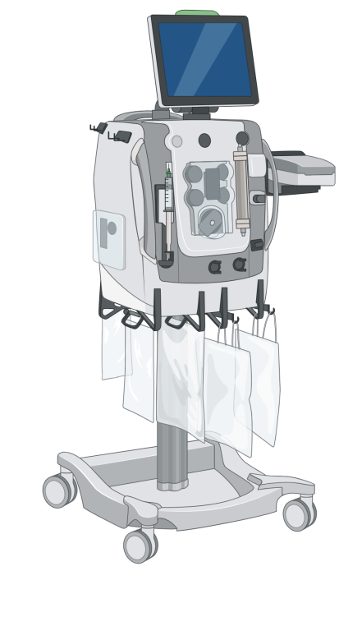


Safety
Renal replacement therapy
Bleeding (BARC 3-5)
Culprit only PCI | Immediate multivessel PCI
32 (27 %) | 37 (36 %)
Culprit only PCI | Immediate multivessel PCI
26 (22 %) | 19 (18 %)
Adjusted subdistribution hazard ratio 1.20 (0.76-1.91)
Adjusted odds ratio 0.75 (0.38-1.49)
europcr.com

Slide 8
Why is this important?
Immediate multivessel PCI was associated with a reduced 180 days mortality in a well-characterized LV-failure cardiogenic shock STEMI cohort with multivessel coronary disease, however, with numerically higher need for renal replacement therapy
With the precaution of hidden confounding, these findings indicate that immediate multivessel PCI in this subset of patients may be safe and potentially improve prognosis
Requires a randomized trial to assess this due to the limitations of the present study
europcr.com

Slide 9
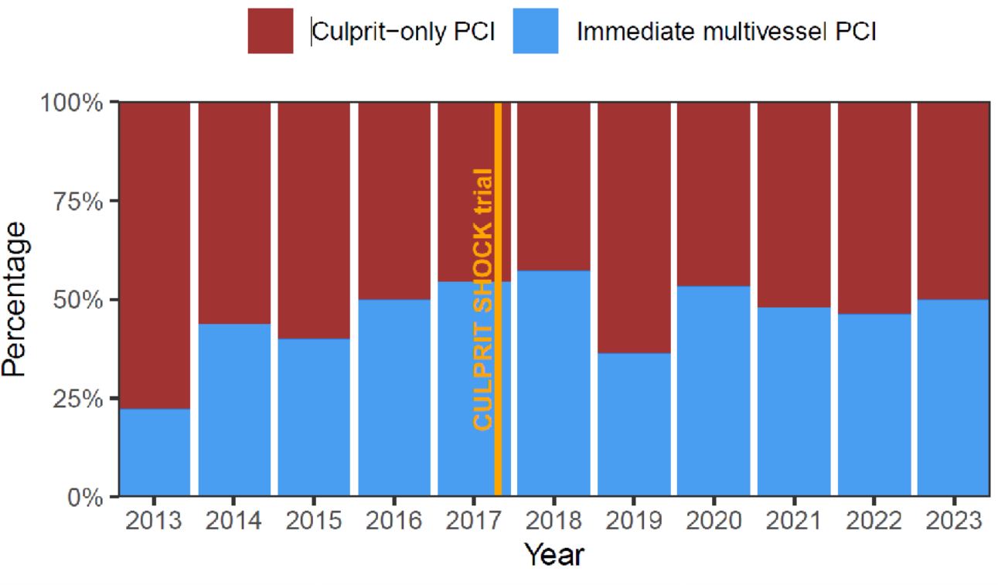
Extra slides: PCI strategy over time
europcr.com

Slide 10
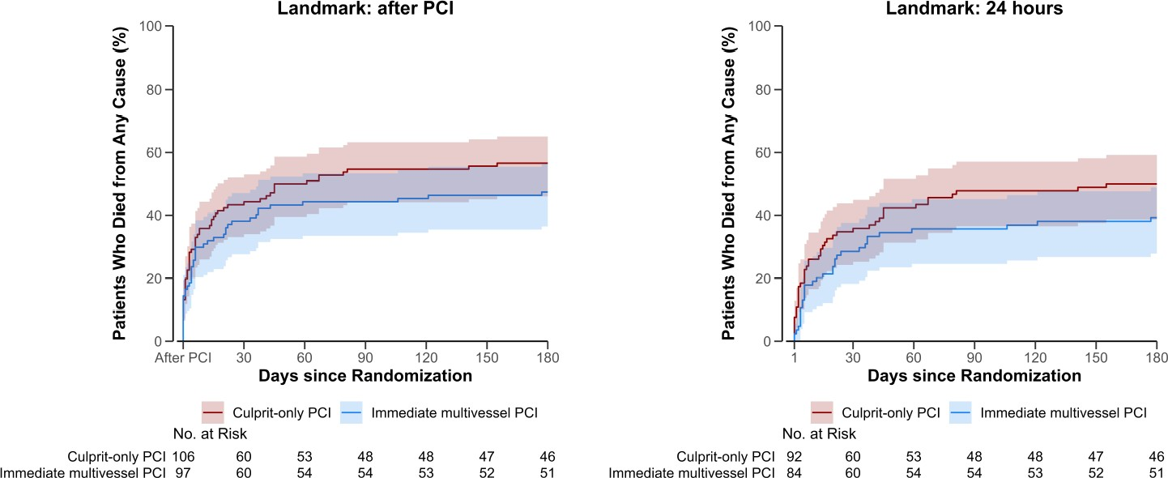
Extra slides: Landmark analysis
europcr.com

Slide 11
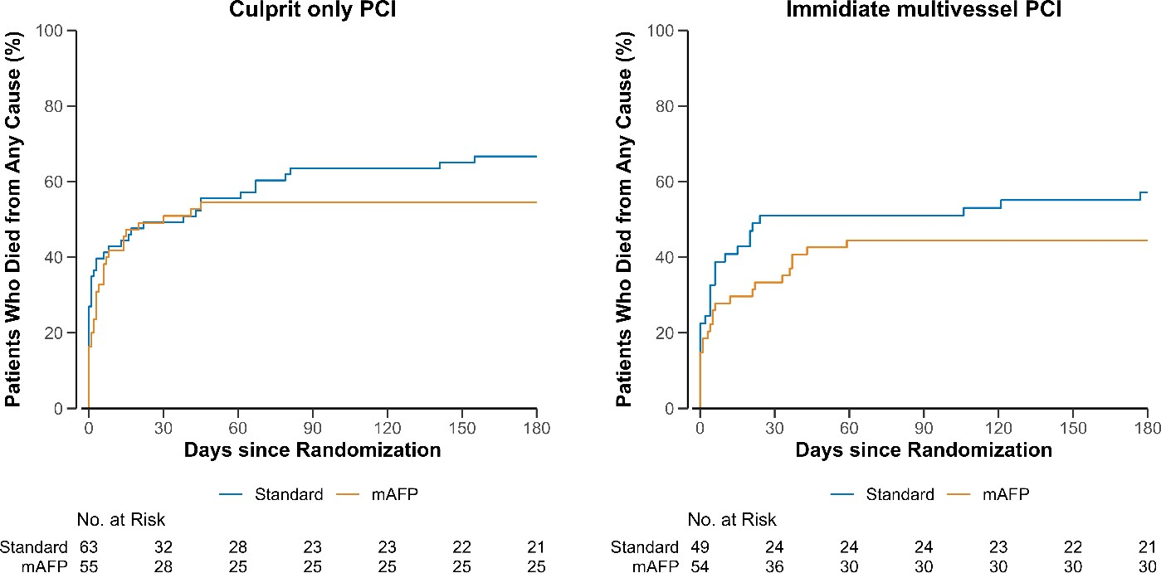
Extra slides: Mortality by PCI strategy and Randomization
europcr.com

Slide 12

pcronline.com

