Slide 1

As a Procedure of Saving Renal Graft; MitraClip

Slide 2

İsmail ATEŞ MD. FACC, FESC, FSCAI
Proctor for MitraClip Transcatheter Mitral Valve Repair – Abbott Structural Heart

Slide 3
CASE
A 41-year-old male patient with the diagnosis of chronic renal failure, coronary artery disease, and mitral valve regurgitation was admitted to the cardiology clinic.
The patient was scheduled for kidney transplantation from a living donor.
The patient was in the routine dialysis program and was receiving optimal medical treatment.

Slide 4
CASE
He had shortness of breath despite effective dialysis. The patient had a history of coronary artery bypass surgery in 2016.
Coronary bypass grafts were found to be patents in coronary angiography performed about a week ago.
Electrocardiogram was in sinus rhythm.
Transthorasic echocardiography (TTE) showed an ejection fraction (EF) of 40%, inferior-inferior septum and posterior walls hypokinetic, severe mitral valve regurgitation, moderate tricuspid regurgitation, and no dilatation in the right cavities and tricuspid annulus.

Slide 5
CASE
The patient was evaluated on cardiology, nephrology and cardiovascular surgery council.
Percutaneous mitral valve repair (MitraClip) was decided to be done.
Mitraclip procedure was successfully applied to the patient under general anesthesia guided by 3D transesophageal echocardiography

Slide 6
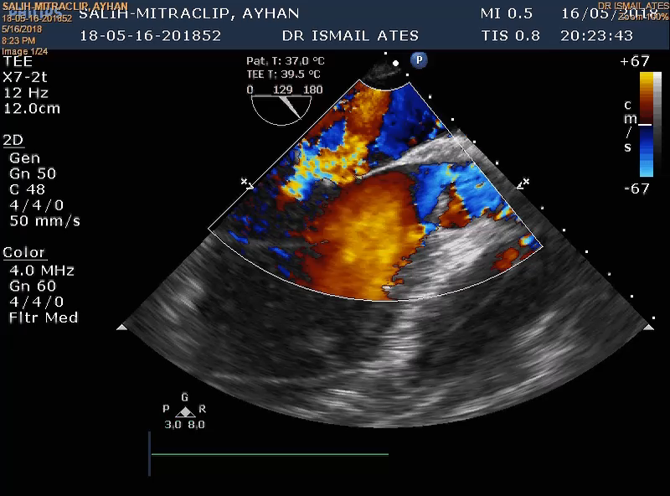
CASE

Slide 7
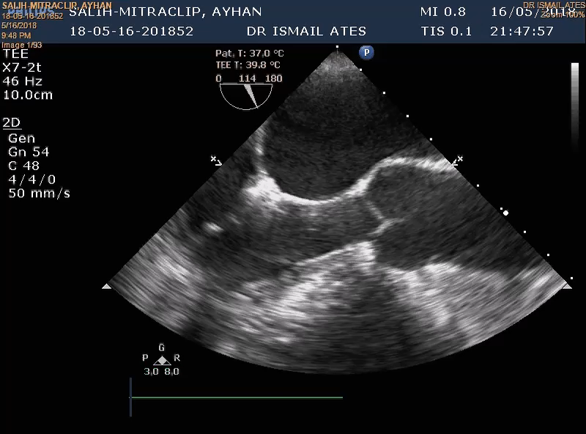
CASE

Slide 8
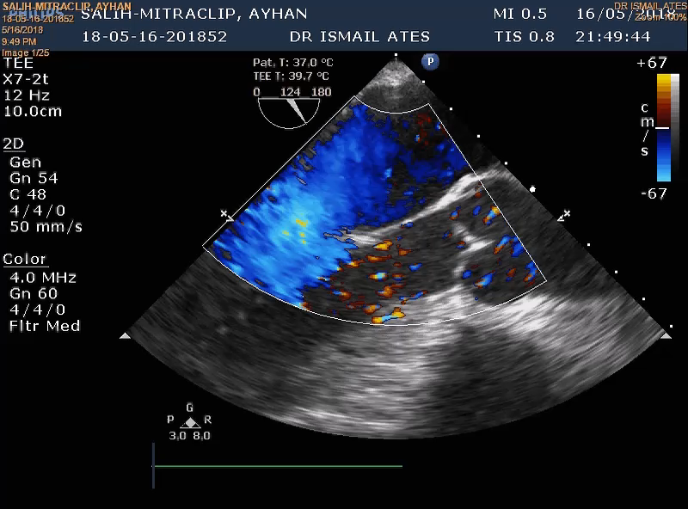
CASE

Slide 9
CASE
One day later, the patient received a successful kidney transplantation from the living donor.
5 months of follow-up; BUN 19 mmol / l (6-24), keratine 1.2 atmol / L (0.7-12) was stable, EF was 50% and mild mitral regurgitation was found in TTE evaluation

Slide 10
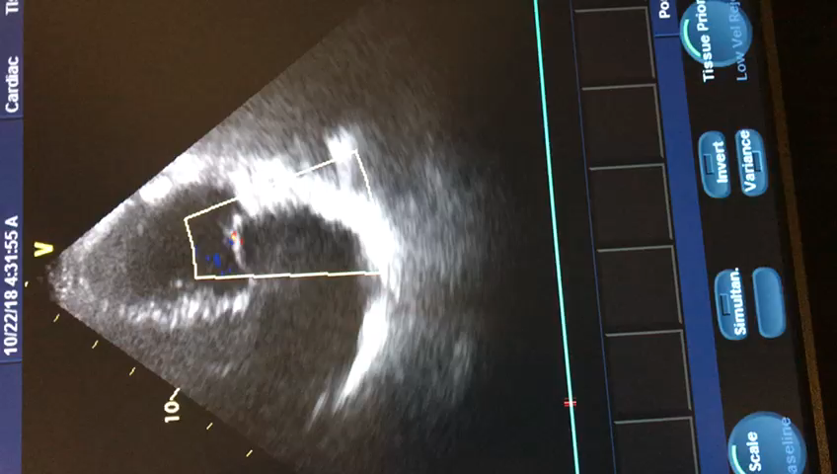
CASE

Slide 11
DISCUSSION
Our patient had ischemic heart failure and degenerative mitral valve regurgitation.
Symptomatic severe mitral valve regurgitation was present in spite of optimal medical treatment and effective hemodialysis.
Since the patient's comorbid status «chronic renal disease, heart failure, previous history of open heart surgery» minimally invasive method; MitraClip procedure was preferred.

Slide 12
TAKE HOME MESSAGE
Cardiac functions are one of the most important factors that determine graft survival in renal transplant patients.
Untreated rhythm problems, heart failure and heart valve problems lead to congestion and hypoxia, leading to negative results on morbidity, mortality and graft survival.
Some of perioperative complications can be prevented with detailed cardiac examination and interventions.

Slide 13
TAKE HOME MESSAGE

