Slide 1
NOTION-3
PCI in patients undergoing transcatheter aortic valve implantation
Funding unrestricted grants: The Danish Heart Association and Boston Scientific
Declaration of Interest: Speakers fee Boston Scientific and Abbott
Dr. Jacob Lønborg
30st August 2024

Slide 2
Conclusion
Among patients with coronary artery disease who were undergoing transcatheter aortic valve implantation (TAVI), percutaneous coronary intervention (PCI) reduced the risk of all-cause mortality, myocardial infarction, or urgent revascularization at a median follow-up of 2 years compared to not performing PCI.

Slide 3
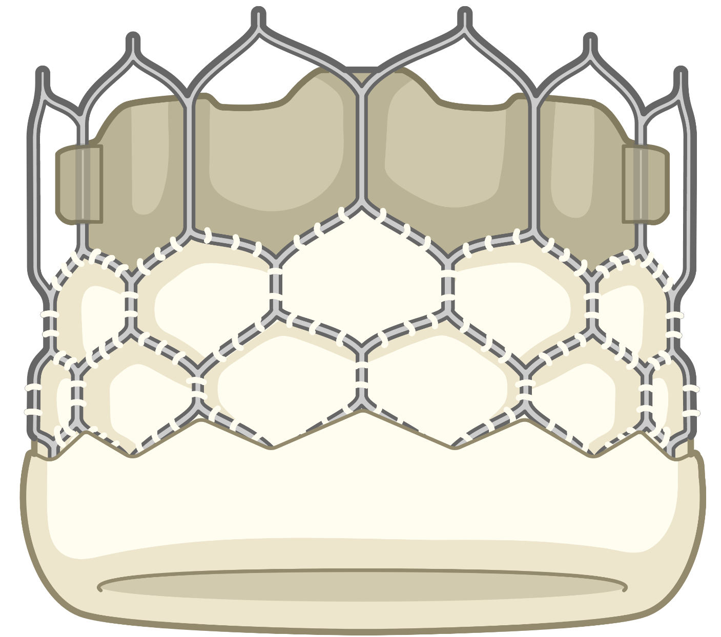
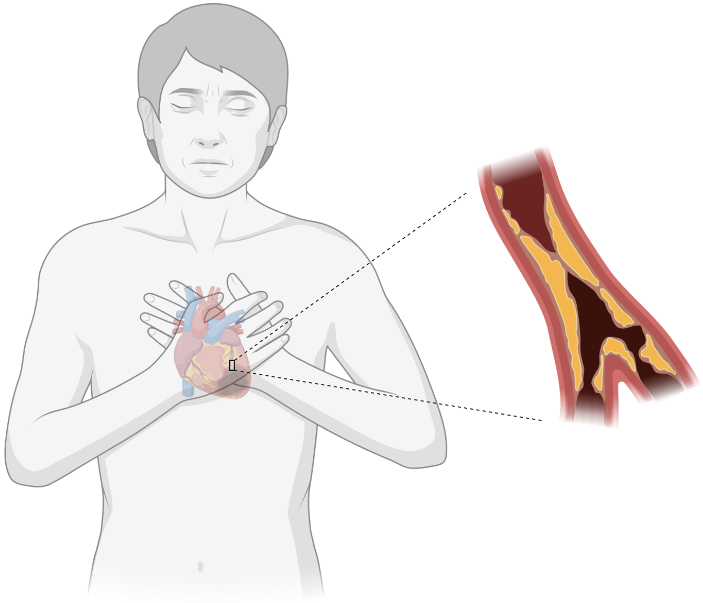
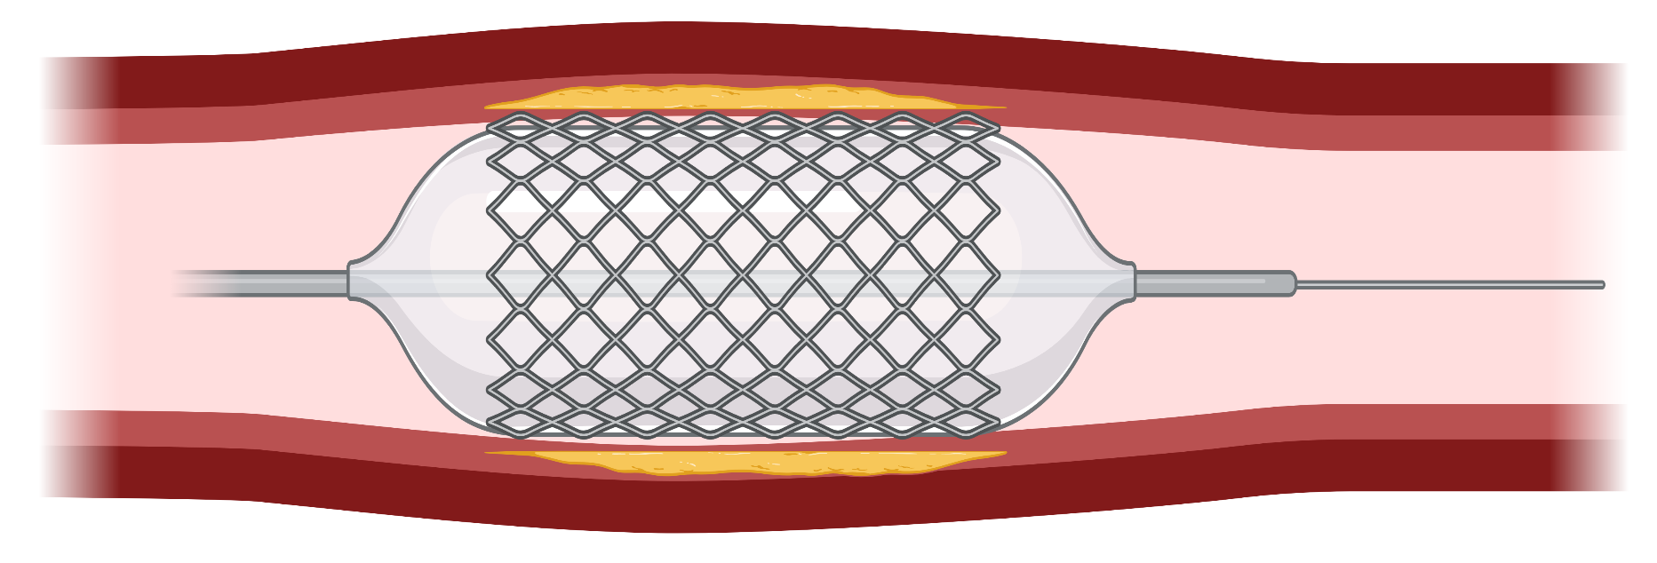
Purpose and key points about methods
?
+
15%
+

Slide 4
Purpose and key points about methods
Patient population (455)
+
vs
+
Primary end point of MACE > 1 year after TAVI
MACE: all-cause mortality, myocardial infarction, or urgent revascularization

Slide 5
Results
vs
+
26%
36%
$\sim$30%
Primary End Point
Myocardial Infarction
7%
14%
$\sim$50%
Bleeding
28%
20%
$\sim$30%

Slide 6
Key messages
Performing PCI in patients undergoing TAVI significantly reduced death, myocardial infarction or urgent revascularisation compared with TAVI alone
The marked reduction in numbers of myocardial infarction with PCI was surprising.
As expected, there was more bleedings with PCI.
For patients treated with TAVI who also have stable coronary artery disease performing PCI should be the standard of care.

