Slide 1
The OCCUPI Randomized Clinical Trial:
OCT-guided PCI for the complex lesions
funded by Abbott Vascular and supported by the Cardiovascular Research center (Korea)
Other declaration of Interest, nothing to disclose directly related to this presentation
Byeong-Keuk Kim, MD,
Hot Line 11 (Sep 2, 2024)

Slide 2
Abstract’s conclusion
In this multi-center randomized OCCUPI trial involving patients requiring PCI with DES implantation because of anatomically complex lesions, OCT guidance resulted in a lower incidence of 1-year composite of cardiac death, myocardial infarction, stent thrombosis, or ischemia-driven target-vessel revascularization than angiography guidance.
These findings support the therapeutic benefit of OCT as an effective intravascular imaging modality in treating complex lesions.

Slide 3
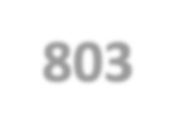



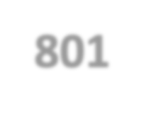



Purpose and key points about methods
Purpose: To compare the clinical benefits of OCT-guided PCI vs. angiography-guided PCI for complex lesions, assessed as the rate of major adverse cardiac events (MACE) at 1 year
Hypothesis: OCT-guided PCI for complex lesions would be superior to angiography- guided PCI in the occurrence of the primary endpoint at 1 year
1604 Patients requiring PCI with DES for complex coronary lesions Between January 9, 2019, and September 22, 2022 (20 centers in South Korea)
 |  | 1:1 Randomization |  | (ClinicalTrials.gov, NCT03625
908)
803 OCT-guided group 801 Angiography-guided group
12-month clinical follow-up after PCI with DESs
Primary endpoint: MACE (cardiac death, myocardial infarction, stent thrombosis, or ischemia-driven target-vessel revascularization) at 1 year

Slide 4

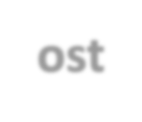


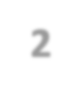
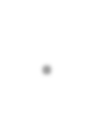

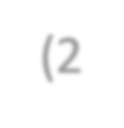

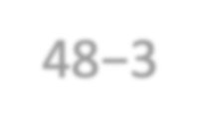

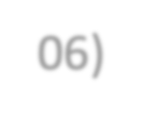
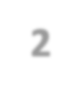
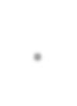

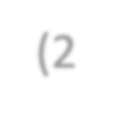
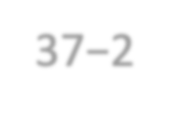
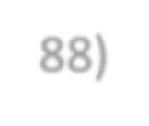

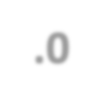
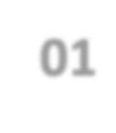


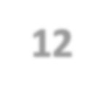

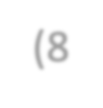
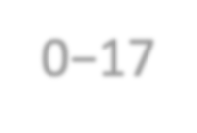
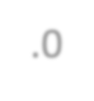
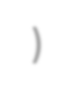
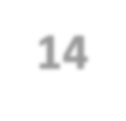

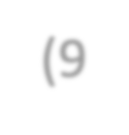
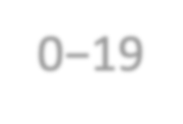
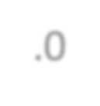
Baseline & Procedural Characteristics
Baseline characteristics did not differ between the two groups;
; Median age (64 yrs), Men (80%), ACS (49%), AMI (20%)
Procedural characteristics | OCT-guidance (N=803) | Angiography-guidance (N=801) | P value
No. of stents per patient | 1.6 ± 0.8 | 1.6 ± 0.8 | 0.88
Stent diameter, mm | 3.2 (3.0−3.5) | 3.0 (2.9−3.4) | <0.001
Total stent length, mm | 37.7 (29.2−53.5) | 36.5 (28.5−51.9) | 0.16
Adjunct post-dilatation High-pressure post-dilatation Maximal inflation pressure, atm | 907 (96.1) 623 (66.0%) 18.0 (16.0−20.0) | 901 (94.8) 425 (44.7%) 14.5 (12.0−17.0) | 0.24 <0.001 <0.001
Post-procedural minimal lumen diameter | 2.75 mm (2.48−3.06) | 2.59 mm (2.37−2.88) | <0.001
Post-procedural diameter stenosis | 12.0% (8.0−17.0) | 14.0% (9.0−19.0) | <0.001
Contrast volume used per patient, mL | 300 (210−400) | 210 (180−270) | <0.001
Procedural time per patient, min | 53.0 (40.0−70.0) | 43.5 (30.0−60.0) | <0.001

Slide 5
Primary Endpoint
MACE, a composite of cardiac death, MI, ST, or TVR at 1 year
15
Cumulative incidence (%)
Absolute difference, - 2·8% [95% CI, -5·1 to -0·4]
HR, 0.62 [95% CI, 0.41 to 0.93]
P = 0.023
Angiography-guided PCI
10
7.4%
5
4.6%
OCT-guided PCI
0
0
3 6 9
Months since randomization
12
Number at risk
Angiography-guided | 801 | 775 | 763 | 754 | 740
OCT-guided | 803 | 780 | 778 | 772 | 763

Slide 6





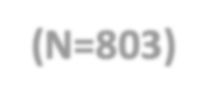
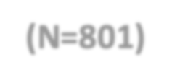
Secondary and other endpoints
OCT-guidance
Angio-guidance
HR (95% CI)
P value
 | (N=803) | (N=801)
All-cause death | 5 (0.6%) | 6 (0.8%) | 0.83 (0.25−2.72) | 0.76
Cardiac death | 1 (0.1%) | 5 (0.6%) | 0.20 (0.03−1.71) | 0.14
MI | 29 (3.6%) | 40 (5.0%) | 0.72 (0.45−1.16) | 0.18
Spontaneous MI | 7 (0.9%) | 19 (2.4%) | 0.36 (0.15−0.86) | 0.022
Peri-procedural MI | 22 (2.7%) | 22 (2.8%) | 1.00 (0.55−1.80) | 0.99
ST | 4 (0.5%) | 10 (1.3%) | 0.40 (0.12−1.26) | 0.12
TVR | 12 (1.5%) | 33 (4.1%) | 0.36 (0.18−0.69) | 0.002
Contrast-induced nephropathy | 10 (1.3%) | 7 (0.9%) | 1.43 (0.54−3.75) | 0.47
Cardiac death, spontaneous MI, or ST | 8 (1.0%) | 20 (2.5%) | 0.39 (0.17−0.90) | 0.026
Cardiac death, spontaneous MI, ST, or TVR 15 (1·9%) |  | 38 (4·7%) | 0·39 (0·21−0·70) | 0·0014

Slide 7

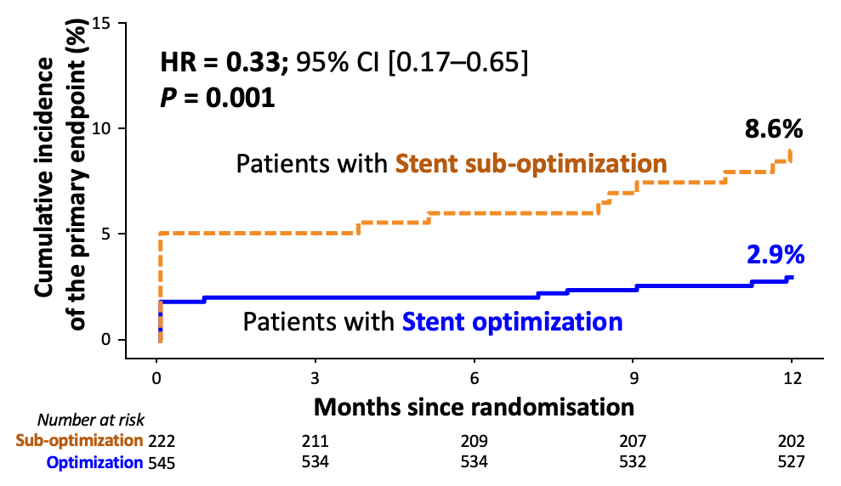
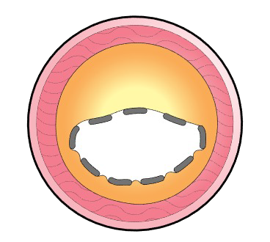
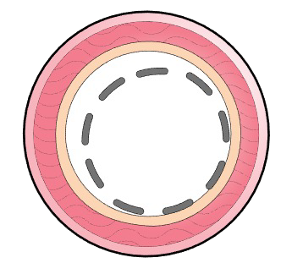
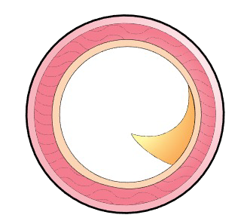
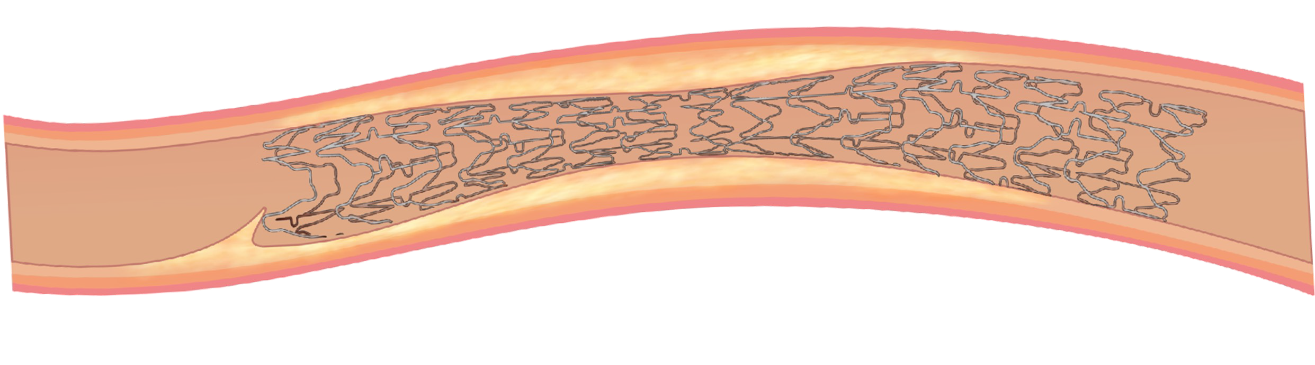
Stent Optimization and clinical outcomes in the OCT-guided PCI
OCCUPI-OCT optimization criteria
Stent expansion
Stent apposition
Edge dissection
Minimal stent area (MSA) segment
Proximal reference segment
Distal reference segment
Considered acceptable expansion
if one of the following criteria is met
Maximal distance
Absence of major edge dissection
(considered optimal expansion if all criteria are met)
between the strut and vessel wall
(considered acceptable if all criteria are met) ① MSA ≥80% of mean reference lumen ① <400 μm; acceptable apposition
① Circumference of dissection <60˚ ② MSA ≥100% of distal reference lumen ② <200 μm; optimal apposition
② Length of dissection: <3 mm
③ No deep vessel injury
③ MSA >4.5 mm² (non-left main)
Stent optimization: meeting the acceptable criteria for all 3 components
(expansion, apposition, and edge dissection)
Acceptable stent expansion: 73.4%
Acceptable stent apposition: 80.8%
Acceptable edge dissection: 99.6%
→ Patients with stent optimization: 71% vs.
→ Patients with stent sub-optimization: 29%

Slide 8
Take home message
In this multi-center randomized OCCUPI trial involving patients requiring PCI with DES implantation because of anatomically complex lesions,
OCT-guided PCI led to a reduced risk of 1-year composite of cardiac death, MI, ST, or TVR compared with angiography-guided PCI.
The main reduction in the OCT-guided group was driven by lowering the occurrences of spontaneous MI and TVR without raising concerns of contrast-induced nephropathy.
In the OCT-guided PCI group, patients who meet the pre-specified OCCUPI-OCT optimization criteria (acceptable expansion, apposition, and edge dissection) had a significantly lower MACE rate compared to those with sub-optimization.
These findings provide the therapeutic value of OCT as an effective intravascular imaging modality in treating complex lesions.

