Slide 1

Comparison of angiography- derived fractional flow reserve- guided and intravascular ultrasound-guided PCI strategies (FLAVOUR II)
Jian’an Wang, M.D., Ph.D.
The Second Affiliated Hospital of Zhejiang University School of Medicine

Slide 2
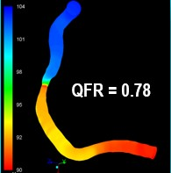
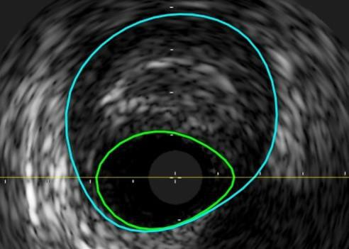

Background
In the cath-lab, a comprehensive strategy is essential for patients with CAD, which includes decision-making for PCI and
optimizing the PCI procedure.
Physiological assessment is effective in guiding PCI decision-making. However, despite strong recommendations and robust evidence, the global adoption of the conventional wire-based physiological assessment in clinical practice remains limited.
AngioFFR is a simplified physiological assessment obtained directly from angiography without additional invasive procedures and carries a Class IB recommendation in current guidelines.
In addition to the role of decision-making, AngioFFR could be used for optimizing procedures.
Intravascular imaging plays a key role in optimizing PCI procedure and is superior than the angiography-only-guided PCI.
Angiography-Derived Fractional Flow Reserve (AngioFFR)
A next-generation non-invasive physiological assessment, excels in determining the need for PCI
Intravascular Ultrasound (IVUS)
The most commonly used intravascular imaging tool, excels in optimizing PCI procedure
vs
Differences in outcomes when a single modality is used for both purposes remain unclear.

Slide 3

Objective and Hypthesis
When employed as a comprehensive strategy, encompassing both PCI decision-making and procedure optimization, whether a novel computational physiologic technique can perform as effectively as the most commonly used conventional intravascular imaging technique ?
Objective: To compare the efficacy of AngioFFR- and IVUS-guided PCI strategies in patients with angiographically significant stenosis.
Hypothesis: The AngioFFR-guided PCI strategy will be non-inferior to the IVUS-guided PCI strategy in terms of clinical outcomes at 12 months.

Slide 4
Clinical Outcomes and Sample Size
Primary outcome
  A composite of death, MI, or revascularization at 12 months
Key Secondary Outcomes
  Death, MI or revascularization at 24 and 60 months
  Target vessel failure (a composite of cardiac death, target-vessel MI, or target lesion revascularization)
  All-cause and cardiac death
  Target-vessel and all-cause nonfatal MI with/without peri-procedural MI
  Any revascularization (ischemia-driven or all)
Sample size calculation
  Assumed 12-month event rate in the AngioFFR-guided PCI group: 7.0%
  Assumed 12-month event rate in the IVUS-guided PCI group: 8.0%
Type I error: one-side 0.025, Power: 80%
Non-inferiority margin: 2.5%
A total of 1,872 cases
4

Slide 5
Randomization and Data Collection
Randomization
  Eligible patients were randomized via a web-based randomization sequence.
  Stratification methods were applied by participating centers and by the presence of diabetes mellitus.
Data collection and management
  Data collected by a web-based electronic case report form (eCRF)
  An independent data and safety monitoring board monitored the trial.
  All clinical events were adjudicated by an independent clinical event adjudication committee.

Slide 6
Study Organization
Principal Investigators
Jian’an Wang
Bon-Kwon Koo
Steering Committee
Jian’an Wang
Bon-Kwon Koo Xinyang Hu Chang-Wook Nam William F Fearon
Clinical Event Adjudication Committee
Jin-Sin Koh (Chair) Keehwan Lee
So Dam Jung
Data Safety Monitoring Board
Xin Du (Chair)
Rongchong Huang Hyun-Kuk Kim Hyun Jong Lee
Woojoo Lee (Statistician)
Data Coordination and Management
Xiaoyuan Qu (Beijing Yjheal Medical Research Center)

Slide 7
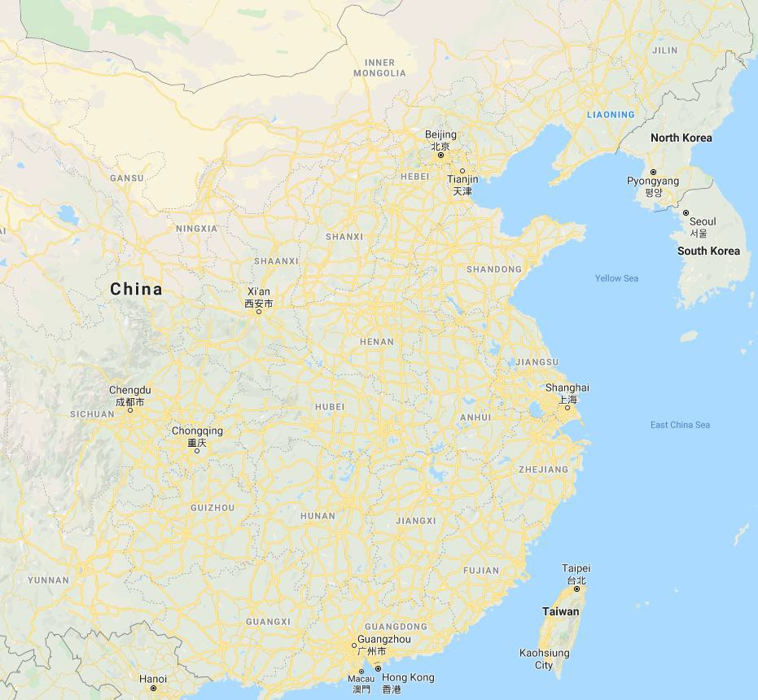
Investigators
FLAVOUR II is an investigator-initiated, multicenter, randomized trial
Linjun Guo / Peking University Third Hospital
Bon-Kown Koo / Seoul National University Hospital
Jian An / Shanxi Cardiovascular Hospital
Bin Yang / Second hospital of Shanxi Medical University
Eun-Seok Shin / Ulsan Medical Center
Jianliang Ma/ The Affiliated Hospital of Shandong University of TCM
Qian Liu / The Fourth People’s Hospitala of Jinan
Daqing Song / Jining No.1 People’s Hospital
Jun Bu / Renji Hospital Shanghai Jiaotong University School of Medicine
Jian’an Wang / Second Affiliated Hospital of Zhejiang University School of Medicine
Jinyu Huang / Affiliated Hangzhou First People’s Hospital
Fan Jiang / The Affiliated Hospital of Hangzhou Normal University
Yongzhen Fan/ Zhongnan Hospital of Wuhan University
Peng Chen / The first affiliated hospital of Wenzhou Medical University Hao Zhou / The second affiliated hospital of Wenzhou Medical University
Wenming He / The Affiliated Hospital of Medical School of Ningbo University
Xiaoping Peng / The First Affiliated Hospital of Nanchang University
Dongsheng Lu / Changxing People’s Hospital Zhenfeng Cheng / Huzhou Central Hospital Yibin Pan / Jinhua Central Hospital
Hongping Si / Dongyang People’s Hospital
Shiqiang Li / Zhejiang Greentwon Cardiovascular Hospital Lijiang Tang / Zhejiang Hospital
Zhaohui Meng / First Affiliated Hospital of Kunming Medical Univsrsity
Jilin Li/ The Second Affiliated Hospital of Shantou University Medical College

Slide 8
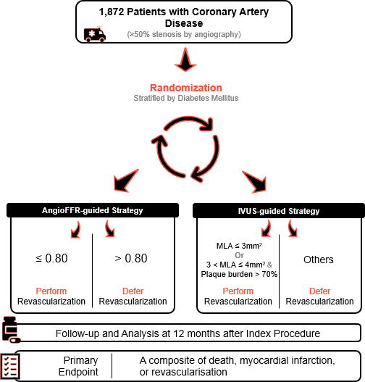
Study Design and Patient Population
1,872 patients from 22 centers in China
Key Inclusion criteria
Subject must be ≥ 18 years Patients with ≥ 50% stenosis by angiography-based visual estimation. Target vessel size ≥ 2.5mm in visual estimation Target vessels are limited to LAD, LCX, and RCA
Exclusion criteria
Target vessel total occlusion Target lesion located in coronary arterial bypass graft Target lesion located in the left main coronary artery Not eligible for AngioFFR (myocardial bridging, severe tortuosity, severe overlap, poor image quality)

Slide 9

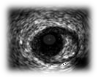
Indications and Optimization Criteria for PCI
AngioFFR-guided PCI group | IVUS-guided PCI group
AngioFFR ≤ 0.80 | Minimum lumen area (MLA) ≤ 3mm² or 3< MLA ≤ 4mm² & Plaque burden > 70%
PCI
Plaque burden at stent edge ≤ 55%
Minimal stent area ≥ 5.5mm²
or
Plaque burden at stent edge ≤ 55%
Minimal stent area ≥ distal reference lumen area
Post PCI AngioFFR ≥ 0.88
or
Post PCI ∆AngioFFR (across the stent) < 0.05

Slide 10

Trial Flow
4417 patients from 22 sites were screened
1872 patients
33 patients excluded from randomization
1839 patients randomized
923 patients were assigned to the AngioFFR group
916 patients were assigned to the IVUS group
30 protocol violations
11 deferred with positive AngioFFR
4 underwent PCI with negative AngioFFR 9 underwent PCI with IVUS
6 received PCI with DCB
48 protocol violations
16 deferred with positive IVUS
13 underwent PCI with negative IVUS
2 deferral guided by AngioFFR 17 received PCI with DCB
14 lost to follow-up
11 lost to follow-up
909 (98.5%) patients completed 12-month follow-up
905 (98.8%) patients completed 12-month follow-up

Slide 11
Clinical Characteristics
 | AngioFFR (n=923) | IVUS (n=916)
Age, years | 66.0 (58.0-72.0) | 66.0 (58.0-72.0)
Sex
Male | 624 (67.6%) | 624 (68.1%)
Female | 299 (32.4%) | 292 (31.9%)
Diagnosis, n (%)
Chronic coronary disease | 371 (40.2) | 365 (39.8)
Acute coronary syndrome | 545 (59.0) | 542 (59.2)
Diabetes mellitus, n (%) | 279 (30.2) | 290 (31.7)
Hypertension, n (%) | 615 (66.6) | 628 (68.6)
Current smoking, n (%) | 242 (26.2) | 235 (25.7)
Prior MI, n (%) | 129 (14.0) | 126 (13.8)
Discharge medication
Aspirin, n (%) | 816 (88.4) | 826 (90.2)
P2Y₁₂ inhibitor, n (%) | 792 (85.8) | 830 (90.6)
Dual antiplatelet therapy, n (%) | 711 (77.0) | 755 (82.4)
Statin, n (%) | 888 (96.2) | 885 (96.6)
Beta blocker, n (%) | 509 (55.1) | 513 (56.0)

Slide 12
Procedural Characteristics
 | AngioFFR | IVUS | p value
Angiographic findings | n=923 | n=916
Patients who received PCI, n (%) | 682 (73.9) | 761 (83.1) | <0.0001
Total stent number per patient | 1.06±0.90 | 1.21±0.92 | <0.0001
SYNTAX score | 10 (5-15) | 9 (5-15) | 0.66
Additional procedures due to suboptimal conditions | 126 (18.5) | 165 (21.7) | 0.15
PCI achieved optimization criteria | 606 (88.9) | 430 (56.5) | <0.0001
Target vessel | n=985 | n=984
Lesion length, mm | 19.0 (12.5-29.8) | 20.3 (13.2-30.5) | 0.083
Reference vessel diameter, mm | 2.93 (2.61-3.30) | 2.96 (2.65-3.35) | 0.16
Diameter stenosis, % | 62.3 (53.8-70.9) | 62.2 (54.7-70.0) | 0.94
Target vessel PCI, n (%) | 688 (69.5) | 797 (81.0) | <0.0001
IVUS findings
Minimal luminal area, mm² |  | 2.68 (2.19-3.35)
Plaque burden, % |  | 76.0 (70.0-81.0)
Post-PCI minimal stent area, mm² |  | 6.76 (5.49-8.57)
AngioFFR findings
AngioFFR | 0.73 (0.56-0.84)
Post-PCI AngioFFR | 0.96 (0.93-0.98)

Slide 13
Primary Outcome
100
10
P for non-inferiority = 0.022
80
8
6.3%
6.0%
6
Patients (%)
60
4
IVUS group
40
2
AngioFFR group
0
20
0
2
4
6
8
10
12
0
 | 0 | 2 | 4 | 6 | 8 | 10 | 12
No. at risk |  |  |  | Months after Randomization
AngioFFR group | 923 | 904 | 901 | 895 | 886 | 865 | 813
IVUS group | 916 | 895 | 889 | 887 | 878 | 864 | 811

Slide 14
Clinical Outcomes
 | Total (n=1839) | AngioFFR (n=923) | IVUS (n=916) | Difference 95%CI
Death
- Any | 28 (1.6) | 16 (1.8) | 12 (1.3) | 0.4% (-0.7 to 1.6)
- From cardiac cause | 10 (0.6) | 6 (0.7) | 4 (0.4) | 0.2% (-0.5 to 0.9)
Myocardial infarction
- Any | 10 (0.6) | 6 (0.7) | 4 (0.4) | 0.2% (-0.5 to 0.9)
- Target vessel | 1 (0.05) | 0 | 1 (0.1) | -0.1% (-0.3 to 0.1)
Revascularization
- Any | 77 (4.4) | 36 (4.1) | 41 (4.7) | -0.6% (-2.5 to 1.4)
- Ischemia driven | 54 (3.0) | 25 (2.8) | 29 (3.3) | -0.4% (-2.0 to 1.2)
- Target vessel | 29 (1.7) | 15 (1.7) | 14 (1.6) | 0.1% (-1.1 to 1.3)
Stroke | 15 (0.8) | 6 (0.7) | 9 (1.0) | -0.3% (-1.2 to 0.5)

Slide 15
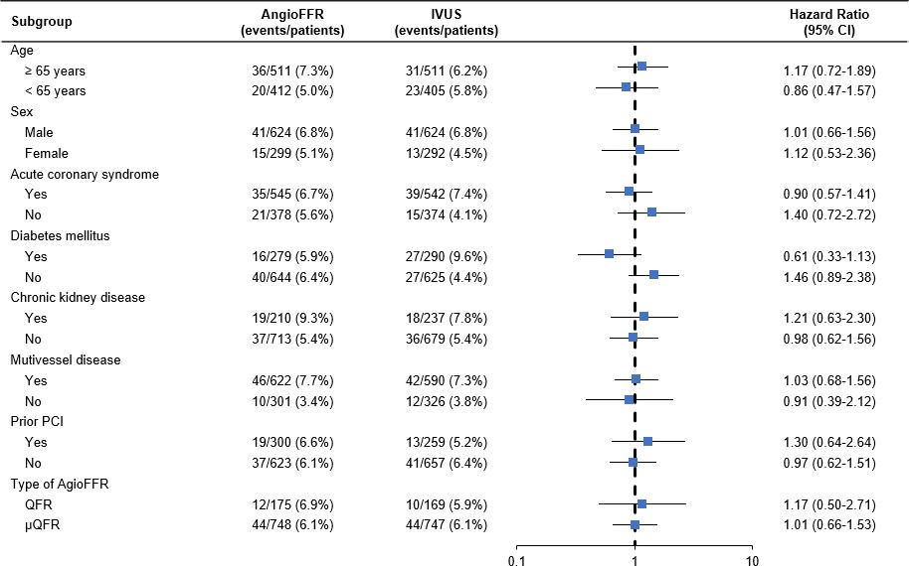
Subgroup Analysis
Favors AngioFFR
Favors IVUS

Slide 16
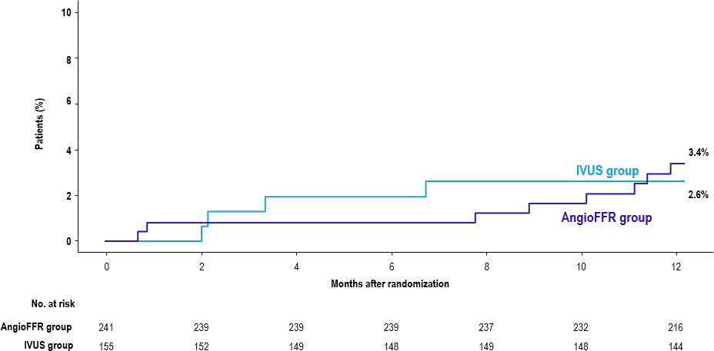
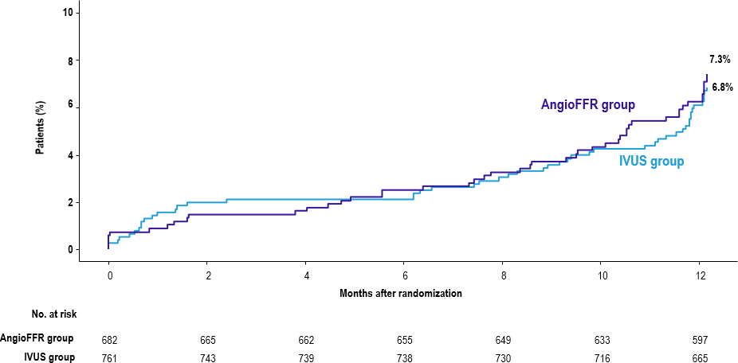
Primary Outcome According to Treatment
Medical treatment
PCI
Absolute difference, 0.8%; 95% CI, -2.7% to 4.2%
Absolute difference, 0.5%; 95% CI, -2.2% to 3.2%

Slide 17
Limitations
The study population had relatively low anatomical complexity, with a median SYNTAX score of 9.
The PCI criteria in the IVUS group may have contributed to the higher PCI rate, given the lack of a definitive standard for IVUS-guided revascularization.
The higher PCI optimization rate was influenced by both the AngioFFR technique itself and the criteria used to define optimization, as no universally accepted standard for AngioFFR-based PCI optimization exists.

Slide 18
Conclusions
In the patients with non-complex coronary artery disease
The AngioFFR-guided comprehensive PCI strategy, encompassing PCI decision-making and stent optimization, was non-inferior to the IVUS-guided strategy with respect to the composite endpoint of death, myocardial infarction, or revascularization at 12 months.
This finding might have implications for future guidelines on its role and application.

Slide 19
The photo was taken in early 20th century. The scene captures Dr. David Duncan Main, a British physician and the first hospital president of Guangji
Hospital, greeted a pediatric patient with reciprocal humility and respect.
Thank You !
It symbolizes the value treasured by SAHZU people till today: ”The Needs of Patients and Customers Come First.”

