Slide 1




DCB with rescue stenting versus intended stenting for de novo CAD: a multicenter, non-inferiority trial (REC-CAGEFREE I)
An investigator-initiated trial sponsored by Xijing Hospital
Grant support from Xijing Hospital (Xi’an, China) and unrestricted grant support from Shenqi Medical (Shanghai, China).
Declaration of Interest: None
Ling Tao, M.D., Ph.D.
Xijing hospital, Xi’an, China; lingtaofmmu@qq.com
On behalf of REC study group and the REC-CAGEFREE I investigators
Sep 1, 2024
Dept of Cardiology

Slide 2
Background
Drug-eluting stent (DES) is currently standard of care for PCI Leave nothing behind with Drug-coated balloon (DCB)
In-stent restenosis: ESC Guidelines for revascularization (Class IA);
De novo, small vessel disease: BASKET-SMALL 2 trial (Non-inferior to DES); not yet been endorsed in guidelines; concerns regarding the small sample sizes
De novo, non-small vessel: Only in small-scale RCTs with surrogate endpoints
AIM: To test for de novo, non-complex PCI and irrespective of target vessel diameter, whether DCB with rescue stenting is non-inferior to intended stenting

Slide 3




Method
Inclusion and Key exclusion
ACS or CCS
De novo lesion, regardless of treated vessel diameter Non-Complex PCI, which is defined as
One or two target lesions or vessels, one or two planned DES or
DCB devices, planned total DES or DCB length of 60 mm or shorter
bifurcations not requiring treatment in both main and side branch
Non-left main lesion
Non-venous or arterial graft lesion
Non-chronic total occlusion lesion
Do not require the use of atherectomy device
Exclude: cardiogenic shock and in-stent restenosis
2902 Patients from 43 sites in China for non-complex PCI for de novo CAD
Successful pre-dilation
Unsuccessful pre-dilation
2272 (78.3%) Randomization 1:1
630 (21.7%)
Nested cohort study
Sirolimus-eluting stent (DES)
Paclitaxel coated balloon (DCB)
Successful pre-dilatation
No type D, E, F dissections
TIMI flow = 3
Visual residual stenoses ≤ 30%
106 (9.4%) DES bailout
(TIMI flow ≤2, dissections type D, E, and F, or
visual residual stenosis >30%)
Primary endpoint: Device-oriented Composite Endpoint at 2 years (non-inferiority)
(cardiac death, target-vessel myocardial infraction, clinically and physiologically indicated target lesion revascularization)

Slide 4
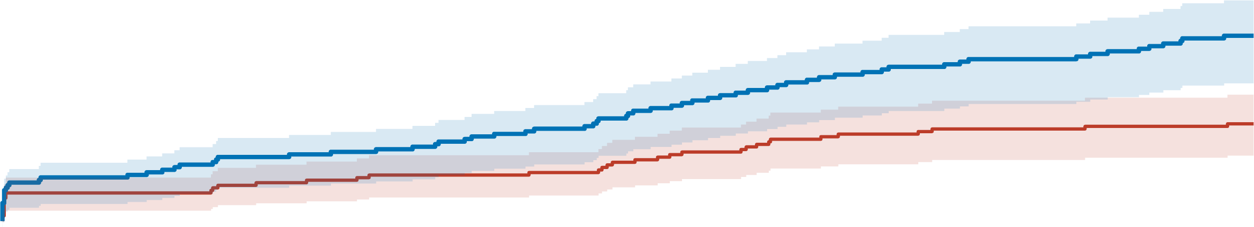
Primary endpoint -DoCE, ITT
Cardiovascular death, TV-MI, and clinically and physiologically indicated-TLR
15
Cumulative incidence (%)
At 2 years (Primary Endpoint)
10
DCB: 72 (6.4%)
DES: 38 (3.4%)
Difference: 3.04%
One-sided 95CI% upper limit: 4.52 Pnon-inferiority=0.65
Two-sided 95CI%: 1.27-4.81
Pinferiority=0.0008
NNT: 33
5
0
0 30 60 90 120 150 180 210 240 270 300 330 360 390 420 450 480 510 540 570 600 630 660 690 720
Number at risk (number censored)
Days since Randomization
DES
1139 1126 1126 1126 1126 1122 1121 1119 1118 1118 1118 1115 1111 1106 1104 1099 1096 1095 1092 1089 1089 1087 1086 1086 1084
(0) (2) (2) (2) (2) (2) (2) (3) (3) (3) (3) (5) (5) (7) (8) (8) (10) (10) (11) (14) (14) (15) (16) (17) (17)
DCB 1133 1116 1116 1114 1111 1108 1107 1105 1102 1099 1095 1093 1087 1080 1074 1070 1066 1063 1061 1058 1056 1052 1050 1046 1045
(0) (0) (0) (0) (0) (0) (0) (1) (2) (2) (4) (4) (5) (8) (10) (10) (10) (11) (12) (12) (14) (16) (16) (16) (16)

Slide 5
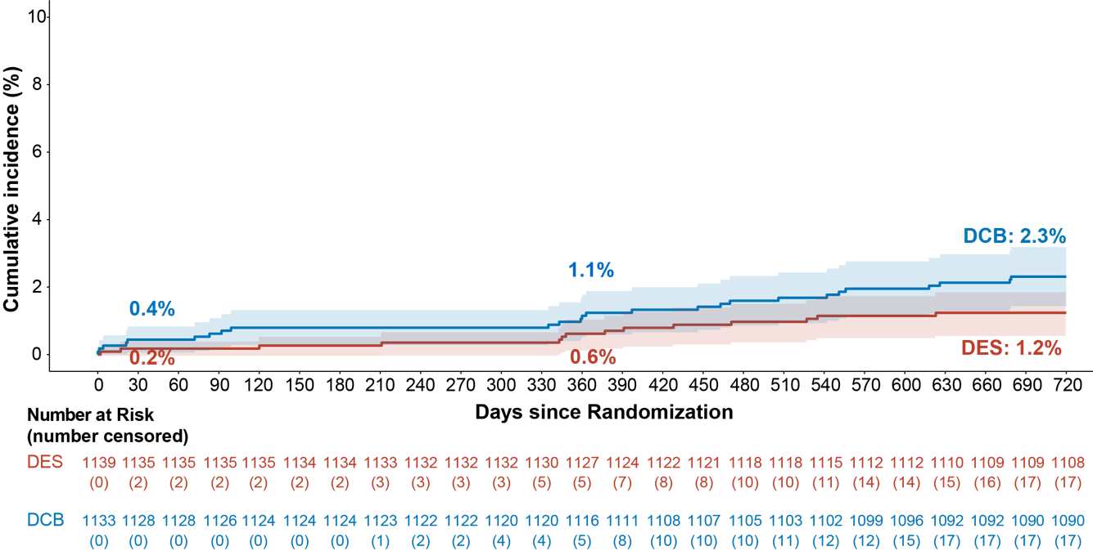
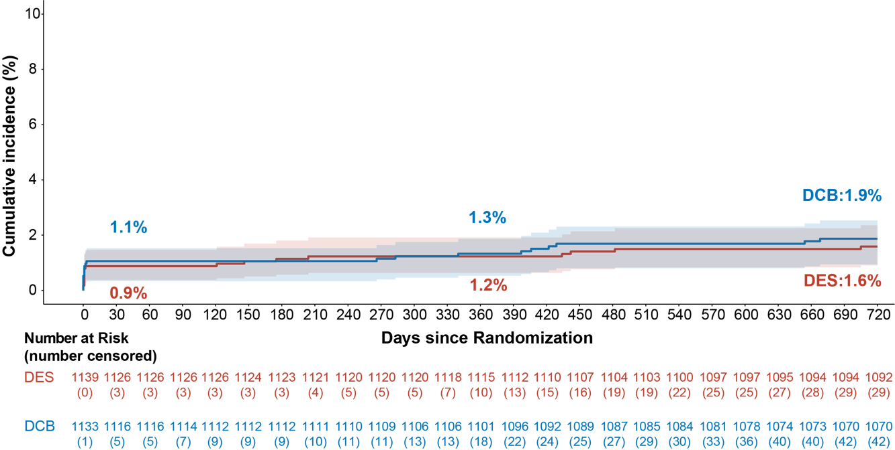
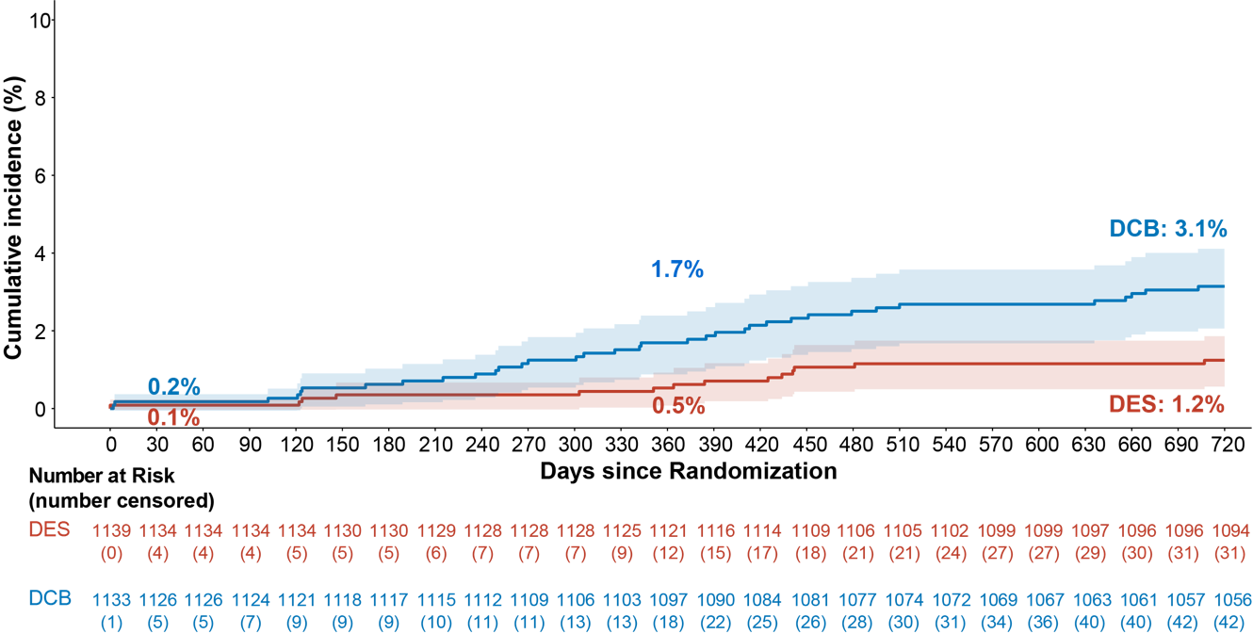
Individual components of DoCE
Cardiovascular death
Difference: 1.07%, Two-sided 95CI%: -0.02, 2.16, P=0.053
Target vessel myocardial infarction
Difference: 0.28%, Two-sided 95CI%: -0.79, 1.36, P=0.606
Clinically and physiologically indicated target lesion revascularization
Difference: 1.90%, Two-sided 95CI%: 0.69, 3.11, P=0.002

Slide 6
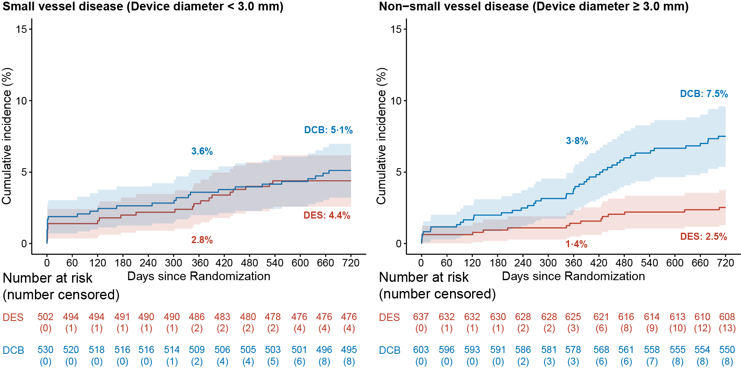
SVD vs non-SVD subgroup (DoCE, ITT)

Slide 7
Take home message
To the best of knowledge, the present study is the first RCT with powered clinical endpoints to investigate DCB versus DES in patients with de novo CAD, regardless of target vessel diameter.
DCB with rescue stenting failed to reach non-inferiority compared to intended DES in terms of DoCE at 2 years.
DES implantation should remain be the preferred treatment strategy for these patients
Will continue to follow the patients for 10 years to explore whether the higher rate of revascularisation in the DCB group would translate into mortality or MI.

