Slide 1
Use of Impella ventricular assist device in a patient with massive pulmonary embolism associated cardiogenic shock
Ali Farooq, MD¹; Frank Annie, MA, MPA, PhD(c); Aravinda Nanjundappa, MD
Department of Cardiovascular Medicine, Charleston Area Medical Center, West Virginia University Charleston Division, Charleston, WV

Slide 2
<
I have no relevant financial relationships

Slide 3
Introduction
Pulmonary embolism is the third most common cause of cardiovascular-related death in the United States.1
cardiogenic shock occurs in less than 5% of patients with PE, the mortality of patients with cardiogenic shock ranges from 25-40%, and is as high as 65-95% in patients requiring cardiopulmonary resuscitation
Mainstay of treatment in acute decompensated RV failure is inotropic and pulmonary vasodilator support. However, these measures are frequently insufficient to augment RV systolic function
One of the novel advancements in percutaneous RV support is axial flow pump Impella RP.
We present a case of massive PE with cardiogenic shock successfully treated with Impella RP RV support system.

Slide 4
Case Presentation
A 71-year-old female presented with loss of consciousness and apnea and was found to be in cardiac arrest.
PMH: Hypertension, hyperlipidemia, transient ischemic attack, coronary artery disease, diabetes.
PE:
BP 89/55, HR 91, RR 15, O2 saturation 74% on room air.
Lungs were clear to auscultation bilaterally.
+2 bilateral lower extremity edema.
Labs:
pH 7.32, pO2 103 on nonrebreather, pCO2 40.
Lactic acid 3.5, potassium 5.9, creatinine 6.9 (baseline 1.0), AST 1363, ALT 1084.
Troponin 2.4, BNP 1083.

Slide 5
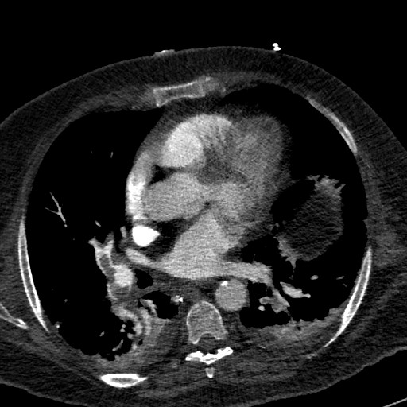
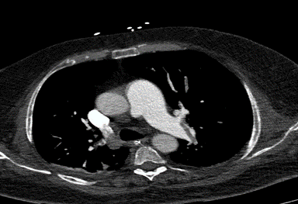
CTA chest revealed saddle PE with massive bilateral PE. The RV/LV ratio was > 1. The Pulmonary Embolism Severity Index (PESI) score was 132, a class V PE with a very high mortality rate of 10% to 24.5% in 30 days.

Slide 6
CT Chest Angiogram

Slide 7
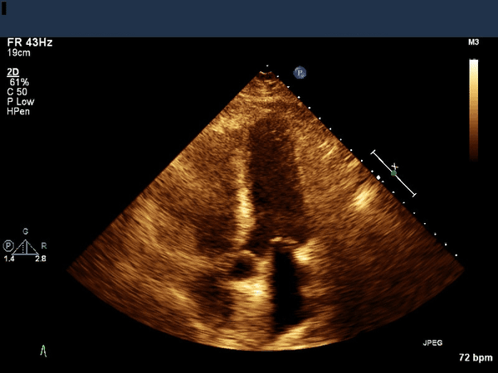
The echocardiogram showed LVEF of 55%, akinetic RV free wall, moderately reduced RV systolic function and McConnell’s sign, which supported the massive PE diagnosis

Slide 8
Hospital Course
Started on vasopressors for shock and required intubation for respiratory support.
Placed on CRRT for acute renal failure with oliguria.
Remained dependent on mechanical ventilation, vasopressors and CRRT with no signs of improvement.
His mean right arterial (RA) pressure was 28, and pulmonary artery (PA) pressure was 65/38. He had right ventricular (RV) failure with a PulmonaryArtery Pulsatility Index (PaPi) score of < 1.

Slide 9
Cather associated thrombolysis (EKOS)

Slide 10
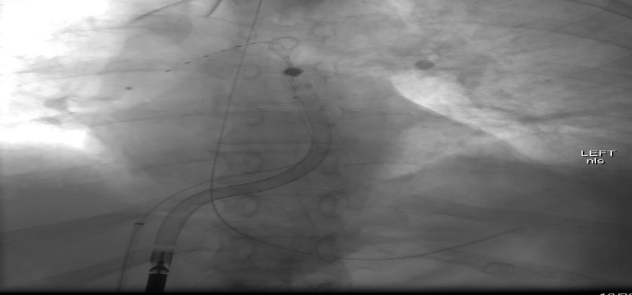
RV Impella Implantation

Slide 11
Following the Impella placement, his RA pressure was 17/19/15 mm Hg, and his RV pressure was 55/11/15 mm Hg. His PA pressure was 58/32/41 mm Hg

Slide 12
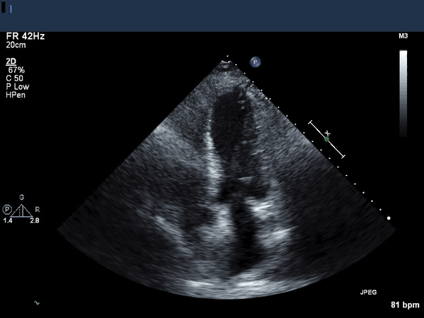
Seventy-two hours after we inserted the Impella, the repeated echo showed better right ventricular function. We were able to wean down the RP Impella and then remove it uneventfully. A day later, the patient was discharged home. A week later, an echo showed that he had near-normal right ventricular function. He was advised to take anticoagulants for the rest of his life

Slide 13
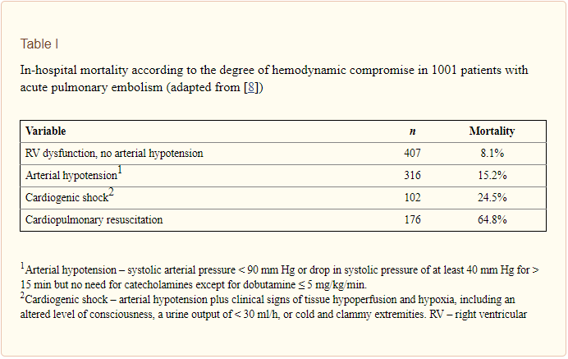
Discussion

Slide 14
Risk stratification using hemodynamic measurements essential and improves optimization of patient care
Pulmonary artery pulsatility index (PAPi)
measured as PA pulse pressure/RA pressure
hemodynamic measurement index which helps to predict severe RV dysfunction
risk stratify those patients requiring RV assist devices (RVAD)

Slide 15
PAPi demonstrated the highest sensitivity (88.9%) and specificity (98.3%)
predicting in-hospital mortality and/or
requirement of a percutaneous RV support device
Using ROC (Receiver operating characteristic) curve derived cut-points, a PAPi <\= 0.9 provided 100.0% sensitivity and 98.3% specificity
Predicting in-hospital mortality and/or
requirement of a RV support device
exceeding the predictive value of the
RA:PCWP ratio or RVSW
Notes:
(C-statistic: 0.998)

Slide 16
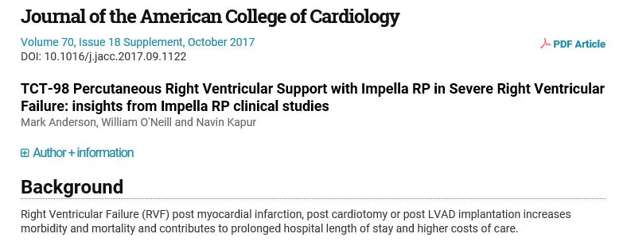
Anderson, et. Al.
Prospective cohort trial
60 patients from 14 US institutions
Study population consisted of 2 cohorts:
1. RV failure post LVAD placement (n=31) and
2. RV failure post cardiotomy, heart transplant or post MI (n=29)
Primary end point was 30 days survival or hospital discharge (whichever was longer)
Improved hemodynamics immediately after initiation of Impella RP support
improved cardiac index from 1.9 (+/- 0.1) to 3.1 (+/-0.2) L/min/m2 (P<0.001), and
decrease in CVP from 19.0 (+/-1) to 13.0 (+/-1) mmHg (P<0.001)
The overall survival at 30 day (or discharge) was 72%

Slide 17
Evidence supporting the use of veno-venous extracorporeal membrane oxygenation (vv-ECMO) in patients with acute PE is limited to animal-model experiments and human case reports/ series.6

Slide 18
Conclusion
Isolated RVI though uncommon, can cause severe hemodynamic and electrophysiologic instability
associated with higher in-hospital morbidity and mortality in patients with inferior MI
Risk stratification using hemodynamic measurements help optimize patient care
PAPi is a hemodynamic measurement index which helps to predict severe RV dysfunction
PAPi <\= 0.9 provided 100.0% sensitivity and 98.3% specificity for predicting in-hospital mortality and/or requirement of a RV support device
Impella RP system is indicated to provide temporary RV support for up to 14 days in patients who develop RV failure or decompensation
Early Impella implantation in cardiogenic shock from AMI was associated with improved hemodynamics and survival benefit

