Slide 1
Results of the REDUCED 1 study assessing the TIVUS system in renal denervation
James Zidar, Michael Jonas, Andre Paixao, Max Arroyo, Matos, Gabby Elbaz-Greener, Iddo Ben-Dov, Christian Spaulding, Ajay Kirtane for the REDUCED 1 Investigators

Slide 2
Potential conflicts of interest
Speaker's name : James Zidar
Within the past 12 months, I or my spouse have had a financial interest or affiliation with the organizations listed:
Receipt of honoraria or consultation fees: Stock shareholder:
Grant/research support
Cordis None Sonivie

Slide 3
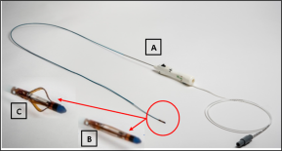
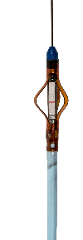
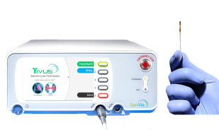
TIVUSTM RMD Catheter: Non-Focused, High Intensity Ultrasonic Catheter for Renal Denervation
Blood vessel wall
Ultrasound
Higher ablation depth
Non occlusive, free floating
No need for a cooling system
Easy to track
One catheter per procedure
Fast and safe procedure
Fast learning curve
Lumen + Blood Flow
Deeper penetration compared to RF
Ultrasonic Catheter
Catheter uses blood flow to passively cool the surface tissue for safety

Slide 4
REDUCED 1 Pilot Study
Objective - Clinical evaluation of the TIVUS™ System for renal denervation in
patients with uncontrolled stage 2 hypertension
Population - Uncontrolled stage 2 hypertension:
Mean office systolic blood pressure (SBP) of 140-180 mmHg
Mean office diastolic blood pressure of 90-110 mmHg
Mean daytime ambulatory systolic blood pressure 135-180 mmHg
On at least one anti-hypertensive medication and a documented intolerance to one or more medications, or on 3 medications
Number of patients – N=40 (25 US patients/15 Israel patients)
Primary endpoints
Effectiveness - Reduction in mean daytime ambulatory SBP from baseline to 3 months
Safety - Serious adverse events at 1 and 12 months post procedure

Slide 5
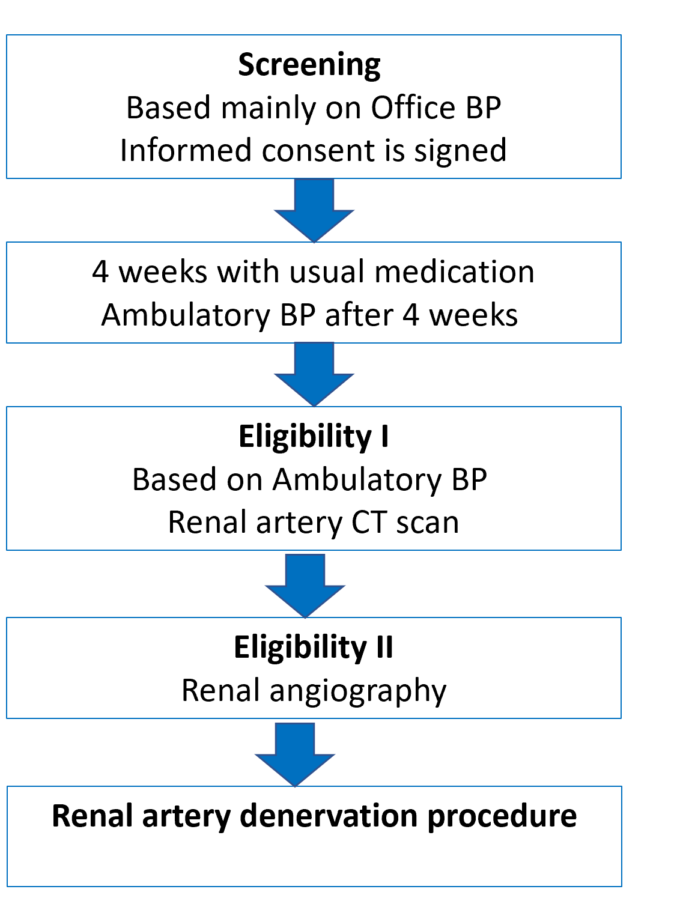
REDUCED 1 Pilot Study

Slide 6
REDUCED 1 Pilot Study: Baseline Characteristics
Characteristics | (N=40)
Age at screening (years), mean ± SD | 55.8 ± 9.4
Male sex n (%) | 25 (62.5%)
BMI at screening, mean ± SD | 34.7 ± 7.7
Race, n (%)
White | 32 (80.0%)
Black or African American | 8 (20.0%) |  | Blood Pressures | (N=40)
Anti-HTN medications at screening, n (%) |  |  | Office blood pressure at screening
One | 1 (2.5%) |  | (mmHg), mean +/- SD
Two | 8 (20.0%) |  | Systolic | 159.3 +/- 15.5
Three or more | 31 (77.5%) |  | Diastolic | 95.3 +/- 1.04
Type of antihypertensive medication at |  |  | Ambulatory daytime systolic BP at | 150.4 +/- 12.4
screening, n (%) |  |  | eligibility (mmHg), mean +/- SD
Ace Inhibitor/ARB | 31 (77.5%)
Calcium Blocker | 26 (65.0%)
Beta Blocker | 22 (55.0%)
Diuretic | 31 (77.5%)
Vasodilator | 5 (12.5%)
Alpha Blocker | 11 (27.5%)

Slide 7
REDUCED 1 Pilot Study: Procedural Characteristics
Characteristics | (N=40)
Femoral approach, n (%) | 40 (100.0%)
Number of excitations, mean ± SD
Left renal artery | 3.4 ± 1.0
Right renal artery | 3.4 ± 1.1
Procedural time (minutes), mean ± SD | 49.9 ± 17.2
Contrast medium (mL), mean ± SD | 81.9 ± 44.6

Slide 8
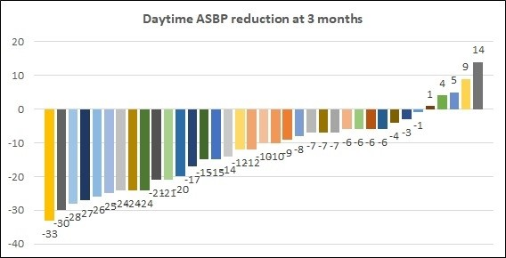
TIVUS Pilot trial results
Visit | n | Baseline Mean for Paired Data | Visit Mean | Change from Baseline | P-Value
Baseline | 40 | N/A | 150.4 ± 12.4 | N/A | N/A
3 months | 37 | 149.8 ± 11.8 | 137.7 ± 16.2 | -12.0 ± 11.4 | <.001
6 months | 23 | 151.7 ± 12.3 | 137.8 ± 15.8 | -13.9 ± 13.6 | <.001
8

Slide 9
REDUCED 1 Pilot Study: Responders
Daytime Systolic ABPM reduction
3-months follow-up (Primary Endpoint):
Responders (at least -5mmHg reduction): 78.4%, with avg ABPM reduction: -16.2mmHg
6-month follow-up:
Responders: 82.6%, with avg ABPM reduction: -17.4mmHg
Safety
No device related Adverse Event reported.

Slide 10
REDUCED 1 Pilot Study: 1 month safety end-points
Days after Procedure
Adverse Event
Access site: Pseudoaneurysm
eGFR dropped after procedure at 31 and stabilized at 55
Endpoints for Adjudication
Vascular and Access Site Complications
21
Renal disease
4
All events were adjudicated by CEC

Slide 11
Renal Denervation with the TIVUSTM Sonivie Ultra-Sound Catheter
The REDUCED 1 pilot trial demonstrates the effectiveness and safety of the TIVUS TM catheter at 3 months
12.0mmHg reduction in daytime systolic ambulatory blood pressure
13.5mmHg and 8.5mmHg reductions in office systolic and diastolic blood pressures
78.4% of patients achieved ≥ 5 mm reduction in daytime systolic ambulatory
blood pressure
No device related adverse event
The THRIVE pivotal study is being actively discussed with FDA

Slide 12
PCRonline.com

