Slide 1
THE SHAM-PVI STUDY
A randomized sham-controlled study of pulmonary vein isolation in symptomatic atrial fibrillation
Sources of funding : Eastbourne Cardiology Research Charity Fund & Medtronic Dr Rajdip Dulai / PI - Dr Rick Veasey
01/09/2024

Slide 2
Declaration of Interest
None

Slide 3
Headlines
Importance :
Estimated 50,000 and 75,000 AF ablations a year in Europe and USA
There are concerns that pulmonary vein isolation (PVI) for atrial fibrillation (AF) may have a profound placebo effect.
Methods
Double blind randomised sham-controlled study of PVI in symptomatic AF patients
Results
PVI results in a statistically significant and clinically important decrease in AF burden with substantial improvements in symptoms and quality of life when compared to a sham procedure.

Slide 4
Purpose and key points about methods
126 patients randomized at 2 large tertiary NHS trusts
Eastbourne District General Hospital
Essex Cardiothoracic Centre
64 patients randomized to PVI with cryoablation and 62 patients randomized to sham intervention (phrenic nerve pacing to simulate an AF ablation)
All patients received an implantable loop recorder
Primary outcome : AF burden at six months excluding 3 month blanking period
Secondary outcomes
Time to events
Patient reported outcome measures AFEQT,MAFSI,EHRA and SF-36
Total atrial tachyarrhythmia episodes Blinding index

Slide 5
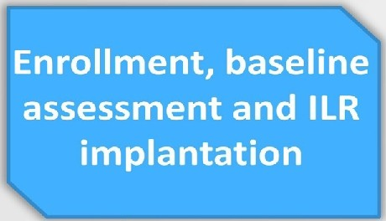
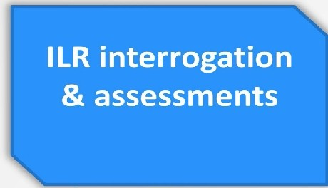
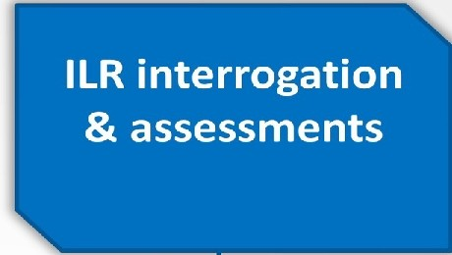
THE SHAM-PVI STUDY TIMELINE
ILR interrogation
& assessments
I
t
I
t
I
t
I
t
₁ Intervention group
Ob servat ion
Minimum 2 weeks before randomisation
DayO Random allocation
3 months
6 months
• •
ESC Congress 2024 London & Online

Slide 6
Results : Primary Outcome AF burden
90
80
70
60
50
40
30
20
10
0
78,3 78,19
43,19
18,21
baseline
Ablation
6 months
Sham intervention
Geometric mean difference at 6 95% CI P-value months
0.25 0.15 - 0.42 < 0.0001

Slide 7
Secondary outcomes : AFEQT at 6 months

Slide 8
Key messages
PVI resulted in a clinically important and statistically significant decrease in AF burden
PVI resulted in substantial improvements in symptoms and quality of life
At 6 months follow-up this study has demonstrated no clinically relevant placebo effect with PVI

