Slide 1





#AHA24
ClinicalTrials.gov: NCT03795298
On behalf of the OPTION Clinical Trial Investigators
RANDOMIZED COMPARISON OF LEFT ATRIAL APPENDAGE CLOSURE WITH ORAL ANTICOAGULATION AFTER CATHETER ABLATION FOR ATRIAL FIBRILLATION
Oussama M. Wazni, MD | Cleveland Clinic

Slide 2


DISCLOSURES
Oussama M. Wazni, MD: Consultant and Speaker for Boston Scientific and Biosense Webster
The OPTION trial was funded by Boston Scientific
Independent statistical validation was conducted by Cleveland Clinic Coordinating Center for Clinical Research
2

Slide 3

BACKGROUND
LAAC is indicated in patients with increased risk of stroke but have an appropriate rationale to
avoid long term OAC
LAAC has not been studied in AF ablation patients usually not deemed to be at high risk for bleeding¹
Current guidelines recommend OAC based on CHA₂DS₂-VASc score and not on perceived
ablation outcome
  Ongoing risk of recurrence
  Silent AF patients may stop OAC and be exposed to stroke
  Truly successful patients may continue OAC and be exposed to bleeding with no benefit
25% of patients stop OAC within one year^{1,3,4}
Limited randomized data on LAAC vs DOACs²
1. Chew and Piccini et al EP Europace 2021; 2. Osmancik et al 2020; 3. Noseworthy et al 2015; 4. Okumura et al 2019
3

Slide 4
OBJECTIVES AND ENDPOINTS
OBJECTIVES: To evaluate the safety and effectiveness of LAAC vs OAC in AF ablation patients who are at moderate-high risk of stroke
PRIMARY EFFICACY ENDPOINT:
All-cause death, stroke, or systemic embolism at 36 months (non-inferiority)
ISTH Major Bleeding:
fatal bleeding, and/or symptomatic bleeding in a critical area or organ, such as intracranial, intraspinal, intraocular, retroperitoneal, intra-articular or pericardial, or intramuscular with compartment syndrome, and/or bleeding causing a fall in hemoglobin levels of 1.24 mmol/L (20 g/L or greater) or more or leading to a transfusion of 2 U or more of whole blood or red cells.
PRIMARY SAFETY ENDPOINT:
Non-procedural ISTH major bleeding or clinically relevant non-major bleeding
at 36 months (superiority)
SECONDARY ENDPOINT:
ISTH major bleeding [including procedural bleeding] at 36 months (non- inferiority)
Clinically Relevant non-major Bleeding: medical intervention leading to hospitalization increased level of care prompting face-to-face evaluation
Study Success = superiority of the 1° safety endpoint and non-inferiority of the 1° efficacy endpoint
4

Slide 5
OPTION STUDY DESIGN
Patient Population
AF patients indicated for ablation
CHA₂DS₂-VASc score of ≥2 for males or ≥3 for females & suitable for OAC
Ablation + WATCHMAN FLX
3mo OAC+ASA; ASA for 12mo (duration of trial recommended)
1:1
Randomization
Ablation + OAC
OAC per IFU for duration of trial
Stratification
0
3
12
24
36 mo
Clinical
1° & 2°
Endpoints
planned ablation/device strategy (sequential/concomitant)
Clinical/
Imaging
Clinical/
Imaging
Clinical
Sequential: AF ablation 90 to 180 days prior to randomization
Concomitant : AF ablation ± WATCHMAN implantation within 10 days of randomization
5

Slide 6

RESULTS
6

Slide 7
PATIENT DISPOSITION
1710 patients assessed for eligibility
1600 eligible for
1:1
Randomization
110 patients were excluded
71 eligibility criteria not met 26 patients withdrew consent
Ablation + WATCHMAN FLX N=803 ITT
475 sequential
328 concomitant
Ablation + OAC N=797 ITT
471 sequential
326 concomitant
~95% of patients were taking DOAC
7 investigator discretion
5 other reasons
1 lost to follow-up
753 received WATCHMAN FLX
796 treated as assigned
82 crossovers
66 1° endpoint event
16 no 1° endpoint event
41 did not receive WATCHMAN FLX procedure
9 unsuccessful implantation
1 treated with device in error
28 withdrew consent 17 lost to follow-up
9 other
4 investigator discretion
2 died
43 withdrew consent 28 lost to follow-up
7 other
5 investigator discretion
1 died
36-month follow-up
94.4% N=758 ITT
36-month follow-up
92.5% N=737 ITT
7

Slide 8
BASELINE CHARACTERISTICS
Demographics & Comorbidities − Intent-to-Treat
C
Characteristic | Ablation + WATCHMAN FLX N=803 | Ablation + OAC N=797
History of CHF. % | 20.0 | 20.8
Diabetes, % | 27.6 | 27.7
Hyperlipidemia, % | 65.0 | 67.3
Hypertension, % | 89.8 | 88.0
History of CAD, % | 30.4 | 33.1
Previous stent intervention, % | 14.5 | 18.0
Previous CABG, % | 5.5 | 5.3
Sequential LAAC, % | 59.2
Concomitant LAAC, % | 40.8 | All p=NS
haracteristic | Ablation + WATCHMAN FLX N=803 | Ablation + OAC N=797
Age, yr | 69.7 ± 7.4 | 69.4 ± 7.9
Female, % | 35.2 | 33.0
HA₂DS₂-VASc score | 3.5 ± 1.3 | 3.5 ± 1.3
Previous stroke/TIA, % | 10.0 | 11.5
HAS-BLED Score | 1.2 ± 0.8 | 1.2 ± 0.8
White | 83.8 | 86.1
Persistent AF, % | 40.6 | 37.1
Paroxysmal AF, % | 59.4 | 62.9
Ablation 90 to 180 days before randomization, % |  | 59.1
Ablation within 10 days of randomization, % |  | 40.9
C
8

Slide 9
LAAC PROCEDURE CHARACTERISTICS
Ablation + WATCHMAN FLX Intent-to-Treat
Characteristic | Ablation + WATCHMAN FLX N=762
General anesthesia, % | 83.8
Type of LAA imaging modality used during the implant procedure, %
Transesophageal echocardiography | 97.9
Intracardiac echocardiography only | 2.1
LAAC success*, % | 98.8
Number of LAAC devices used per case, % | 1.1 ± 0.3
Length of stay, days | 1.3 ± 1.5
Device-related SAE, % | 0.6
LAAC procedure-related SAE, % | 2.8
*device successfully deployed and released
9

Slide 10
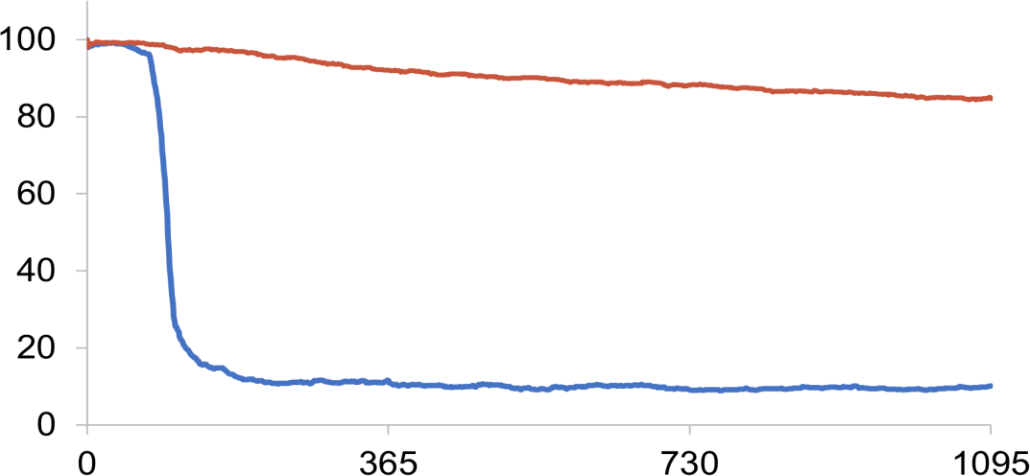
ORAL ANTICOAGULATION OVER TIME
Intent-to-treat
Protocol Mandated OAC
Ablation + OAC
84.8%
Control
Any OAC Usage
Patients (%)
OAC per IFU for duration of trial
Ablation + WATCHMAN FLX
WATCHMAN FLX
10.1%
3mo OAC+ASA
ASA for 12mo (duration of trial recommended)
Days after randomization
~95% of patients were taking DOAC

Slide 11
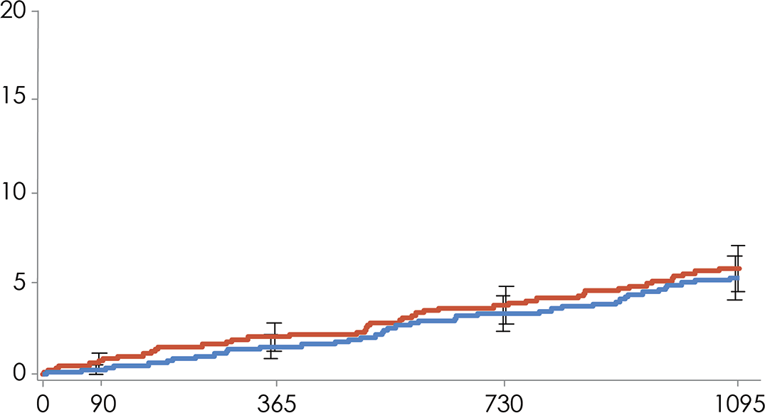

1° EFFICACY ENDPOINT: MET NONINFERIORITY
All-cause death, stroke, or systemic embolism at 36 months
^{P}noninferiority^{<0.0001}
Noninferiority Margin
5.0%
HR 0.91 [95% CI 0.59, 1.39]
-0.5%
*
Cumulative Incidence (%)
-2 0 2 4 6
Difference (WM – Control)
Ablation + OAC
5.8%
5.3%
Ablation + WATCHMAN FLX
No. at risk
Ablation + WATCHMAN FLX | 803 | 772 | 757 | 722
Ablation + OAC | 797 | 754 | 740 | 701
days after randomization
ITT; KM Event Rate ± 1.5 SE; log-rank P value
*1-sided 97.5% Z upper confidence Interval = 1.8%
11

Slide 12
COMPONENTS OF THE 1° EFFICACY ENDPOINT
Intent-to-Treat
3-year outcomes Endpoint — KM % (n) |  | Ablation + WATCHMAN FLX N=803 | Ablation + OAC N=797 | P value
All-cause Mortality |  | 3.8 (29) | 4.5 (34) | 0.46
Cardiovascular/Unknown |  | 2.0 (15) | 2.0 (15) | 0.94
Cardiovascular |  | 1.2 (9) | 1.3 (10) | 0.78
Unknown |  | 0.8 (6) | 0.7 (5) | 0.80
Non-cardiovascular |  | 1.9 (14) | 2.6 (19) | 0.34
Stroke |  | 1.6 (12) | 1.7 (13) | 0.80
 | Ischemic | 1.2 (9) | 1.3 (10) | 0.77
Hemorrhagic |  | 0.4 (3) | 0.4 (3) | 0.99
Systemic embolism |  | 0.3 (2) | 0.1 (1) | 0.58
ITT; KM Event Rate % (n)
12

Slide 13
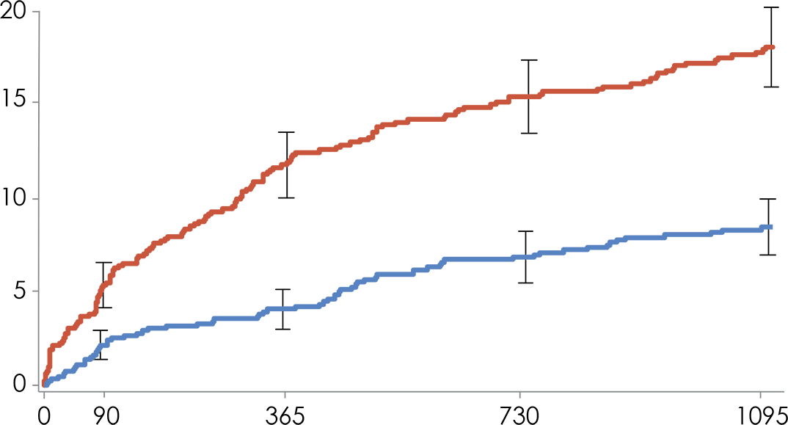
1° SAFETY ENDPOINT: MET SUPERIORITY
Non-procedural ISTH major bleeding/clinically relevant non-major bleeding at 36 months
^{P}superiority^{<0.0001}
HR 0.44 [95% CI 0.33, 0.59]
Ablation +
OAC
Cumulative Incidence (%)
18.1%
Ablation + WATCHMAN FLX
8.5%
No. at risk
Ablation + WATCHMAN FLX | 803 | 749 | 728 | 681
Ablation + OAC | 797 | 701 | 657 | 598
days after randomization
ITT; KM Event Rate ± 1.5 SE; log-rank P value
13

Slide 14

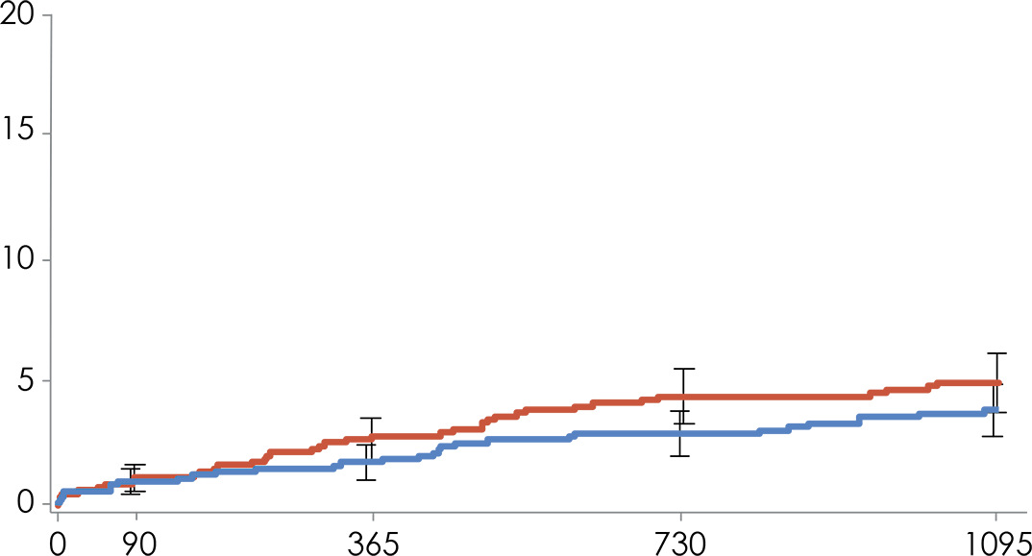

2° ENDPOINT: MET NONINFERIORITY
ISTH major bleeding at 36 months (including procedural bleeding)
^{P}noninferiority^{<0.0001} Noninferiority Margin
5.25%
HR 0.77 [95% CI 0.48, 1.24]
Cumulative Incidence (%)
-1.1%
*
-2 0 2 4 6
Difference (WM – Control)
Ablation + OAC
5.0%
3.9%
Ablation + WATCHMAN FLX
days after randomization
No. at risk
Ablation + WATCHMAN FLX | 803 | 763 | 746 | 708
Ablation + OAC | 797 | 749 | 726 | 678
ITT; KM Event Rate ± 1.5 SE; log-rank P value
*1-sided 97.5% Z upper confidence Interval = 1.0%
14

Slide 15
1° EFFICACY & SAFETY: SUBGROUPS
 | 1° Effic | acy Hazard Ratio (95% CI) |  |  | 1 | ° |  |  |  |  | afety | Hazard Ratio (95% CI)
Age | <75 years | 0.93 [0.56, 1.53] |  |  |  |  |  |  |  |  |  | 0.41 [0.29, 0.58]
 | ≥75 years | 0.85 [0.38, 1.94] |  |  |  |  |  |  |  |  |  | 0.53 [0.30, 0.92]
Sex | Male | 0.96 [0.56, 1.65] |  |  |  |  |  |  |  |  |  | 0.34 [0.23, 0.50]
 | Female | 0.81 [0.41, 1.62] |  |  |  |  |  |  |  |  |  | 0.68 [0.42, 1.09]
CHA₂DS₂ -VASc | Score 2-3 | 1.23 [0.56, 2.72] |  |  |  |  |  |  |  |  |  | 0.32 [0.20, 0.50]
 | Score 4-5 | 0.72 [0.40, 1.29] |  |  |  |  |  |  |  |  |  | 0.62 [0.41, 0.95]
 | Score ≥6 | 1.10 [0.37, 3.28] |  |  |  |  |  |  |  |  |  | 0.37 [0.12, 1.17]
HAS- BLED | Score 0 | 1.04 [0.28, 3.86] |  |  |  |  |  |  |  |  |  | 0.25 [0.10, 0.63]
 | Score 1-2 | 0.81 [0.48, 1.37] |  |  |  |  |  |  |  |  |  | 0.49 [0.35, 0.68]
 | Score ≥3 | 1.32 [0.55, 3.19] |  |  |  |  |  |  |  |  |  | 0.40 [0.17, 0.98]
AF type | Paroxysmal | 0.87 [0.45, 1.70] |  |  |  |  |  |  |  |  |  | 0.40 [0.27, 0.59]
 | Persistent | 0.88 [0.50, 1.53] |  |  |  |  |  |  |  |  |  | 0.51 [0.32, 0.81]
S
0.1
Ablation
+ WM FLX better
1
10
Ablation
+ OAC better
0.1
Ablation
+ WM FLX better
1
10
Ablation
+ OAC better
15

Slide 16
LIMITATIONS
Pulse field ablation was not available at the time of the study
  Ablation technology used will not likely alter stroke prevention strategies
Patients with a left ventricular ejection fraction <30% were excluded
Open-label design could have led patients assigned to anticoagulation to seek medical attention more frequently
16

Slide 17

CONCLUSIONS
OPTION: First head-to-head trial of WATCHMAN FLX to DOAC
Equivalent thromboembolic protection at 3 years (ischemic stroke 1.2% FLX vs 1.3% OAC; systemic embolism 0.3% FLX vs 0.1% OAC)
Reduced the risk of major/clinically-relevant non-major non- procedural bleeding compared to OAC at 3 years (8.5% FLX vs 18.1% OAC)
17

Slide 18

CLINICAL IMPLICATIONS
WATCHMAN FLX is a safe and effective first line option for AF ablation patients
Similar thromboembolic protection but superior bleeding outcomes compared to OAC
Concomitant AF ablation and LAAC
  In OPTION, 40% of patients received a concomitant AF ablation and LAAC procedure
  Potentially reduce procedural risks and recovery times for patients
  In one procedure, we have the potential to
    Decrease AF burden
    Decrease the risk of stroke and bleeding
18

Slide 19
Thank You to the OPTION Trial Team, Investi
gators, Sites, and Pati | ents | Claudio Tondo
 |  | Centro Cardiologico Monzino
Dhanunjaya Lakkireddy | Bryan Raybuck | Thomas Wallace
Overland Park Regional Medical Center | West Virginia University Hospitals | Heart Clinic Arkansas
Nicolas Lellouche | Eathar Razak | Stanislav Weiner
CHU Henri Mondor | CHI Franciscan Health System | Christus Trinity Mother Frances Health System
Moussa Mansour | Madhu Reddy
 |  | Mark Willcox
Massachusetts General Hospital | University of Kansas Hospital
 |  | Alaska Regional Hospital
Eloi Marijon | James Reiss
 |  | Stephan Willems
ter European Georges Pompidou Hospital, and Cardiology Department, European Georges Pompidou Hospital | PeaceHealth Southwest Medical
 |  | Asklepios Klinik Saint Georg
 | Ashish Sadhu
George Mark |  | Alan Wimmer
 | Phoenix Cardiovascular Research Group
Cardiovascular Associates of the Delaware Valley |  | St. Luke's Hospital of Kansas City
Felix Meincke | Moeen Saleem | Christopher Woods
Allgemeines Krankenhaus Altona | Edward Hospital | Mills Peninsula Health Services
William Michael Mellana | Walid Saliba | Vamsee Yaganti
MyMichigan Medical Center Midland | Cleveland Clinic | St. Mark's Hospital
Brad Mikaelian | Carlos Sanchez | BSC: Whitney Anderson, Anne Cornaille, Lis Gabin, Erin Hynes, Robert Shipley Elisa Vireca, Hong Wang, Kellie Windle
Memorial Hospital | OhioHealth Research and Innovation Institute - Riverside Methodist Hospital
Suneet Mittal
 | Boris Schmidt
Valley Hospital
Devi Nair | Cardioangiologisches Centrum Bethanien, Agaplesion Markus Krankenhaus
St. Bernard's Medical Center
Jens Erik Nielsen-Kudsk |  | CRO – Iqvia
 | Steffen Schnupp
 |  | Core Lab - MedStar, Director: Federico Asch
Aarhus University Hospital
 | Klinikum Coburg GmbH
Luis Nombela
 | Brian Schuler
Hospital Clinico San Carlos |  | Steering Committee - Lucas Boersma, Rahul Doshi, Jeff Healey, Wael Jaber, Moussa Mansour, Karen Phillips, Claudio Tondo, Vivek Reddy
 | Wellspan Health
Jeffrey Olson
 | Manish Shah
St Vincent Heart Center of Indiana, Indianapolis Carmel
 | Washington Hospital Center
 | Sidharth Shah
Ahmed Osman
 | Rex Hospital
Broward General Medical Center
 | Carsten Skurk
Saumil Oza
 | Deutsches Herzzentrum der Charité (DHZC), Campus Benjamin Franklin | DMC - Joseph Kannam, Richard Asinger, Christopher Pulling, Wendy Shear, Viken Babikian, Allan Ingenito, Stephen Hustead
Ascension St. Vincent’s Medical Center
Chinmay Patel
 | Sri Sundaram
UPMC Pinnacle
 | South Denver Cardiology
David Pederson
 | Vijendra Swarup
Cardiology Clinic of San Antonio
 | Arizona Arrhythmia Research Center
Jonathan Piccini
 | Roland Tilz
 |  | CEC - Michael Manoles, Robert Taylor, Alejandro Rabinstein, John Schoenhard, Timothy Betts, Jonathan Kleefield
Duke University Medical Center
 | Universitaetsklinikum Schleswig- Holstein
Robert Pickett
Saint Thomas Health | Gery Tomassoni
Anil Rajendra
 | Baptist Health Lexington
Grandview Medical Center
Stuart Adler
HealthEast St. Joseph's Hospital
Jeffery Allison
Heart Center Research, LLC
Ignacio Amat-Santos
Clinico de Valladolid
Charles Athill
Sharp Memorial Hospital
Gregory Bashian
Centennial Medical Center
Lucas Boersma
St. Antonius Ziekenhuis
Leif-Henrik Boldt
Charite Universitaetsmedizin Berlin
Serge Boveda
Clinique Pasteur
Francois Brigadeau
CHRU de Lille
German Calle Perez
H. Puerta Del Mar
Benjamin D'Souza
Presbyterian University of Pennsylvania Medical Center
Srinivas Dukkipati
Mount Sinai Medical Center
Guillaume Duthoit
Hospital de la Pitie-alpetriere
Henning Ebelt
Catholic Hospital "St. Johann Nepomuk"
Joachim Ehrlich
St. Josefs-Hospital GmbH
Meyer Elbaz
Centre Hopital Universitaire Rangueil
Romain Eschalier
CHRU de Clermont-Ferrand
Rodrigo Estévez Loureiro
Hospital Alvaro Cunqueiro
Scott Ewing
HeartPlace Mid-Cities EP
Robert Feldman
Terri Hall
Advara HeartCare
Russell Heath
Medical Center of the Rockies (Loveland)
Jeffrey Heslop
St. Alphonsus Regional Medical Center
Michael Ho
Kaiser Permanente Santa Clara Medical Cen
Ivan Ho
University of Southern California Hospital
John Holshouser
Carolinas Medical Center
Rodney Horton
Texas Cardiac Arrhythmia Research
Troy Hounshell
Iowa Heart Center
Astrid Hummel
Universitaetsmedizin Greifswald
Jose Luis Ibáñez-Criado
Hospital General Universitario
Ziad Issa
St. John's Hospital
Vivek Iyer
Sheetal Chandhok
Lankenau Institute for Medical Research ^{AdventHealth Ocala}
Ghulam Chaudhry
Lahey Clinic Hospital
Jason Chinitz
Northwell Health
Ignacio Cruz Gonzalez
Hospital Clinico Salamanca
Mithilesh Das
Methodist Hospital of Indianapolis
Tom De Potter
Onze Lieve Vrouw Ziekenhuis
Pascal Defaye
CHU Grenoble - Hopital Michallon
David Delurgio
Emory Saint Joseph's Hospital
J. Deville
The Heart Hospital Baylor Plano
Luigi Di Biase
Montefiore Medical Center
Federico Ferraris
Azienda Ospedaliero-Universitaria Citta della Marin General Hospital
Salute e della Scienza di Torino
James Freeman
Yale University School of Medicine
Daniel Friedman
Manatee Memorial Hospital
Wissam Gharib
Monongalia General Hospital
Douglas Gibson
Scripps Memorial Hospital
Brett Gidney
Marian Regional Medical Center
Rakesh Gopinathannair
Kansas City Cardiac Arrhythmia Research
Marek Grygier
Uniwersytecki Szpital Kliniczny w Poznaniu
Madhukar Gupta
Sandeep Jain
University of Pittsburgh Medical Center
Charles Joyner
Chippenham & Johnston-Willis Hospital
Arvindh Kanagasundram
Vanderbilt University Medical Center
Narendra Kanuru
Wellstar Kennestone Hospital
Farhat Khairallah
Tallahassee Memorial Hospital
Arfaat Khan
Henry Ford Hospital
Ammar Killu
Mayo Clinic Foundation
Jamie Kim
Catholic Medical Center
Lindner Center for Research and Education _{Norbert Klein}
at Christ Hospital
Klinikum St. Georg

Slide 20
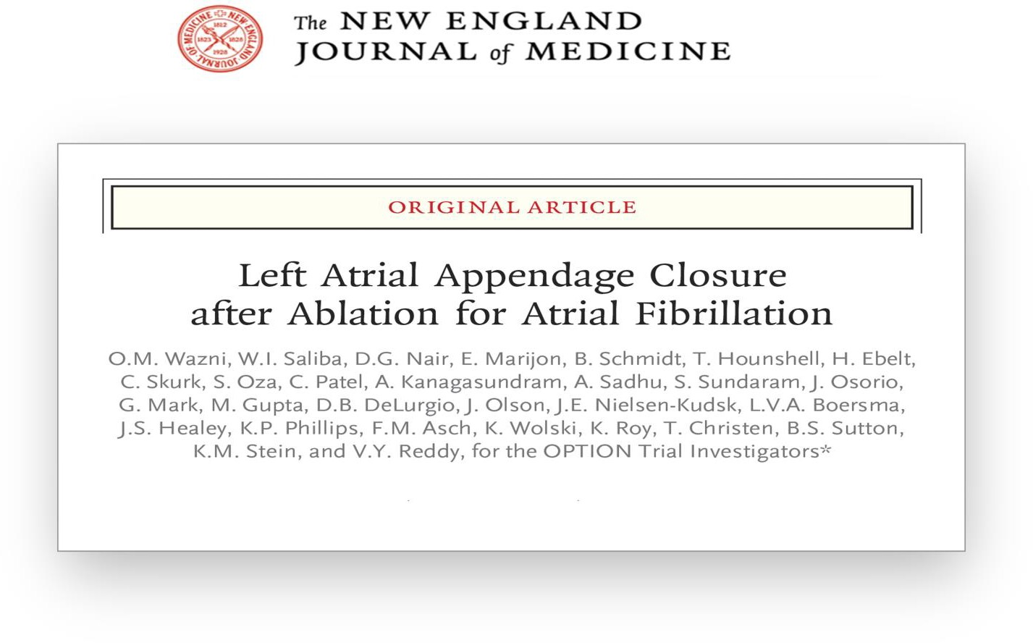
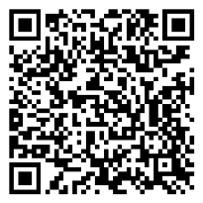

Slide 21
THANK YOU
#AHA24

Slide 22
BACK-UP

Slide 23
SENSITIVITY ANALYSIS: ON-TREATMENT
Ablation + WATCHMAN FLX (N=611) |  | Ablation + OAC (N=737) | Difference (1-sided 97.5% Z upper confidence bound) | Non inferiority Margin | P Value
no. (%)
Primary Safety Endpoint |  |  |  |  | Superiority
Non-procedural bleeding through 36 months after randomization, | 8.1% | 18.0% | — | — | <0.0001
Primary Efficacy Endpoint |  |  |  |  | Noninferiority
All-cause death, stroke, or systemic embolism) 36 months after randomization
 | 4.5% | 6.0% | -1.5% (0.9%) | 5.0% | <0.0001
Secondary Endpoint
Major bleeding event through 36 months after randomization | 3.3% | 5.3% | -2.0 (0.2%) | 5.25% | <0.0001
*Sensitivity analyses were performed in the on-treatment population (patients in each treatment group were tested according to LAAC or
OAC treatment received and if they were compliant to protocol medication at ≥80% until a primary or secondary event or end of study).
23

Slide 24
DEVICE OR PROCEDURE-RELATED SERIOUS ADVERSE EVENTS
Site-reported Events | Ablation + LAAC |  | Site-reported Events Ablation + LAAC
Device-related serious adverse events | 5 patients with 5 events (0.6%) |  | LAAC procedure-related serious 22 patients with 26 events adverse events (2.8%)
Pericardial effusion | 2 |  | Bleeding event 4
Air embolism | 2 |  | Arrythmia 3
Pericarditis | 1 |  | Pericardial effusion 3
Pseuodaneurysm | 3
Air embolism | 2
Infection | 2
Pericarditis | 2
Chest pain | 1
Chronic kidney disease | 1
Elevated blood sugar | 1
Heart failure | 1
Odynophagia | 1
Pulmonary edema | 1
TIA 1
24

Slide 25
CAUSE OF DEATHS
Rand Group | Type of Death | Day Post rand
Control Group | Cardiovascular - Pulmonary edema/respiratory distress | 91
Control Group | Cardiovascular - Respiratory failure | 159
Control Group | Cardiovascular - Stroke | 178
Control Group | Cardiovascular - Cerebral hemorrhage | 183
Control Group | Cardiovascular - MI | 298
Control Group | Cardiovascular - Atrial fibrillation | 489
Control Group | Cardiovascular - Atrial fibrillation | 508
Control Group | Cardiovascular - Cardiac arrest | 511
Control Group | Cardiovascular - CAD | 851
Control Group | Cardiovascular - cardiopulmonary arrest | 906
Control Group | Unknown | 509
Control Group | Unknown | 559
Control Group | Unknown | 600
Control Group | Unknown | 623
Control Group | Unknown | 1240
Control Group | Septic shock | 19
Control Group | Septic shock | 26
Control Group | Cancer | 248
Control Group | Cancer | 332
Control Group | Suicide | 390
Control Group | ALS | 460
Control Group | Multiple organ failure | 529
Control Group | Septic shock | 569
Control Group | Accident | 587
Control Group | Cancer | 702
Control Group | Covid | 706
Control Group | Small bowel ischemia | 760
Control Group | Covid | 830
Control Group | Multiple organ failure | 923
Control Group | Bleeding - GI | 947
Control Group | Sepsis | 957
Control Group | Cancer | 992
Control Group | Hepatic Failure | 992
Control Group | Alcohol withdrawl | 1059
Rand Group | Type of Death | Day Post rand | Days post- LAAC
Device Group | Cardiovascular - Sudden cardiac death | 167 | 166
Device Group | Cardiovascular - Cardiorespiratory arrest | 199 | 190
Device Group | Cardiovascular - Syncopal malaise | 289 | 282
Device Group | Cardiovascular - Cardiac arrest | 408 | 336
Device Group | Cardiovascular - Stroke | 460 | 460
Device Group | Cardiovascular - Ventricular fibrillation | 482 | 473
Device Group | Cardiovascular - Cardiorespiratory arrest | 556 | 549
Device Group | Cardiovascular - STEMI | 817 | 817
Device Group | Cardiovascular - Cardiac arrest | 969 | 942
Device Group | Unknown | 278 | 278
Device Group | Unknown | 342 | 342
Device Group | Unknown | 662 | 658
Device Group | Unknown | 908 | 900
Device Group | Unknown | 944 | 935
Device Group | Unknown | 1006 | 999
Device Group | Pneumonia | 270 | 260
Device Group | Encephalpathy | 311 | 291
Device Group | Cancer | 341 | 341
Device Group | Cancer | 399 | 399
Device Group | Renal failure | 432 | 429
Device Group | Cancer | 520 | 519
Device Group | Covid | 524 | 510
Device Group | Cancer | 683 | 682
Device Group | Suicide | 684 | 675
Device Group | Cancer | 786 | 777
Device Group | Covid | 798 | 794
Device Group | Renal failure | 864 | 857
Device Group | Infection | 881 | 881

Slide 26
CAUSE OF DEATHS – DEVICE CV/UNKNOWN
Detailed description of the event | Type of Death | Day post rand | Day Post LAAC
An arrhythmic death in the context of a coronary event | Cardiovascular - Sudden cardiac death | 167 | 166
Intra-hospital cardiopulmonary arrest following a stay in intensive care for septic shock due to ulcer perforation | Cardiovascular - Cardiorespiratory arrest | 199 | 190
AF100%, Vpacing 100% after his-bundle ablation. No clear cause of death has been established. | Unknown | 278 | 278
Death of the patient, after sudden syncopal malaise in her home. 3 external electric shocks delivered by the SAMU + cordarone and adrenaline | Cardiovascular - Syncopal malaise | 289 | 282
His smartwatch also showed a sudden stop in the heart rate somewhere around 2 a.m. no indications were found for other causes. | Unknown | 342 | 342
While in hospital recovery from extensive bowel surgery, patient complained of trouble breathing. Became pulseless. CPR/ACLS for 50 minutes unsuccessful and was pronounced dead. | Cardiovascular - Cardiac arrest | 408 | 336
Multiple cerebral infarctions during ,hospitalisation, which led to his death | Cardiovascular - Stroke | 460 | 460
Patient collapsed on golf course, CPR for 10 min before EMS arrived. Multiple medications and shocks by EMS and continued in ER. Upon admission to ER: no pulse, asystole, pupils fixed and dilated, no spontaneous respirations. Aggressive ACLS in ER with no return of spontaneous circulation. | Cardiovascular - Ventricular fibrillation | 482 | 473
SAMU report relates a call for pre-hospital cardiorespiratory arrest. On arrival, patient in asystole (no shockable rhythm) failure of cardiopulmonary resuscitation despite adrenaline and external cardiac massage | Cardiovascular - Cardiorespiratory arrest | 556 | 549
Death of unknown origin. | Unknown | 662 | 658
Atrial Septal Defect with Cardiogenic Shock, causal probably a STEMI 2 weeks before event onset, VA- ECMO | Cardiovascular - STEMI | 817 | 817
Unknown cause of death. | Unknown | 908 | 900
Cause of Death Unknown | Unknown | 944 | 935
Subject had witnessed arrest at home. EMS notified. Patient initially was in VF. ACLS protocol followed. Transported to hospital. Progressed to PEA. Pt expired at the hospital. | Cardiovascular - Cardiac arrest | 969 | 942
Death, cause unknown | Unknown | 1006 | 999

