Slide 1
Introduction
Atrial Fibrillation (AF) and Heart Failure (HF) frequently coexist.
Rhythm control using catheter ablation for AF in HF with reduced LVEF (HFrEF) has been shown to be superior to other medical therapy.
  increased LVEF
  decreased HF hospitalization
  decreased mortality
However, the majority of these studies were conducted using radiofrequency (RF) ablation, and there remains a lack of evidence regarding the efficacy of other ablation energies, such as cryoballoon (CB) ablation, in AF patients with HFrEF.

Slide 2
Declaration of interest
- Others : funding/grants received from Medtronic and speakers' bureaus from Medtronic outside the submitted work.
• •
ESC Congress 2024 London & Online

Slide 3
Clinical Questions for Catheter Ablation of AF in Patients with HFrEF
PV isolation (PVI) in HFrEF
・Generally, the durability of PVI is: CB ≥ RF.
・The area covered by PVI tends to be: RF > CB.
・In patients with HFrEF, larger pulmonary vein (PV) ostia and a thicker PV antrum are expected.
→ Given these characteristics, which technique—CB or RF—leads to better outcomes in terms of reducing the recurrence of atrial tachyarrhythmias?
Impact of Irrigation During RF Ablation
・Does the infusion used during RF ablation (irrigation) negatively affect patients with HFrEF?
→ How does this irrigation impact intracardiac pressure?
→ Is there a risk of worsening heart failure due to the ablation procedure?
Outcomes of PVI Alone in HFrEF Patients
・A more aggressive ablation strategy is believed to be necessary to maximize the benefit of CA, especially in patients with HF, in whom advanced atrial damage is expected.
→ What are the clinical outcomes when PVI alone is performed in patients with HFrEF?

Slide 4

Flow Chart of the CRABL-HF Study
Subjects
Patients with AF and LVEF ≤40%
Randomization
Randomization 1:1
CB ablation group N = 55
RF ablation group N = 55
Trial Arms
Secondary Endpoints
Procedural time, Complication rate, LA pressure measured before and after CA
Follow-up
Electrocardiograms were recorded twice daily for 1-year post-CA
Primary Endpoint
Secondary Endpoints
The occurrence of ATs at 1-year with a BP of 90 days post-CA
Mortality, HF hospitalizations, and Changes in the LVEF, LA volume index, and Quality of life

Slide 5
Patient Characteristics
 | CB group (N = 55) | RF group (N = 55)
Age, y | 68±9 | 65±12
Female sex, n (%) | 9 (16.4) | 14 (25.5)
AF type, Persistent AF, n (%) | 39 (70.9) | 41 (74.5)
Ischemic heart disease, n (%) | 37 (67.3) | 43 (78.2)
LV end-diastolic diameter, mm | 55 (51–59) | 55 (50–61)
LV ejection fraction, % | 31 (25–37) | 33 (29–35)
LA volume index, ml/m² | 57 (45–63) | 54 (44–64)
BNP at baseline, pg/ml | 124.8 (47.8–362.0) | 136.7 (51.6–260.5)
AFEQT: Total score, Q1-20, 0-100 | 68 (60–78) | 72 (56–82)
Onset of AF and HF
HF followed by AF | 26 (47.3) | 15 (27.3)
AF followed by HF/Concurrent onset of AF and HF | 29 (52.7) | 40 (72.7)

Slide 6
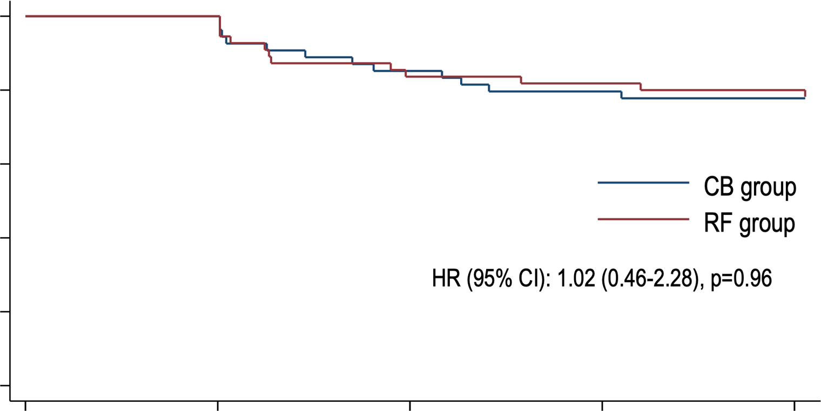
Kaplan-Meier Analysis of the Primary Endpoint#
100
90-day blanking period
Atrial tachyarrhythmia free survival (%)
80
60
CB group RF group
40
20
Hazard ratio (95% CI): 1.02 (0.46-2.28), P=0.96
P=0.033 for non-inferiority
0
0 90
180
270
360
Days since the Catheter Ablation
No. at Risk
CB group
55
54
46
43
42
RF group
55
55
46 45 44
#The occurrence of atrial tachyarrhythmias at 1-year after the 90-day blanking period

Slide 7
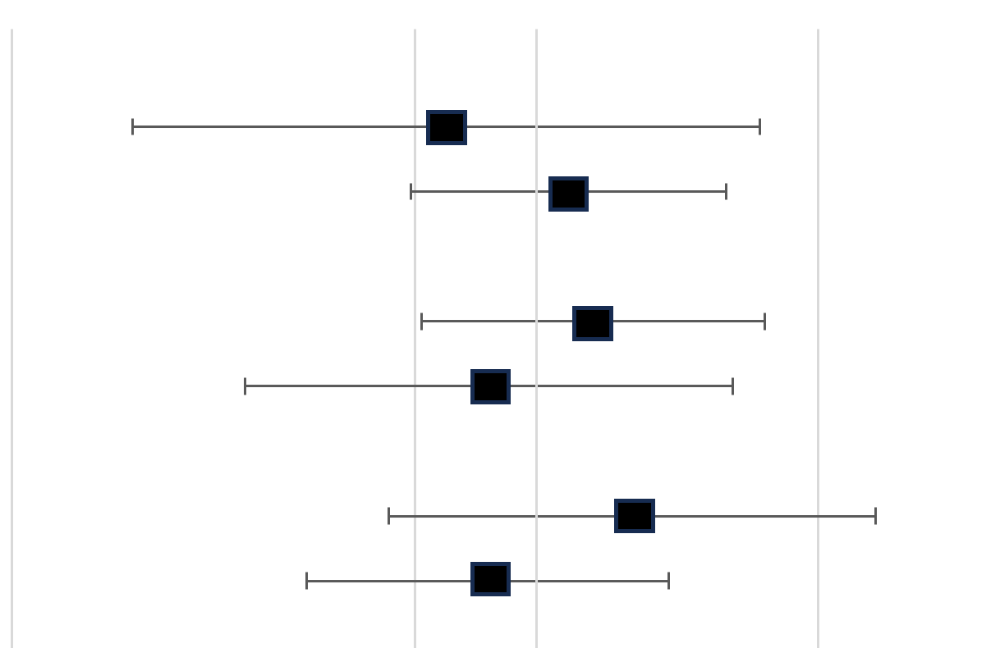


Sub-Group Analysis： AT occurrence at 1y
Subgroup | CB group | RF group |  |  | HR (95% CI) | P for interaction
 | Number of events/patients
Type of AF |  |  |  |  |  | 0.488
Paroxysmal | 2/15 | 3/14 |  |  | 0.60 (0.10–3.59)
Persistent | 10/39 | 9/41 |  |  | 1.20 (0.49–2.96)
Age |  |  |  |  |  | 0.49
≤70 years | 8/24 | 8/32 |  |  | 1.38 (0.52–3.68)
>70 years | 4/30 | 4/23 |  |  | 0.77 (0.19–3.07)
LV ejection fraction |  |  |  |  |  | 0.35
≤30% | 6/23 | 3/19 |  |  | 1.74 (0.43–6.95)
>30% | 6/31 | 9/36 |  |  | 0.76 (0.27–2.13)
LA volume index |  |  |  |  |  | 0.851
≤50 ml/m² | 3/17 | 4/23 |  |  | 1.03 (0.23–4.61)
>50 ml/m² | 8/32 | 8/29 |  |  | 0.88 (0.33–2.35)
Cause of HF |  |  |  |  |  | 0.222
Ischemic | 2/17 | 3/12 |  |  | 0.41 (0.07–2.45)
Nonischemic | 10/37 | 9/43 |  |  | 1.39 (0.56–3.42)
0.05
0.5 1
CB better
5
RF better

Slide 8
Summary
・ The CRABL-HF study was a prospective, multicenter, open-label, controlled, randomized, non-inferiority clinical trial designed to compare the efficacy and safety of AF ablation at 1-year with a blanking period (BP) of 90 days after the CA between CB and RF ablation in patients with HFrEF.
・ The total procedure time was significantly shorter in the CB group than RF group (101 [84–129] vs. 165 minutes [144–197]; P<0.001). The total infusion volume was less in the CB group than RF group (180 [141–240] vs. 1053 ml [949–1215]; P<0.001). The LA pulse pressure significantly increased only in the RF group (6 [4–8] to 8 mmHg [6–9]; P<0.001), but No procedure-related worsening HF nor death was observed in both..
・ The primary endpoint, defined as the occurrence of atrial tachyarrhythmias (ATs) at 1-year with a 90-day blanking period after CA, was observed in 12 patients (22.2%) in the CB group and 12 (21.8%) in the RF group and the CB group demonstrated non-inferiority compared to the RF group for the primary endpoint.
・The LVEF improved and the LAVI decreased significantly after CA in both the CB and RF groups (LVEF: CB group: 32% [24–36] to 50% [34–62] at 1-year, RF group: 33% [29–35] to 56% [38–59] at 1-year, LAVI: CB
group: 57 [46–64] to 47 ml/m2 [38–59 ] at 1-year, RF group: 55 [46–62] to 42 ml/m2 [35–50] at 1-year).

Slide 9
Take Home Message
CB ablation demonstrated non-inferiority to RF ablation for the occurrence of ATs at 1-year after the 90-day BP in patients with AF and HFrEF with a comparable efficacy for the LV and LA function.
In addition, CB ablation could be performed with a shorter procedure time and lesser fluid balance without increasing the LA pulse pressure during CA.

