Slide 1
EUROPE
Niels Ramsing Holm, MD
Birgitte Krogsgaard Andersen, MD
Birgitte Krogsgaard Andersen , Martin Sejr-Hansen, Luc Maillard, Gianluca Campo, Truls Råmunddal, Barbara E. Stähli, Vincenzo Guiducci, Luigi Di Serafino, Javier Escaned, Ignacio Amat Santos, Ramón López-Palop, Ulf Landmesser, Ruthe Storgaard Dieu, Hernán Mejía-Rentería, Lukasz Koltowski, Greta Žiubrytė, Laura Cetran, Julien Adjedj, Youssef S. Abdelwahed, Tommy Liu, Lone Juul Hune Mogensen, Ashkan Eftekhari, Jelmer Westra, Karsten Lenk, Gianni Casella, Eric Van Belle, Simone Biscaglia, Niels Thue Olsen, Paul Knaapen, Janusz Kochman, Ramón Calviño Santos Roberto Scarsini,
Evald Høj Christiansen, Niels Ramsing Holm
On behalf of the trial Investigators
TCT Washington D.C. - 30. October 2024

Slide 2
Disclosure of Relevant Financial Relationships
Within the prior 24 months, I have had a relevant financial relationship with a company producing, marketing, selling, re-selling, or distributing healthcare products used by or on patients:
Nature of Financial Relationship | Company
Institutional Research Grant Speaker fees | Medis Medical Imaging Abbott Bbraun Biosensors Boston Scientific Abbott EPS
All relevant financial relationships have been mitigated.
Faculty disclosure information can be found on the app

Slide 3
Invasive diagnosis of intermediate coronary stenosis
Pressure-wire based assessment with FFR
Reduces revascularization
Improves early outcomes
Pijls et al. Circulation 1993
De Bruyne et al NEJM 2012
Van Nunen et al Lancet 2015

Slide 4
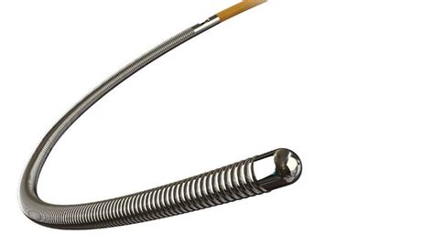
Pressure wire-based lesion evaluation
2024 ESC guidelines on Chronic coronary syndrome
Still low penetration in most countries, due to:
Physicians self-belief in angiographic diagnosis
Questionable long-term clinical value
Reimbursement issues
Risks and discomfort
Vrints C et al EHJ 2024
2021 ACC/AHA/SCAI Clinical practice guidelines
Vrints et al. EHJ 2024
Tebaldi et al. JACC CI 2018
Lawton et al. Circulation 2021

Slide 5
Quantitative flow ratio (QFR)
Tu al. JACC CI 2014
Estimation of FFR by computer analysis of angiographic images
QFR does not require the use of a pressure wire
No need for hyperaemia-inducing drugs
Potential for reduction in risks, side effects, and costs associated with pressure-wire based methods
2024 ESC guidelines on Chronic coronary syndrome
Vrints et al. European Heart Journal 2024

Slide 6
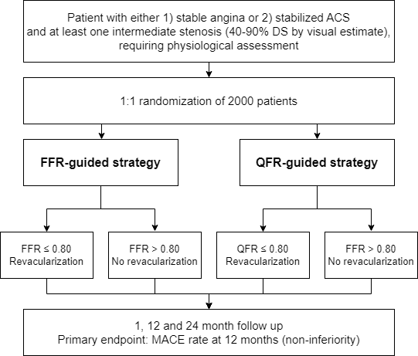
FAVOR III Europe: Trial overview
Aim
To evaluate if QFR is non-inferior to FFR in terms of 1-year clinical outcomes
Patient with either CCS or ACS and least one intermediate coronary stenosis (40-90% diameter stenosis by visual estimate), requiring functional assessment
Randomization of 2000 patients
QFR-guided strategy
FFR-guided strategy
Design
Investigator initiated trial
34 European heart centres
Open-label design
Independent CEC and DSMB
Funded by Medis medical imaging and Aarhus University
QFR ≤ 0.80
Revascularization
QFR > 0.80
No revascularization
FFR ≤ 0.80
Revascularization
FFR > 0.80
No revascularization
Primary endpoint: MACE at 12 months (non-inferiority)
MACE: Death, myocardial infarction, and unplanned revascularization

Slide 7
Flow chart
2369 screened
Ineligible (n=369)
Did not meet inclusion criteria (n=283)
Met exclusion criteria (n=86)
2000 randomized
QFR-guided diagnostic strategy
(n=1008)
FFR-guided diagnostic strategy
(n=992)
Incomplete in-procedure QFR-guided evaluation (n=33)
Off-line QFR-evaluation (n=12)
FFR-guided evaluation (n=12)
RFR-guided evaluation (n=1)
Angiography-guided evaluation (n=3)
Direct stenting due to dissection (n=1)
QFR evaluation before randomization (n=2)
Withdrawn before QFR (n=2)
Incomplete FFR-guided evaluation (n=37)
Pd/Pa-guided evaluation (n=13)
Angiography-guided evaluation (n=10)
Bailout resting measurement (n=6)
QFR-guided evaluation (n=5)
Direct stenting due to dissection (n=1)
Were randomized post-PCI (n=1)
Withdrawn before FFR (n=1)
QFR-guided evaluation (n=975)
FFR-guided evaluation (n=955)
Complete 1-year follow-up (n=995), 98.7%
Lost to follow-up (n=10)
Withdrew consent (n=1)
Complete 1-year follow-up (n=978), 98.6%
Lost to follow-up (n=8)
Withdrew consent (n=5)
Primary intention-to-treat analysis (n=1008)
Primary intention-to-treat analysis (n=992)

Slide 8
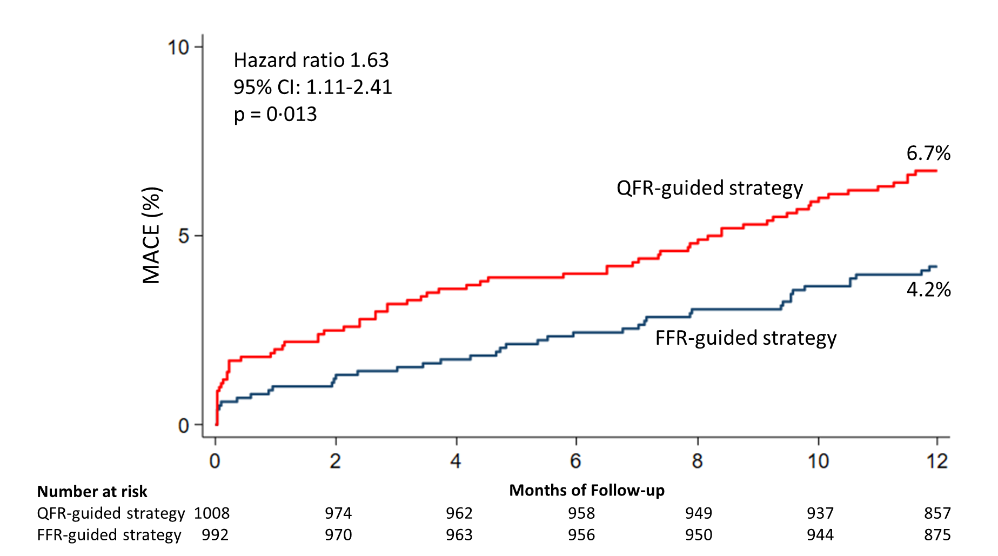
Primary endpoint of 1-year MACE
Hazard ratio 1.63
95% CI: 1.11-2.41
p=0.013
MACE: All-cause death, myocardial infarction, unplanned revascularization
Kaplan Meier estimates
Comparison by unadjusted Cox analysis
CONFIDENTIAL

Slide 9
Primary endpoint of 1-year MACE
QFR did not meet non-inferiority to FFR in terms of MACE at 1 year
MACE: All-cause death, myocardial infarction, unplanned revascularization
CONFIDENTIAL

Slide 10
Procedural characteristics
 | QFR Group (n=1008) | FFR Group (n=992)
Patients with successful in-procedure study measurement | 975 (96.9%) | 955 (96.4%)
Median QFR / FFR | 0.81 (0.71, 0.90) | 0.84 (0.76, 0.90)
Patients with any study lesion revascularization | 548 (54.4%) | 454 (45.8%)
Total number of stents implanted | 1183 | 989
Total number of stents implanted in study lesions | 823 | 650
Significant lesions per vessel
LAD | 358 (55.2%) | 338 (51.0%)
Cx | 100 (37.2%) | 42 (15.4%)
RCA | 126 (36.0%) | 98 (30.8%)
CONFIDENTIAL

Slide 11
Conclusion
A QFR-guided revascularization strategy did not meet non-inferiority to a standard FFR-guided strategy in terms of a composite endpoint of death, myocardial infarction and unplanned revascularization at 1 year
Differences in outcomes were mainly driven by higher rates of myocardial infarction and unplanned revascularization with the QFR-guided strategy
Use of QFR for decision-making was associated with a higher number of lesions treated, than with an FFR-guided strategy
CONFIDENTIAL

Slide 12
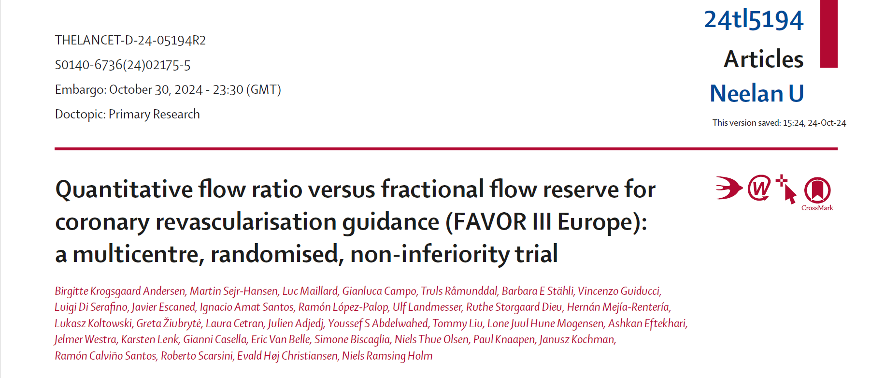
Now available on-line in The Lancet
CONFIDENTIAL

