Slide 1

Stingray-facilitated antegrade fenestration and re-entry
Neisser Morales-Victorino MD¹, Jose Ramon Rumoroso MD², Mizraym Rojas-ChavezMD¹, Lorenzo Azzalini, MD PhD MSc³.
¹ Interventional Cardiology Division, Hospital Lic. Adolfo Lopez Mateos ISSSTE. Mexico City, Mexico.
² Chief of Interventional Cardiology Department. Hospital Galdakao, Vizcaya, Spain.
³ Interventional Cardiology Division, Cardio-Thoracic-Vascular Department, San Raffaele Scientific Institute, Milan, Italy.

Slide 2

Neisser Morales-Victorino MD.
I have no relevant financial relationships

Slide 3
Previous History
  56 year-old Men
  Diabetes
Cardiac History
  Angioplasty with stent in RCA
  Angioplasty with stent in Circunflex
  Two prior attempts at CTO recanalization with AWE had failed.
  The patient persisted symptomatic with functional class II
  Dyspnea, despite optimal medical therapy.
  Myocardial perfusion revealed significant anterior and apical ischemia.

Slide 4
  Baseline coronary angiogram, showing mid left anterior descending chronic total occlusion (distal to a large diagonal branch)
  With contralateral collaterals and negatively remodeled distal vessel.
  Antegrade wire escalation achieves a subintimal situation at the distal landing zone.

Slide 5
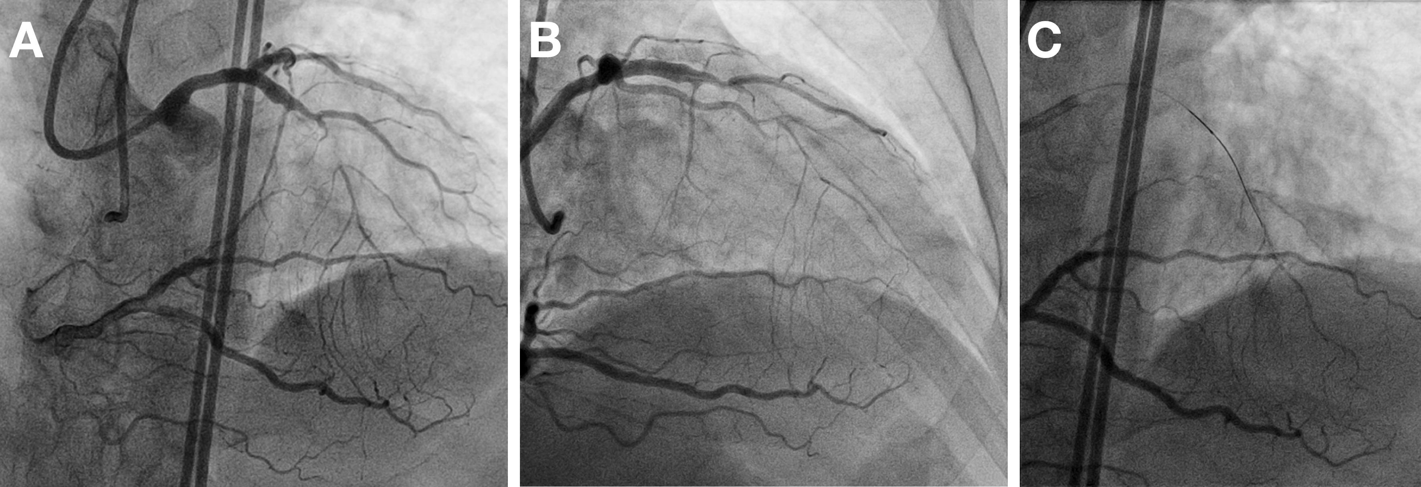

Slide 6
  Stingray-based re-entry is set up. Immediately after Stingray balloon inflation, the latter changes its orientation (insert)
  A new projection, longitudinal to the Stingray balloon main axis, is achieved. Contralateral injection demonstrates that the Stingray balloon is very close to the distal true lumen, in a negatively remodeled vessel.
  FA workhorse wire (Samurai RC) is advanced through the Stingray most distal port directly into the true lumen.

Slide 7
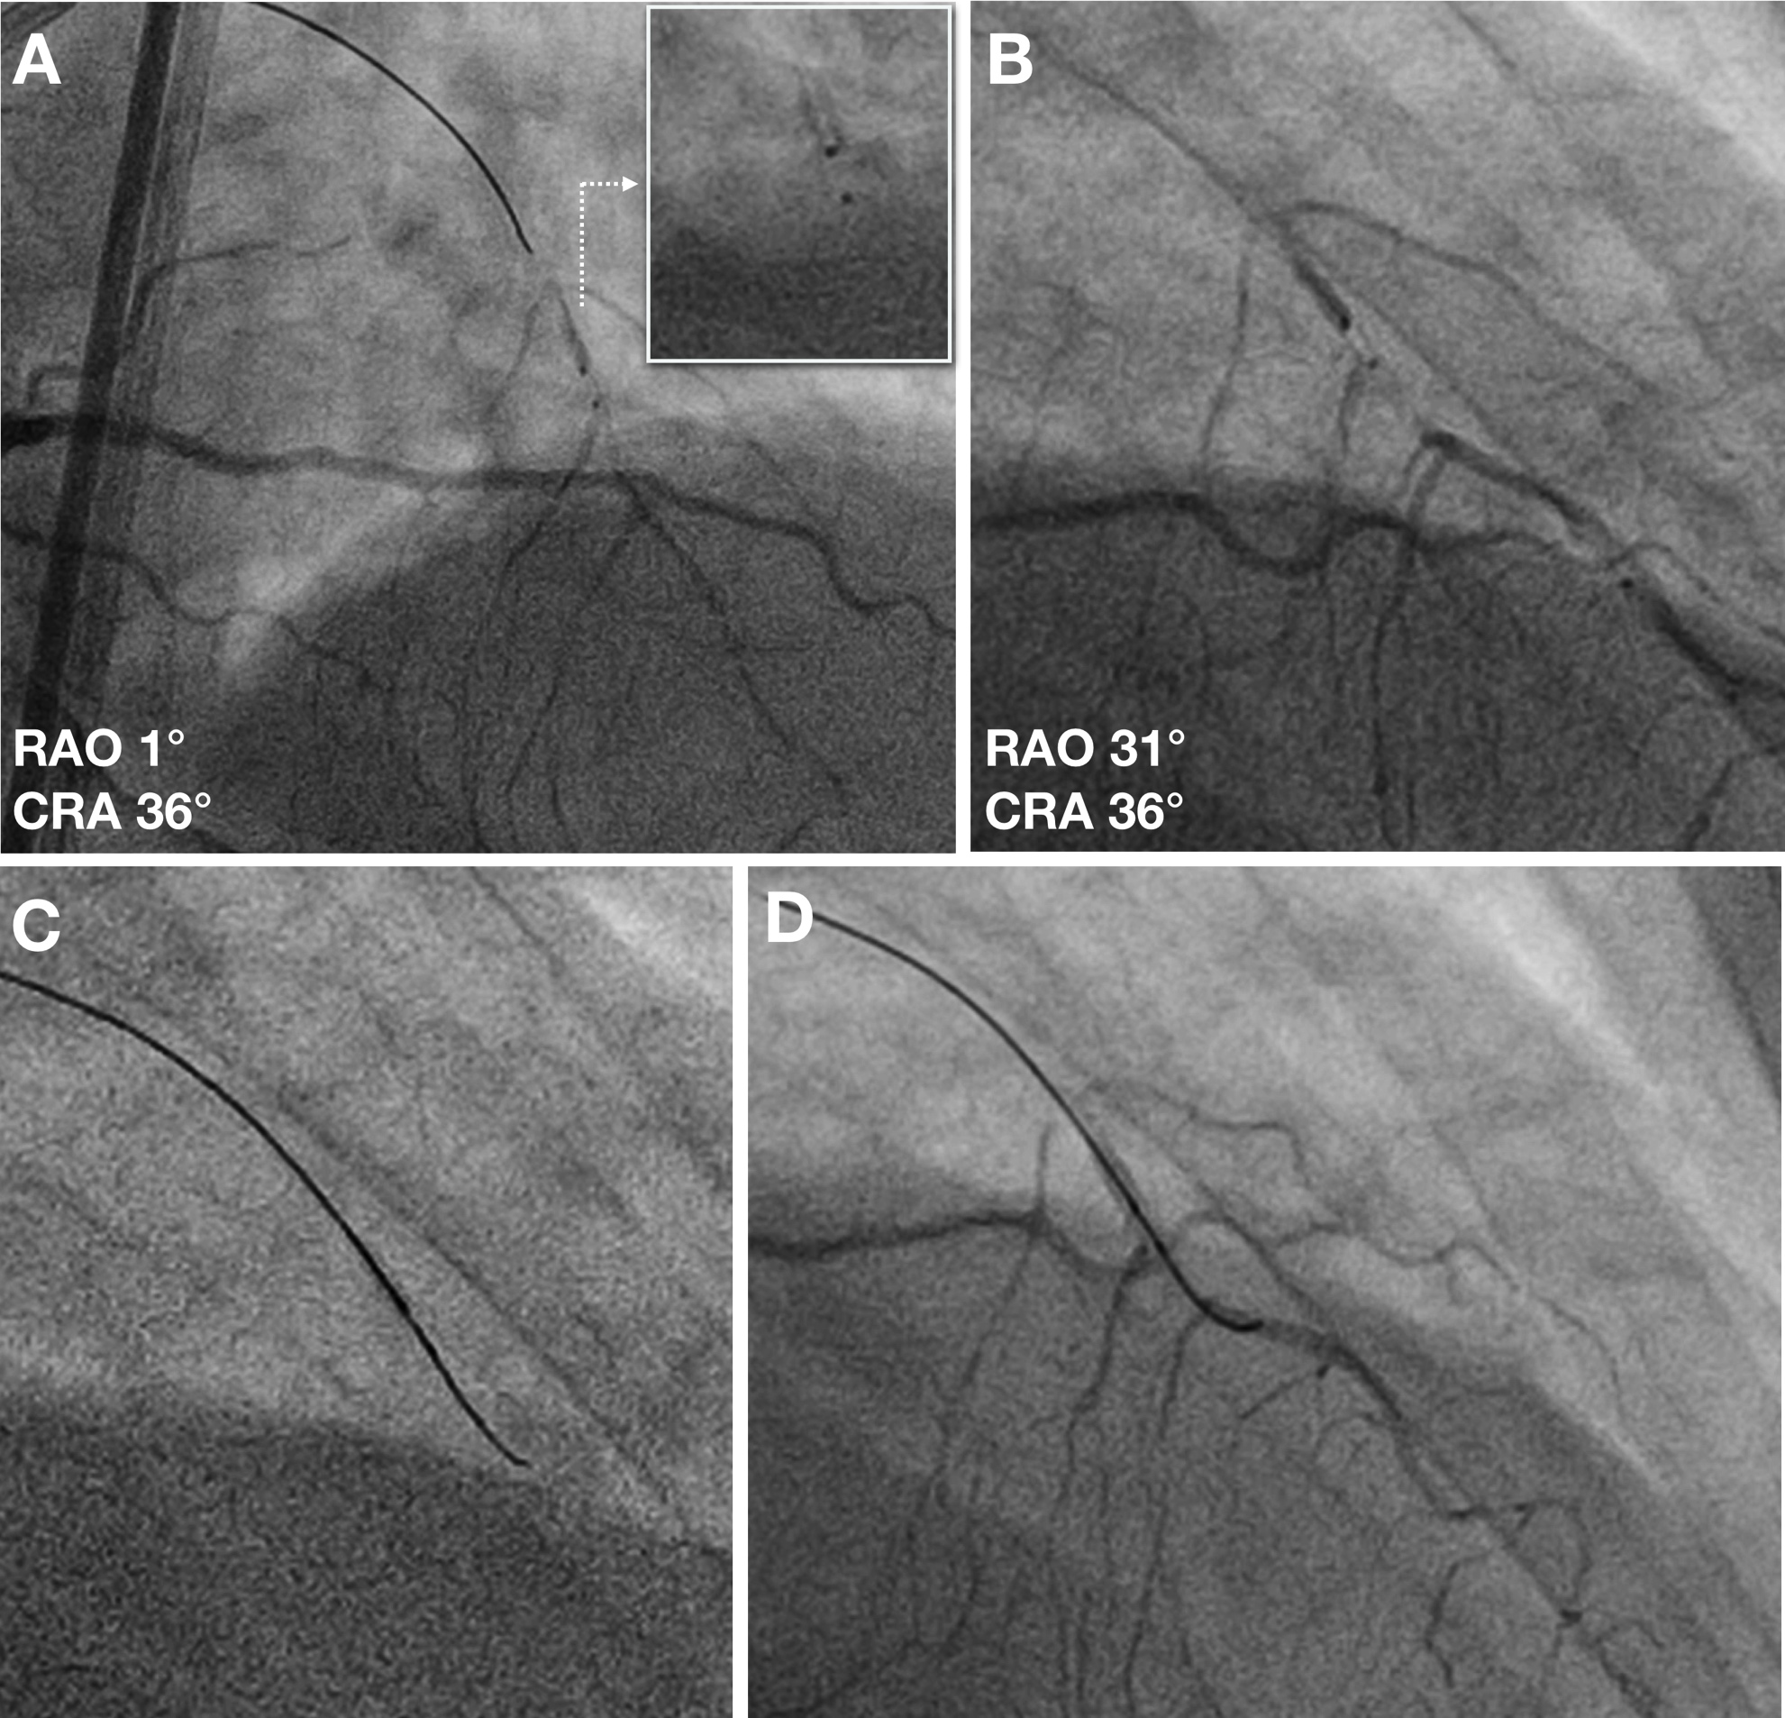

Slide 8
Intravascular Ultrasound insights following Stingray-mediated antegrade fenestration and re- entry (AFR)

Slide 9
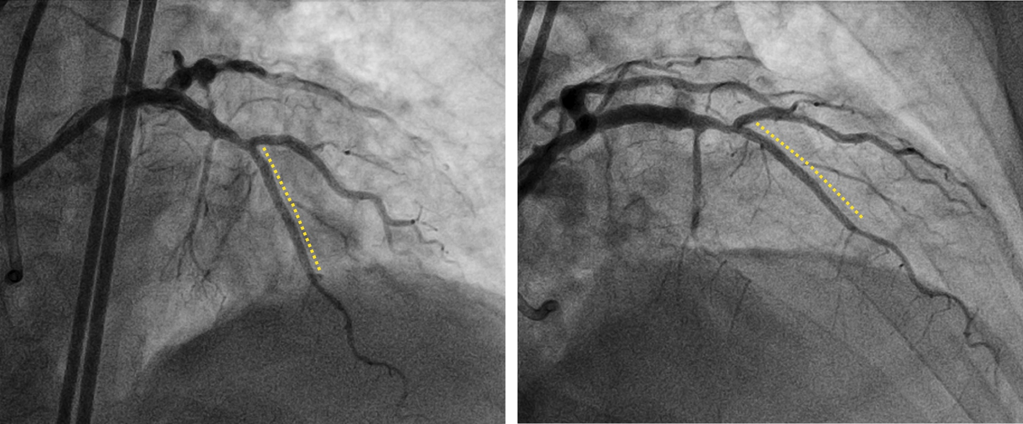
Final Result, after implantation of two drug-eluting stents.

Slide 10
Take Home Messanges
Chronic total occlusions (CTO) remain one of the most challenging lesion subset in percutaneous coronary intervention (PCI).
The introduction ADR represented a major improvement in the field of CTO PCI, with improved success.
Recently, the AFR technique has been proposed as a potential alternative to Stingray-based re-entry.

Slide 11
Take Home Messanges
In the present report, we describe a successful case of CTO recanalization in a severely negatively remodeled vessel, where conventional AWE-based recanalization had previously failed.
This case suggests the feasibility of performing AFR even with a Stingray balloon in selected cases with diseased distal vessels

