Slide 1

C.V.A - Whodunit?
PFO or LV diverticulum

Slide 2

Arpit Shah, MD
I have no relevant financial relationships

Slide 3
History of present illness
29 year old female 3 month post-partum presents with sudden onset of expressive aphasia and right arm/leg weakness.
Not a candidate for thrombolysis as out of window
PMH: ADHD, Hypothyroidism and G1P1A0(vaginal delivery)

Slide 4
Brain Imaging
MRI/MRA consistent with:
  acute infarct of inferior left frontal lobe
  focal occlusion of anterior division of MCA

Slide 5
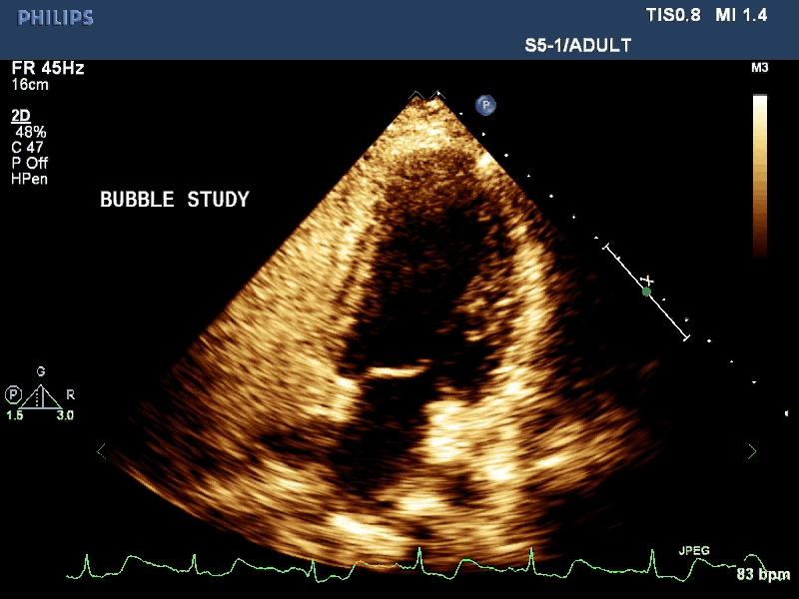
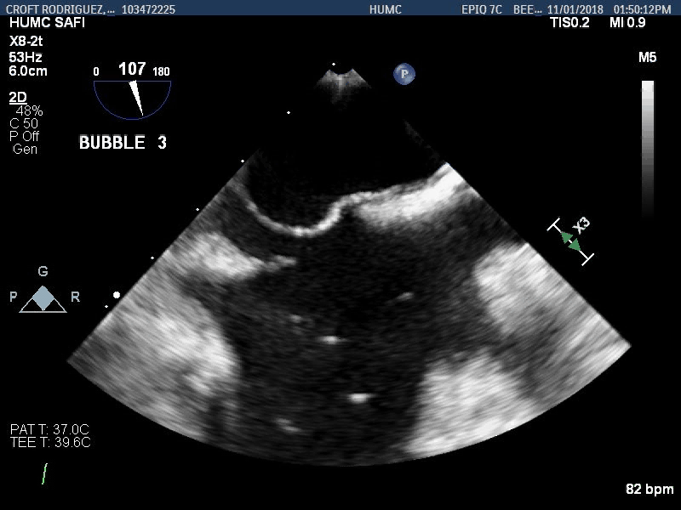
Bubble study
LA
RA
Eustachian Valve

Slide 6
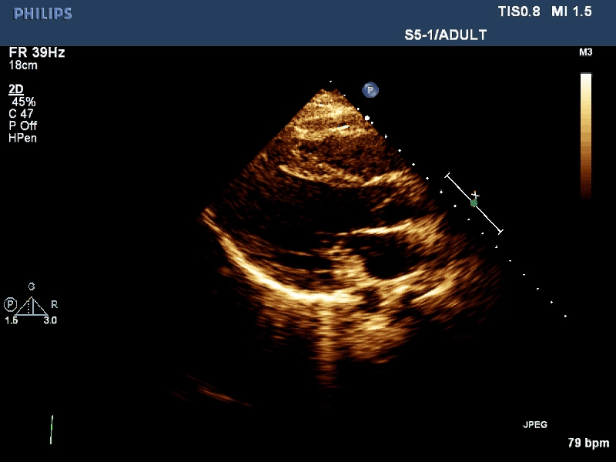
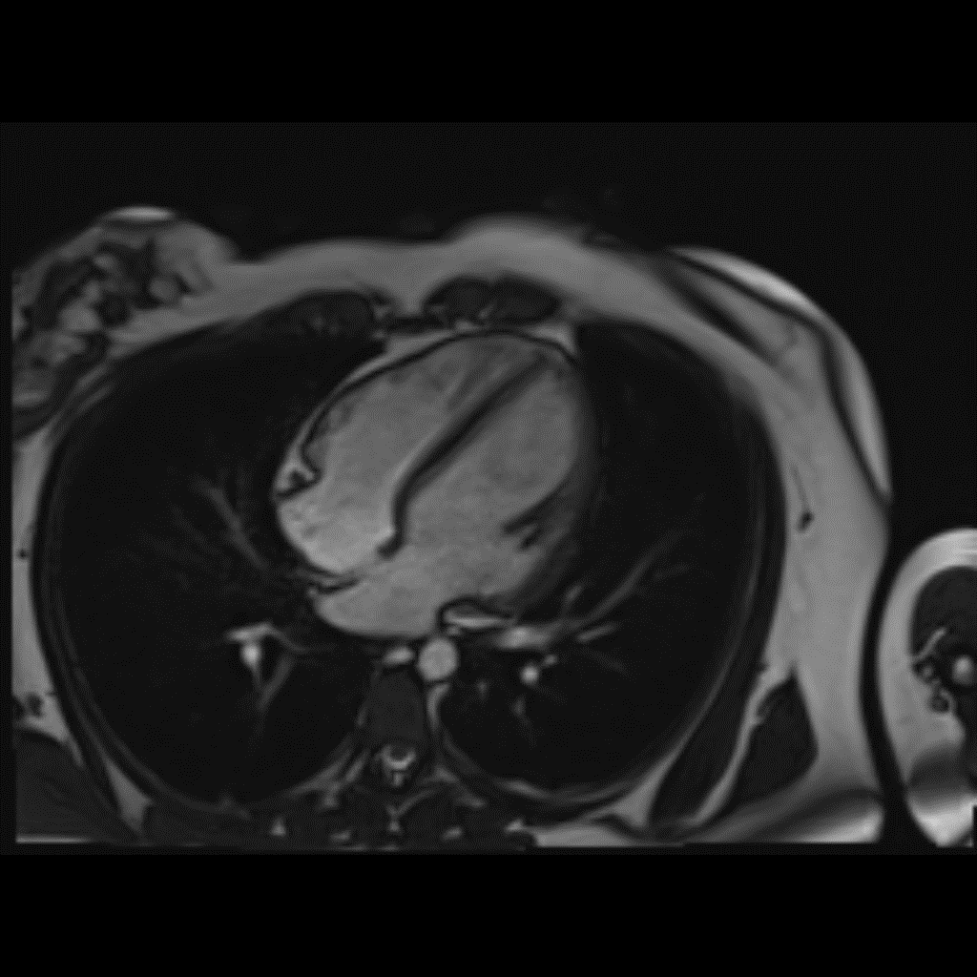
Cardiac Imaging
RV
LV
LV
RA
LA
LA
Hyperechogenic mass
LV Diverticulum
Hyperechogenic mass

Slide 7
Management?
Surgical Closure of LV diverticulum
Percutaneous exclusion of LV diverticulum
Rule out other causes of CVA

Slide 8
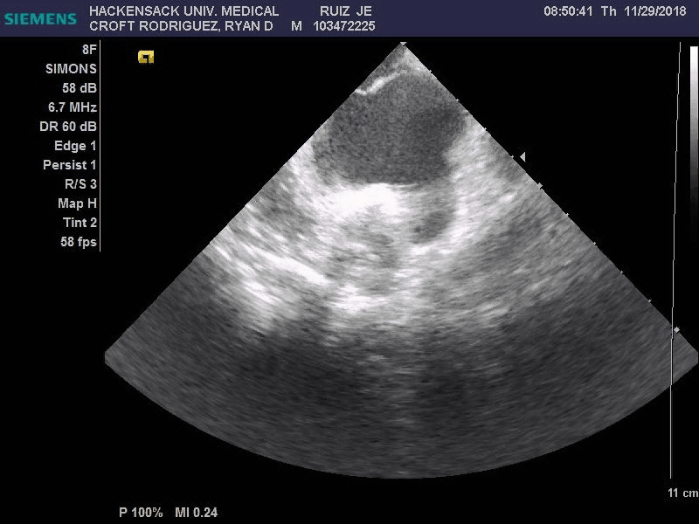
ICE bubble study with Valsalva through leg injection
RA
LA

Slide 9
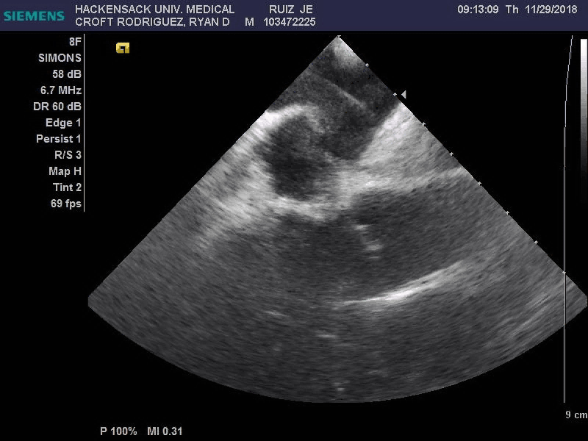
ICE predeployment
Eustachian Valve
RA
RA Disk

Slide 10
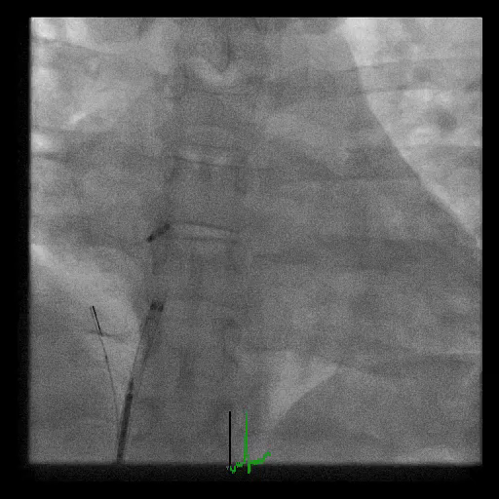

Slide 11
Take Home message
LV diverticulum is not associated with thromboembolism
Pregnancy is associated with a hypercoagulable state
Prominent Eustachian valve may lead to false negative bubble study through arm injection
Dedicated ICE study prior to deployment of PFO occluder device is necessary to avoid formation of tripartite right atrium in cases with prominent Eustachian valve

