Slide 1
Single PCI for complete revascularization after CABG graft failure
Arturo Giacaman, MD
Interventional Cardiology Fellow
San Borja Hospital & University of Chile

Slide 2
Arturo Giacaman, MD
I have no relevant financial relationships

Slide 3
Case presentation
70 year-old-female
Hypertension
Dyslipidemia
Previous inferior MI and CABG in 2002
LIMA to LAD, SVG to diagonal branch and SVG to RCA
Typical angina in the last month

Slide 4
CTO of RCA

Slide 6
SVG to RCA

Slide 7
SVG to
Diagonal branch

Slide 8
Atretic
LIMA to LAD

Slide 9
Case presentation
Myocardial perfusion SPECT
LVEF 55%
Fixed defect in the inferior wall (Prior MI)
Large (25%) anterolateral reversible defect consistent with ischemia

Slide 10
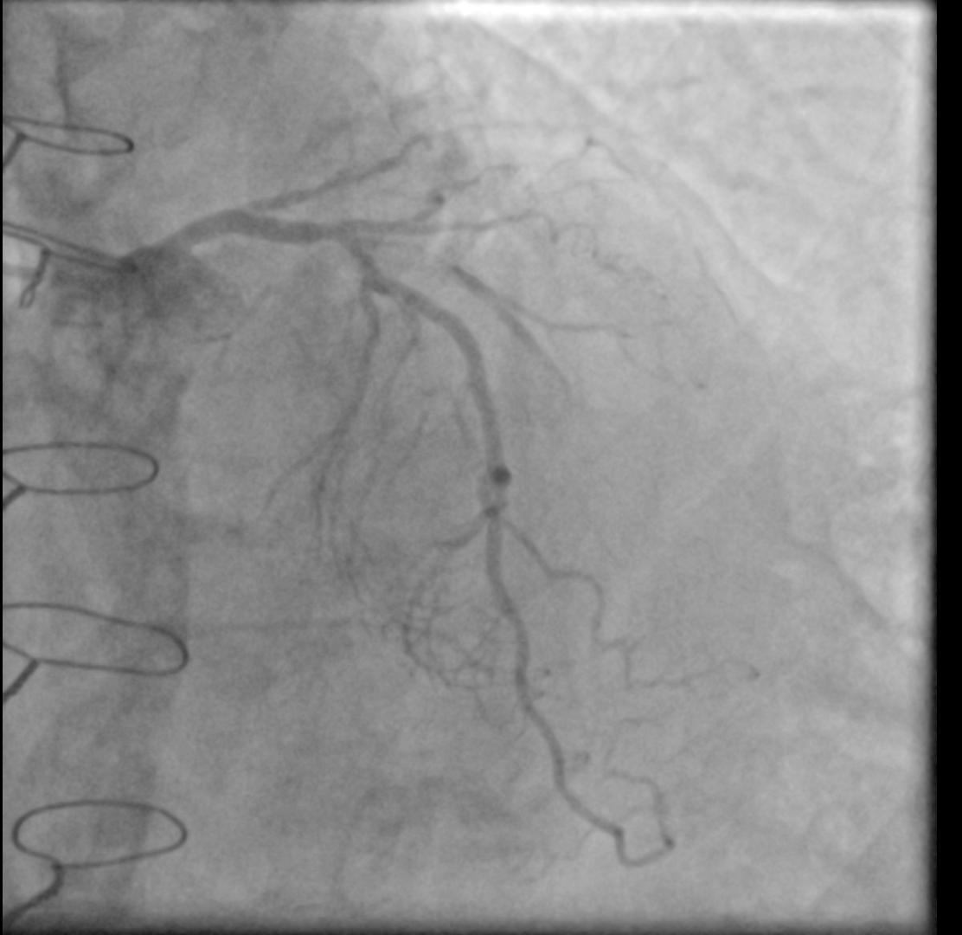
A
A
B
C
B
1.93 mm2
C

Slide 11
Pre-dilatation

Slide 12
Xience Sierra
2,5 x 33 mm:
LAD->Dg->SVG

Slide 13
Rewiring and
Kissing balloon

Slide 14
Sequential SVG graft from Dg to OM branch

Slide 15
LAD stent
Xience Sierra
3,5 x 28 mm
(Culotte)

Slide 16
Final kissing
balloon

Slide 18
SVG-Dg-LAD
LAD
3.73 mm2
7.40 mm2

Slide 19
Take Home Messages
Complete revascularization of all viable territories should be always the primary goal
Current evidence support native coronary PCI over failed graft PCI whenever possible
PCI of native diagonal allowed to recover sequential graft to marginal branch, completing revascularization of lateral wall
IVUS allowed to understand the anatomy and to guide bifurcation/SVG PCI

