Slide 1
Use of Turnpike Spiral for Uncrossable CTO

Slide 2
Ulises Lopez, MD
I have no relevant financial relationships

Slide 3
Clinical Features
70 year old male
Previous medical history
Systemic hypertension
Inferior STEMI – 2014 - Medical management
August 2018 Anterior STEMI – PPCI LAD
A RCA CTO (JCTO Score 2) was noted

Slide 4
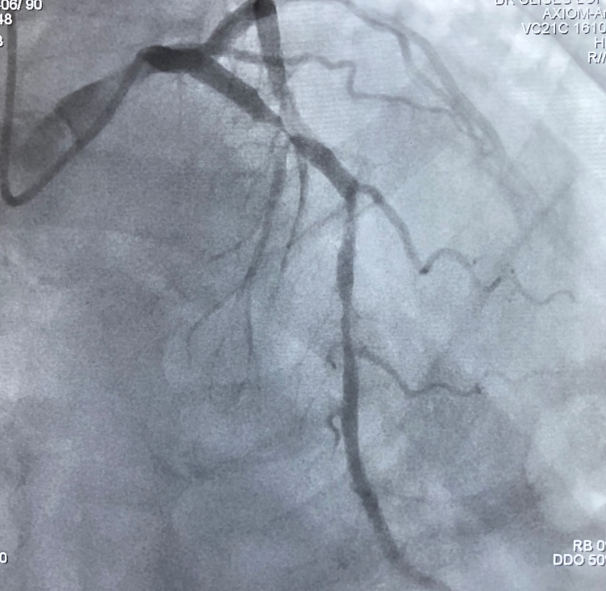
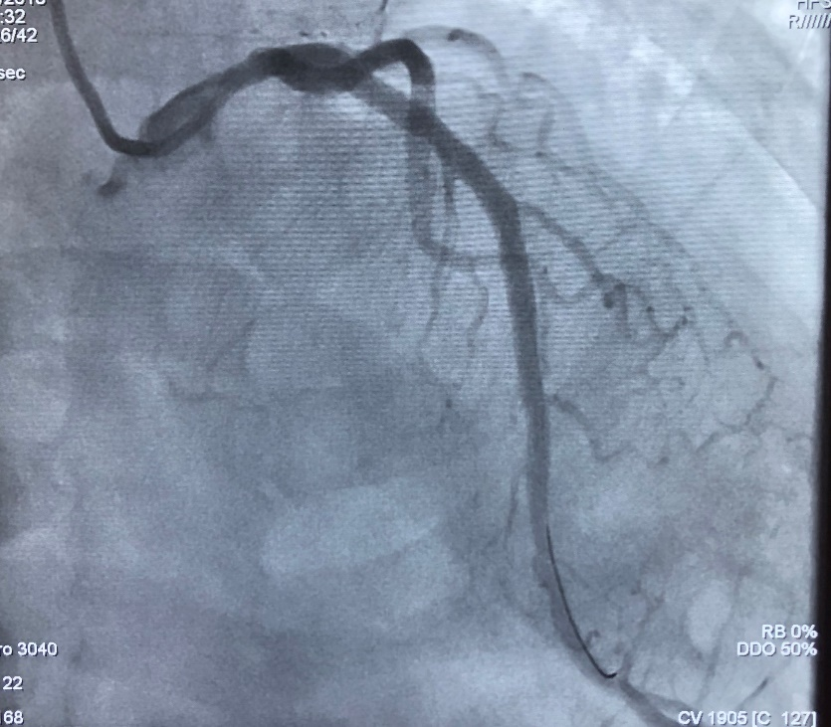
LAD Primary PCI
IVUS Guided
Orsiro 3.5x

Slide 5
Follow Up
The patient was discharged home
However, he was admitted twice in the last month due persistent angina (CCS III) despite anti anginals at full dose
Stress echocardiogram positive for inferior ischemia
Case assessed and accepted for RCA CTO PCI

Slide 6
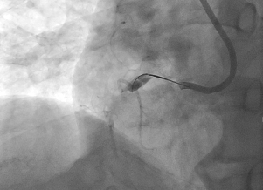
RCA CTO PCI
AL 1 8Fr Right Femoral
Fighter 0.014 with Turnpike LP
Lack of support and couldn’t cross the lesion

Slide 7
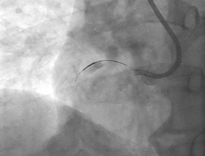
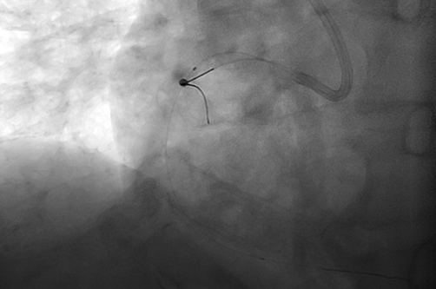
RCA CTO PCI
Escalate to Pilot 200, crossing the lesion
Could not advance the smallest balloons (Acrosstak 1.1x15mm and MiniTrek 1.2x12mm)
Samurai to side branch with anchoring balloon (2x10mm)
Could not advance the smallest balloons (Acrosstak 1.1x15mm and MiniTrek 1.2x12mm)
Tried grenadoplasty, unsuccessful

Slide 8
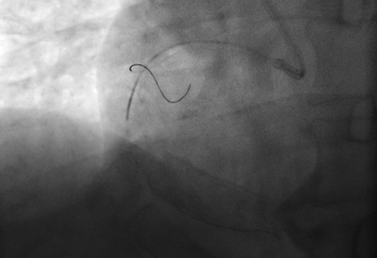
RCA CTO PCI
Advanced Turnpike Spiral (clockwise) successfully through the lesion
Notes:
Avanza Turnpike Spiral
Apoyo posterior con Guidezila y se logran cruzar balones
IVUS 3.5 y 4
Stent 3.5x48 y 4x18

Slide 9
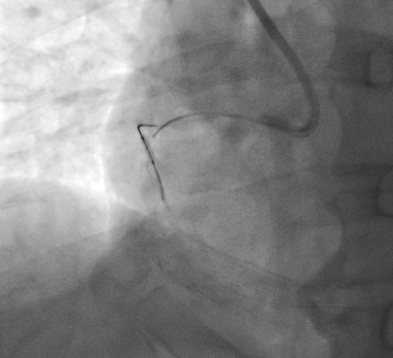
RCA CTO PCI
Once crossed the lesion, pulled it back (without counterclockwise movement) and repeated it twice, modifying the plaque
Notes:
Apoyo posterior con Guidezila y se logran cruzar balones
IVUS 3.5 y 4
Stent 3.5x48 y 4x18

Slide 10
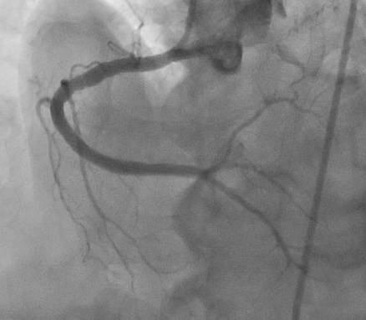
RCA CTO PCI
Using Guidezilla II, advance balloons (Emerge 1.20x12mm, empire 2x10mm and emerge 2.5x12mm)
IVUS guided PCI (distal reference diameter 3.5mm, proximal 4.5mm)
Deployed Symergy 3.5x48 and Onyx 4x18

Slide 11
Take Home Messages
Uncrossable lesions have multiple approaches
Grenadoplasty
Laser/ Rotational atherectomy
Anchoring balloon
We describe a simple technique using Turnpike Spiral microcatheter to cross the lesion (with clockwise rotation) and by pulling it back (without counter-clockwise rotation) the plaque is modified letting us advance balloons eventually

