Slide 1
3-month versus 12-month DAPT after PCI with biodegradable polymer sirolimus TARGET-eluting coronary stent
Department of Cardiology Zhongshan Hospital
Shanghai Institute of Cardiovascular Diseases
Principal Results From the Open-label, Non-inferiority TARGET-DAPT Trial
Hongbo Yang M.D.
on behalf of Junbo Ge and the TARGET-DAPT Investigators
ClinicalTrials.gov number: NCT03008083

Slide 2
Background
International guidelines currently recommend DAPT with aspirin plus P2Y₁₂ inhibitor for 6 months in patients with an CCS and 12 months for ACS treated with PCI to prevent MI and stent thrombosis
3-month DAPT followed 2nd-generation zotarolimus DES with a durable polymer was non-inferior to 12-month DAPT.
OCT proved early healing and reendothelialization of the biodegradable-polymer drug-eluting Firehawk stent at 3 months post-procedure.
Limited data exist regarding 3-month DAPT after PCI with DES with biodegradable-polymer.

Slide 3
Primary Endpoint
Net adverse clinical and cerebral events (NACCE), at 18-month
all-cause death
myocardial infarction (MI)
cerebral vascular accident (CVA)
major bleeding assessed by Bleeding Academic Research Consortium (BARC) type 2, 3 or 5

Slide 4
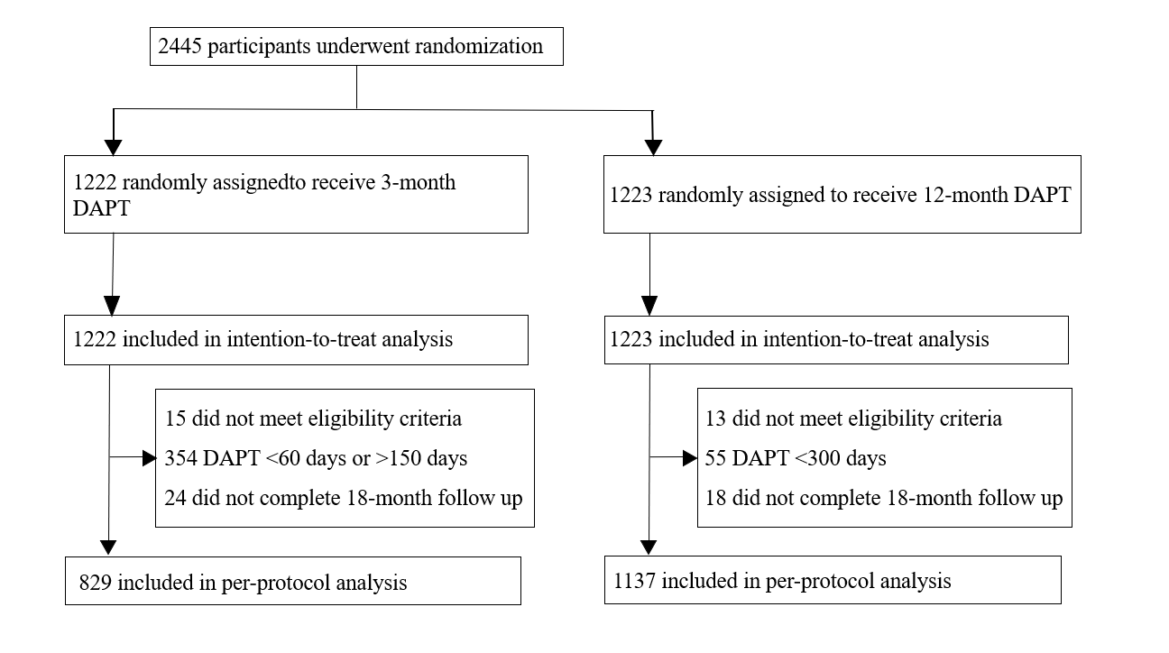
Randomization & Study Flowchart

Slide 5
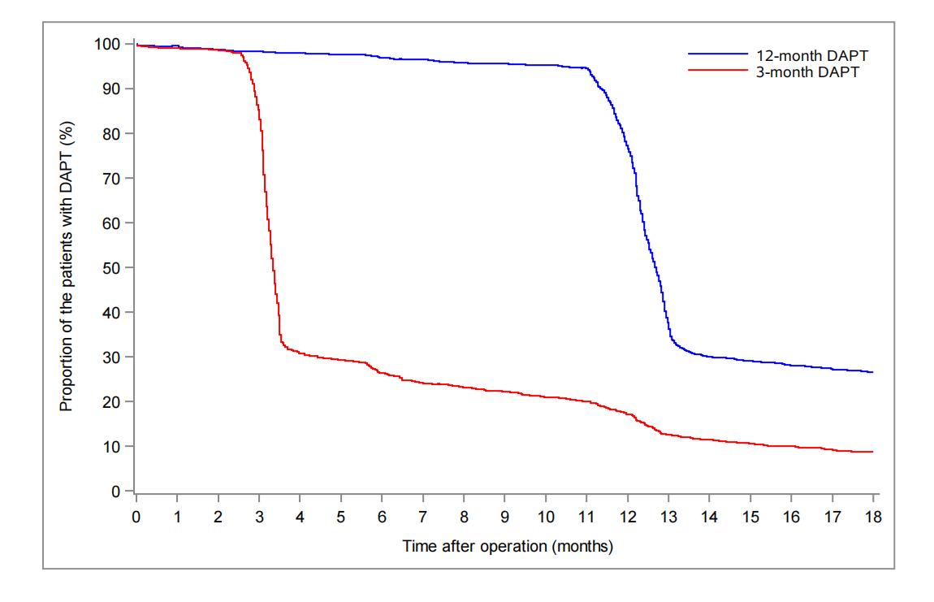
DAPT Adherence During Follow-up
Adherence：
71.0% (868/ 1222) in 3-month DAPT
95.5% (1168/1223) in 12-month DAPT

Slide 6
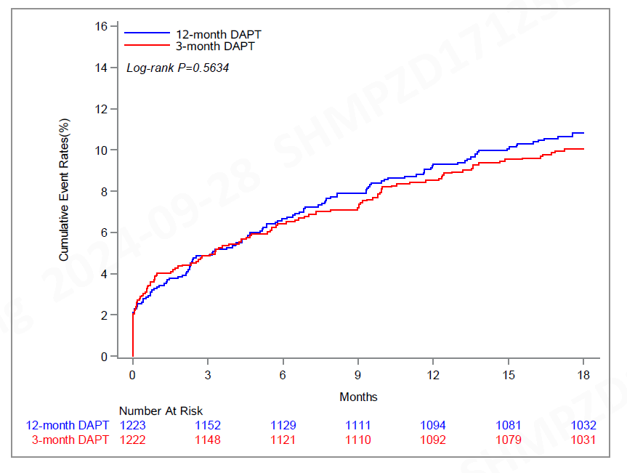
Primary Endpoint: NACCE
NACCE
3-month: 10.1%
12-month: 10.9%
Rate difference: 1.7%
Margin: 3.5%
P_{non-inferiority}=0.0003

Slide 7
Conclusions
The present results demonstrate that in patients who underwent PCI with Firehawk stent implantation, short-term (3-month) DAPT was noninferior to long-term (12-month) therapy in terms of all-cause death, myocardial infarction, cerebrovascular accident, and major bleeding.

