Slide 1
Randomized Comparison of a Novel Low-Dose Sirolimus-Eluting Biodegradable Polymer Stent vs. Second Generation DES: The TARGET-IV NA Trial
Olivier F. Bertrand, MD, PhD
on behalf of the TARGET-IV NA Steering Committee
Quebec Heart and Lung Institute

Slide 2
Disclosure of Relevant Financial Relationships
I, Olivier F. Bertrand, disclose the following conflicts of interest:
Equity – Nanostent, Inc.
Consultant Fees – MicroPort Medical, Ltd., Boston Scientific, and Opsens Medical
Grant Support – investigator-initiated support from Opsens Medical
President at Nanostent, Inc.
This trial was funded by Microport Medical, Ltd. (Shanghai, China)
Faculty disclosure information can be found on the app

Slide 3
Background
Drug-eluting stents (DES) reduce restenosis risk, but durable polymers can delay healing and inhibit re-endothelialization
The Firehawk® DES* has a fully biodegradable sirolimus-containing polymer coating localized to recessed abluminal grooves on the stent surface and delivers roughly 1/3 the drug dose of other DES
The TARGET-IV NA Trial Multicenter Randomized Assessment of the Firehawk® rapamycin TARGET eluting cobalt chromium coronary stent system –North American Trial sought to investigate clinical outcomes with Firehawk compared to currently used 2nd generation DES
*Firehawk® DES is an investigational device in the US and CA
Notes:
2
This is the Bulleted List slide.
To create this particular slide, click the NEW SLIDE button on your toolbar and choose the BULLETED LIST format. (Top row, second from left)
The Sub-Heading and footnote will not appear when you insert a new slide. If you need either one, copy and paste it from the sample slide.
If you choose not to use a Sub-Heading, let us know when you hand in your presentation for clean-up and we’ll adjust where the bullets begin on your master page.
Also, be sure to insert the presentation title onto the BULLETED LIST MASTER as follows:
Choose View / Master / Slide Master from your menu.
Select the text at the bottom of the slide and type in a short version of your presentation title.
Click the SLIDE VIEW button in the lower left hand part of your screen to return to the slide show. (Small white rectangle)

Slide 4
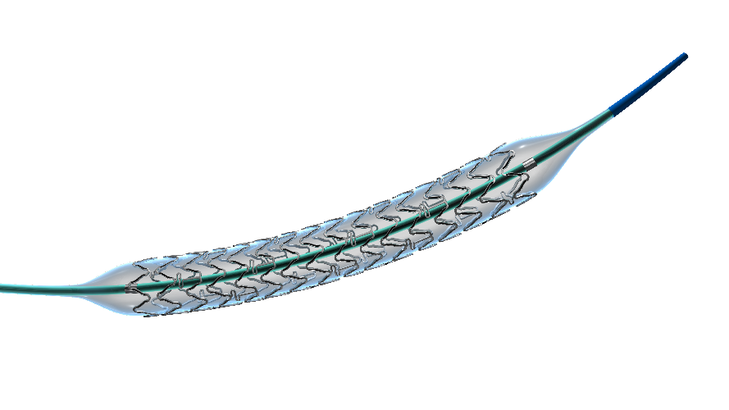
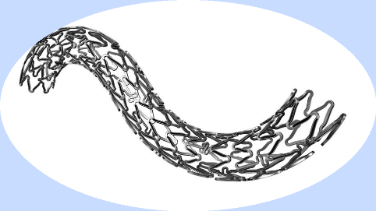
Firehawk® DES* Abluminal Groove-Filled Biodegradable Polymer Targeting Release Sirolimus-Eluting Stent
S” type design in connecting rods improves flexibility and
may increase lesion coverage
Biodegradable polymer
Thin strut Co-Cr (86 μm) stent with abluminal grooves
Sirolimus: 0.30 μg/mm²
90% released at 90 days
Patented in-groove
coating technology
*Firehawk® DES is an investigational device in the US and CA
Notes:
3
This is the Bulleted List slide.
To create this particular slide, click the NEW SLIDE button on your toolbar and choose the BULLETED LIST format. (Top row, second from left)
The Sub-Heading and footnote will not appear when you insert a new slide. If you need either one, copy and paste it from the sample slide.
If you choose not to use a Sub-Heading, let us know when you hand in your presentation for clean-up and we’ll adjust where the bullets begin on your master page.
Also, be sure to insert the presentation title onto the BULLETED LIST MASTER as follows:
Choose View / Master / Slide Master from your menu.
Select the text at the bottom of the slide and type in a short version of your presentation title.
Click the SLIDE VIEW button in the lower left hand part of your screen to return to the slide show. (Small white rectangle)

Slide 5
Target-IV NA Trial Design
A Prospective, multicenter, single blind, 1:1
randomized non-inferiority trial for patients with
chronic or acute coronary syndrome
eligible for DES
1720 patients, 64 sites
(North America and Europe)
Substudies: OCT 37 pts; QCA 107 pts
Firehawk® DES*
n = 860
2nd generation DES
N=860
Secondary endpoints and TLF
30d
6mo
12mo
13mo
QCA and OCT Substudy
Primary Endpoint: TLF (ARC defined) = Cardiac Death, TV MI, ID-TLR at 12mo
Secondary Powered Endpoint:
In-stent late loss at 13mo by QCA;
Mean neo-intimal thickness at 13mo by OCT
*Firehawk® DES is an investigational device in the US and CA
Notes:
Key Inclusion: Vessel diameter of ≥2.25 mm to ≤4.0 mm, Lesion length <44 mm
Key Exclusions: STEMI or any PCI within 24 hours, cardiogenic shock, LVEF <30,

Slide 6
Key Inclusion/Exclusion Criteria
Inclusion
Age >18 years Patients with an indication for PCI Native coronary artery Vessel diameter of ≥2.25 mm to ≤4.0 mm Lesion length <44 mm Complex lesions are allowed Overlapping stents are allowed A maximum of 2 TV and up to 2 TL per vessel
Exclusion
STEMI or any PCI within 24 hours Prior stent thrombosis Cardiogenic shock Known LVEF <30% Unprotected LM intervention Bifurcation lesions with dual stent implantation Lesion with intended ≥3 stent implantation Planned staged procedures
Notes:
5
This is the Bulleted List slide.
To create this particular slide, click the NEW SLIDE button on your toolbar and choose the BULLETED LIST format. (Top row, second from left)
The Sub-Heading and footnote will not appear when you insert a new slide. If you need either one, copy and paste it from the sample slide.
If you choose not to use a Sub-Heading, let us know when you hand in your presentation for clean-up and we’ll adjust where the bullets begin on your master page.
Also, be sure to insert the presentation title onto the BULLETED LIST MASTER as follows:
Choose View / Master / Slide Master from your menu.
Select the text at the bottom of the slide and type in a short version of your presentation title.
Click the SLIDE VIEW button in the lower left hand part of your screen to return to the slide show. (Small white rectangle)

Slide 7
Demographics
Patient characteristics
Lesion characteristics
 | Firehawk® DES n=860 | 2nd gen. DES n=860
Age, years | 65.3 ± 10.2 | 65.8 ± 10.0
Sex, male | 74% | 74%
Diabetes mellitus | 27% | 29%
Renal insufficiency | 4.5% | 4.4%
Prior MI | 32% | 27%
LVEF, % | 49.7 ± 11.0 | 47.7 ± 12.2
Chronic coronary syn | 62% | 60%
Unstable angina | 31% | 33%
STEMI/NSTEMI | 8% | 7%
>1 lesions treated | 24% | 26%
 | Firehawk® DES n=1021 | 2nd gen. DES n=1049
LAD | 45% | 46%
LCX | 25% | 25%
RCA | 30% | 28%
LM | 0.1% | 0.7%
Lesion length, mm | 24.4 ± 12.5 | 24.2 ± 11.9
Lesion class B2/C | 85% | 84%
Bifurcation lesion | 24% | 23%
Calcium (mod/sev) | 61% | 59%
Thrombus | 4.7% | 4.0%
Tortuosity (mod/sev) | 8.6% | 8.6%

Slide 8
Primary Endpoint: TLF at 12 months
 | Firehawk® DES (n=860) | 2nd gen. DES (n=860) | P value
Target Lesion Failure (TLF) | 3.4% (29/845) | 3.3% (28/847) | <0.0001*
Cardiac Death | 0.8% (7/845) | 0.7% (6/847) | 0.78
Target Vessel Myocardial Infarction† | 2.4% (20/845) | 2.1% (18/847) | 0.74
Ischemia Driven Target Lesion Revascularization | 0.9% (8/845) | 1.4% (12/847) | 0.37
*P-value for TLF derived from Farrington-Manning test of non-inferiority for two binomial proportions with a non-inferiority margin of 3.85%; †Myocardial infarction (including periprocedural) assessed per the 4th Universal Definition of Myocardial Infarction.

Slide 9
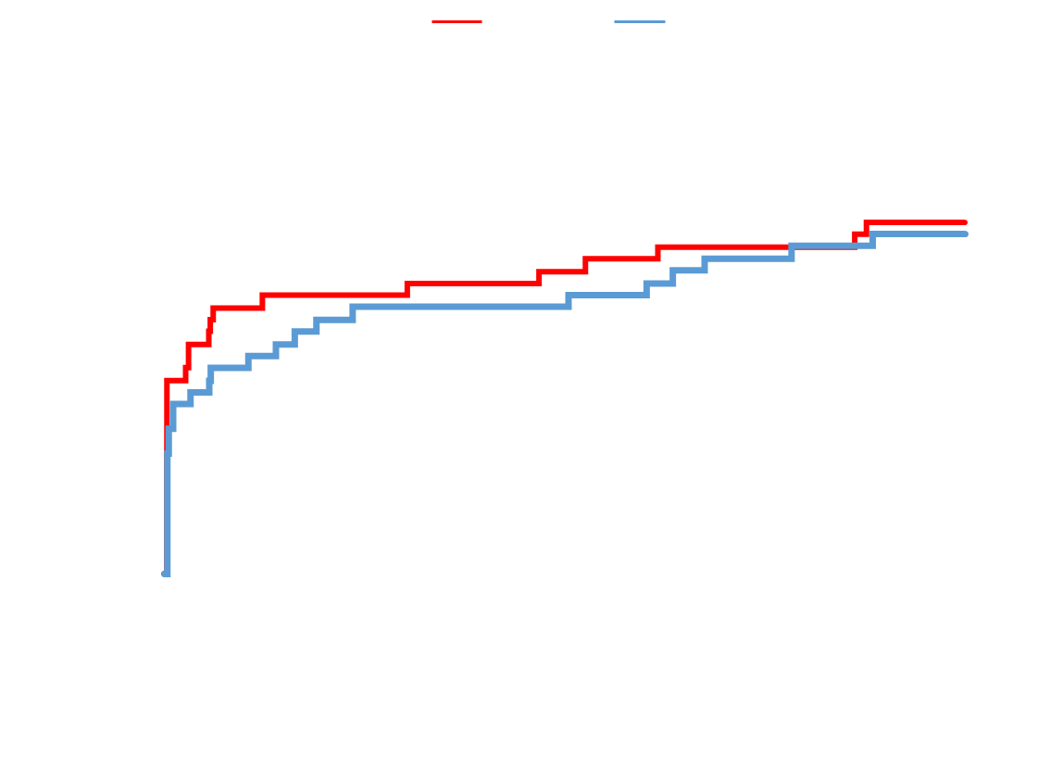
Primary Endpoint: TLF at 12 months
Notes:
8
This is the Bulleted List slide.
To create this particular slide, click the NEW SLIDE button on your toolbar and choose the BULLETED LIST format. (Top row, second from left)
The Sub-Heading and footnote will not appear when you insert a new slide. If you need either one, copy and paste it from the sample slide.
If you choose not to use a Sub-Heading, let us know when you hand in your presentation for clean-up and we’ll adjust where the bullets begin on your master page.
Also, be sure to insert the presentation title onto the BULLETED LIST MASTER as follows:
Choose View / Master / Slide Master from your menu.
Select the text at the bottom of the slide and type in a short version of your presentation title.
Click the SLIDE VIEW button in the lower left hand part of your screen to return to the slide show. (Small white rectangle)

Slide 10
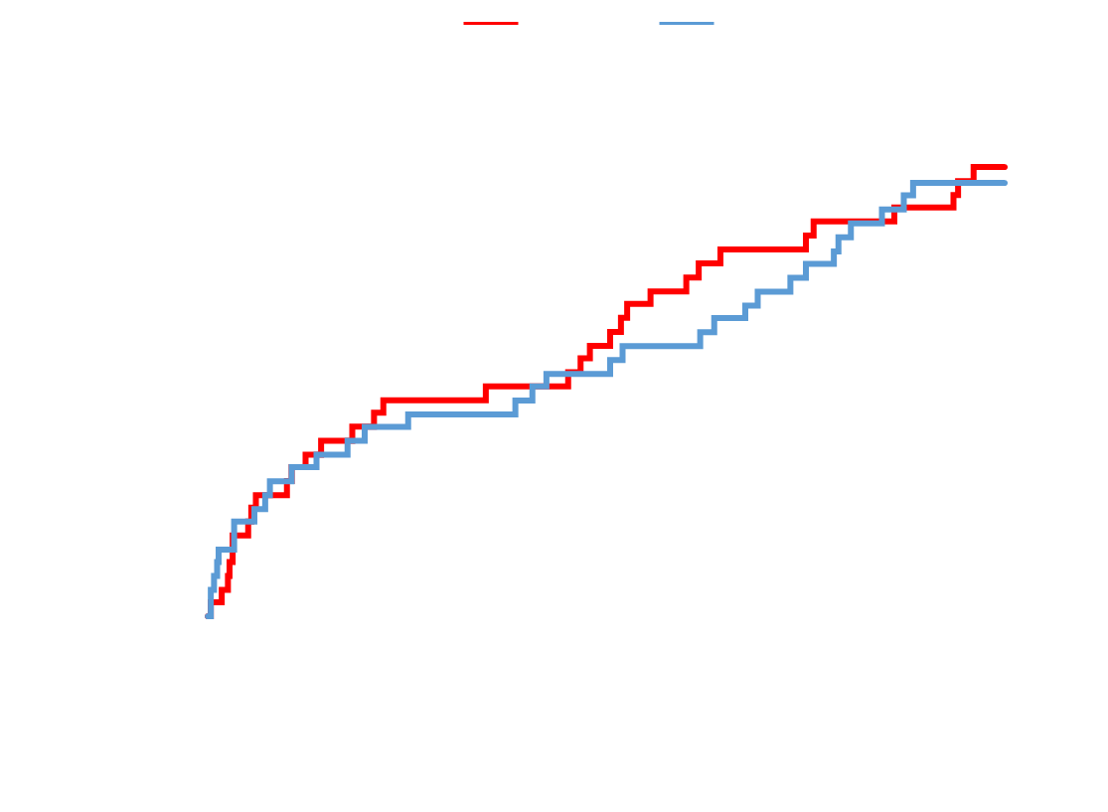
Revascularization: TLR; TV non-TLR; non-TVR
 | Firehawk® DES (n=860) | 2nd gen. DES (n=860) | P value
ALL Revasc | 3.9% | 3.8% | 0.88
All TVR (non-TLR) | 1.1% | 1.4% | 0.52
ID TVR | 0.9% | 1.4% | 0.37
Any TLR | 0.9% | 1.4% | 0.37
ID TLR | 0.9% | 1.4% | 0.37
Notes:
9
This is the Bulleted List slide.
To create this particular slide, click the NEW SLIDE button on your toolbar and choose the BULLETED LIST format. (Top row, second from left)
The Sub-Heading and footnote will not appear when you insert a new slide. If you need either one, copy and paste it from the sample slide.
If you choose not to use a Sub-Heading, let us know when you hand in your presentation for clean-up and we’ll adjust where the bullets begin on your master page.
Also, be sure to insert the presentation title onto the BULLETED LIST MASTER as follows:
Choose View / Master / Slide Master from your menu.
Select the text at the bottom of the slide and type in a short version of your presentation title.
Click the SLIDE VIEW button in the lower left hand part of your screen to return to the slide show. (Small white rectangle)

Slide 11
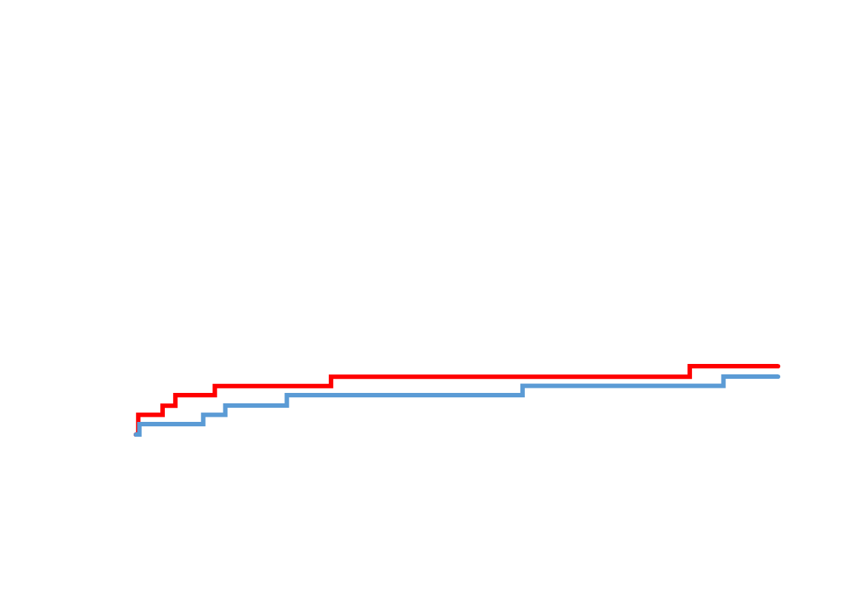
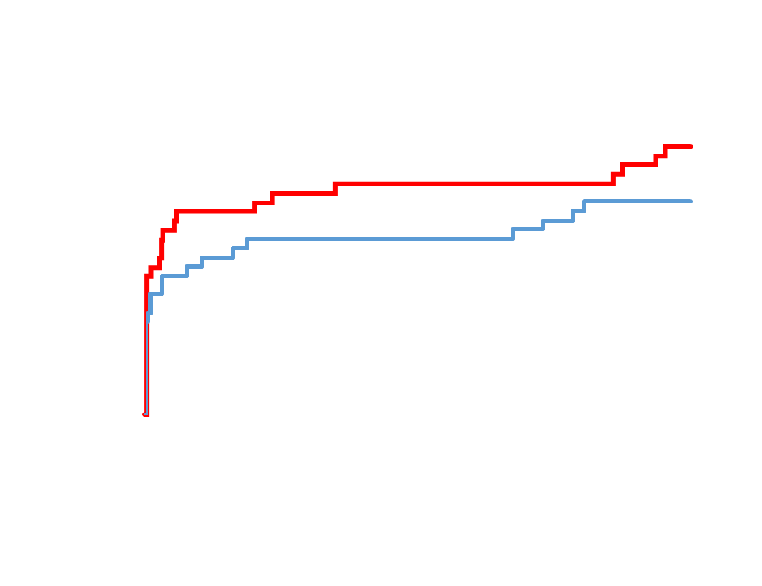
KM rates at 12 months
Firehawk
DES
Cardiac Death
Myocardial Infarction

Slide 12
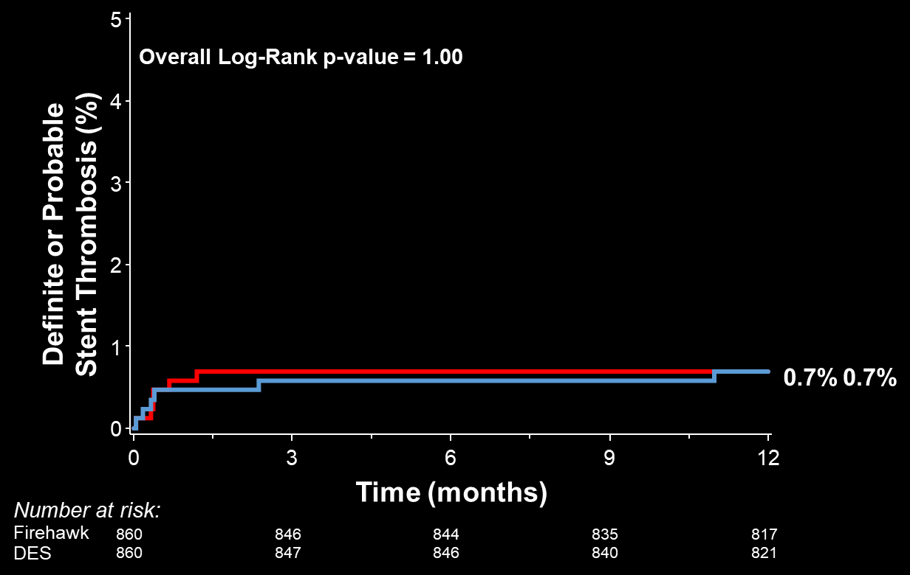
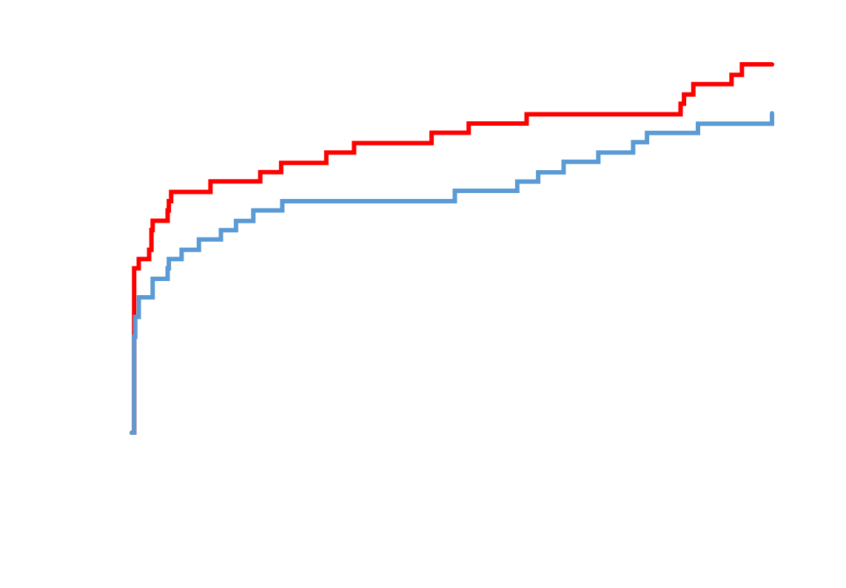
KM rates at 12 months
Firehawk
DES
Definite/Probable Stent Thrombosis
Major Adverse Cardiac Events

Slide 13
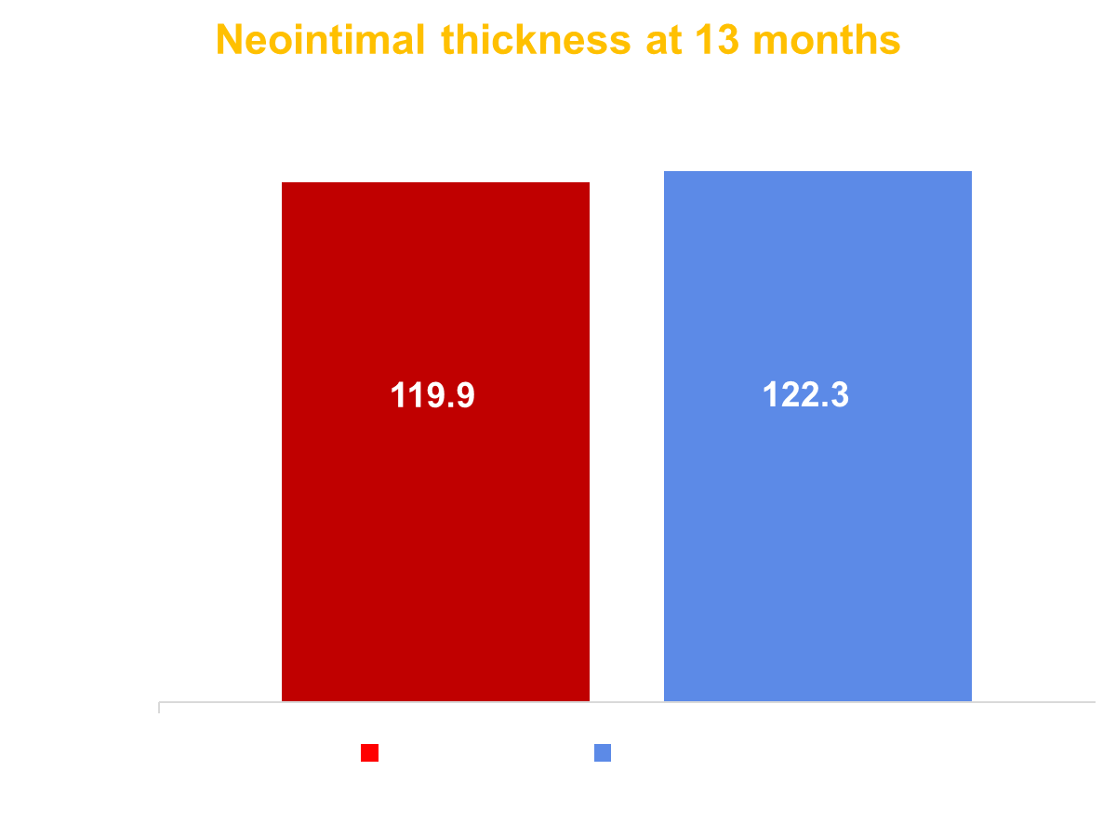
QCA and OCT Sub-studies
P_{non-inferiority} < 0.0001
P_{non-inferiority} = 0.01

Slide 14
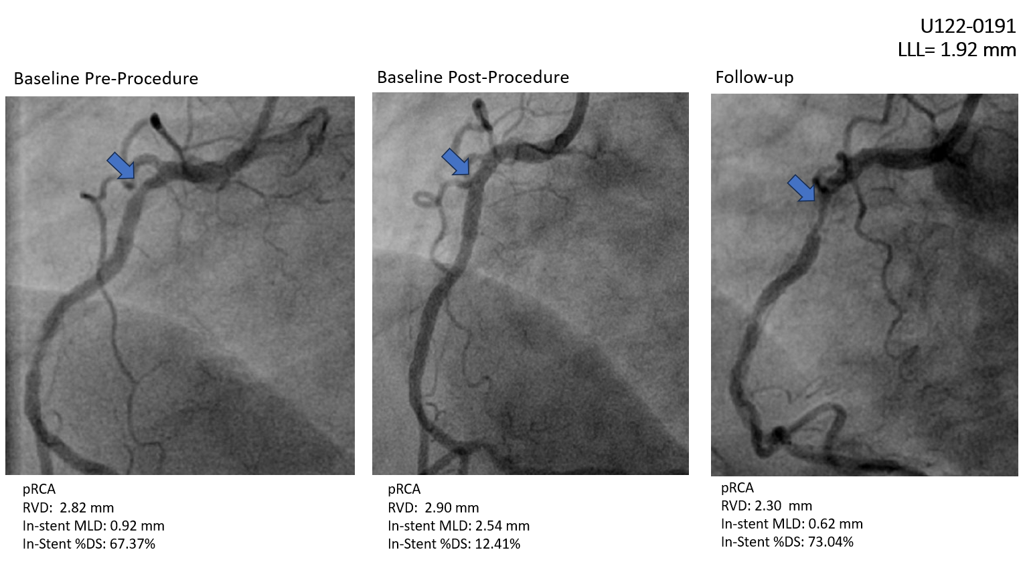
Patients with LLL >0.8 mm
Patient | Stent Type | In-Stent LLL
I | Firehawk | 0.81
II | Synergy | 0.90
III | Firehawk | 1.04
IV | Xience | 1.14
V | Xience | 1.24
VI | Xience | 1.34
VII | Resolute | 1.46
VIII | Synergy | 1.65
IX | Xience | 1.92

Slide 15
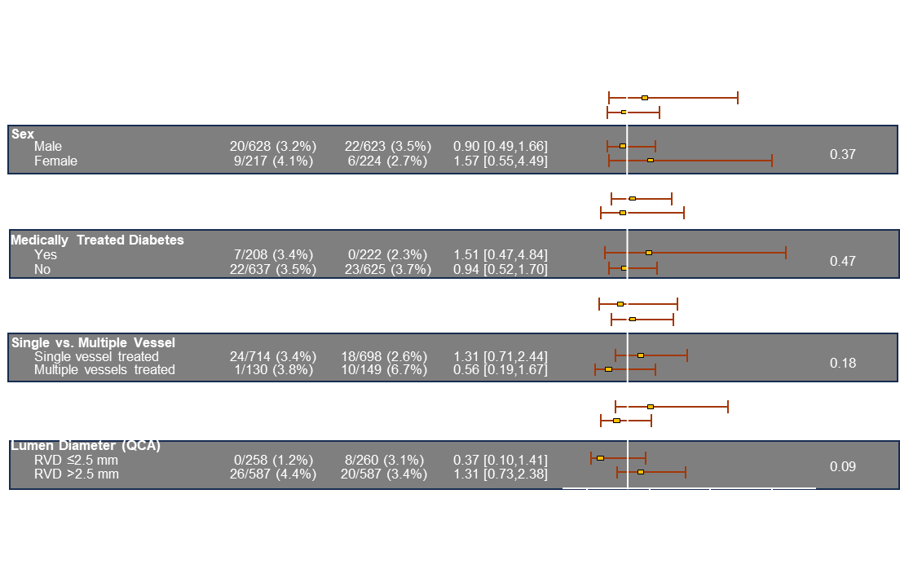
TLF Subgroup Analysis at 12 Months

Slide 16
Conclusions
TARGET-IV NA shows that the biodegradable polymer Firehawk® DES* was noninferior to currently used second-generation DES in terms of TLF at 1 year
Longer-term follow-up (5 years) is needed to determine whether these findings will impact efficacy and safety outcomes.
*Firehawk® DES is an investigational device in the US and CA

Slide 17
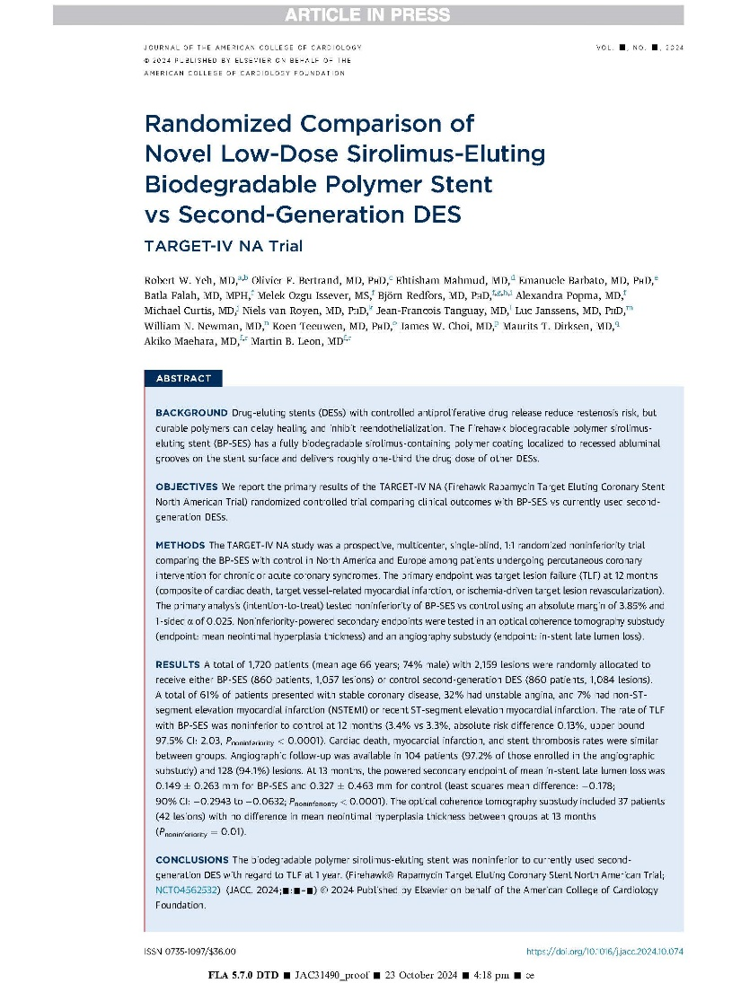
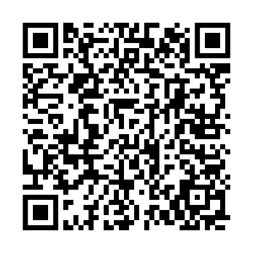
Simultaneously published in JACC
@rwyeh

Slide 19
Back-up Slides

Slide 20
Cumulative Frequency Distribution of In-Stent Late Loss at 13 Months
P_{superiority} = 0.014

