Slide 1

Failed Retrograde PCI, Successful Antegrade PCI For RCA CTO
Nizam’s Institute of Medical Sciences (NIMS), Hyderabad, India

Slide 2

Presenter - Jyotsna Maddury , MD DM, FACC, FESC, FICC
Jyotsna Maddury , MD DM, FACC, FESC, FICC
Lalita Nemani , MD DM, FESC
Satish Kumar Rao Vavilala, MD DTCD , DM Resident
I have no relevant financial relationships

Slide 3
Case details
61 year old male known HTN since 3 years, known CAD s/p CAG – TVD s/p CABG – 2 grafts ( LIMA to LAD, left RA to OM2 – 9 years back).
C/o SOB FC-II & Chest Pain on exertion Since 3 days, hemodynamically stable at the time of admission
ECG – Normal Sinus Rhythm 80 bpm Normal Axis No ST-T changes
ECHO – Normal Sized Cardiac Chambers No RWMA Good LV Function Grade I diastolic dysfunction
Provisional Diagnosis - CAD unstable Angina NSR Good LV Function
Conventional angiogram shows native TVD (RCA CTO)
Plan – Retrograde PCI to RCA.

Slide 4
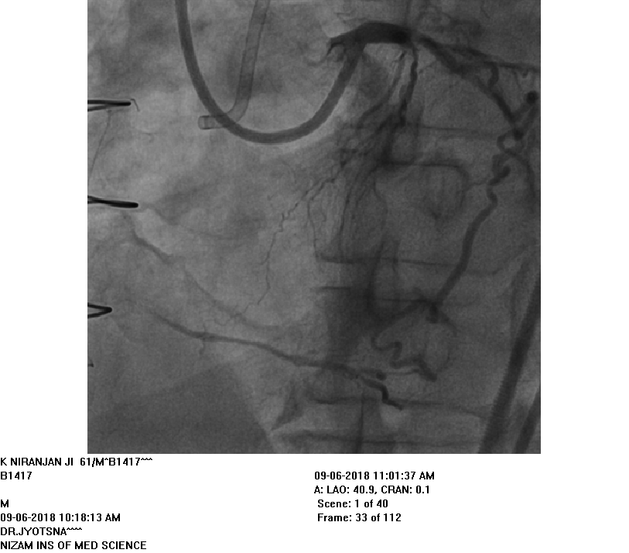
LAO view

Slide 5
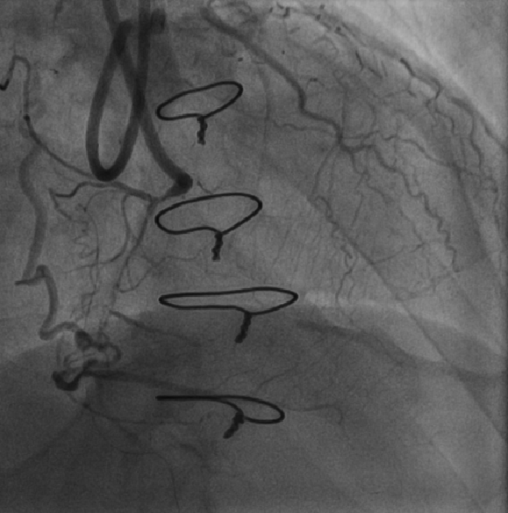
RAO Cranial view

Slide 6
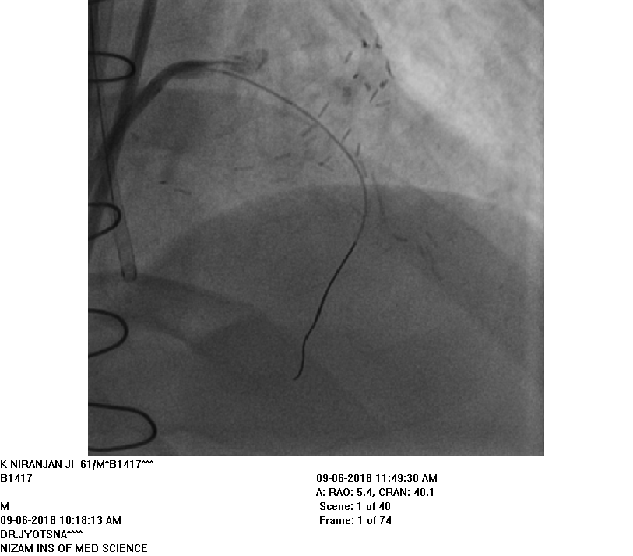
AP Cranial view

Slide 7
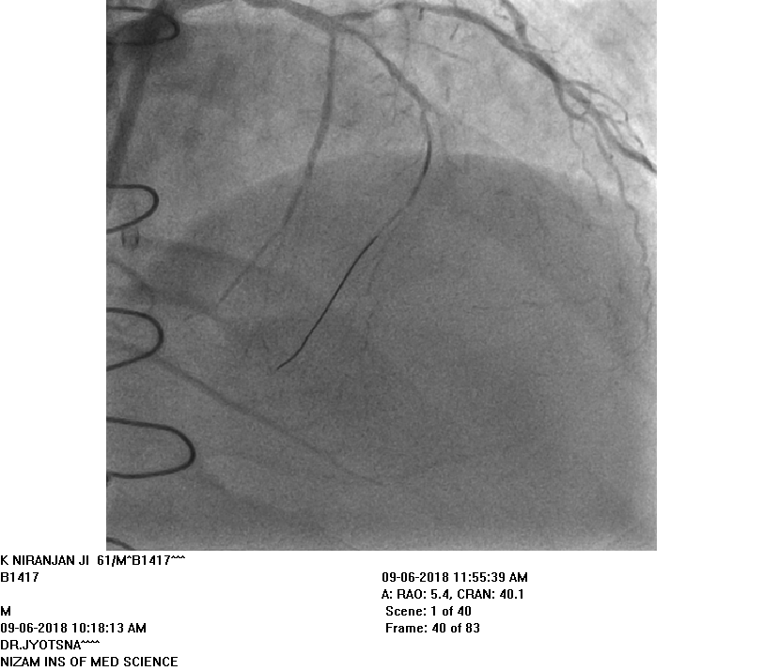
AP Cranial view

Slide 8
Retrograde PCI planned, but definite continuity to RCA could not be established even after surfing two septal branches. So Antegrade approach for PCI is planned.

Slide 9
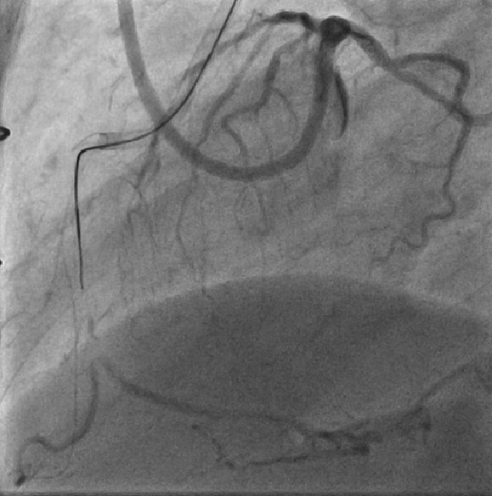
LAO view

Slide 10
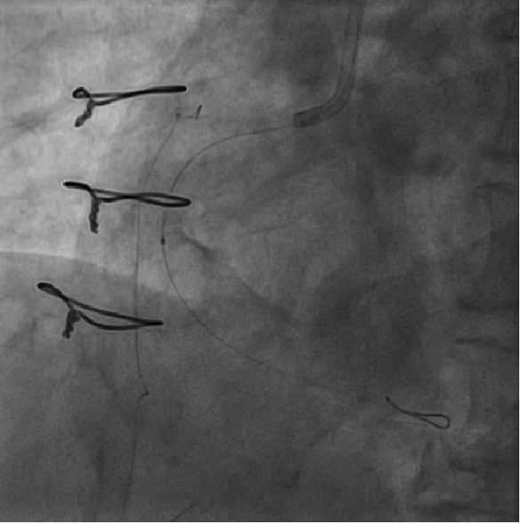
LAO view

Slide 11
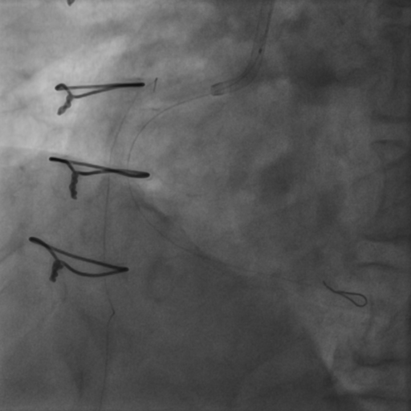

Slide 12
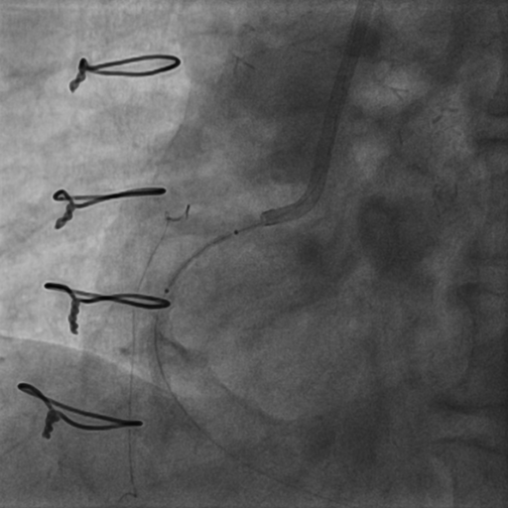

Slide 13
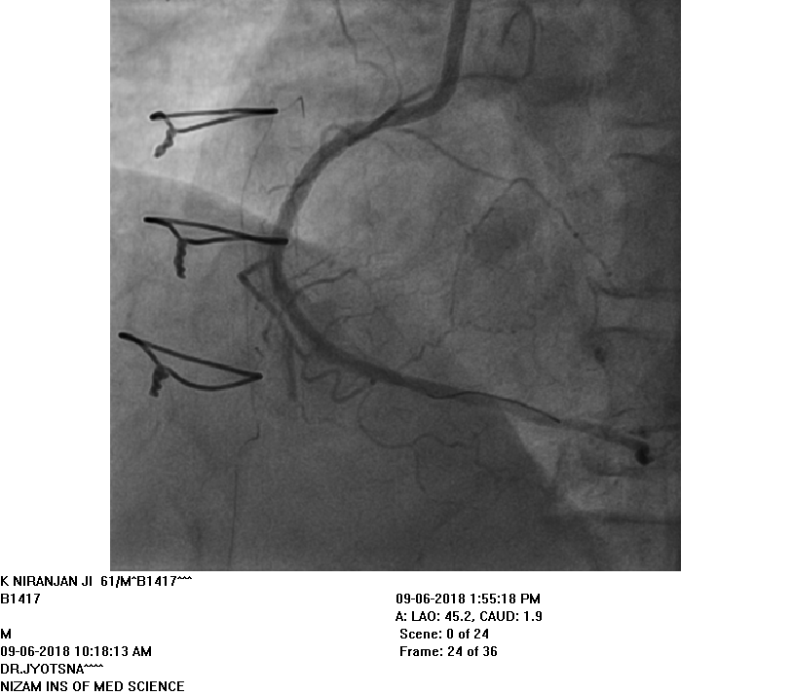
Final result after PCI

Slide 14
Take Home Message
Successful recanalization of CTO of coronary arteries is associated with improved survival, improved LV systolic function, reduced Angina and increased exercise capacity.
The perceived procedural complexity of Angioplasty in CTO represents the most common reason for referral to CABG or medical management.
Procedural success rate of CTO has improved overtime but is still low and is mainly due to failure to cross the lesion with the guide wire.

Slide 15
Thank you

