Slide 1

Dissection and Intramural Hematoma after Drug Eluting Balloon Treatment of SFA Occlusion
Yulanka Castro, MD
Cardiovascular Disease Fellow
Yale University Medical School
Diaa Hakim, MD
Clinical Research Scientist
Yale University Medical School
S. Elissa Altin, MD
Assistant Professor
Yale University Medical School

Slide 2

Yulanka Castro, MD
I have no relevant financial relationships

Slide 3
History
HPI
64-year-old man presenting with complaints of lifestyle-limiting Rutherford class 3 left lower extremity claudication.
Past Medical History
Coronary artery disease with prior PCI
Diabetes (non insulin dependent)
Active smoker (actively cutting down)
Peripheral arterial disease with right mid SFA drug-coated balloon angioplasty 6 months prior for claudication and resolution of symptoms

Slide 4
History
Physical Exam
HR: 74, BP:130/84
Cardiovascular: regular rate and rhythm, no murmurs, no JVD, bilateral carotid bruits
Extremities: warm, no wounds
Pulses: right popliteal pulse palpable 1+, left popliteal pulse absent with monophasic Doppler signal, DP/PT monophasic signal bilaterally

Slide 5
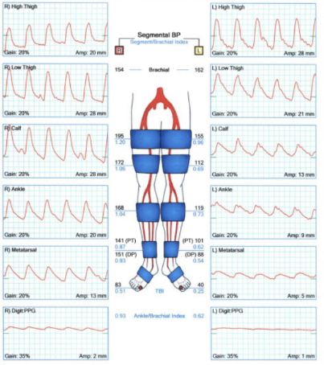
Ankle-Brachial Index

Slide 6
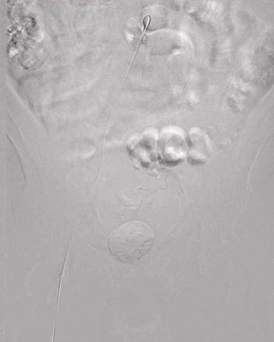
Diagnostic Angiogram – Distal Aorta

Slide 7
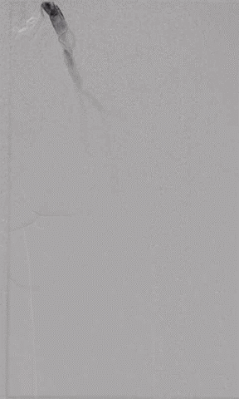
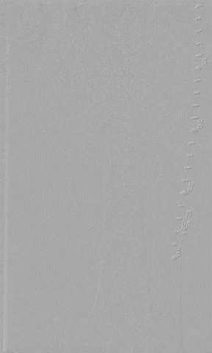
Tandem high grade 90% SFA stenosis
Notes:
tandem high grade 90% stenosis

Slide 8
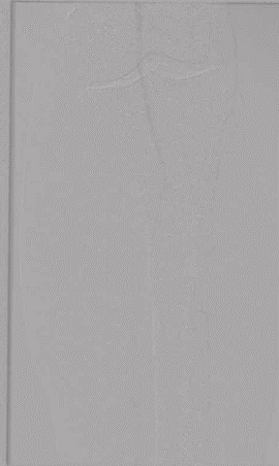
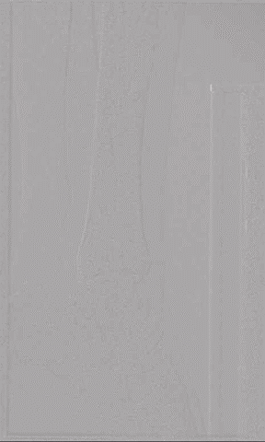
Occluded AT with distal DP reconstitution

Slide 9
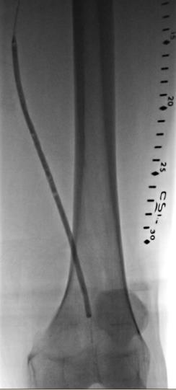
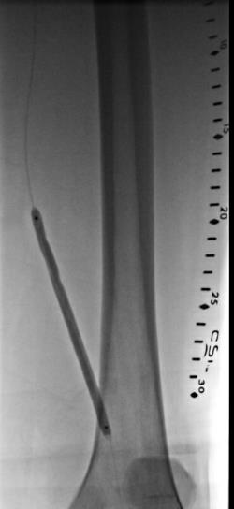
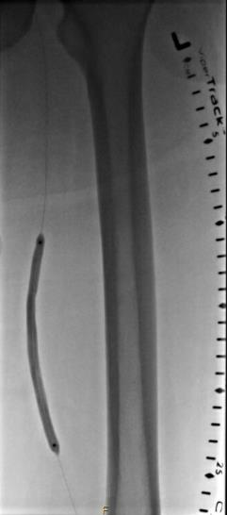
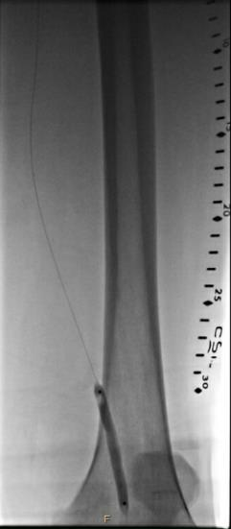
Notes:
Predilated with 4x200mm Angiosculpt followed by DEB x 3 to entire SFA (6x60mm, 6x120mm, 6x120mm).

Slide 10
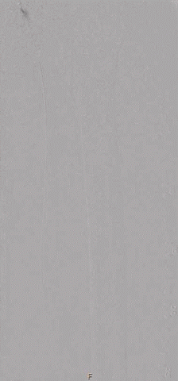
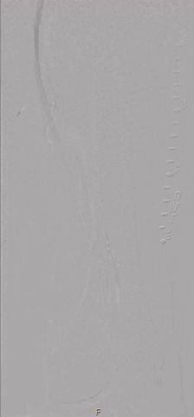
Final result: patent SFA with two vessel runoff

Slide 11
Post-Procedure Course
Patient tolerated procedure well in immediate post-procedure period.
6-hours post procedure developed significant pain and tenderness of the medial thigh with intact pulses.

Slide 12
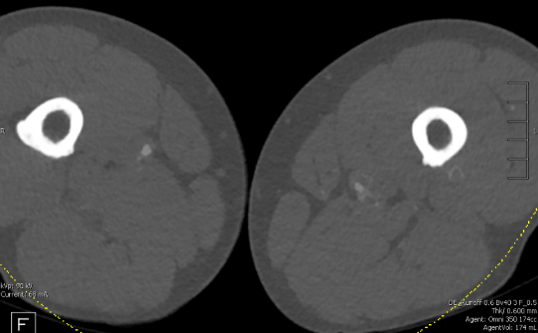
CTA
Long segmental nonocclusive acute thrombosis with opacification of the peri-arterial venous plexus extending from mid superficial femoral artery to proximal popliteal artery and severe stenosis of the distal SFA.

Slide 13
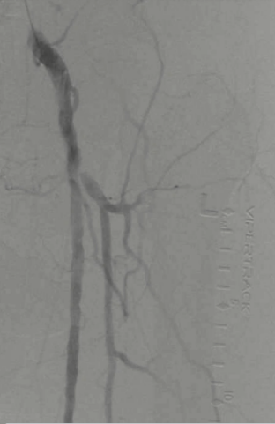
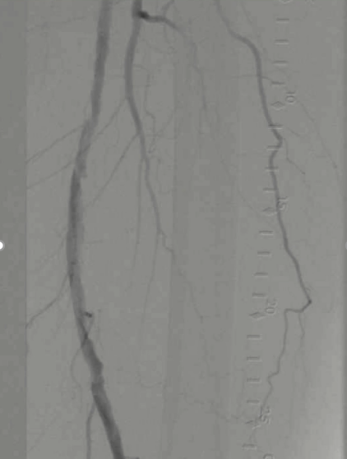
Spiral dissection in mid-distal SFA – Type D

Slide 14
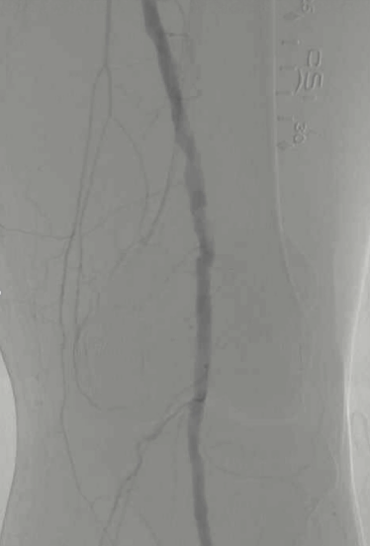
Dissection in distal SFA

Slide 15
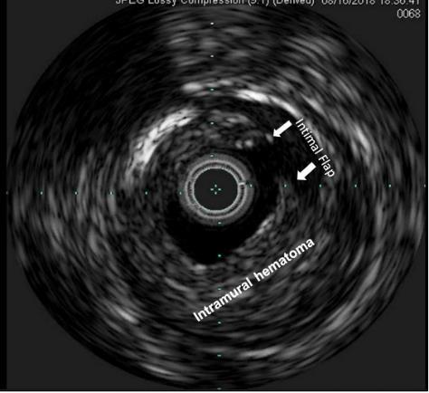
IVUS
Notes:
areas of dissection with intramural hematoma.

Slide 16
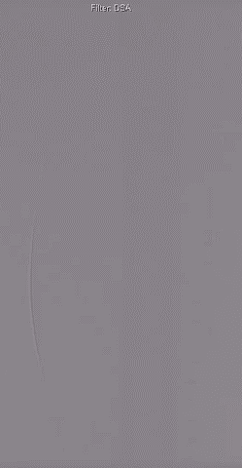
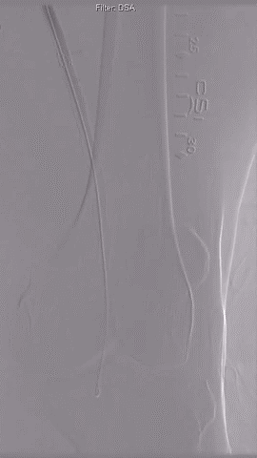
Stenting of popliteal to proximal SFA with Zilver PTX
Notes:
LifeStent 6x100mm and overlapped with a Zilver 6x120mm and another Zilver 6x120mm to the prox SFA. We post dilated with 6x200mm Ultraverse balloon. Final IVUS reveals patent outflow, good stent apposition throughout the SFA/pop with resolution of dissection.

Slide 17
Conclusions
Plain angiography can miss the presence of a dissection after angioplasty.
IVUS can reveal the presence of dissections not readily seen in angiography.
Presence of long segments of intramural hematoma poses a higher risk of acute vessel closure.

