Slide 1

The Tight K Trial
Providing an evidence base to change an engrained and widely implemented clinical practice
Funded by The British Heart Foundation Benjamin O’Brien
Funding by the BHF and by the NIHR for research on related topics No other Conflicts of Interest
31. August 2024

Slide 2
Declaration of interest
- I have nothing to declare
• •
ESC Congress 2024 London & Online

Slide 3
Conclusion
The widespread practice of routinely / proactively / aggressively supplementing potassium to achieve high-normal levels after heart bypass surgery can be abandoned
This will decrease patient risk from an unnecessary intervention and reduce healthcare costs

Slide 4
Purpose
Atrial Fibrillation after Cardiac Surgery (AFACS)
is the most common Adverse Event after heart surgery
It affects one in three patients after Coronary Artery Bypass Grafting
and is associated with morbidity, mortality, length of stay and cost of care
There are many interventions to try and prevent it, but most of them have no evidence to support them.
One example is the wide-spread practice to proactively and aggressively give potassium to keep its levels at the upper end of normal

Slide 5


Methods
We compared such a protocol to give potassium to keep it at the upper end of the normal range to only giving it if the patients became ‘hypokalaemic’
(when the potassium levels in the blood drop below normal)
Randomized controlled trial, 1690 patients at 23 cardiac centres in UK and Germany
5.5
Tight control
Potassium supplementation only if serum K+ drops below 4.5mEq/L
Relaxed control
4.5
Normal Range of Potassium
Potassium supplementation only if serum K+ drops below 3.6mEq/L
3.6
Low Potassium
mEq/L

Slide 6
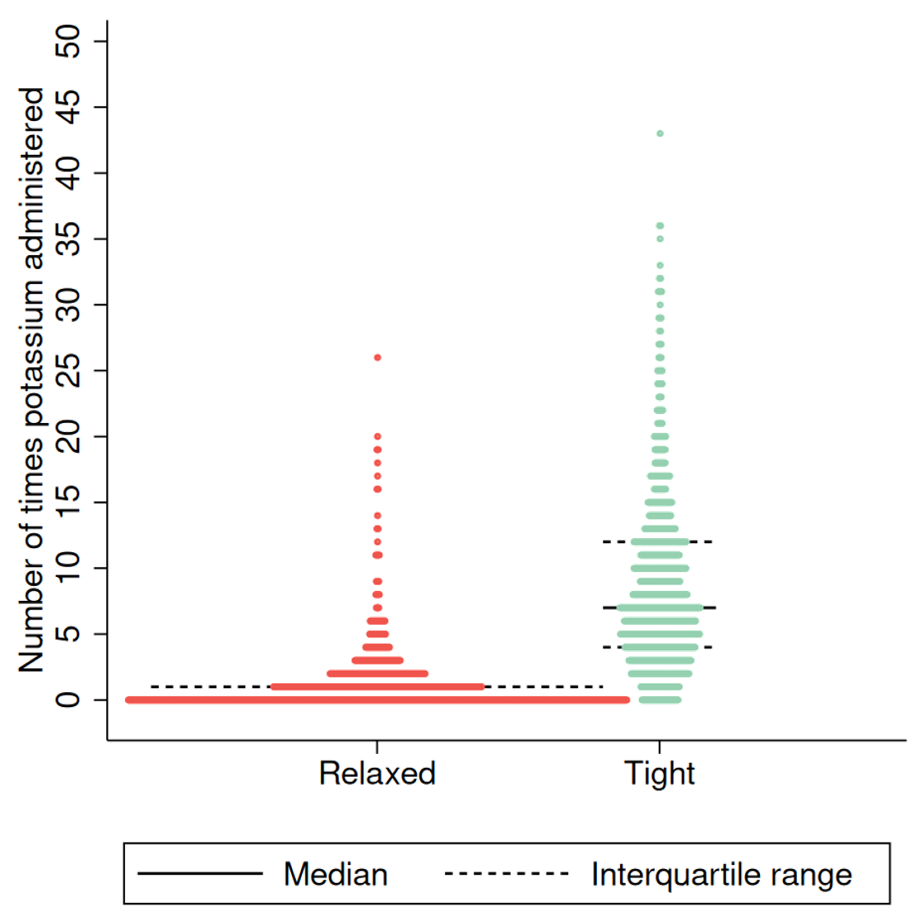
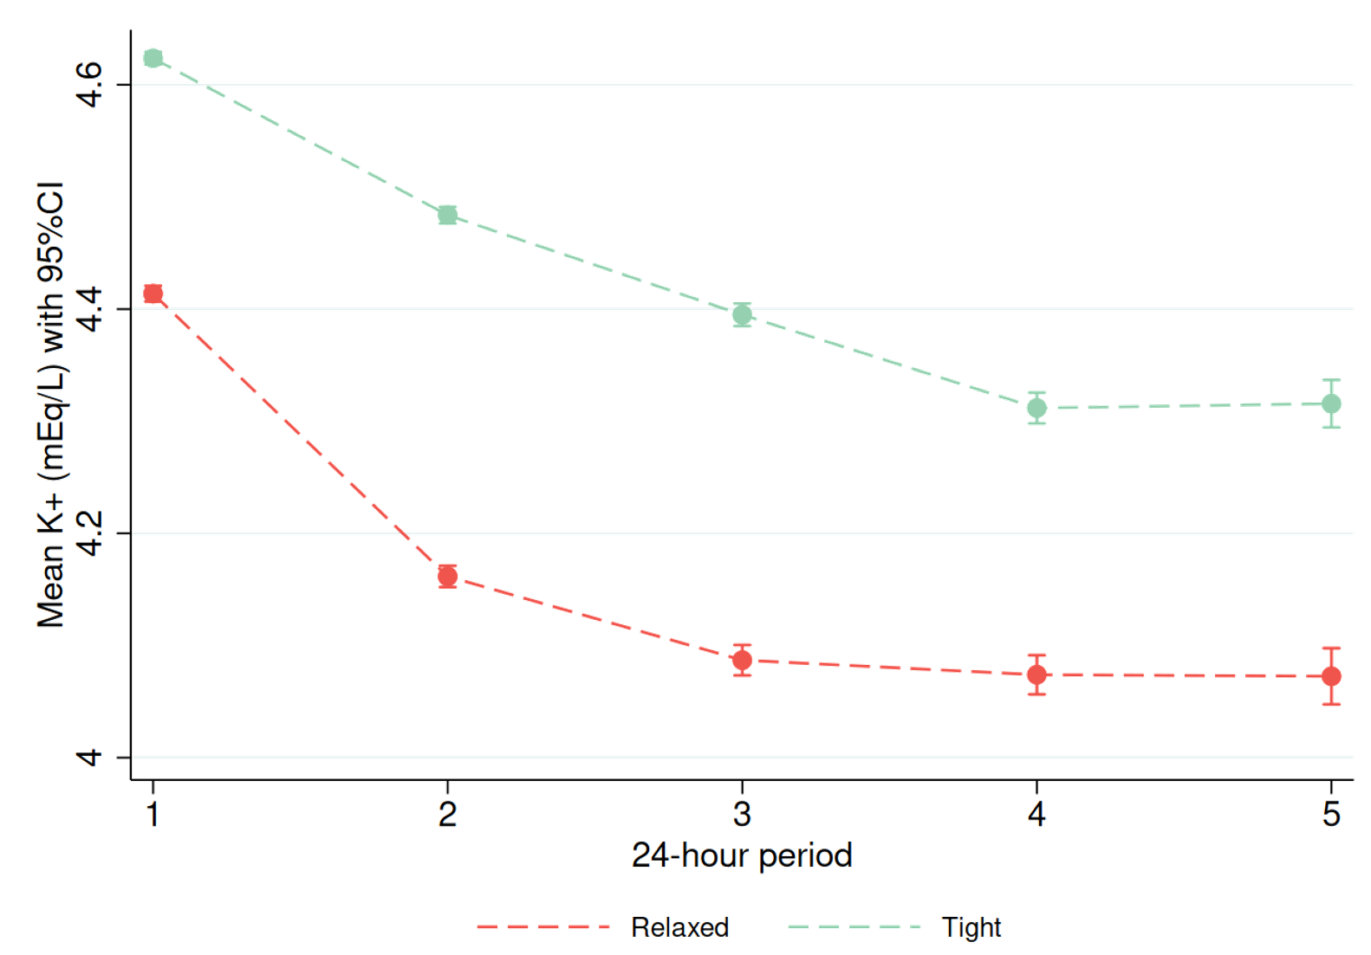
Potassium administration and serum levels
Frequency of potassium administration by arm Mean serum potassium levels by arm
Median: 0 Median: 7

Slide 7
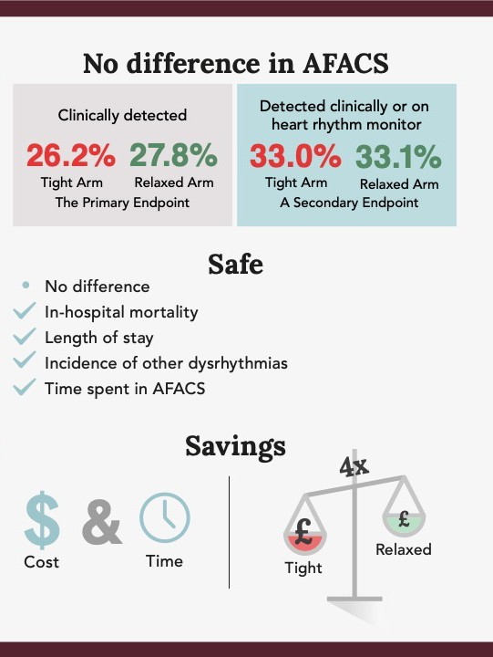
Results

Slide 8
Key messages
Impact on clinical practice
Until now, the literature did not provide any evidence-based guidance on the matter of routine potassium supplementation as a means of preventing AFACS
Widespread and engrained practice should now change
Impact for the person on the street
The widespread practice of giving patients potassium after bypass heart surgery, even though their blood levels are within the normal range, can be abandoned
This will decrease patient risk from an unnecessary intervention and reduce healthcare costs
Final take away message
There is a long history in medicine where interventions undertaken with the best of intentions turned out not to be helpful, or even harmful to the patient
The Tight K trial tested an intervention that was firmly engrained and widespread and found that we should discontinue it

