Slide 1


INFINITY-SWEDEHEART
Percutaneous coronary intervention with a Bioadaptor compared to a contemporary Drug-eluting Stent (DES) in a large broad clinical population
David Erlinge, M.D., Ph.D. on behalf of Stefan James, M.D., Ph.D. and the INFINITY-SWEDEHEART investigators
Lund University, Lund, Sweden
Disclosures: David Erlinge has received honorarium for advisory board/speaker fees from Amgen, AstraZeneca, Chiesi, Sanofi, NovoNordisk, InfraredX/Nipro and Kaminari Medical
Study sponsored by Elixir Medical

Slide 2
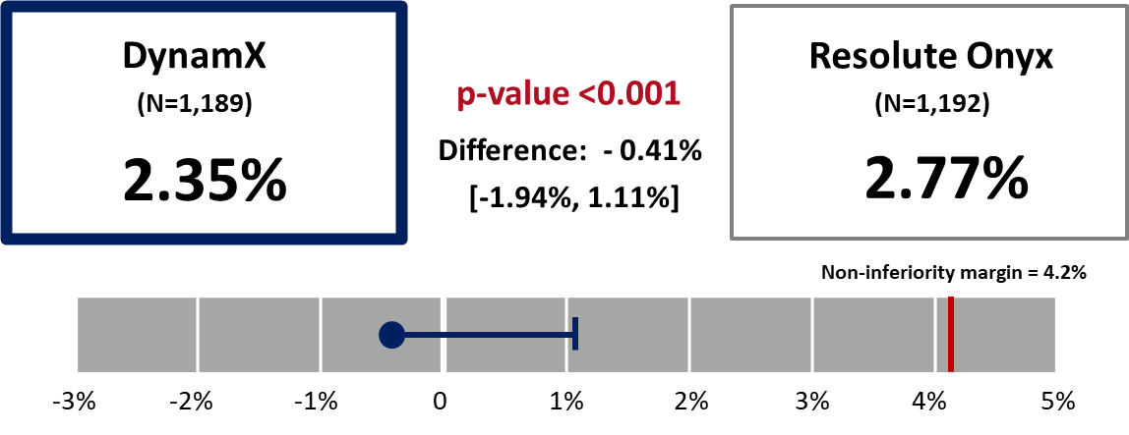
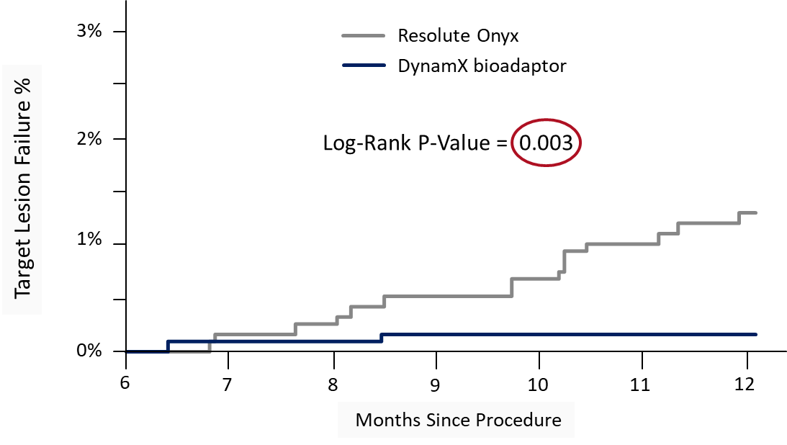
Primary Endpoint Met – Target Lesion Failure (TLF) Non-Inferiority at 12 Months
Secondary endpoint in a landmark analysis from 6 – 12 months demonstrate statistically significant reduction in TLF, confirming the bioadaptor technology unique mechanism of action is superior to DES
Primary Endpoint Met
TLF Non-Inferiority at 12 Months
Pre-specified Secondary Endpoint: TLF after 6 months
Significant Reduction and Plateau in TLF Events

Slide 3

Percutaneous Coronary Intervention (PCI) Background
Persistent Adverse Events Post 1-Year¹
Stent related adverse events continue to accrue after the first year post-PCI at a non-plateauing rate of 2-3% a year, with no difference between 2nd generation DES, 1st generation DES and BMS¹.
20
BMS
Bare-Metal Stent
First-Generational Drug-Eluting Stent Second-Generation Drug-Eluting Stent
17.8%
Target Lesion Failure (%)
15
p < 0.0001
p < 0.0001
10
1st Gen DES
9.5%
7.7%
7.7%
8.1%
“Adverse events, which occur after the first year at a rate of approximately 2% to 3% per year, may be attributed to strut fractures, loss of vessel compliance, vasomotion, the capability for vascular adaptive remodeling… and the development of late neoatherosclerosis.”²
5
5.0%
2nd Gen DES
0
0
3
6
12 24 36
Time After Procedure (Months)
48
60
Number at risk:
BMS 1,830 | 1,725 | 1,636 1,462 1,395 1,335 1,267 | 479
DES1 4,591 | 4,384 | 4,296 4,108 3,916 3,465 2,850 | 1,470
DES2 13,157 | 12,792 | 12,653 12,287 11,819 10,928 5,679 | 3,446
Bare-Metal Stent (BMS)
First-Generational Drug-Eluting Stent (DES1) Second-Generation Drug-Eluting Stent (DES2)
Madhavan MV et al. J Am Coll Cardiol 2020;75:590-604
Gregg W. Stone, et al. JAMA Cardiology. 2019

Slide 4



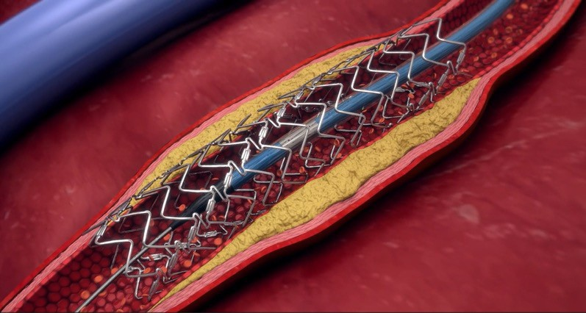
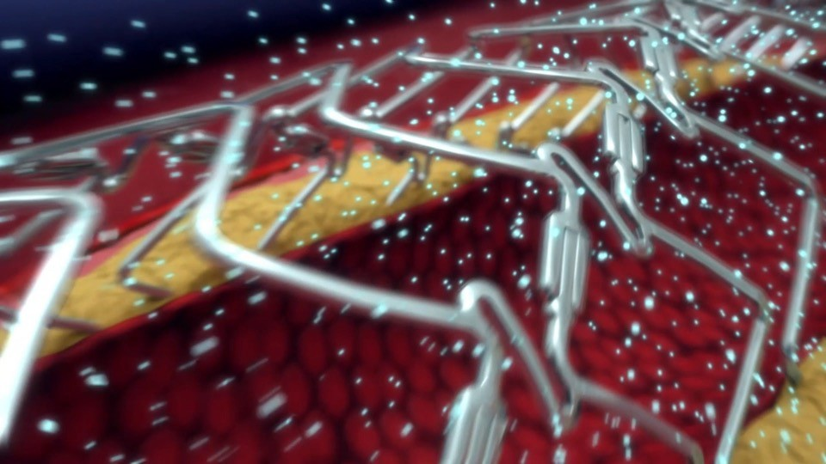

Study Technology: Bioadaptor Mechanism of Action
Bioadaptor (DynamX®, Elixir Medical, CA) is a novel technology designed to
restore hemodynamic modulation of the vessel.
0 – 6 months after 6 months
1. Locked:
Establish Flow Lumen
2. Unlocked:
Maintain Flow Lumen
3. Dynamic Support:
Restore Hemodynamic Modulation
Restore flow and achieve high acute gain and low residual %DS^{1,2}
Restore adaptive remodeling and maintain low %DS^{1,2}
Restore pulsatility, compliance, adaptive coronary flow¹⁻⁴
Saito S et al. 12-Months Outcomes BIODAPTOR-RCT. The Lancet eClinicalMedicine. 2023;65:102304.
Verheye S et al. Twelve-month clinical and imaging outcomes of the uncaging coronary DynamX bioadaptor system, EuroIntervention 2020, 16(12);E974
Kwak BR et al. Biomechanical factors in atherosclerosis: mechanisms and clinical implications. European heart journal. 2014 Nov 14;35(43):3013-20.

Slide 5
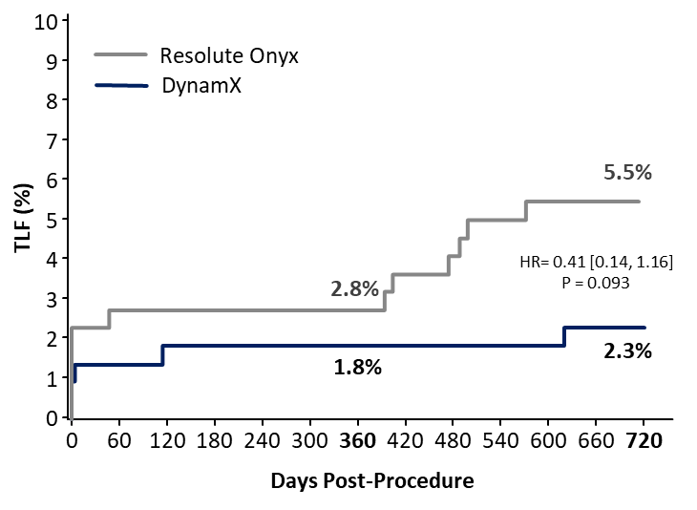
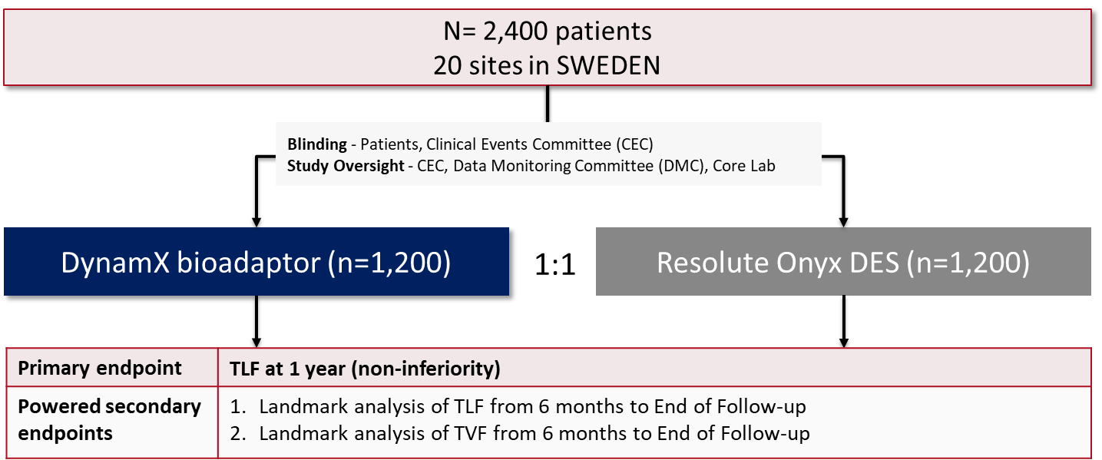
INFINITY-SWEDEHEART RCT Objectives
BIOADAPTOR RCT 2-Year
Prior BIOADAPTOR RCT (DynamX versus Resolute Onyx, N=445) demonstrated safety and efficacy of DynamX bioadaptor, and confirmed the mechanism of action, with observed reduction and plateauing in TLF, TVF through 2 years.¹⁻²
INFINITY-SWEDEHEART was designed to:
  Evaluate the safety and efficacy of the DynamX bioadaptor compared to the Resolute Onyx in a large multi-center RCT in a broad patient population representative of every day clinical practice, including patients with Acute Coronary Syndrome (ACS)
  Evaluate the effect of the mechanism of action of restoring hemodynamic modulation in a pre-specified landmark analysis at 6 months and thereafter, powered for superiority
Saito S et al. 12-Months Outcomes BIODAPTOR-RCT. The Lancet eClinicalMedicine. 2023;65:102304.
Saito S. BIOADAPTOR-RCT 24-month Clinical Outcomes. EuroPCR 2024

Slide 6
Primary Non-Inferiority Endpoint Met – TLF, and ST at 12 Mos
DynamX bioadaptor (n=1,189) Resolute Onyx (n=1,192)
6
P<0.001
for non-inferiority
6
4
4
TLF (%)
2,77
2,35
(%)
2,11
2
1,52
2
1,27
1,27
0,59
0,50
0,68
0,51
0
0
Target Lesion Failure
Cardiovascular Death
Target-vessel MI
Ischemia-driven TLR
Def/Prob Stent Thrombosis

Slide 7
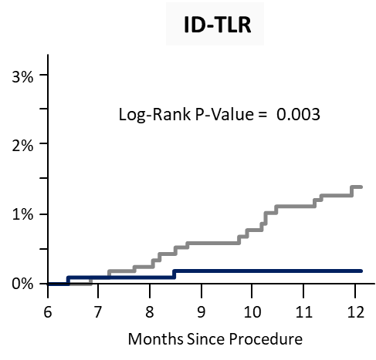
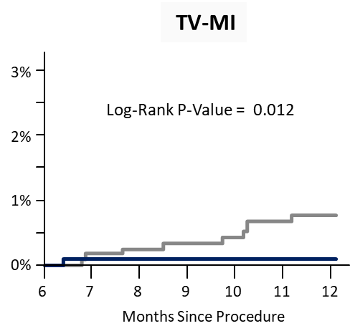
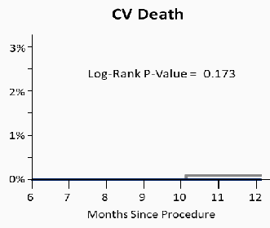
Significant Reduction and Plateau in TLF Events After 6 Mos
Prespecified Powered Secondary Endpoint Landmark Analysis
3%
Resolute Onyx DynamX bioadaptor
Target Lesion Failure %
2%
Log-Rank P-Value = 0.003
1%
0%
6
7
8 9 10
Months Since Procedure
11
12

Slide 8
Key Messages
Primary endpoint of TLF non-inferiority at 12 months was met
INFINITY-SWEDEHEART is the largest RCT to confirm consistency of low and plateauing adverse event rates with Bioadaptor versus DES after the unlocking of the Bioadaptor at 6 months:
  Significant reduction in TLF (p=0.003) and TVF (p=0.008) after 6 months in prespecified landmark analyses, driven by reduction in all components
These results confirm the novel impact of the Bioadaptor in CAD treatment through its unique mechanism of action of restoring the hemodynamic modulation and function of a diseased artery
Adoption of Bioadaptor in clinical practice has the potential to significantly reduce adverse events and repeat procedures in millions of PCI patients being treated today

