Slide 1




RESHAPE-HF2 Trial
Randomized Investigation of the MitraClip Device in Heart Failure: 2nd Trial in Patients with Clinically Significant Functional Mitral Regurgitation
Stefan D. Anker, MD PhD on behalf of the RESHAPE-HF2 Steering Committee, Trial Committees, Investigators & Coordinators
Dept. of Cardiology / DHZC (CVK), Charité Berlin, Germany
s.anker@cachexia.de
ESC Press Conference – London, 30th August, 2024

Slide 2
RESHAPE-HF2 – testing MitraClip in the 3rd population
NYHA class II–IV
- LVEF 20–50%
Functional MR 3+/4+
Hospit. for HF within 12mo OR raised NP
Device group (MitraClip, within 14 days)
plus guideline-directed medical therapy
30 days M6 M12 M24
FPFV: March 2015
LPFV: October 2023
LPLV: April 2024
Screening
N=505
1:1
Follow-up:
at least 6 months follow-up for last patient
All-cause mortality: up to 8 years follow-up average (3.5 years)
R
Control group
guideline-directed medical therapy
Statistics:
Primary EPs: (i) Recurrent events of CV death & HHF
Alpha = 0.05 Significance level controlled using Hochberg procedure
Recurrent events of HHF
KCCQ (change BL to 12mo)
Secondary EPs: - 6MWT-distance (change BL–12mo)
(Hochberg)
ACM (all available FU)
NYHA class I/II (24mo)
Recurrent hospitalization (any)
Grade 2+ or less MR (12mo)
Anker SD et al. Reshape-HF2 Design.
EJHF 2024

Slide 3

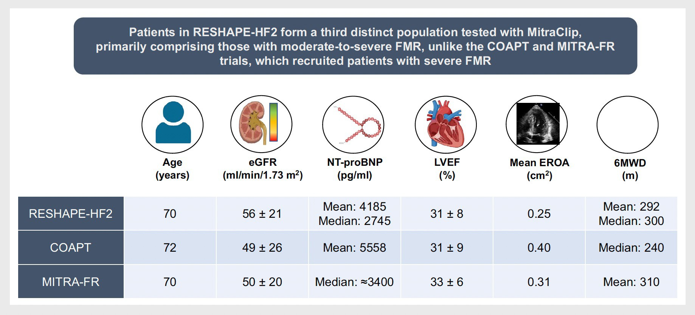

RESHAPE-HF2 – testing MitraClip in the 3rd population
0.23
Anker SD et al. Reshape-HF2 baseline clinical data. EJHF 2024 von Bardeleben RS et al. Reshape-HF2 baseline echo data. Global Cardiology 2024

Slide 4


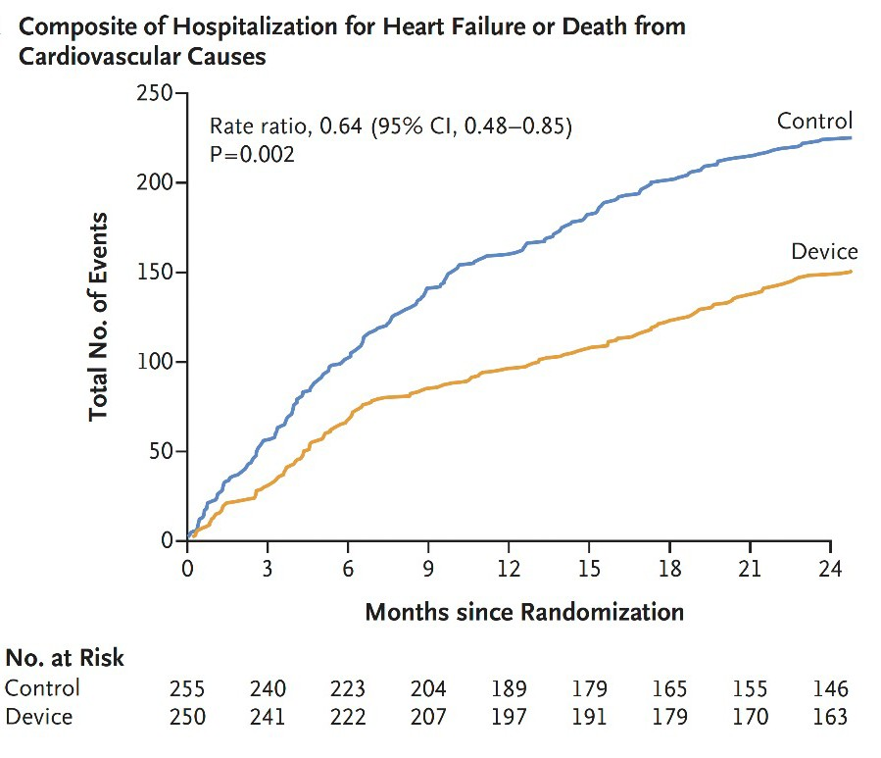
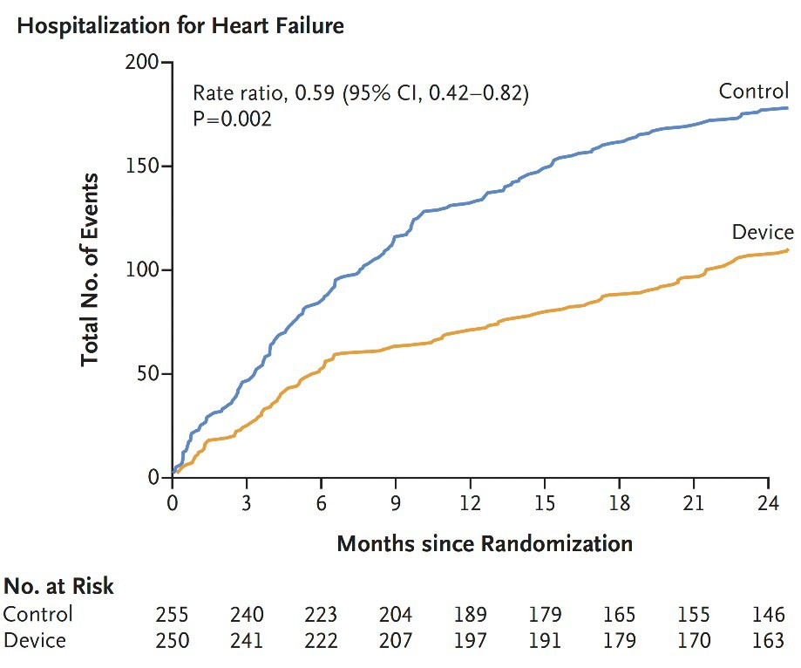
Primary Endpoint 1: Recurrent HHF or CV death within 24 months Primary Endpoint 2: Recurrent HHF within 24 months
RRR 36%
RRR 41%

Slide 5

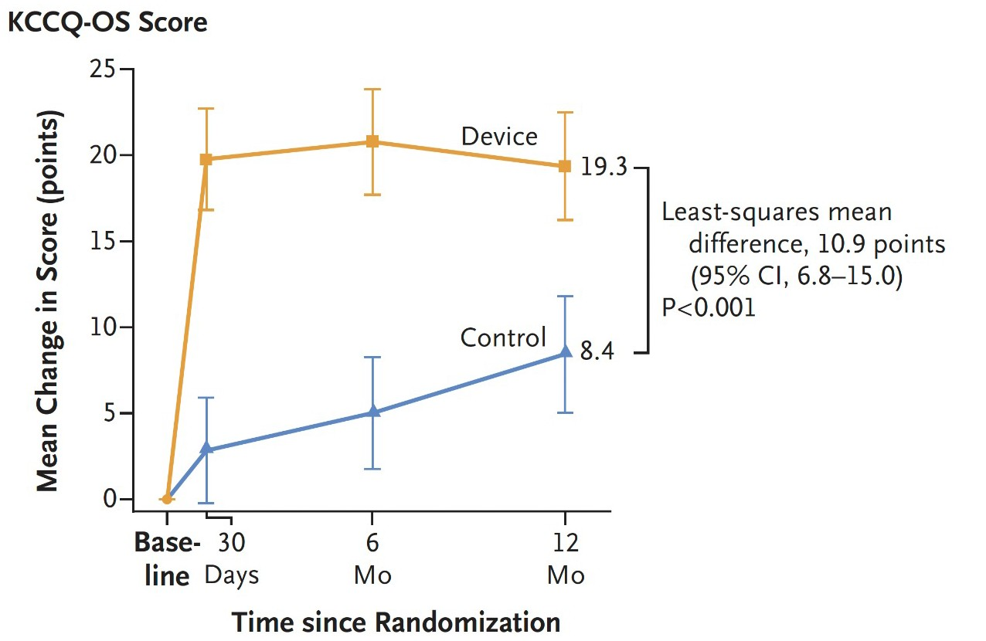
Primary Endpoint 3 – Change from baseline over a period of 12 months in the KCCQ–Overall Summary score for QoL

Slide 6

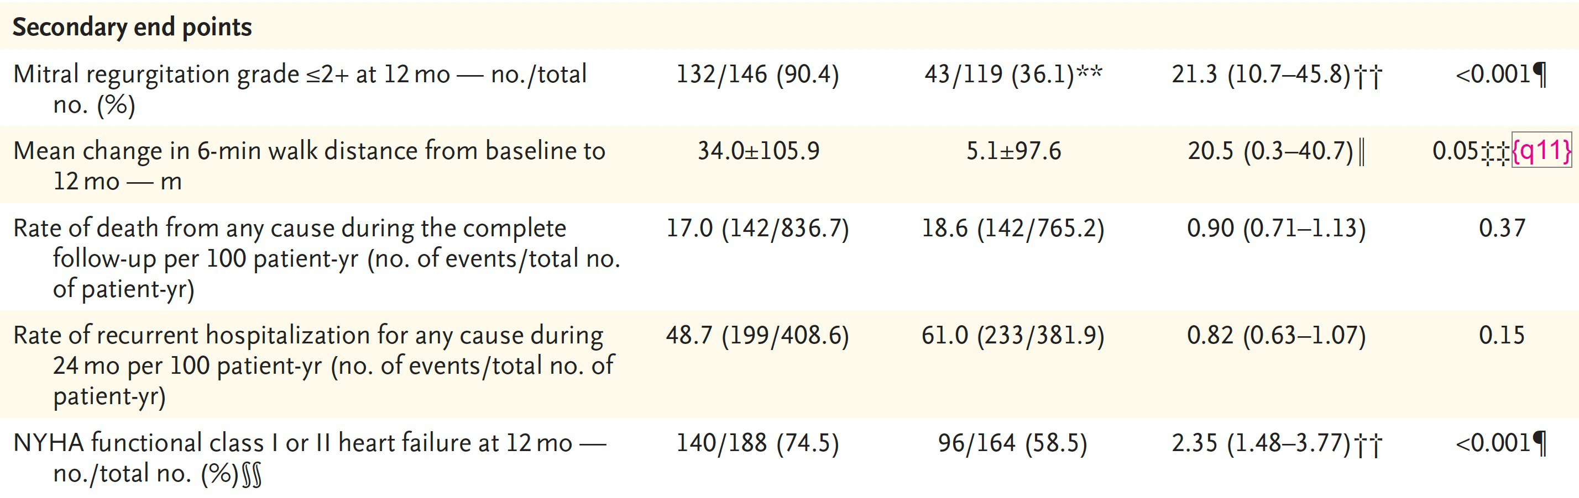


Secondary Endpoints
*
*Follow-up times for 24 months assessments:
Overall: median 24.0 months (IQR 12.0–25.0); Device group: 24.2 (IQR 15.7–25.0); Control group: 23.6 (IQR 10.4–24.9).
Follow-up times for all-cause mortality assessment:
Overall: median 29.4 months (IQR 14.0–61.1); Device group: 34.3 (IQR 16.0–63.1); Control group: 27.0 (IQR 11.6–58.0)

Slide 7






Success on all 3 primary endpoints & more
Primary Endpoints
36% in risk
P = 0.002
41% in risk
P = 0.002
11 point in QoL P < 0.0001
Rate of heart failure hospitalizations
or CV death (at 24 months
Rate of recurrent heart failure hospitalizations (at 24 months)
KCCQ overall summary score (at 12 months)
Secondary Endpoints
NYHA class I/II (at 12 months)
6min-walking test distance (at 12 months)
2.35 more likely P < 0.0001
20.5 m performance P = 0.046

Slide 8
Conclusions
Among patients with heart failure with moderate to severe functional mitral regurgitation who received medical therapy, the addition of transcatheter mitral-valve repair led to a lower rate of first and recurrent hospitalization for heart failure or cardiovascular death and a lower rate of first or recurrent hospitalization for heart failure at 24 months and better health status at 12 months than medical therapy alone.
A broader application of M-TEER for heart failure with functional mitral regurgitation of less than severe disease grade may be appropriate and deserves further study.

