Slide 1

RHEIA
Randomized researcH in womEn all comers wIth Aortic stenosis
Transcatheter versus surgical aortic valve replacement in women
Hélène Eltchaninoff & Didier Tchétché, co-investigators, on behalf of the RHEIA investigators
August 31, 2024

Slide 2
RHEIA Trial Design
Investigator initiated, multicenter, international RCT to evaluate safety and efficacy of TAVI vs. Surgery in women with symptomatic severe AS
Women with symptomatic severe AS
1:1 Randomization 440 patients
TAVI
Sapien 3 / Sapien 3U
Surgery
Any commercially available surgical valve
Exclusion criteria:
Bicuspid aortic valve
Non-calcified aortic valve
Complex coronary artery disease
Other anatomical features increasing the risk of complications with TAVI or surgery
PRIMARY ENDPOINT
Composite endpoint at 1 year post procedure:
all cause MORTALITY, all STROKE and REHOSPITALIZATION
STUDY VISITS
Screening, procedure, post-procedure, discharge, 30 days, and 1 year

Slide 3
Patient Enrollment
Patients screened
Nov 2019 - Mar 2023 (N=490)
Eligible for Enrollment and Randomization (N=443)
Excluded from randomization N=47
TAVI (ITT)
N=221
Surgery (ITT)
N=222
Excluded before treatment N=6
Excluded before treatment N=17
30 Day FU
212/215 (98.6%)
Procedure initiated (AT)
N=215
Procedure initiated (AT)
N=205
30 Day FU
200/205 (97.6%)
1 year FU
210/215 (97.7%)
1 year FU
198/205 (96.8%)
ITT: Intention To Treat
AT: As Treated

Slide 4
Baseline Patient Characteristics
 | TAVI (N=215) | Surgery (N=205)
Age — years | 73.1 ± 4.5 | 73.3 ± 5.2
Society of Thoracic Surgeons risk score — % | 2.1 ± 1.1 | 2.2 ± 1.3
EuroSCORE II risk score — % | 1.7 ± 0.8 | 1.7 ± 1.1
New York Heart Association class III or IV — % | 34.0% | 39.0%
Coronary artery disease — % | 19.1% | 19.0%
Carotid artery stenosis >50% — % | 1.9% | 3.9%
 | TAVI (N=215) | Surgery (N=205)
Aortic-valve area — cm² | 0.8 ± 0.2 | 0.8 ± 0.2
Aortic-valve gradient (mean) — mm Hg | 47.8 ± 13.7 | 47.5 ± 13.8
Left ventricular ejection fraction — % | 66.9 ± 9.7 | 68.5 ± 8.0
Systolic annular area on CT — mm² | 403.7 ± 63.1 | 392.8 ± 55.3
Small annulus: annular area < 430 mm² — % | 70.4 % | 75.5%
Notes:
Patient baseline characteristics were balanced in the two AT groups, except for:
- lower rate of peripheral artery disease (2.3% vs. 5.4%)
- carotid artery stenosis (1.9% vs. 3.9%)
in TAVI patients

Slide 5

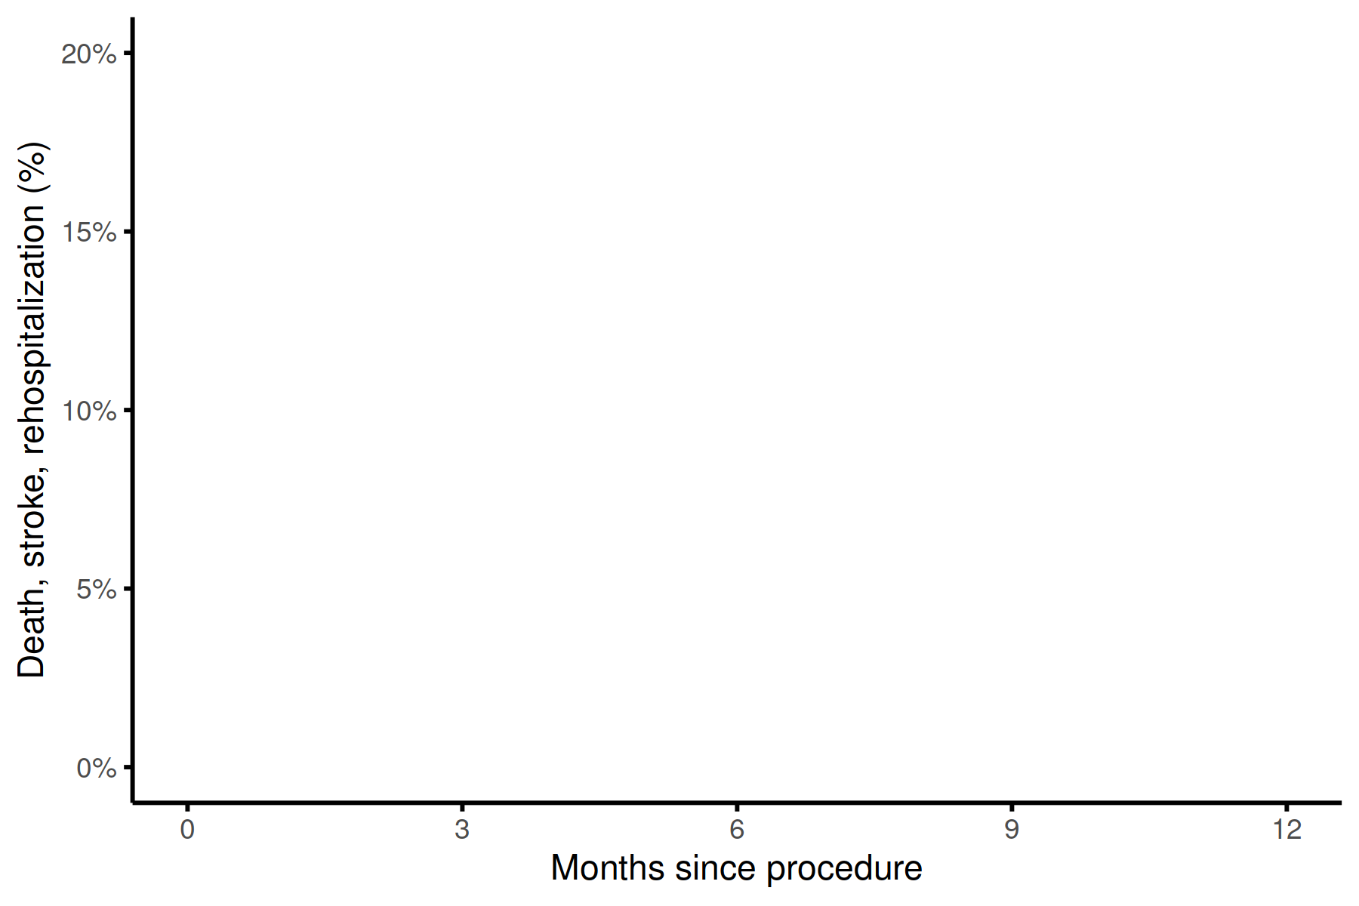
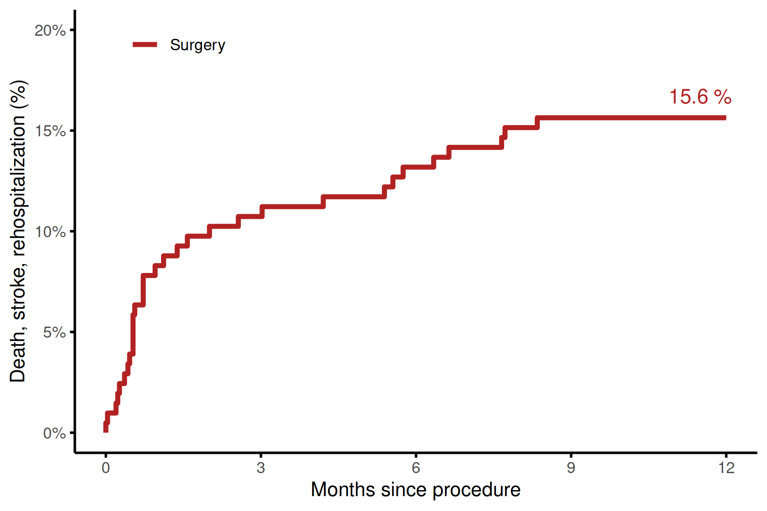
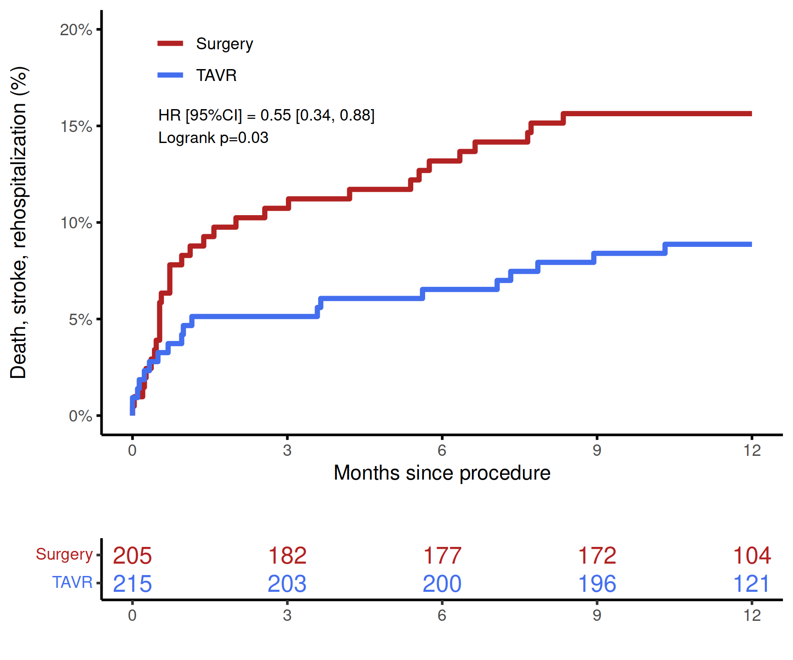
Primary Endpoint Kaplan–Meier Estimates
Surgery
TAVI
✓
15.6 %
NON-INFERIORITY
✓
SUPERIORITY
8.9 %
No. at risk
Surgery
TAVI
Notes:
One-year Kaplan-Meier event rates are 8.9% and 15.6%, respectively.
The event rates for primary EP at 1 year mirror very closely those of PARTNER 3-

Slide 6
Primary Endpoint Components at 1 year
 | TAVI (N=215) | Surgery (N=205) | TAVI- Surgery | P-Value
Death | 2 (0.9%) | 4 (2.0%) | -1.0% [-3.3%, 1.3%] | 0.44
Stroke | 7 (3.3%) | 6 (3.0%) | 0.3% [-3.0%, 3.7%] | 1.00
Rehospitalization valve-related or procedure-related or worsening congestive heart failure | 10 (4.8%) | 23 (11.4%) | -6.6% [-11.9%, -1.4%] | 0.02
Key Secondary Endpoints at 1 year
 | TAVI (N=215) | Surgery (N=205) | TAVI - Surgery | P-Value
Major vascular complications | 7 (3.3%) | 1 (0.5%) | 2.8% [0.2%, 5.3%] | 0.07
New permanent pacemaker | 19 (8.8%) | 6 (2.9%) | 5.9% [1.5%, 10.4%] | 0.01
New onset atrial fibrillation | 7 (3.3%) | 59 (28.8%) | -25.5% [-32.2%, -18.9%] | <0.001
 | TAVI (N=215) | Surgery (N=205) | TAVI - Surgery | P-Value
Major vascular complications | 7 (3.3%) | 1 (0.5%) | 2.8% [0.2%, 5.3%] | 0.07
New permanent pacemaker | 19 (8.8%) | 6 (2.9%) | 5.9% [1.5%, 10.4%] | 0.01
New onset atrial fibrillation | 7 (3.3%) | 59 (28.8%) | -25.5% [-32.2%, -18.9%] | <0.001

Slide 7
Other Secondary Endpoints

Slide 8
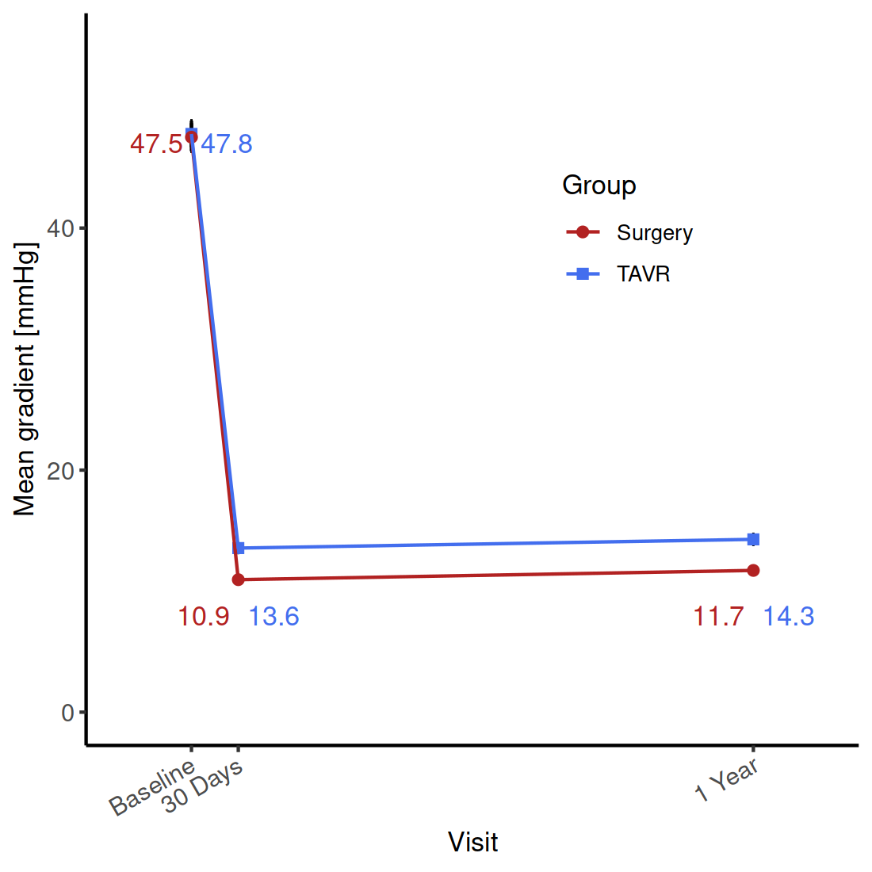
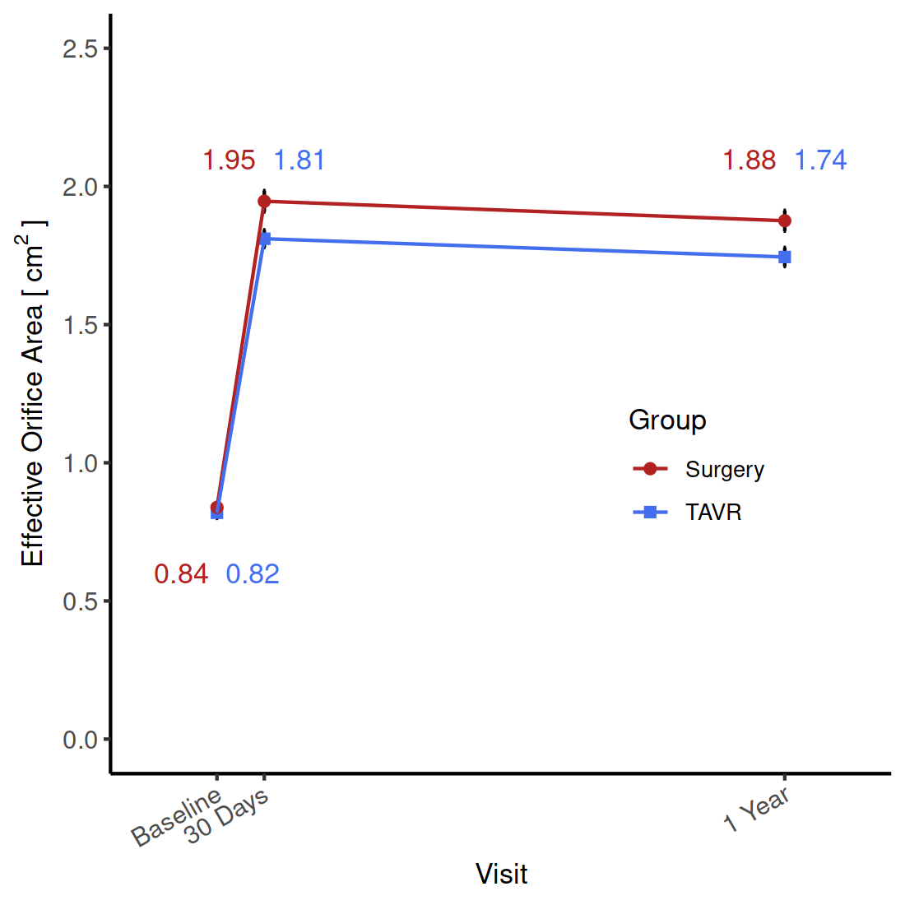
Echocardiography findings
Mean Gradient
Aortic Valve Area
Mean Gradient
Effective Orifice Area
Surgery
TAVI
p = 0.007
p = 0.01
Surgery
TAVI
p < 0.001
p < 0.001
No. of echos
Surgery 142 171 174
TAVI 157 185 192
No. of echos
Surgery 132 163 159
TAVI 153 172 176
P-values for TAVI vs Surgery
Notes:
P values are indicated in case of statistically significant differences, and they relate to the difference between TAVI and Surgery
Error bars: standard deviation of the mean

Slide 9
Conclusions
In women all comers with severe aortic stenosis, TAVI using SAPIEN 3 or SAPIEN 3 Ultra was superior to surgery for the primary composite end point of death, stroke, or rehospitalization at one year. This superiority was essentially driven by the lower rate or rehospitalizations
TAVI had a lower incidence of new onset AF at 30 days, a quicker recovery and shorter length of index hospital stay, but higher rates of mild paravalvular aortic regurgitation and new permanent pacemaker implantation
Excellent hemodynamics were achieved with both procedures in a population where around 75% of women had a small annulus
Besides the patient benefit, the less invasive TAVI treatment also provides benefits in terms of health care resources: less rehospitalization, shorter index hospital stay, and more patients discharged home

Slide 10
Back up slides

Slide 11
RHEIA
Randomized researcH in womEn all comers wIth Aortic stenosis
Transcatheter versus surgical aortic valve replacement in women
Hélène Eltchaninoff & Didier Tchétché, on behalf of the RHEIA investigators
August 31, 2024

Slide 12
Background
Recent data suggest that the risk of mortality after aortic valve replacement is higher following Surgery but lower following Transcatheter Aortic Valve Implantation (TAVI) in women vs. men
However, women are under-represented in low-risk TAVI vs. Surgery trials
A randomized clinical trial is needed to confirm the benefit of TAVI over Surgery in women

Slide 13
Purpose
Compare the outcomes of TAVI with a balloon-expandable valve vs. conventional surgery in women all comers with severe symptomatic aortic stenosis

Slide 14
RHEIA Trial Design
Investigator initiated, multicenter, international RCT to evaluate safety and efficacy of TAVI vs. Surgery in women with symptomatic severe AS
Women with symptomatic severe AS
1:1 Randomization 440 patients
TAVI
Sapien 3 / Sapien 3U
Surgery
Any commercially available surgical valve
PRIMARY ENDPOINT
Composite endpoint at 1 year post procedure:
all cause MORTALITY, all STROKE and REHOSPITALIZATION
STUDY VISITS
Screening, procedure, post-procedure, discharge, 30 days, and 1 year

Slide 15
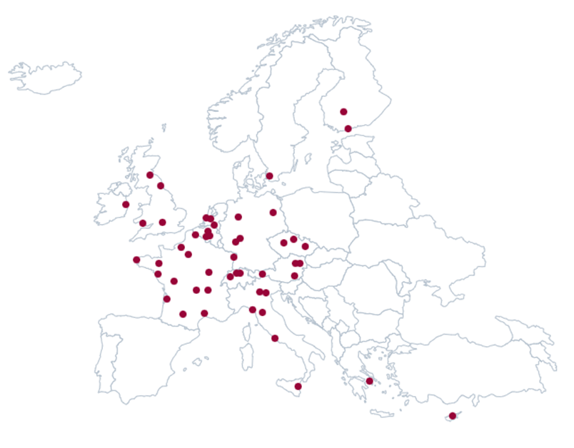
48 Clinical Sites - 443 Patients - 12 Countries
Top 10 enrolling sites
Clinique Pasteur, Toulouse, France (Tchétché Didier, Berthoumieu Pierre, 31 pts.)
St Antonius Ziekenhuis Nieuwegein, Nieuwegein, The Netherlands (Swaans Martin, Timmers Leo, 29 pts.)
Universitätsklinik der Ruhr-Universität Bochum Herz- und Diabeteszentrum Nordrhein-Westfalen, Bad Oeynhausen, Germany (Rudolph Tanja, Bleiziffer Sabine, 27 pts.)
Hôpital Cardiologique du Haut-Lévêque, Bordeaux, France (Leroux Lionel, Modine Thomas, 25 pts.)
Leids University Medical Center, Leiden, The Netherlands (Bax Jeroen, Frank van der Kley, 22 pts.)
CHU Rouen - Hopital Charles Nicolle, Rouen, France (Eltchaninoff Hélène, 18 pts.)
CHU Rennes - Hopital de Pontchaillou, Rennes, France (Auffret Vincent, Tomasi Jacques, 18 pts.)
Universitätskliniken Innsbruck, Innsbruck, Austria (Bonaros Nikolaos, Stastny Lukas, 17 pts.)
Allgemeines Krankenhaus der Stadt Wien, Vienna, Austria (Hengstenberg Christian, Andreas Martin, 17 pts.)
CHU Montpellier - Hopital Arnaud de Villeneuve, Montpellier, France (Leclercq Florence, Gandet Thomas, 16 pts.)

Slide 16

Trial Leadership
Principal investigators
Hélène Eltchaninoff, Didier Tchétché
Steering committee
Nicolas Dumonteil, Fabian Nietlispach, Nikolaos Bonaros, Bernard Prendergast, Mariuca Vasa-Nicotera, Stephan Windecker, Philippe Pibarot, Jeroen Bax, Alaide Chieffo
Data Safety Monitoring Board
Marco Barbanti, Torsten Doenst
Katja Bohmann
Clinical Endpoint Committee
Richard Steeds, Anna Franzone
Francesco Saia
Core Labs
CT: David Messika-Zeitoun
Echo: Philippe Pibarot
Case Review Board
Didier Tchétché, Philippe Pibarot
Nicolas Dumonteil, other SC members
Sponsor Independent CRO
Funder Edwards Lifesciences

Slide 17
Key Inclusion and Exclusion Criteria
Inclusion:
Women with severe symptomatic AS meeting the following criteria:
High gradient severe AS
  or
Low gradient severe AS
per ESC guidelines
Exclusion:
Bicuspid aortic valve
Unicuspid aortic valve
Non-calcified aortic valve
Complex coronary artery disease
Other anatomical features increasing the risk of complications with TAVI or surgery
Notes:
Mention paper on Study Design

Slide 18
Study methodology
Eligibility for study participation of each patient was assessed by multi-disciplinary Heart Team and Case Review Board
Primary endpoint events were adjudicated by the CEC (VARC-2 definitions when applicable) that was blinded to treatment assignment
30 day and 1 year clinical and echocardiography follow-up were collected and analyzed by core labs

Slide 19
Primary Endpoint
Composite of all-cause mortality, stroke, and rehospitalization for valve or procedure-related symptoms or worsening heart failure within one year of randomization

Slide 20
Sample size calculation
Assumed event rates for the primary endpoint: 16% for Surgery vs. 8% for TAVI
Sample size of 132 patients provides 80% power to demonstrate non-inferiority with a margin of 6.0% and a one-sided alpha of 0.05
Sample size of 402 patients provides 70% power to demonstrate superiority with a two-sided alpha 0.05 (increased to 440 patients for loss to follow-up, withdrawals and other contingencies)

Slide 21
Statistical analysis
Non-inferiority Testing for Primary Endpoint
  Upper bound of the 95% CI for the risk difference (TAVR-surgery) less than the pre-specified non-inferiority margin of 6%
Superiority Testing for Primary Endpoint
  If non-inferiority hypothesis met, superiority testing performed using a 2-sided alpha 0.05

Slide 22
Patient Enrollment
Patients screened between November 2019 and March 2023 (N=490)
Excluded from randomization N=47
Eligible for Enrollment and Randomization (N=443)
TAVI
N=221
Surgery
N=222

Slide 23
Patient Allocation
TAVI (ITT)
N=221
Surgery (ITT)
N=222
Excluded before treatment N=6
Exclusion criterion detected after randomization N=2
Consent withdrawn N=1
Patient refused intervention and switched to Surgery N=1
Non-study valve implanted N=2
Excluded before treatment N=17
Exclusion criterion detected after randomization N=1
Consent withdrawn N=3
Patient refused intervention and switched to TAVI N=4
Physician decided for TAVI N=8
Other N=1
Procedure initiated (AT)
N=215
Procedure initiated (AT)
N=205
ITT: Intention To Treat
AT: As Treated
Notes:
Among patients who did not undergo the assigned procedure (6 TAVI and 17 surgery), the most common reasons were the investigator’s decision to perform TAVI despite allocation to surgery (n=8), patient refusing allocation to surgery (n=4), and withdrawal of informed consent (n=4).

Slide 24
Patient Follow up
TAVI initiated (AT)
N=215
Surgery initiated (AT)
N=205
3 conversions to Surgery
Valve Implant population
N=212
2 conversions to TAVI
Valve Implant population
N=203
30 Day FU
212/215 (98.6%)
30 Day FU
200/205 (97.6%)
1 year FU
210/215 (97.7%)
1 year FU
198/205 (96.8%)

Slide 25
Baseline Patient Characteristics
 | TAVI (N=215) | Surgery (N=205)
Age — years | 73.1 ± 4.5 | 73.3 ± 5.2
Race/ethnicity (non-white) — % | 0% | 0%
Body Mass Index | 29.2 ± 5.8 | 29.8 ± 5.8
Society of Thoracic Surgeons risk score — % | 2.1 ± 1.1 | 2.2 ± 1.3
EuroSCORE II risk score — % | 1.7 ± 0.8 | 1.7 ± 1.1
New York Heart Association class III or IV — % | 34.0% | 39.0%
Coronary artery disease — % | 19.1% | 19.0%
Previous stroke — % | 3.7% | 3.4%
Carotid artery stenosis >50% — % | 1.9% | 3.9%
Peripheral arterial disease — % | 2.3% | 5.4%
Creatinine >2 mg/dl (177 μmol/L) — % | 0% | 0%
Diabetes — % | 26.0% | 27.3%
Notes:
Patient baseline characteristics were balanced in the two AT groups, except for:
- lower rate of peripheral artery disease (2.3% vs. 5.4%)
- carotid artery stenosis (1.9% vs. 3.9%)
in TAVI patients

Slide 26
Baseline Patient Characteristics
 | TAVI (N=215) | Surgery (N=205)
Atrial fibrillation — % | 5.1% | 3.0%
Permanent pacemaker — % | 2.3% | 4.0%
Left bundle-branch block — % | 7.5% | 5.5%
Right bundle-branch block — % | 5.2% | 7.5%
Overall frailty — % | 1.4% | 0%
Pulmonary hypertension — % | 2.8% | 3.9%
Aortic-valve area — cm² | 0.8 ± 0.2 | 0.8 ± 0.2
Aortic-valve gradient (mean) — mm Hg | 47.8 ± 13.7 | 47.5 ± 13.8
Left ventricular ejection fraction — % | 66.9 ± 9.7 | 68.5 ± 8.0
Moderate or severe valve regurgitation — %
Aortic | 4.7% | 3.4%
Mitral | 1.4% | 0%
Systolic annular area on CT — mm² | 403.7 ± 63.1 | 392.8 ± 55.3
Small annulus: annular area < 430 mm² — % | 70.4 % | 75.5%
Notes:
Groups balanced, randomization “succeeded”

Slide 27
Procedural Findings
TAVI
Surgery
 | %
Valve type: SAPIEN 3 / SAPIEN 3 ULTRA | 43% / 57%
 | %
Valve type: Edwards Magna Ease / Intuity Livanova Perceval | 59.7% / 12.2% 15.5%
Surgery approach: Full / Mini sternotomy | 66.3% / 27.3%
Concomitant procedures | %
Percutaneous Coronary Intervention Pacemaker implantation Other | 0% 0.5% 0%
Concomitant procedures | %
CABG Aortic annulus enlargement Surgery for AF Ascending Aorta replacement Mitral valve intervention Tricuspid valve intervention Other | 6.8% 0% 2.9% 1.5% 0.5% 1.0% 0.5%
Notes:
Surgical valves: An Edwards Magna Ease valve was used in 59.7%, followed by Livanova Perceval S (15.5%) and Edwards Intuity (12.2%)

Slide 28
Valve size distribution
No 29 mm

Slide 29
Procedural Complications and Outcomes
Complication / Outcome | TAVI (N=215) | Surgery (N=205) | P-Value
In-hospital death – % | 0.5% | 0.5% | 1.00
Valve embolization - % | 0% | NA | NA
Annulus rupture | 0% | NA | NA
Aortic dissection | 0.5% | 0% | 1.00
Coronary obstruction | 0.5% | 0% | 1.00
Notes:
In hospital death reasons
TAVI:
Surgery

Slide 30
Primary Endpoint Kaplan–Meier Estimates
Surgery
TAVI
15.6 %
8.9 %
No. at risk
Surgery
TAVI
Notes:
One-year Kaplan-Meier event rates are 8.9% and 15.6%, respectively.
The event rates for primary EP at 1 year mirror very closely those of PARTNER 3-

Slide 31
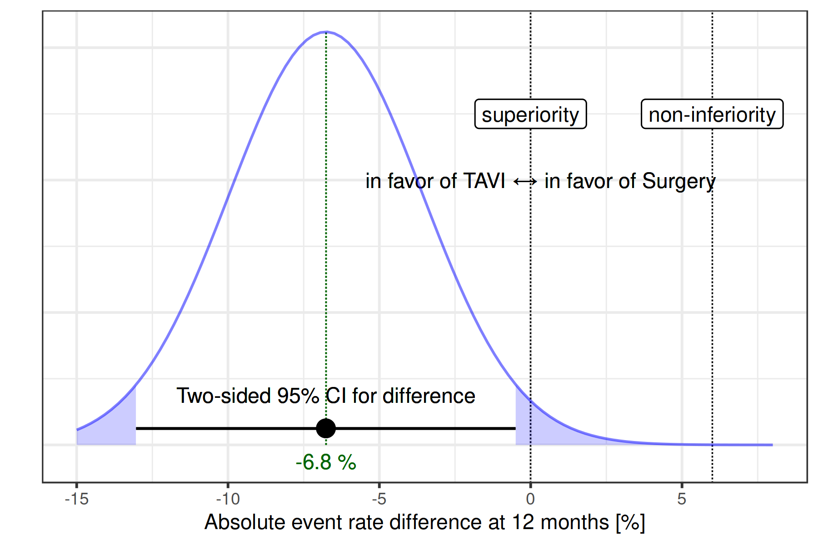
Primary Endpoint at 1 year
✓
NON-INFERIORITY
P-value < 0.001
meets non-inferiority
✓
P-value = 0.034
meets superiority
SUPERIORITY
Notes:
Originally the trial was powered for a 1-sided test for superiority with 80% power.
Best practice though is a 2-sided test to test for superiority, but that reduced the power to 70% (assuming the same number of patients)
Despite this, superiority of TAVI was demonstrated!

Slide 32
Primary Endpoint Components at 1 year
 | TAVI (N=215) | Surgery (N=205) | TAVI- Surgery | P-Value
Death | 2 (0.9%) | 4 (2.0%) | -1.0% [-3.3%, 1.3%] | 0.44
Cardiac death | 1 (0.5%) | 1 (0.5%) | 0.0% [-1.3%, 1.3%] | 1.00
Non-cardiac death | 1 (0.5%) | 3 (1.5 %) | -1.0% [-2.9%, 0.9%] | 0.36
Stroke | 7 (3.3%) | 6 (3.0%) | 0.3% [-3.0%, 3.7%] | 1.00
Disabling stroke | 2 (0.9%) | 3 (1.5%) | -0.6% [-2.7%, 1.6%] | 0.68
Non-disabling stroke | 5 (2.4%) | 3 (1.5%) | 0.9% [-1.7%, 3.5%] | 0.72
Rehospitalization valve-related or procedure-related or worsening congestive heart failure | 10 (4.8%) | 23 (11.4%) | -6.6% [-11.9%, -1.4%] | 0.02

Slide 33
Key Secondary Endpoints at 1 year
 | TAVI (N=215) | Surgery (N=205) | TAVI - Surgery | P-Value
Major vascular complications | 7 (3.3%) | 1 (0.5%) | 2.8% [0.2%, 5.3%] | 0.07
Life-threatening / disabling bleeding | 9 (4.2%) | 9 (4.4%) | -0.2% [-4.1, 3.7] | 1.00
Life-threatening / disabling, or major bleeding | 13 (6.0%) | 22 (10.7%) | -4.7% [-10.0, 0.6] | 0.11
Myocardial infarction | 0 (0.0%) | 2 (1.0%) | -1.0% [-2.3%, 0.4%] | 0.24
Acute kidney injury Stage II or III | 2 (0.9%) | 6 (2.9%) | -2.0% [-4.6%, 0.6%] | 0.17
New permanent pacemaker | 19 (8.8%) | 6 (2.9%) | 5.9% [1.5%, 10.4%] | 0.01
New onset atrial fibrillation | 7 (3.3%) | 59 (28.8%) | -25.5% [-32.2%, -18.9%] | <0.001
NYHA Class II/III/IV | 83 (38.6%) | 92 (44.9%) | -6.3% [-15.7%, 3.1%] | 0.20
5m walk test (sec) change from baseline | -1.1 ± 4.5 | -0.9 ± 4.6 | -0.17 [-1.16, 0.82] | 0.38
KCCQ-OS score change from baseline | 20.7 ± 1.1 | 18.2 ± 1.2 | 2.5 [-0.7, 5.7] | 0.13
Valve Reintervention | 2 (0.9%) | 0 | 0.9% [-0.4, 1.4%] | 0.50
Valve thrombosis | 1 (0.5%) | 0 | 0.5% [-0.4%, 1.4%] | 1.00
Valve dysfunction | 1 (0.5%) | 0 | 0.5% [-0.4%, 1.4%] | 1.00
 | TAVI (N=215) | Surgery (N=205) | TAVI - Surgery | P-Value
Major vascular complications | 7 (3.3%) | 1 (0.5%) | 2.8% [0.2%, 5.3%] | 0.07
Life-threatening / disabling bleeding | 9 (4.2%) | 9 (4.4%) | -0.2% [-4.1, 3.7] | 1.00
Life-threatening / disabling, or major bleeding | 13 (6.0%) | 22 (10.7%) | -4.7% [-10.0, 0.6] | 0.11
Myocardial infarction | 0 (0.0%) | 2 (1.0%) | -1.0% [-2.3%, 0.4%] | 0.24
Acute kidney injury Stage II or III | 2 (0.9%) | 6 (2.9%) | -2.0% [-4.6%, 0.6%] | 0.17
New permanent pacemaker | 19 (8.8%) | 6 (2.9%) | 5.9% [1.5%, 10.4%] | 0.01
New onset atrial fibrillation | 7 (3.3%) | 59 (28.8%) | -25.5% [-32.2%, -18.9%] | <0.001
NYHA Class II/III/IV | 83 (38.6%) | 92 (44.9%) | -6.3% [-15.7%, 3.1%] | 0.20
5m walk test (sec) change from baseline | -1.1 ± 4.5 | -0.9 ± 4.6 | -0.17 [-1.16, 0.82] | 0.38
KCCQ-OS score change from baseline | 20.7 ± 1.1 | 18.2 ± 1.2 | 2.5 [-0.7, 5.7] | 0.13
Valve Reintervention | 2 (0.9%) | 0 | 0.9% [-0.4, 1.4%] | 0.50
Valve thrombosis | 1 (0.5%) | 0 | 0.5% [-0.4%, 1.4%] | 1.00
Valve dysfunction | 1 (0.5%) | 0 | 0.5% [-0.4%, 1.4%] | 1.00
Notes:
TAVI was associated with
1: a higher rate of new pacemaker implantation and major vascular complications
2: a lower incidence of new onset atrial fibrillation
compared to surgery

Slide 34
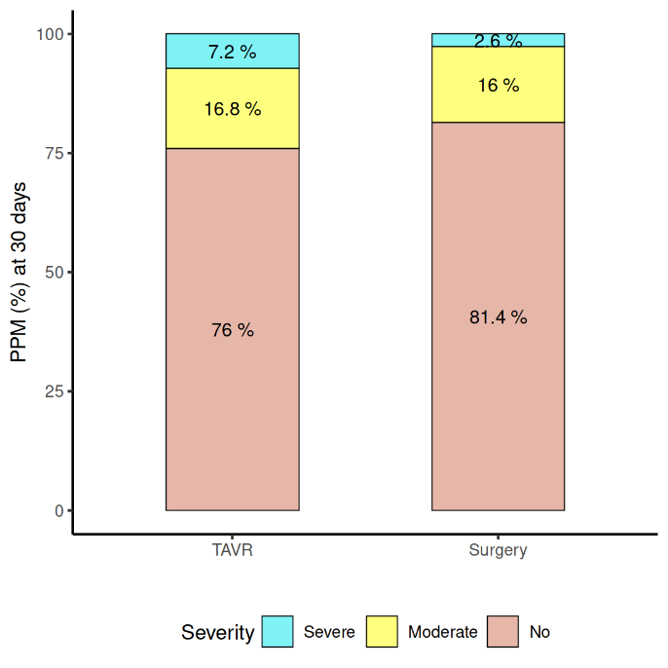
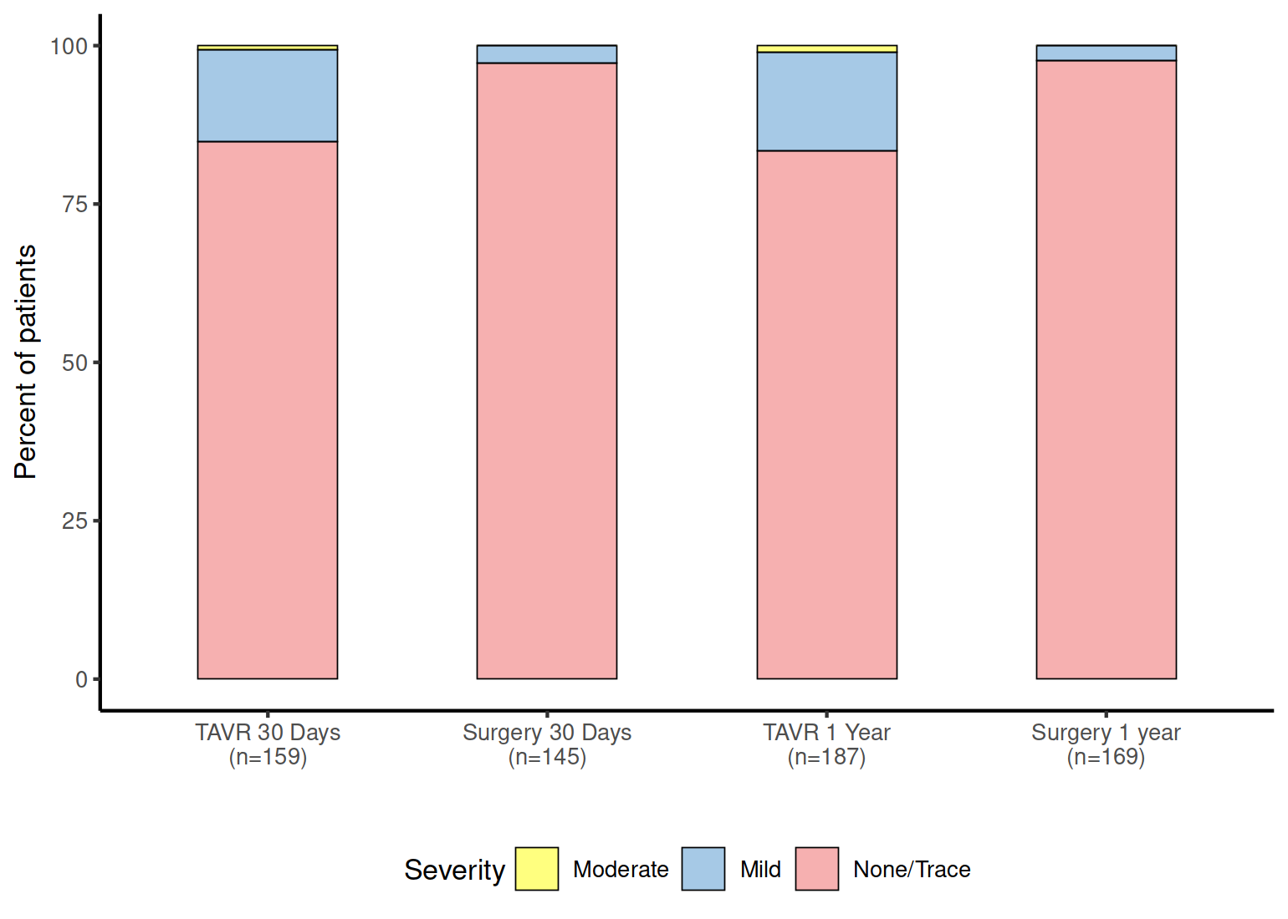
Echocardiography findings
Patient-Prosthesis Mismatch 30 Days
Paravalvular Aortic Regurgitation
0.6%
0.0%
1.1%
0.0%
2.8%
2.4%
14.5%
15.5%
84.9%
97.2%
83.4%
97.6%
TAVI
(N=167)
Surgery
(N=156)
TAVI 30 Days
(n=159)
Surgery 30 Days
(n=145)
TAVI 1 Year
(n=187)
Surgery 1 Year
(n=169)
Mild PVR 30 Days p < 0.001
Mild PVR 1 Year p < 0.001

Slide 35
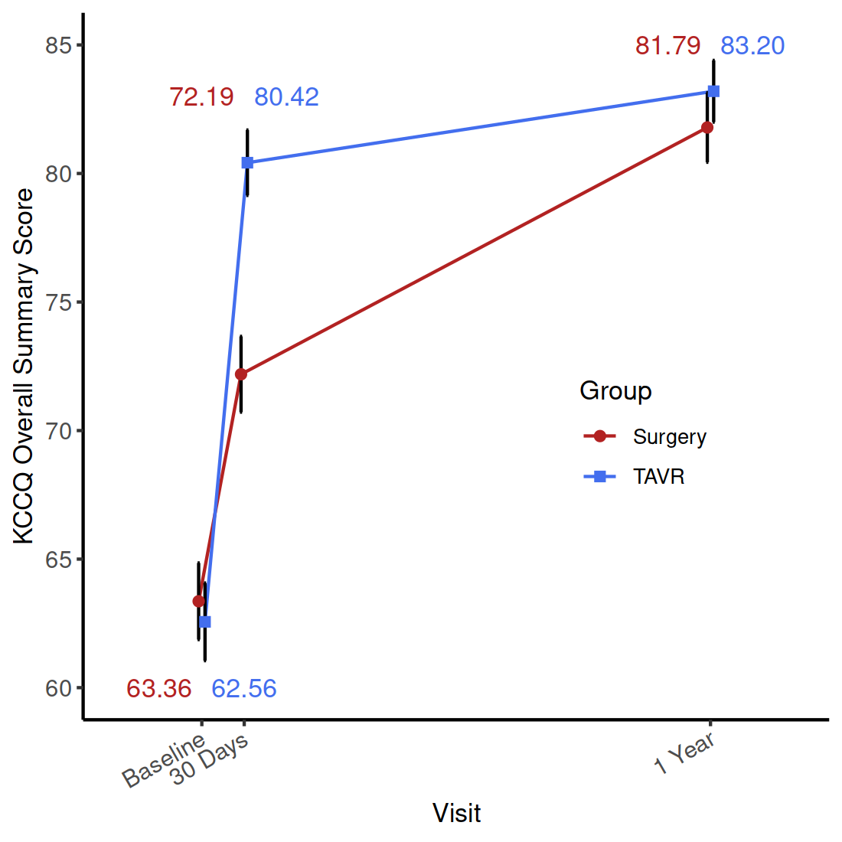
Quality of Life KCCQ evaluation
p = 0.13
p < 0.001
Surgery
TAVI
No. of patients
Surgery 198 191 186
TAVI 209 204 203

Slide 36
Conclusions
In women all comers with severe aortic stenosis, TAVI using SAPIEN 3 or SAPIEN 3 Ultra was superior to surgery for the primary composite end point of death, stroke, or rehospitalization at one year. This superiority was essentially driven by the lower rate or rehospitalizations
TAVI had a lower incidence of new onset AF at 30 days, a quicker recovery and shorter length of index hospital stay, but higher rates of mild paravalvular aortic regurgitation and new permanent pacemaker implantation

Slide 37
Conclusions (cont.)
Hemodynamics of the implanted valves were comparable between TAVI and surgery with no differences in mean gradient or aortic valve area
Besides the patient benefit, the less invasive TAVI treatment also provides benefits in terms of health care resources:
  Less rehospitalization
  Shorter index hospital stay
  More patients discharged home

Slide 38
Clinical Implications
In women with symptomatic severe aortic stenosis, TAVI using balloon-expandable devices could be considered the preferred therapy

Slide 39
Study Limitations
RHEIA trial was of limited size so there is inevitable uncertainty reflected by wide confidence intervals for treatment difference
Women with unicuspid, biscuspid, or non-calcified valves were excluded
The recruitment period was long (~3·5 years) and this was related to the fact that this phase of the trial occurred during the COVID pandemic
Concomitant procedures were performed in 13.2 % of the surgical patients
The findings relate to a third-generation balloon-expandable valve system and cannot be extrapolated to other valve types

