Slide 1
The TRISCEND II Trial: Transcatheter Valve Replacement Versus Optimal Medical Therapy for Severe Tricuspid Regurgitation
Susheel Kodali, MD Columbia University Irving Medical Center, New York, New York, USA
Suzanne V. Arnold, MD, MHA Saint Luke's Mid America Heart Institute
University of Missouri-Kansas City, Kansas City, Missouri, USA
on behalf of the TRISCEND II Trial investigators

Slide 2
Disclosure of Relevant Financial Relationships
Within the prior 24 months, I have had a financial relationship with a company producing, marketing, selling, re-selling, or distributing healthcare products used by or on patients:
Nature of Financial Relationship | Ineligible Company
Susheel Kodali, MD
Grant/Research Support | Edwards Lifesciences, Medtronic, Boston Scientific, Abbott Vascular, JenaValve
Consultant Fees/Honoraria | Anteris, Dura Biotech, Shifamed, Tricares, Phillips, Nyra Medical, Helix Valve Repair, X-Dot, MicroInterventional Devices, Moray Medical, Supira, Adona, Tioga
Individual Stock(s)/Stock Options | Thubrikar Aortic Valve, Inc, Dura Biotech, Supira, MID, TriFlo, Adona, Tioga, Xdot, Moray Medical, Cardiomech
Suzanne V. Arnold, MD, MHA
Grant/Research Support (Institutional) | FDA, NIH/NHLBI
All relevant financial relationships have been mitigated. Faculty disclosure information can be found on the app. TRISCEND II Trial (NCT04482062) is funded by Edwards Lifesciences.

Slide 3
Background
Severe TR causes debilitating symptoms, significantly impacting quality of life
Current treatment options are limited
The TRISCEND II trial previously met 30-day safety and 6-month effectiveness endpoints in the cohort of first 150 patients enrolled
We report the 1-year primary endpoint and clinical and quality-of-life outcomes for the randomized full cohort
TR, tricuspid regurgitation
Notes:
2

Slide 4
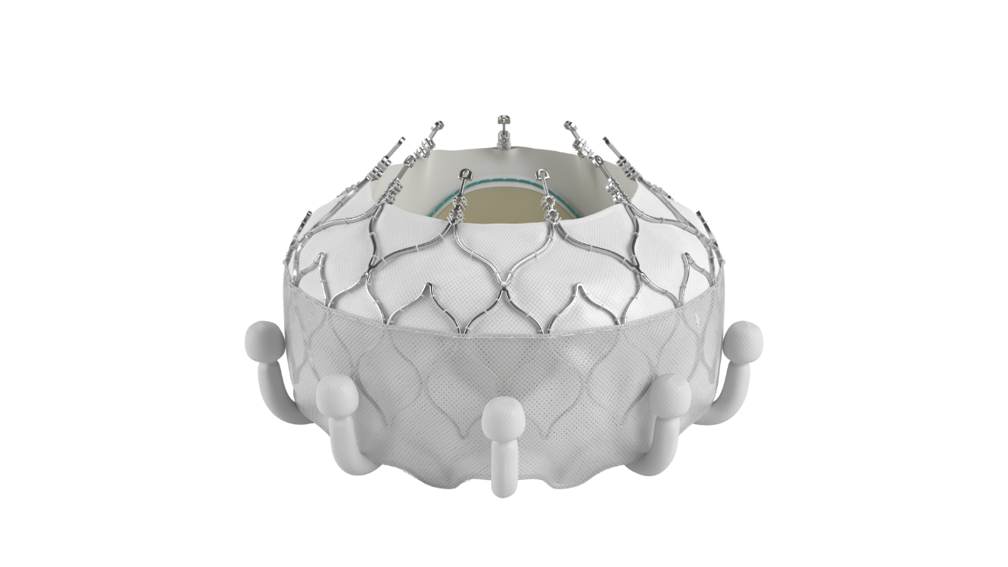
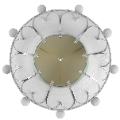
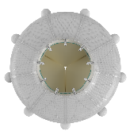
EVOQUE Transcatheter Tricuspid Valve Replacement System
Designed for
anatomical compatibility
Self-expanding shape-memory nitinol frame designed to conform to native valve anatomy
4 sizes treat wide range of anatomies
Designed to seal within native tricuspid annulus
Intra-annular sealing skirt and frame
44mm
48mm
52mm
56mm
Transfemoral
28 Fr outer diameter
3 planes of movement
Delivery System
CAUTION: Federal (United States) law restricts this device to sale by or on the order of a physician. See instructions for use for full prescribing information.
Notes:
3

Slide 5
Purpose
Evaluate the safety and effectiveness of the EVOQUE tricuspid valve replacement system with optimal medical therapy compared with optimal medical therapy alone in patients with at least severe TR
Key Inclusion Criteria
Age ≥ 18 years
Signs/symptoms of TR or prior heart failure hospitalization
Medical therapy at the time of screening
TR ≥ severe
Key Exclusion Criteria
Anatomy precluding proper implant
Life expectancy < 12 months
LVEF < 25%
Evidence of severe RV dysfunctionª
Severe renal insufficiency^{b}
Severe pulmonary hypertension^{c}
ªAssessed by echo core lab; Baylor Scott and White Research Institute Cardiac Imaging Core Laboratory, Plano, TX, USA. ^{b}Estimated glomerular filtration rate ≤25 mL/min/1.73m² or requiring chronic renal replacement therapy. ^{c}Pulmonary artery systolic pressure >60 mmHg by echo Doppler or >70 mmHg by right heart catheterization (RCH), or pulmonary vascular resistance >5 Wood units by RHC. LVEF, left ventricular ejection fraction; RV, right ventricular; TR, tricuspid regurgitation
Notes:
4

Slide 6
Screening and enrollment by Heart Team
Eligibility confirmed by Central Screening Committee
TTVR
Pre-procedure medical therapy continued ≥ 3 months post-implant​
Concomitant procedures not permitted​
Annual follow-up to 5 years
N=267
R
2:1
Control
Pre-study medical therapy continued (primarily oral diuretics)​
N=133
Primary endpoints
30 Days
Safety
6 Months
Effectiveness
1 Year
Hierarchical Composite Safety and Effectiveness
​R, randomization; TTVR, transcatheter tricuspid valve replacement
Notes:
5

Slide 7
Trial Leadership & Oversight
TRICUSPID PROGRAM LEADERSHIP
TRIAL OVERSIGHT
Steering Committee
Teresa De Marco, MD |  | Jörg Hausleiter, MD |  |  |  |  |  | Mark Reisman, MD
Tom Smith, MD |  | Ralph Stephan von Bardeleben, MD, PhD |  |  |  |  |  | Firas Zahr, MD
Echocardiographic Core Laboratory, Baylor Scott & White, Plano, TX, USA
Paul Grayburn, MD |  |  |  |  | Anna Sannino, MD, PhD
Clinical Events Committee (CEC)
Carey D. Kimmelstiel, MD, Interventional Cardiologist |  |  |  |  | Gregory Smaroff, MD, Cardiothoracic Surgeon
Pablo A. Quintero Pinzon, MD, Cardiologist, Heart Failure |  |  |  |  | David E. Thaler, MD, PhD, Neurologist
Data Safety Monitoring Board (DSMB)
Eugene A. Grossi, MD, Cardiothoracic Surgery |  |  |  |  | John Lopez, MD, Interventional Cardiology
Michael M. Givertz, MD, Cardiology / Heart Failure |  |  |  |  | Frederick S. K. Ling, MD, Interventional Cardiology / Cardiovascular Disease
John Orav, PhD, Biostatistics
Central Screening Committee (CSC)
Cardiac Surgery |  |  | Heart Failure |  | Echocardiography | Echocardiography | Echocardiography
S. Chris Malaisrie, MD |  |  | Aasim Afzal, MD |  | Paul Grayburn, MD | Paul Grayburn, MD | Paul Grayburn, MD
Robert L. Smith, MD |  |  | Shirin Jimenez, MD |  | Anna Sannino, MD, PhD | Anna Sannino, MD, PhD | Anna Sannino, MD, PhD
Howard K. Song, MD, PhD |  |  | Johannes Steiner, MD |  | Thomas Smith, MD | Thomas Smith, MD | Thomas Smith, MD
Interventional Cardiology
Colin Barker, MD | Marvin Eng, MD |  | Neil Fam, MD | Raj Makkar, MD | Mark Reisman, MD | Rahul Sharma, MD | Rahul Sharma, MD |  | Ralph Stephan von Bardeleben, MD, PhD
Charles Davidson, MD | Neil Fam, MD | Mark Reisman, MD |  | Andrew Rassi, MD | Volker Rudolph, MD | Brian Whisenant, MD | Brian Whisenant, MD
Mackram Eleid, MD | Jörg Hausleiter, MD | Volker Rudolph, MD |  | Mark Reisman, MD | Pradeep Yadav, MD | Pradeep Yadav, MD | Pradeep Yadav, MD | Ralph Stephan von Bardeleben, MD, PhD
Sammy Elmariah, MD | D. Scott Lim, MD | Rahul Sharma, MD |  | Volker Rudolph, MD | Firas Zahr, MD | Firas Zahr, MD | Firas Zahr, MD
Martin Leon, MD
Michael Mack, MD
GLOBAL PRINCIPAL INVESTIGATORS
Rebecca Hahn, MD
Susheel Kodali, MD
Vinod Thourani, MD
Philipp Lurz, MD, PhD
Notes:
6

Slide 8
45 Enrolling Sites
United States
United States
CA | Cedars Sinai Medical Center Kaiser Permanente San Francisco Medical Center Stanford University Scripps Memorial Hospital La Jolla UC Davis Medical Center Sacramento | NJ | Morristown Medical Center Rutgers Robert Wood Johnson Medical School
 |  | NY | Columbia University Irving Medical Center Montefiore Medical Center NYU Langone Health St. Francis Medical Center
CO | UTHealth Medical Center of the Rockies
FL | Florida Heart & Vascular Care–JFK The Cardiac & Vascular Institute Research Foundation | OH | The Christ Hospital Cleveland Clinic
 |  | OK | Oklahoma Heart Institute
GA | Emory University Hospital Piedmont Heart Institute | OR | Oregon Health & Science University
 |  | PA | Lankenau Medical Center University of Pennsylvania
IL | Northwestern University
IN | Ascension St. Vincent Heart Center | TN | Vanderbilt University Medical Center
KS | Cardiovascular Research Institute of Kansas | TX | Baylor Scott & White The Heart Hospital – Plano The University of Texas Health Science Center at Houston
MA | Brigham and Women’s Hospital Massachusetts General Hospital
MI | Henry Ford Hospital University of Michigan Hospital | UT | Intermountain Medical Center
MO | Saint Luke's Hospital of Kansas City | VA | University of Virginia Health University Hospital Sentara Norfolk General Hospital
MN | Mayo Clinic
NC | Carolinas HealthCare System | WA | University of Washington
Germany
Herzzentrum Leipzig GmbH Herzzentrum Universitätsklinik Bonn Herzzentrum der UniKlinik Köln | Herz-und Diabetiszentrum NRW Johannes Gutenberg-Universität Mainz Klinikum der Universität München – Großhadern
Germany
Enrolling sites for N=400 randomized patients
Notes:
7

Slide 9
Top Enrolling Sites
1 | Cedars-Sinai Medical Center, Los Angeles, CA
2 | Stanford University Medical Center, Palo Alto, CA
3 | Northwestern University, Chicago, IL
4 | Henry Ford Hospital, Detroit, MI
5 | Piedmont Heart Institute, Atlanta, GA
6 | Oregon Health & Science University, Portland, OR
7 | Columbia University Irving Medical Center, New York, NY
8 | Mayo Clinic, Rochester, MN
9 | Baylor Scott & White The Heart Hospital – Plano, Plano, TX
10 | Intermountain Medical Center, Murray, UT The Christ Hospital, Cincinnati, OH
11 | University of Leipzig, Leipzig, Germany
12 | Atlantic Health System Morristown Medical Center, Morristown, NJ University of Virginia, Charlottesville, VA The Cleveland Clinic Foundation, Cleveland, OH
Top enrolling sites for N=400 randomized patients
Notes:
8

Slide 10
Patient Enrollment and Follow-up
Patients Enrolled
N=400
TTVR
N=267
Control
N=133
8 procedures not attempted (4 deathsª, 4 withdrew)
Procedure Attempted
N=259
Analysis population
Medical Therapy
N=133
Analysis population
6 deaths
1 withdrew
2 withdrew
30-Day Follow-up
N=252
30-Day Follow-up
N=131
14 deaths
5 withdrew
6 deaths
11 withdrew
6-Month Follow-up
N=233
6-Month Follow-up
N=114
9 deaths
7 deaths
3 withdrew
1-Year Follow-up
N=224
215 visits completed (96.0%)
1-Year Follow-up
N=104
97 visits completed (93.3%)
Includes 22 crossover patients^{b}
1-year visit window, 320 to 410 days. ªDeaths were cardiovascular (n=2) and non-cardiovascular (n=2). ^{b}Patients randomized to medical therapy alone are eligible for treatment with the EVOQUE system following 1- or 2-year follow-up visits, or after commercial approval in applicable geography. TTVR, transcatheter tricuspid valve replacement
Notes:
9

Slide 11
Baseline Characteristics
 | TTVR N=259 Mean ± SD or % | Control N=133 Mean ± SD or %
Age, years | 79.3 ± 7.4 | 79.1 ± 7.8
Female​ | 74.9% | 76.7%
NYHA class III-IV | 73.0% | 69.2%
KCCQ overall score, points | 52.8 ± 22.0 | 50.6 ± 21.4
STS score, mitral valve replacement, % | 9.6 ± 5.1 | 10.0 ± 5.2
Left ventricular ejection fraction, % | 54.4 ± 9.9 | 54.3 ± 11.1
TAPSE, mm | 16.3 ± 4.5 | 15.6 ± 4.2
Pulmonary artery systolic pressure, mmHg | 38.6 ± 10.9 | 37.6 ± 11.3
Atrial fibrillation​ | 96.1% | 92.5%
Stroke | 15.1% | 9.0%
Chronic kidney disease | 54.1% | 59.4%
Ascites | 18.5% | 21.8%
HF hospitalization in past 12 months | 34.0% | 36.1%
History of pacemaker/CIED | 38.2% | 39.8%
Prior valve surgery/intervention | 33.6% | 30.8%
TR Etiology | TTVR N=259​ | Control N=133
Primaryª | 14.7% | 14.3%
Secondary^{b} | 74.1% | 71.4%
Mixed | 9.7% | 9.0%
Indeterminate | 1.5% | 5.3%
TR Severity by Core Lab
Baylor Scott and White Research Institute Cardiac Imaging Core Laboratory, Plano, TX, USA. Data from patients with available assessments. ªDegenerative, organic, structural or pacer related. ^{b}Functional or nonstructural. CIED, cardiac implantable electronic device; HF, heart failure; KCCQ, Kansas City Cardiomyopathy Questionnaire; NYHA, New York Heart Association; STS, Society of Thoracic Surgeons; TAPSE, tricuspid annular plane systolic excursion; TR, tricuspid regurgitation; TTVR, transcatheter tricuspid valve replacement
Notes:
10

Slide 12
EVOQUE System Procedural Characteristics
 | TTVR N=259
Patients with study valve implanted | 95.4%ª
Procedure time, minutes^{b} | 98.0 (76.0, 127.0)
Device time, minutes^{c} | 56.5 (41.0, 75.0)
Percutaneous access Right femoral vein Left femoral vein | 100.0% 89.1% 10.9%
Conversion to surgery | 1.2%
Length of hospital stay (post procedure), days | 3.0 (2.0, 6.0)
Discharged to home | 93.0%
% or median (Q1, Q3). ªTwelve patients did not receive an EVOQUE valve due to challenging anatomy (n=7), imaging preventing confirmation of leaflet capture (n=4), or TR that was no longer severe on transesophageal echocardiography (n=1). ^{b}Time from skin incision to closure. ^{c}Time from delivery system insertion to removal. TTVR, transcatheter tricuspid valve replacement
Notes:
11

Slide 13
Safety Outcomes
CEC-adjudicated Event | Early Events (≤ 30 Days) |  | Late Events (31 to 365 Days)ª
 | TTVR​ N=259​ % (n)​ | Control ​ N=133​ % (n)​ | TTVR​ N=247​ % (n)​ | Control ​ N=128​ % (n)​
Cardiovascular mortality | 3.1% (8)​ | 0.0% (0)​ | 5.7% (14)​ | 7.8% (10)​
Myocardial infarction | 0.8% (2)​ | 0.0% (0)​ | 1.2% (3)​ | 0.8% (1)​
Stroke | 0.4% (1)​ | 0.0% (0)​ | 1.2% (3)​ | 0.0% (0)​
Severe bleeding^{b} | 10.4% (27)​ | 1.5% (2)​ | 5.3% (13)​ | 4.7% (6)​
Nonelective TV reintervention | 0.8% (2)​ | 0.8% (1)​ | 0.0% (0)​ | 2.3% (3)​
New Pacemaker/CIED Implantation
CIED implant in pacemaker-naïve patients^{c} | 24.7% (40/162) | 0.0% (0/80)​ | 4.2% (5/118)^{d} | 3.9% (3/76)^{d}
ªPatients must have at least 31 days in study to count in denominator. ^{b}Severe bleeding defined as fatal, life-threatening, extensive or major per the Mitral Valve Academic Research Consortium. ^{c}Excludes patients with pre-existing CIED. ^{d}Patients who had a pacemaker implanted in the first 30 days are excluded. CEC, clinical events committee; CIED, cardiac implantable electronic device; TTVR, transcatheter tricuspid valve replacement; TV, tricuspid valve

Slide 14
TR Grade Reduction at 1 Year with EVOQUE System
99.1%
≤ moderate
Patients (%)
95.3%
≤ mild
16.1%
≤ moderate
TTVR
n=212
Control
n=87
Baylor Scott and White Research Institute Cardiac Imaging Core Laboratory, Plano, TX, USA. Graphs show paired analysis. TR, tricuspid regurgitation; TTVR, transcatheter tricuspid valve replacement

Slide 15
Primary Safety and Effectiveness Endpoint – Percent Wins Superior Clinical Benefits with EVOQUE System
TTVR
N = 259
34,447 Patient Pairs
Control
N = 133
% TTVR Wins
Ties
% Control Wins
All-cause Mortality
Site reported + vital status sweep
14.8%
72.7%
12.5%
RVAD or Heart Transplant
CEC adjudicated
0.0%
72.7%
0.0%
Win Ratio = 2.02
(95% CI, 1.56, 2.62) Finkelstein-Schoenfeld: P<0.001
TV Intervention CEC adjudicated
3.2%
68.9%
0.6%
Annualized Rate of HFH
CEC adjudicated
9.7%
49.2%
10.0%
KCCQ-OS Improvement
Δ Score ≥ 10
23.1%
20.1%
6.0%
NYHA Improvement
Δ ≥ 1 Class
10.2%
9.1%
0.8%
6MWD Improvement
Δ ≥ 30 Meters
1.1%
7.1%
0.9%
62.1%
30.7%
6MWD, 6-minute walk distance; CEC, clinical events committee; HFH, heart failure hospitalization, KCCQ-OS, Kansas City Cardiomyopathy Questionnaire Overall Summary score; NYHA, New York Heart Association; RVAD, right ventricular assist device; TTVR, transcatheter tricuspid valve replacement; TV, tricuspid valve

Slide 16
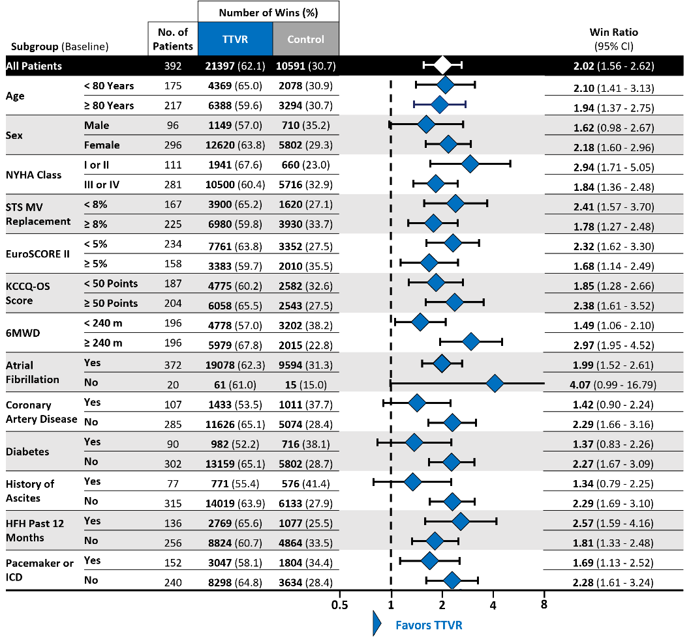
Clinical Benefits Maintained in Subgroups to 1 Year
Favors TTVR
Favors TTVR
ªAdjudicated by clinical events committee. ^{b}In pacemaker-naïve patients. 6MWD, 6-minute walk distance; HFH, heart failure hospitalization; ICD, implantable cardioverter defibrillator;
KCCQ-OS, Kansas City Cardiomyopathy Questionnaire Overall Summary score; MV, mitral valve; NYHA, New York Heart Association; PASP, pulmonary artery systolic pressure; PPM, permanent pacemaker; RV, right ventricle; STS, Society of Thoracic Surgeons; TAPSE; tricuspid annular plane systolic excursion; TR, tricuspid regurgitation; TTVR, transcatheter tricuspid valve replacement

Slide 17
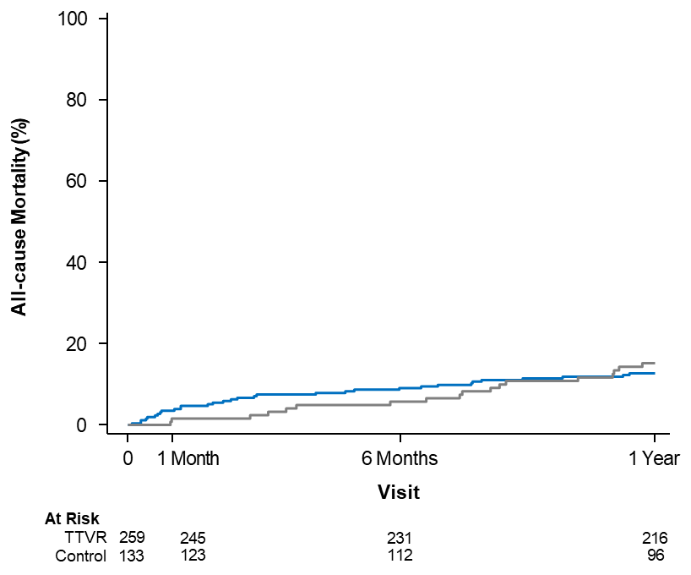
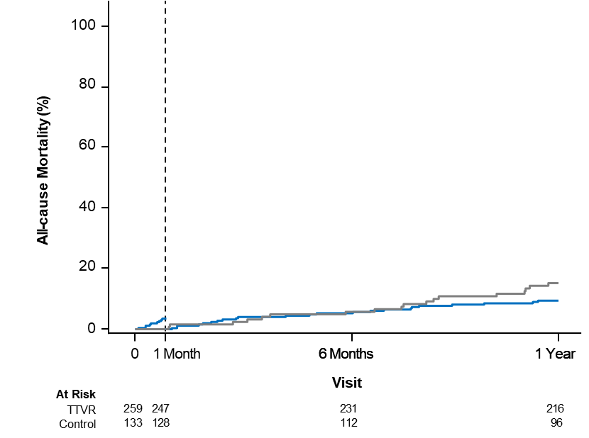
CEC-adjudicated All-cause Mortality to 1 Year
Kaplan-Meier Analysis
TTVR
Control
All-cause Mortality
All-cause Mortality Landmarked at 30 Days
30-day Landmark
TTVR 12.6 ± 2.1%
Control 15.2 ± 3.3%
TTVR 9.4 ± 1.9%
Control 15.2 ± 3.3%
Kaplan-Meier estimates include standard error. CEC, clinical events committee; TTVR, transcatheter tricuspid valve replacement

Slide 18
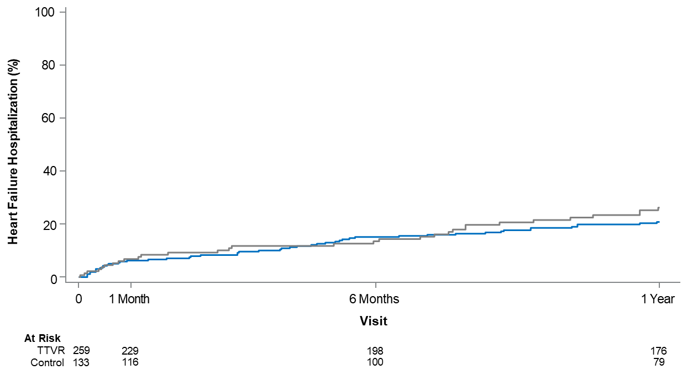
CEC-adjudicated HF Hospitalization to 1 Year
Kaplan-Meier Analysis
TTVR
Control
TTVR 20.9 ± 2.6%
Control 26.1 ± 4.1%
HF Hospitalization (%)
Kaplan-Meier estimates include standard error. CEC, clinical events committee; HF, heart failure; TTVR, transcatheter tricuspid valve replacement

Slide 19
Functional and Quality-of-Life Improvements at 1 Year
Difference between groups (paired)
100
29.9%
54.9%
15.8%
80
TTVR
60
Control
40
20
0
N: 211 96 213 96 185 88
6MWD, 6-minute walk distance; KCCQ-OS, Kansas City Cardiomyopathy Questionnaire Overall Summary score; NYHA, New York Heart Association; TTVR, transcatheter tricuspid valve replacement

Slide 20
Quality of Life After Transcatheter Tricuspid Valve Replacement
Suzanne V. Arnold, MD, MHA Saint Luke's Mid America Heart Institute
University of Missouri-Kansas City, Kansas City, Missouri, USA
on behalf of the TRISCEND II Trial investigators

Slide 21
Health Status Methods
Health status assessed at baseline, 30 days, 6 months, 1 year
Kansas City Cardiomyopathy Questionnaire (KCCQ)*
Scores 0-100; higher=better; MCID=5 points
Primary Health Status Endpoint: Overall Summary score (KCCQ-OS)
SF-36 Physical and Mental Summary Scores
Population mean 50 ± 10; higher=better; MCID=2.5 points
Health status over 1 year compared between groups using mixed effects linear repeated measures models
Categorical analyses integrated survival and health status at 1 year
Alive and well = KCCQ-OS ≥60, no decline ≥10 points from baseline
*Validated in TR: Arnold SV et al. JAMA Cardiol. 2024. MCID, minimal clinically important difference

Slide 22
Key Health Status Outcome: KCCQ-OS
1
KCCQ-OS, Kansas City Cardiomyopathy Questionnaire Overall Summary score

Slide 23
Key Health Status Outcome: KCCQ-OS
Control
1
KCCQ-OS, Kansas City Cardiomyopathy Questionnaire Overall Summary score

Slide 24
Key Health Status Outcome: KCCQ-OS
Δ 11.8 Δ 20.8 Δ 17.8
(7.4, 16.3) (16.1, 25.5) (13.0, 22.5)
TTVR
Control
1
KCCQ-OS, Kansas City Cardiomyopathy Questionnaire Overall Summary score; TTVR, transcatheter tricuspid valve replacement
All treatment comparisons P<0.001

Slide 25
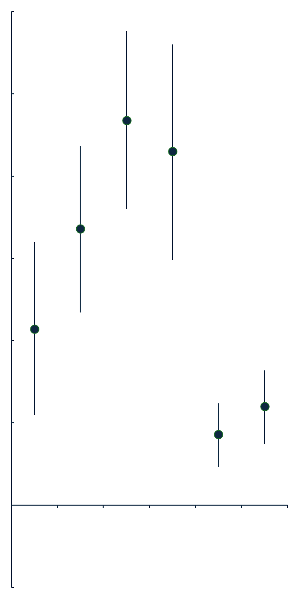
KCCQ Domains and SF-36 at 1 Year
KCCQ
Physical Limitations
Total Symptoms
Quality of Life
Social Limitations
Physical Summary
Mental Summary
10.7
MCID 5 points
16.8
23.4
21.5
SF-36
-5 | 0 | 5 | 10 | 15 | 20 | 25 | 30
Mean Between Group Difference (95% CI)
(TTVR – Control)
KCCQ, Kansas City Cardiomyopathy Questionnaire; MCID, minimal clinically important difference; TTVR, transcatheter tricuspid valve replacement

Slide 26
KCCQ Domains and SF-36 at 1 Year
KCCQ
Physical Limitations
Total Symptoms
Quality of Life
Social Limitations
Physical Summary
Mental Summary
10.7
MCID 5 points
16.8
23.4
21.5
SF-36
4.3
MCID 2.5 points
6.0
-5 | 0 | 5 | 10 | 15 | 20 | 25 | 30
Mean Between Group Difference (95% CI)
(TTVR – Control)
KCCQ, Kansas City Cardiomyopathy Questionnaire; MCID, minimal clinically important difference; TTVR, transcatheter tricuspid valve replacement

Slide 27
Survival and Health Status by KCCQ-OS at 1 Year
TTVR
Control
NNT 3.8
NNT 5.0
NNT 3.0
Moderate improvement: increase in KCCQ-OS ≥10; Large improvement: increase in KCCQ-OS ≥20; Alive and well: KCCQ-OS at 1 year of ≥60 and no decline from baseline of ≥10 points. KCCQ-OS, Kansas City Cardiomyopathy Questionnaire Overall Summary score; NNT, number needed to treat; TTVR, transcatheter tricuspid valve replacement
All treatment comparisons P<0.001

Slide 28
Change in Health Status by KCCQ-OS at 1 Year
58%
24%
TTVR
Large
Moderate
Small
No Change
Worse
Dead
Control
No Change
Large
Moderate
Small
Worse
Dead
31%
45%
Degree of change (in points): large: ≥20; moderate: ≥10 and <20; small: ≥5 and <10; no change >-5 and <5; worse: ≤-5. KCCQ-OS, Kansas City Cardiomyopathy Questionnaire Overall Summary score; TTVR, transcatheter tricuspid valve replacement
Treatment comparison P<0.001

Slide 29
Baseline Subgroup Analyses at 1 Year by KCCQ-OS
TR grade | n
Severe | 172
Massive | 94
Torrential | 126
Interaction P-value
0.049
11.3
22.6
23.3
-20 | -10 | 0 | 10 | 20 | 30 | 40
Mean Between Group Difference (95% CI)
(TTVR – Control)
KCCQ-OS, Kansas City Cardiomyopathy Questionnaire Overall Summary score; TR, tricuspid regurgitation; TTVR, transcatheter tricuspid valve replacement
Notes:
28

Slide 30
Baseline Subgroup Analyses at 1 Year by KCCQ-OS
TR grade | n
Severe | 172
Massive | 94
Torrential | 126
6-min walk distance
<238.5 meters | 196
≥238.5 meters | 192
Interaction P-value
0.049
0.016
11.3
22.6
23.3
11.9
23.3
-20 | -10 | 0 | 10 | 20 | 30 | 40
Mean Between Group Difference (95% CI)
(TTVR – Control)
KCCQ-OS, Kansas City Cardiomyopathy Questionnaire Overall Summary score; TR, tricuspid regurgitation; TTVR, transcatheter tricuspid valve replacement
Notes:
29

Slide 31
Baseline Subgroup Analyses at 1 Year by KCCQ-OS
TR grade | n
Severe | 172
Massive | 94
Torrential | 126
6-min walk distance
<238.5 meters | 196
≥238.5 meters | 192
RV fractional area change
<35% | 99
≥35% | 257
Interaction P-value
0.049
0.016
0.013
11.3
22.6
23.3
11.9
23.3
7.1
21.4
-20 | -10 | 0 | 10 | 20 | 30 | 40
Mean Between Group Difference (95% CI)
(TTVR – Control)
Additional non-significant treatment interactions: age, sex, COPD, LVEF, tricuspid annular plane systolic excursion, cardiac index, pulmonary hypertension, HF hospitalization in prior year, daily diuretic dose, baseline KCCQ-OS. KCCQ-OS, Kansas City Cardiomyopathy Questionnaire Overall Summary score; RV, right ventricle; TTVR, transcatheter tricuspid valve replacement
Notes:
30

Slide 32
Summary and Conclusions
At 1 year, TRISCEND II primary endpoint demonstrated superiority of EVOQUE TTVR for a patient population with limited treatment options
TTVR with the EVOQUE system led to sustained TR reduction to ≤ mild in nearly all patients
These TR reductions were associated with significant and marked improvement in symptoms, function, and quality of life at 1 year with favorable numerical trends in mortality and HF hospitalization
These quality-of-life and symptomatic benefits should be balanced against periprocedural risks
The TRISCEND II trial confirms the clinical and quality-of-life benefits of the
EVOQUE system for patients with ≥ severe TR
HF, heart failure; TR, tricuspid regurgitation; TTVR, transcatheter tricuspid valve replacement
Notes:
31

Slide 33
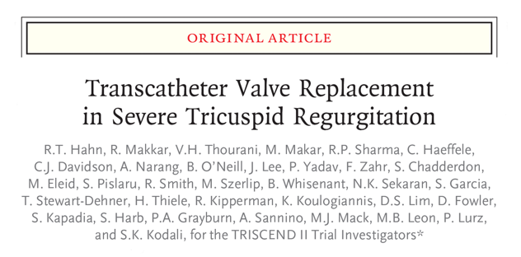
Simultaneously Published in NEJM and JACC

