Slide 1





One-Month DAPT Followed by Prasugrel Monotherapy at a Reduced Dose in ACS: The 4D-ACS Randomized Trial
Woong Chol Kang MD
Division of Cardiology, Department of Internal Medicine, Gachon University Gil Medical Center, Gachon University College of Medicine, Incheon, Korea

Slide 2


Potential conflicts of interest
Speaker's name: Woong Chol Kang
☑ I have the following potential conflicts of interest to report
Receipt of grants / research supports - Biosensors International
europcr.com

Slide 3



Background: Gap in Evidence
Evolving Evidence
Prasugrel 10 mg
-based
12-month DAPT
Prasugrel 5 mg
-based
12-month DAPT
Prasugrel 3.75mg
-based Short-DAPT
Prasugrel 5mg- or 10 mg-based Short-DAPT
Aspirin-free Prasugrel 3.75mg
TRITON-TIMI 38
(2007)
ISAR-REACT 5
(2019)
HOST-REDUCE
-POLYTECH
-ACS (2020)
PRASFIT-ACS (2014)
None
STOPDAPT-3 (2024)
europcr.com

Slide 4









4D-ACS Trial
Short
Drug-
Coated Stent
Dose
Reduction
Duration
DAPT
ACS
Patients

Slide 5

Study Design
ACS patients with BioFreedom™ Ultra stent implantation
1:1 Randomization
1M-DAPT
12M-DAPT
Aspirin 100mg + Prasugrel 10mg*
Aspirin 100mg + Prasugrel 10mg*
Prasugrel Dose reduction
at 1 month
Prasugrel 5mg
Aspirin 100mg + Prasugrel 5mg
N=328
N=328
* Prasugrel 5mg, if body weight < 60 kg or age ≥ 75
europcr.com

Slide 6

Study Endpoints
Primary Endpoint
Net Adverse Clinical Events (NACE)
  A composite of death, non-fatal MI, ischemia-driven target vessel revascularization, stroke, and bleeding (BARC type 2, 3, or 5)
Secondary Endpoints
All cause death
Cardiovascular death
Non-fatal MI
Ischemia-driven TVR
Stent thrombosis
Stroke
Major bleeding (BARC type 3 or 5)
Minor or major bleeding (BARC type 2 to 5)
MACE (cardiovascular death, non-fatal MI, stroke, and ischemia-driven TVR)
europcr.com

Slide 7


Sample Size Calculation and Statistical Analysis
ORIGINAL PLAN
Noninferiority design
Expected annual event rate of the primary end point
  6.0% in aspirin + prasugrel 5mg (12M-DAPT)
  4.0% in prasugrel 5mg (1M-DAPT)
Noninferiority margin: 2.0%
Power: 90%
One-sided alpha: 0.025
Sample size: 1370 (623 patients per group considering 10% loss)
MODIFIED PLAN
Noninferiority design
Expected annual event rate of the primary end point
  8.0% in aspirin + prasugrel 5mg (12M-DAPT)
4.0% in prasugrel 5mg
Noninferiority margin: 2.0%
Power: 90%
One-sided alpha: 0.025
(1M-DAPT)
Sample size: 656 (328 patients per group)
europcr.com

Slide 8

Results

Slide 9
Baseline characteristics
 | Prasugrel-based 12-month DAPT (N=328) | Prasugrel 5mg monotherapy after 1 month of DAPT (N=328)
Demographics
Age, years
Mean | 61.3 ± 9.6 | 60.4 ± 9.8
≥75 | 20 (6.1) | 19 (5.8)
Male sex | 273 (83.2) | 269 (82.0)
Dose reduction of prasugrel during 1st month of DAPT | 66 (20.1) | 54 (16.5)
Weight, kg
Mean | 69.2 ± 12.0 | 70.7 ± 12.2
<60 | 67 (90.5) | 51 (83.6)
Body mass index | 25.0 ± 3.1 | 25.2 ± 3.4
High bleeding risk | 44 (13.5) | 37 (11.3)
Hypertension | 197 (60.1) | 179 (54.6)
Diabetes | 104 (31.7) | 104 (31.7)
Left ventricular ejection fraction, % | 55.0 ± 11.9 | 54.3 ± 13.2
Clinical presentation
ST-elevation myocardial infarction | 99 (30.2) | 116 (35.4)
Non-ST-elevation myocardial infarction | 103 (31.4) | 98 (29.9)
Unstable angina | 126 (38.4) | 114 (34.8)
europcr.c
om

Slide 10
Angiographic and procedural characteristics
 | Prasugrel-based 12-month DAPT (N=328) | Prasugrel 5mg monotherapy after 1 month of DAPT (N=328)
Transradial_access | 279 (85.1) | 276 (84.1)
Multivessel coronary artery disease | 200 (61.0) | 186 (56.7)
Left main disease | 6 (1.8) | 1 (0.3)
Bifurcation lesion | 8 (2.4) | 15 (4.6)
In-stent restenosis lesion | 1 (0.3) | 3 (0.9)
Number of lesions | 1.9 ± 1.0 | 1.8 ± 1.0
Multilesion intervention (%) | 174 (62.4) | 186 (66.4)
Multivessel intervention (%) | 200 (61.0) | 186 (56.7)
Disease extent
1VD | 128 (39.0) | 142 (43.3)
2VD | 116 (35.4) | 116 (35.4)
3VD | 84 (25.6) | 70 (21.3)
Treated lesion
Left main coronary artery | 7 (2.1) | 4 (1.2)
Left anterior descending artery | 228 (69.5) | 217 (66.2)
Left circumflex artery | 31 (9.5) | 43 (13.1)
Right coronary artery | 62 (18.9) | 64 (19.5)
Ramus intermedius artery | 0 (0.0) | 1 (0.3)
Total stent length (mm) | 26.9 ± 10.9 | 26.5 ± 9.2
Stent diameter (mm) | 3.07 ± 0.44 | 3.09 ± 0.45
Stent length (mm) | 24.67 ± 6.69 | 24.18 ± 6.44
Diameter stenosis (%) | 88.3 ± 13.9 | 89.2 ± 13.2
europcr.c
om

Slide 11

Primary Endpoint: NACE
10.0%
HR, 0.51 (95% CI, 0.27–0.95)
Noninferiority P = 0.014 Superiority P = 0.034
Prasugrel-based 12-month DAPT
Cumulative incidence of NACE (%)
8.8%
7.5%
5.0%
4.9%
Prasugrel 5mg monotherapy after 1 month of DAPT
2.5%
0.0%
0 30
Numbers at risk
60
90
120
150 180 210 240
Days after index procedure
270
300
330
360
328 | 312 | 309 | 307 | 305 | 304 | 298 | 294 | 293 | 289 | 288 | 287 | 287
328 | 312 | 311 | 311 | 310 | 309 | 307 | 305 | 304 | 304 | 302 | 301 | 301
europcr.com

Slide 12

Landmark Analysis: NACE
10.0%
P = 0.800
P = 0.003
Cumulative incidence(%)
7.5%
Prasugrel-based 12-month DAPT
7.1%
5.0%
2.8%
Prasugrel 5mg monotherapy after 1 month of DAPT
2.5%
1.9%
2.2%
0.0%
0 30
Numbers at risk
60
90
120
150 180 210
Days after index procedure
240
270
300
330
360
328 | 312 | 309 | 307 | 305 | 304 | 298 | 294 | 293 | 289 | 288 | 287 | 287
328 | 312 | 311 | 311 | 310 | 309 | 307 | 305 | 304 | 304 | 302 | 301 | 301
europcr.com

Slide 13

Major Bleeding
10.0%
HR, 0.13 (95% CI, 0.03–0.58)
P = 0.007
7.5%
Cumulative incidence(%)
5.0%
Prasugrel-based 12-month DAPT
4.6%
2.5%
Prasugrel 5mg monotherapy after
1 month of DAPT
0.6%
0.0%
0
30
60
90
120
150 180 210
Days after index procedure
240
270
300
330
360
Numbers at risk
328 | 313 | 310 | 308 | 306 | 305 | 300 | 295 | 294 | 290 | 289 | 288 | 288
328 | 312 | 311 | 311 | 310 | 309 | 307 | 305 | 304 | 304 | 302 | 301 | 301
europcr.com

Slide 14
Ischemic Composite Endpoints: MACE
10.0%
HR, 0.66 (95% CI, 0.27–1.61)
P = 0.360
7.5%
Cumulative incidence(%)
5.0%
Prasugrel-based 12-month DAPT
3.7%
2.5%
2.4%
Prasugrel 5mg monotherapy after 1 month of DAPT
0.0%
0 30
Numbers at risk
60
90
120
150 180 210
Days after index procedure
240
270
300
330
360
328 | 313 | 310 | 308 | 306 | 305 | 300 | 295 | 294 | 290 | 289 | 288 | 288
328 | 312 | 311 | 311 | 310 | 309 | 307 | 305 | 304 | 304 | 302 | 301 | 301
europcr.com

Slide 15

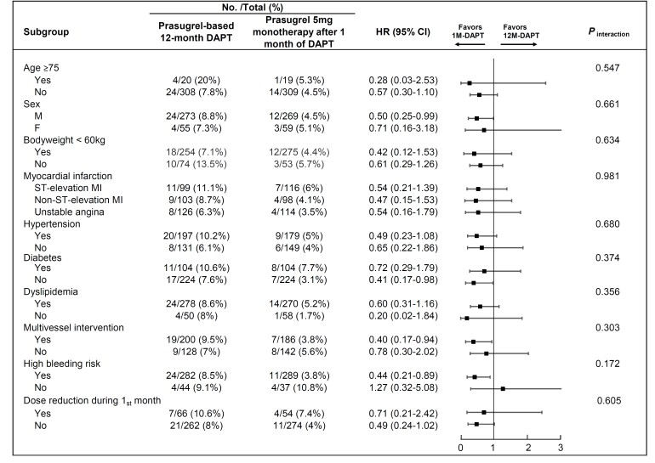
Subgroup Analysis
europcr.com

Slide 16












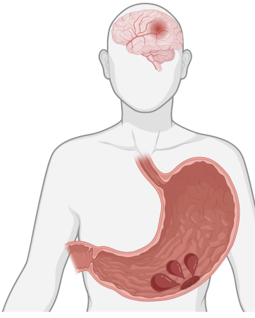

Summary and Conclusions
Design and Population
Results
4D-ACS Trial
Cumulative incidence of NACE (%)
Noninferiority P = 0.014
Superiority P = 0.034 HR: 0.51 (0.27-0.95)
P = 0.004
10.0
Short Duration DAPT
Doseose
Drug- Coated Stent
Reduction
7.5
Prasugrel-based 12-month DAPT
ACS
Patients
5.0
Prasugrel 5mg monotherapy after 1 month of DAPT
2.5
1-month DAPT
0.0
A_{A}s_{s}p_{p}ir_{ir}in_{in}
1₁00 m_{m}g_{g}
Prasugrel
1₁0₀m_{m}g_{g}
0 30 60 90 120 150 180 210 240 270 300 330 360
Days after index procedure
Control
Investigation
NACE
(Death, Non-fatal MI, stroke, TVR, and BARC type 2-5 bleeding)
Bleeding events: Major bleeding: Minor bleeding:
MACE
(CV death, Non-fatal MI, stroke, and TVR)
49%
0.51 (0.27-0.95)
77%
0.23 (0.08-0.69)
87%
0.13 (0.03-0.58)
A_{A}s_{s}p_{p}ir_{ir}in_{in}
1₁00 m_{m}g_{g}
Prasugrel
5₅m_{m}g_{g}
Prasugrel
5₅m_{m}g_{g}
N=328
N=328
ITT Analysis
0.98 (0.14-6.98)
0.66 (0.27-1.61)
NACE (Net Adverse Clinical Events)
europcr.com

Slide 17

https://eurointervention.pcro nline.com/doi/10.4244/EIJ- D-25-00331

Slide 18

pcronline.com

