Slide 1



Safety and Efficacy of Obicetrapib in Patients with Heterozygous Familial Hypercholesterolemia
Stephen J. Nicholls, Adam J. Nelson, Marc Ditmarsch, John J.P. Kastelein, Christie M. Ballantyne, Kausik K. Ray, Ann Marie Navar, Steven E. Nissen, Anne C. Goldberg, Liam R. Brunham, Erin Wuerdeman, Annie Neild,
Douglas Kling, Andrew Hsieh, Brian A. Ference, Ulrich Laufs, Maciej Banach, Roxana Mehran, Alberico L. Catapano and Michael H. Davidson

Slide 2
Disclosures
Research support: AstraZeneca, Amgen, Anthera,
Eli Lilly, Esperion, Novartis, Cerenis, The Medicines Company, Resverlogix, InfraReDx, Roche, Sanofi-Regeneron and LipoScience
Consulting and honoraria: AstraZeneca, Akcea,
Eli Lilly, Anthera, Omthera, Merck, Takeda, Resverlogix, Sanofi-Regeneron, CSL Behring, Esperion, Boehringer Ingelheim, Cyclarity, Daiichi Sankyo, CSL Seqirus, Vaxxinity

Slide 3
Background
Heterozygous familial hypercholesterolemia (HeFH) is associated with an increased risk of premature CVD.
Many patients with HeFH fail to achieve LDL-C targets despite use of existing lipid lowering therapies.
Obicetrapib is a cholesteryl ester transfer protein (CETP) inhibitor which reduces atherogenic lipid parameters and raises HDL-C when added to statins.

Slide 4
Objective
To evaluate the efficacy, safety and tolerability
of obicetrapib, as an adjunct to maximally
tolerated lipid-modifying therapies, in patients
with HeFH and suboptimal LDL-C control.

Slide 5
Study Design
Main Inclusion Criteria
HeFH diagnosed by
  Genetic confirmation
  WHO criteria / Dutch Clinical Network
  Simon Broome criteria
On maximally tolerated lipid lowering therapy
LDL-C ≥ 70mg/dL
TG ≤ 400mg/dL
Exclusion Criteria
CV event in the last 3 months
HoFH
Uncontrolled hypertension
Study Design: Randomized, double-blind, placebo-controlled
Patients (n=354)
HeFH
≥18 years
Baseline LDL-C:
≥70 mg/dL
Obicetrapib 10mg (n=236)
Safety FU
Placebo (n=118)
Safety FU
Visit:
Days:
1
-14 to -1
2
1
3
30
4
84
5
180
6
270
7
365
8
+35
Eligibility
Labs, PK
Safety
Labs, PK
Safety
Labs, PK
Safety
Labs, PK
Safety
Labs, PK
Safety
Labs, PK
Safety
Labs, PK
Safety
1°endpoint
Key 2°endpoint
Primary endpoint: percent change in LDL-C from baseline to day 84
Secondary endpoints: change in LDL-C at day 365 and changes in other lipid parameters and percent of patients achieving a LDL-C <100 mg/dL at day 84

Slide 6
Demographics
Parameter | Placebo (N=118) | Obicetrapib (N=236)
Age (yrs) | 56.6 | 57.0
Females (%) | 55.1 | 53.0
White (%) | 93.2 | 92.8
BMI (kg/m²) | 29.6 | 29.3
Diabetes (%) | 22.0 | 19.9
Statin use(%) | 83.9 | 88.6
High intensity statin use (%) | 67.8 | 78.8
Ezetimibe use (%) | 50.0 | 53.8
PCSK9 inhibitor use (%) | 22.6 | 14.0

Slide 7
Baseline Lipid Parameters
Parameter | Placebo (N=118) | Obicetrapib (N=236)
LDL-C (mg/dL) | 119.9 | 123.4
Non-HDL-C (mg/dL) | 146.7 | 148.4
Apolipoprotein B (mg/dL) | 105.3 | 107.2
HDL-C (mg/dL) | 50.2 | 53.2
Triglycerides (mg/dL) | 139.9 | 133.6
Lp(a) (nmol/L) | 34.9 | 45.8

Slide 8
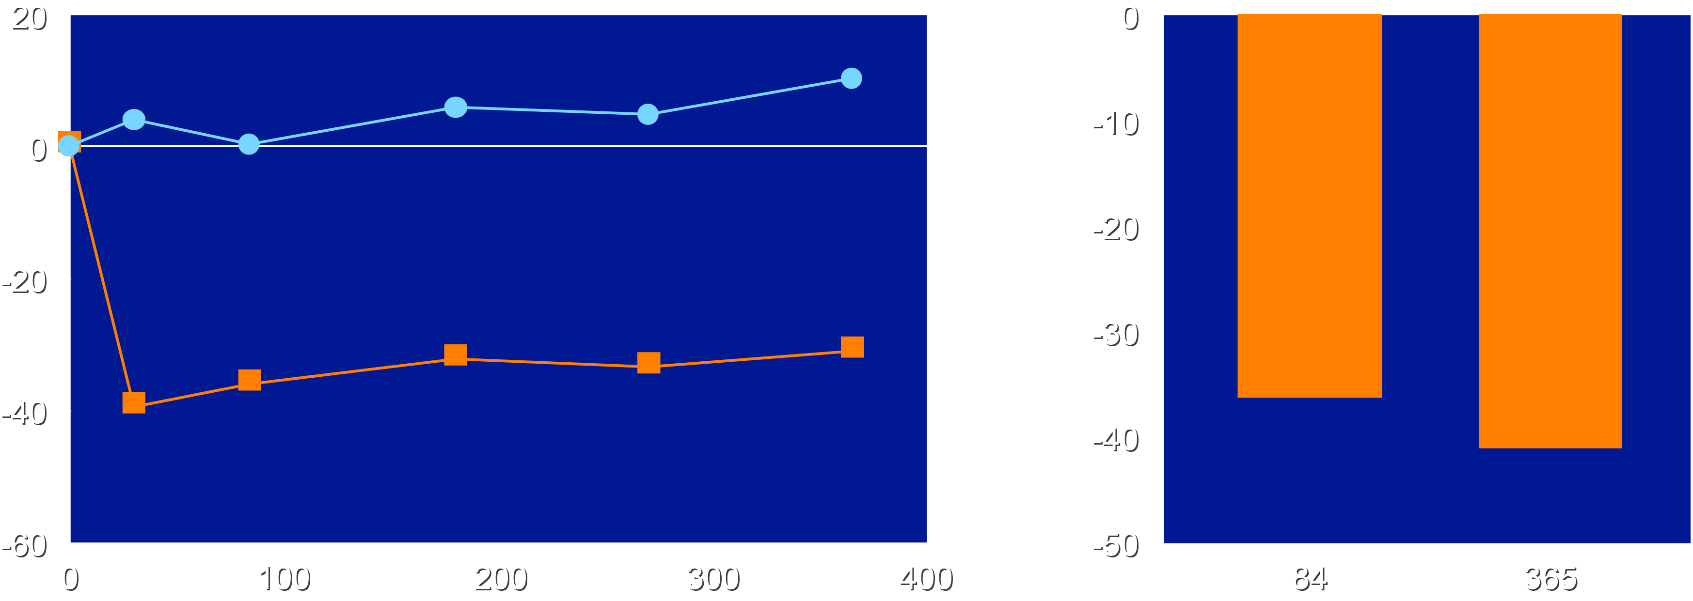
Percent Change in LDL-C with Obicetrapib
Percent Change in LDL-C
Placebo-adjusted Percent
Change in LDL-C
10.3
4.0
5.9
4.8
0.3
Percent Change LDL-C
LS Mean Change (%)
-32.3
-33.5
-31.1
-36.1
-39.6
-36.3
Placebo Obicetrapib
-41.5
Both P<0.0001 from baseline
Day
Day

Slide 9
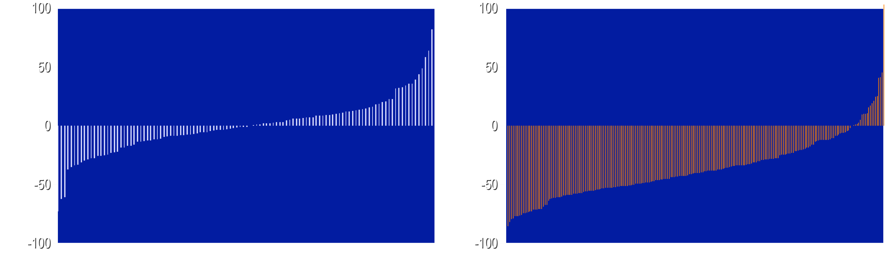
Individual Changes in LDL-C with Placebo and Obicetrapib at Day 84
Placebo
Obicetrapib
Mean Change from Baseline (%)
Mean Change from Baseline (%)
3% achieved LDL-C lowering >50%
34% achieved LDL-C lowering >50%

Slide 10
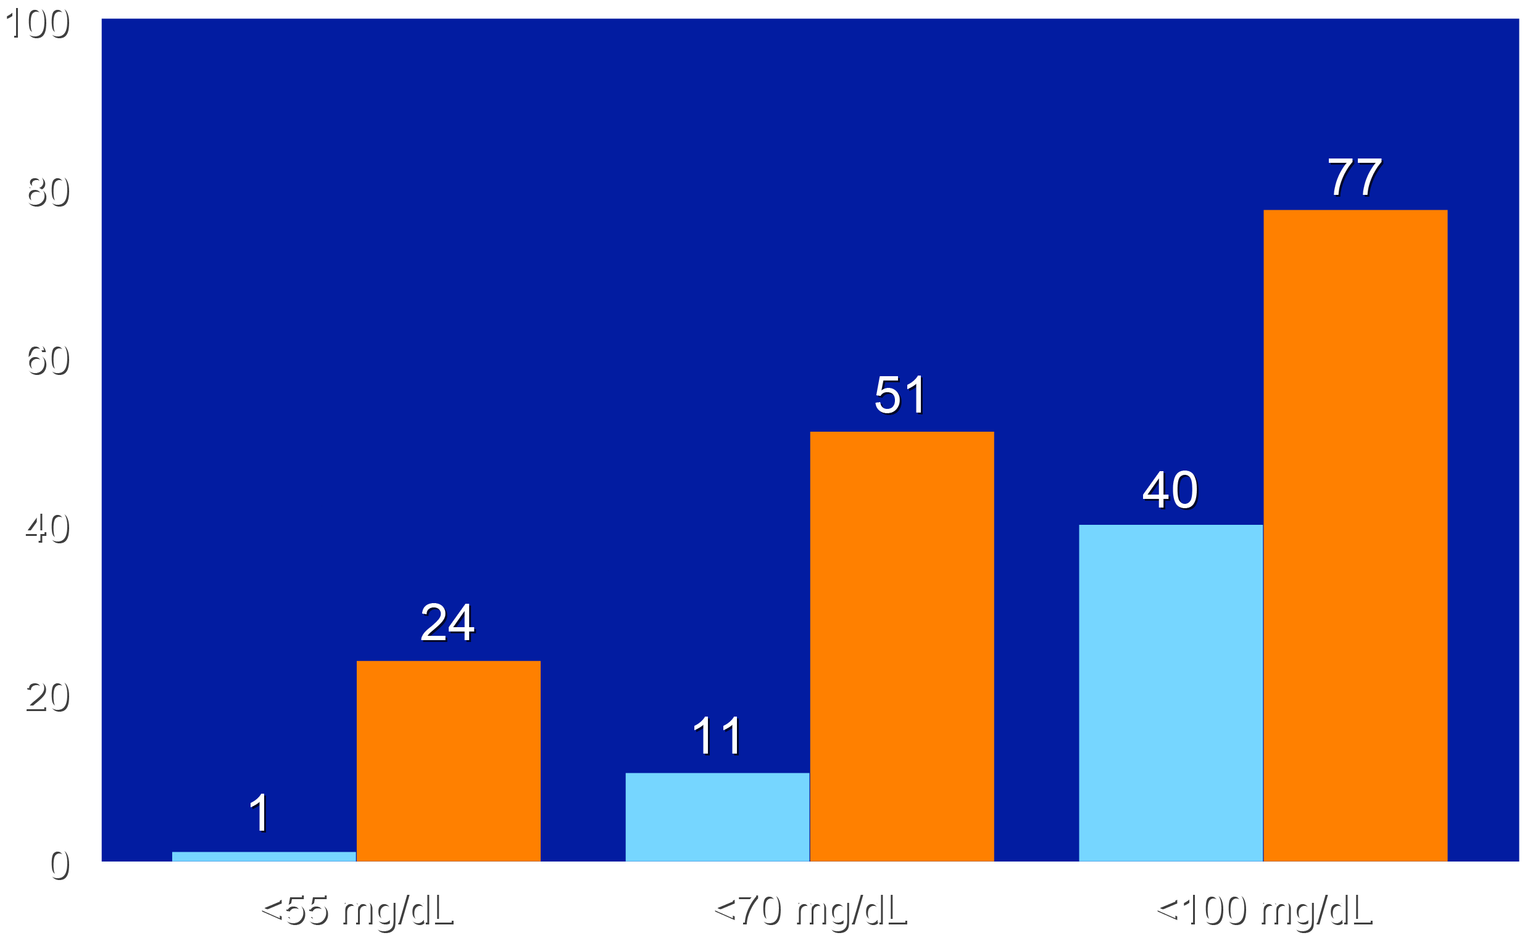
Percent of Patients Achieving LDL-C Goals
Placebo
Obicetrapib
Percent

Slide 11
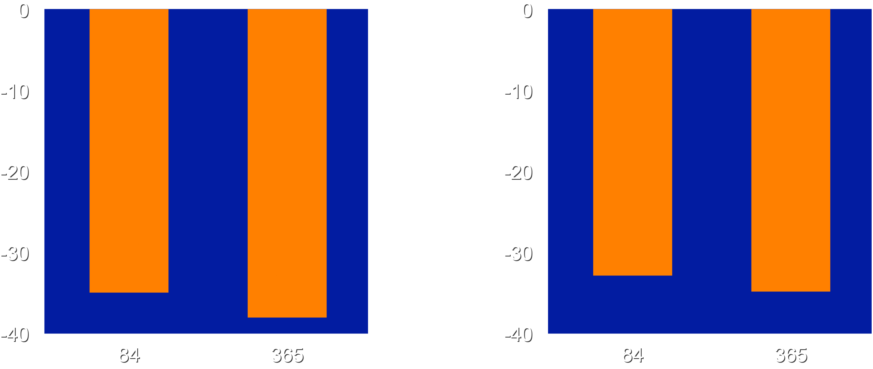
Percent Change in non-HDL-C and ApoB
Placebo-adjusted Percent Change in non-HDL-C
Placebo-adjusted Percent
Change in ApoB
LS Mean Change (%)
LS Mean Change (%)
-24.4
-34.5
-37.5
-24.4
-25.8
-34.5
-25.8
-37.5
Day
Day

Slide 12
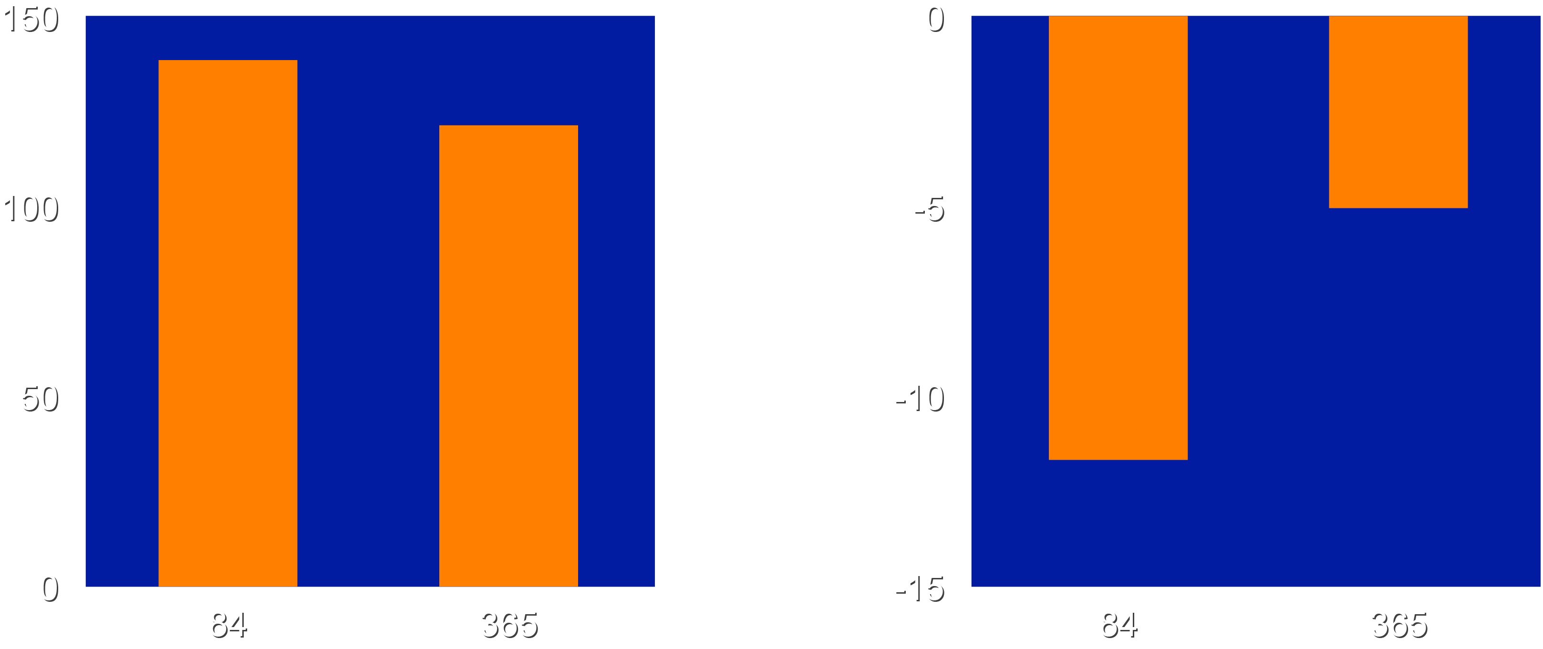
Percentage Change in HDL-C and Triglycerides
Placebo-adjusted Percent Change in HDL-C
Placebo-adjusted Percent
Change in Triglycerides
138.7
121.4
-5.1
LS Mean Change LDL-C
LS Mean Change (%)
-11.7
Day
Day

Slide 13
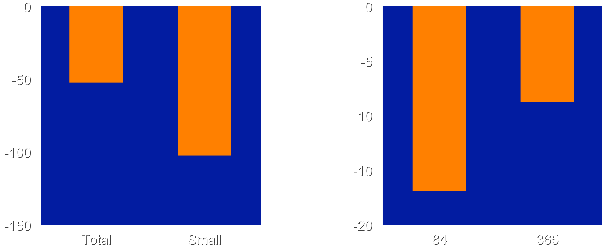
Percent Change in LDL Particles and hsCRP
Placebo-adjusted Percent Change in LDL Particles at Day 180
Placebo-adjusted Percent
Change in hsCRP
-52.5
Percent Change
Percent Change
-8.8
-102.4
-16.8
LDL Particles
Day

Slide 14
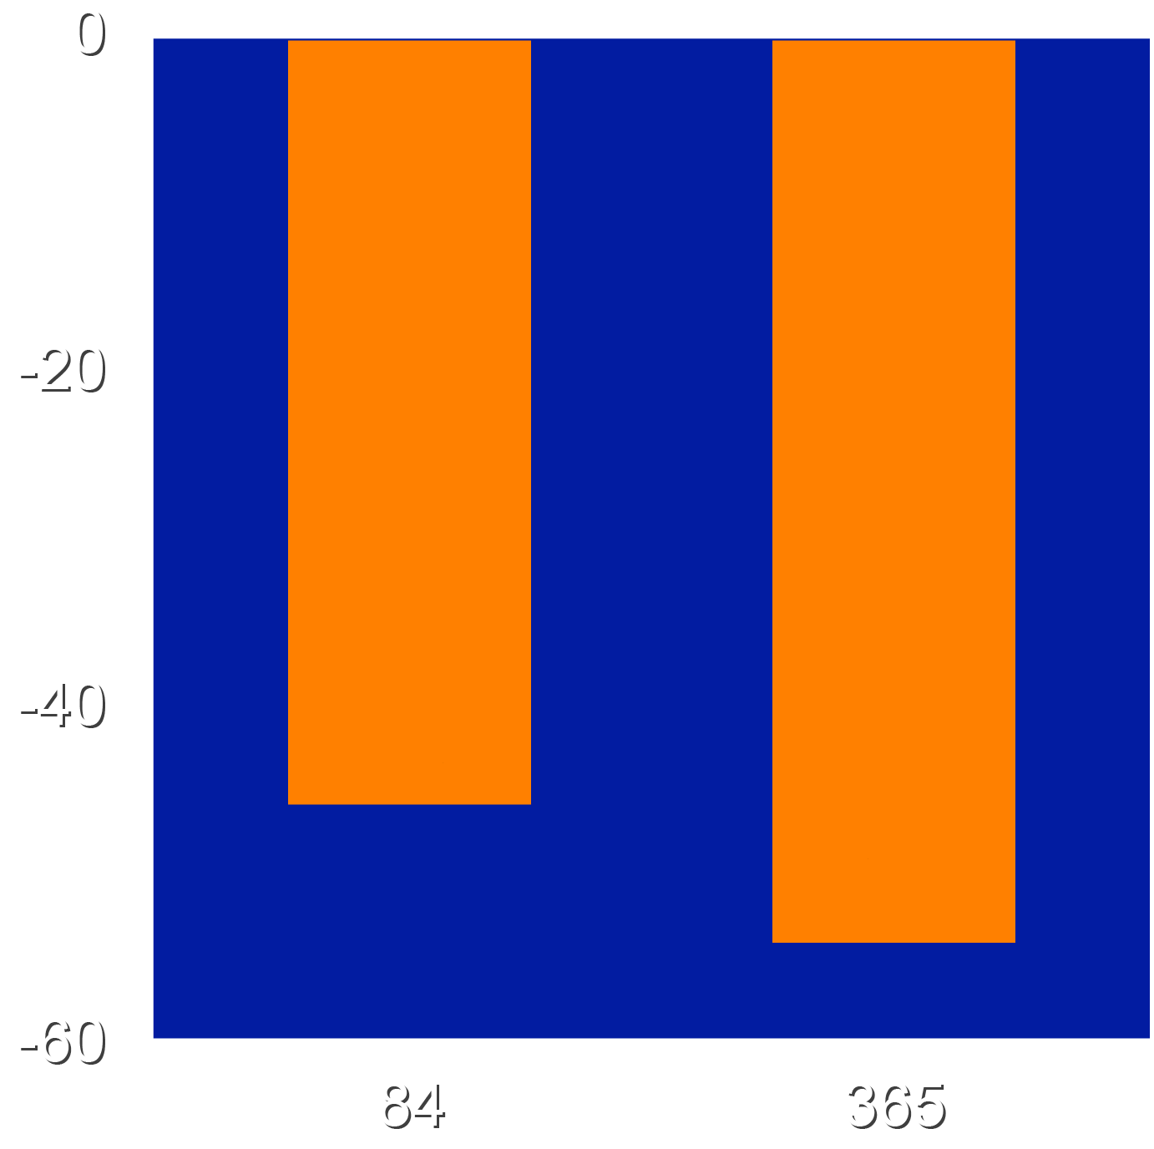
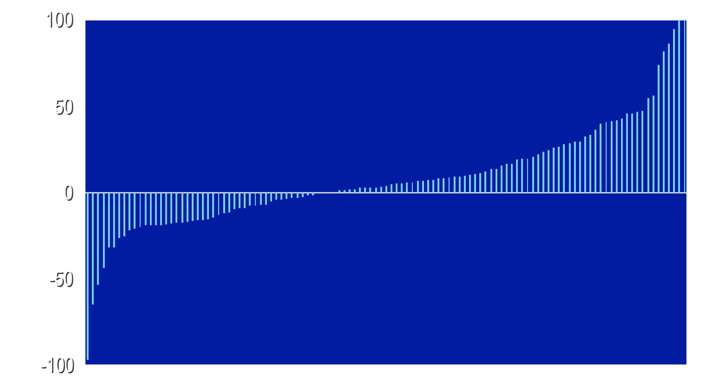
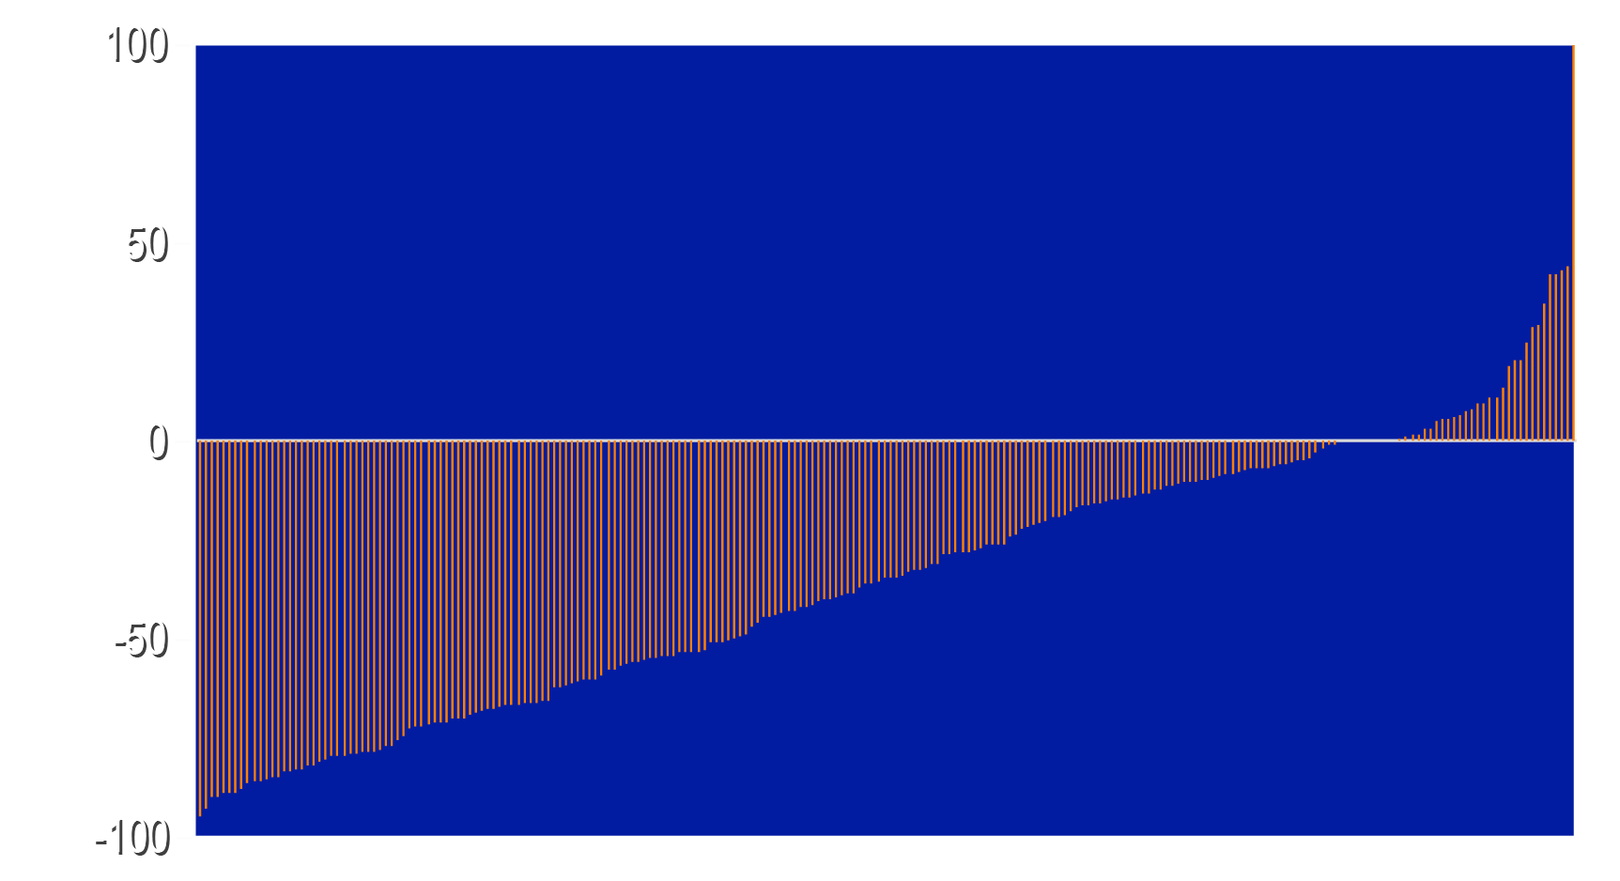
Percent Changes in Lp(a)
Placebo-adjusted Percent Change in Lp(a)
Individual Percent
Changes in Lp(a)
Placebo
% Change Lp(a)
% LS Mean Change
3% achieved >50% lowering
Obicetrapib
-45.9
-45.9
-54.3
-54.3
% Change Lp(a)
Day
38% achieved >50% lowering

Slide 15
Safety and Tolerability
Parameter |  | Placebo (N=118) | Obicetrapib (N=236)
Treatment emergent adverse events (%) |  | 70.3 | 63.7
Study drug related adverse events (%) |  | 6.8 | 4.3
 | Mild (%) | 4.2 | 2.1
 | Moderate (%) | 2.5 | 2.1
 | Severe (%) | 0 | 0
Adverse events leading to drug discontinuation (%) |  | 6.8 | 4.3
Adverse events leading to death (%) |  | 1.7 | 1.3
AEs experienced by >5% of patients included influenza, hypertension, nasopharyngitis, diarrhea, upper respiratory tract infection, back pain, headache and fatigue with no difference between the treatment groups.

Slide 16
Events of Special Interest
Parameter | Placebo (N=118) | Obicetrapib (N=236)
AST or ALT >3x ULN (%) | 0 | 0
Bilirubin >2x ULN (%) | 1.7 | 0
CK >5x ULN (%) | 3.4 | 1.3
New diabetes or worsening glycemic control (%) | 22.0 | 20.5
HbA1c increase >0.5% from baseline (%) | 5.1 | 3.4
eGFR <30 or >25% decrease eGFR (%) | 8.5 | 4.3
Macular degeneration (%) | 0 | 0
Cardiovascular events (%) | 4.2 | 2.6

Slide 17
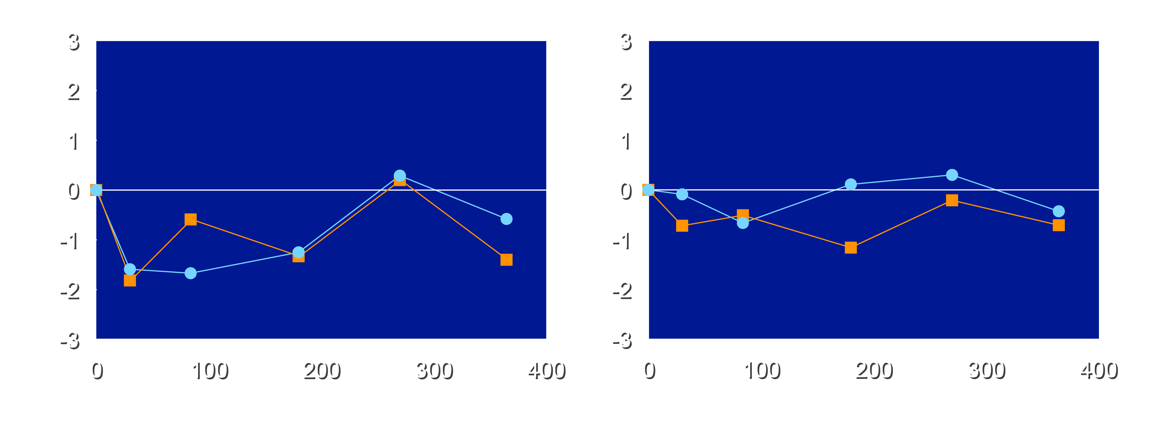
No Significant Change in
Blood Pressure with Obicetrapib
Systolic BP
Diastolic BP
Placebo
Obicetrapib
Placebo
Obicetrapib
0.3
0.1
0.3
-0.1
-0.5
-0.4
-0.6
-0.6
Change Systolic BP (mmHg)
-0.2
Change Systolic BP (mmHg)
-1.6
-1.3
-0.2
-0.7
-0.7
-0.7
-1.3
-1.2
-1.7
-1.4
-1.8
Day
Day

Slide 18
Limitations
The study evaluated the effect of obicetrapib for 365 days,
the effect of longer treatment requires further evaluation.
The Lp(a) lowering was observed in a cohort who were not required to have elevated levels at study entry.
Additional studies will evaluate the impact of obicetrapib in individuals with elevated Lp(a) levels.
Whether treatment with obicetrapib results in a reduction in cardiovascular events remains to be determined.

Slide 19
Summary
Obicetrapib reduced placebo-adjusted LDL-C 36.3% at day 84 and 41.5% at day 365 with >50% reductions observed in 34% of patients
Obicetrapib resulted in placebo-adjusted reductions in Lp(a) by 54.3%, independent of lowering atherogenic lipid parameters and raising HDL-C.
Obicetrapib was well tolerated with no safety concerns.
The longer-term effect of obicetrapib on cardiovascular outcomes
is currently being evaluated in the PREVAIL trial.
The findings suggest that obicetrapib has considerable promise as an approach to more effective lipid control in high CV risk patients.

