Slide 1
OCT Guided LMCA to LAD Angioplasty in Dominant LCX
Nizam’s Institute of Medical Sciences (NIMS), Hyderabad, India

Slide 2
Presenter - Jyotsna Maddury , MD DM, FACC, FESC, FICC
Jyotsna Maddury , MD DM, FACC, FESC, FICC
Lalita Nemani , MD DM, FESC
Satish Kumar Rao Vavilala, MD DTCD , DM Resident
I have no relevant financial relationships

Slide 3
Case details
56 year old male known DM since 5 years, Ex-smoker
C/o SOB FC-II & Chest Pain Since 2months, hemodynamically stable at the time of admission
ECG – Normal Sinus Rhythm 72 bpm Normal Axis No ST-T changes
ECHO – Normal Sized Cardiac Chambers No RWMA Good LV Function
Provisional Diagnosis - CAD CSA NSR Good LV Function
Conventional angiogram shows LMCA disease with proximal LAD disease with dominant LCX.
Plan - OCT+ PCI LMCA to LAD.

Slide 4
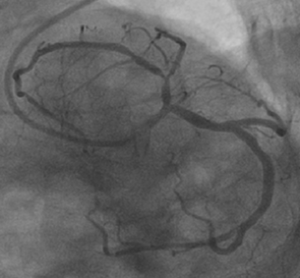
LAO Caudal view

Slide 5
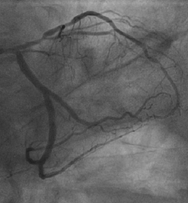
RAO caudal view

Slide 6
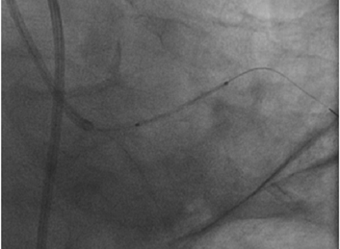
Stent position in proximal LAD

Slide 7
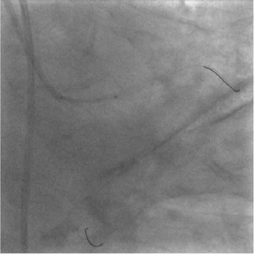
LMCA stent position

Slide 8
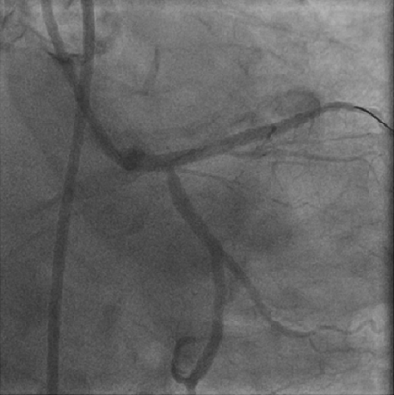
Final Result after LMCA to LAD stent overlap

Slide 9
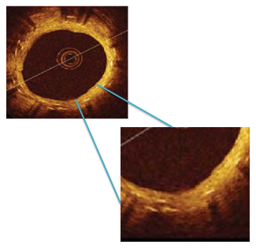
Stent overlap from LMCA to LAD

Slide 10
STENT overlap from LMCA to LAD

Slide 11
Take home message
OCT imaging is useful tool for planning PCI and optimizing stent deployment in patient with significant LMCA disease.
OCT provides valuable information regarding lumen dimensions, plaque composition,extension and also helpful in stent overlap.
Frequency domain OCT provides 10 times greater resolution than IVUS and offers excellent contrast between lumen and vessel wall imaging.

Slide 12
Thank you

