Slide 1







Dapagliflozin after Transcatheter Aortic Valve Implantation
Sergio Raposeiras-Roubin
MD, PhD
@S_Raposeiras
SOCIEDAD GALLEGA DE CARDIOLOGÍA

Slide 2





CHICAGO
March 29
Dapagliflozin after Transcatheter Aortic Valve Implantation
ClinicalTrials.gov Identifier: NCT04696185 EudraCT 2020-003930-18
@DapaTAVI
Sergio Raposeiras-Roubin

Slide 3









DapaTAVI is an independent trial
Disclosures
SOCIEDAD GALLEGA DE CARDIOLOGÍA
All authors declare no conflicts of interest related to this study
FUNDING: DapaTAVI received partial financial from unrestricted grants from the Spanish Government [Instituto de Salud Carlos III (ISCIII; FIS PI19/01882)], the Castilla-León Government [Gerencia Regional de Salud de la Junta de Castilla y León y Fondos FEDER (2459/A/21; GRS 2459/A/21, 2022)], the Spanish Society of Cardiology (SEC/FEC-INV-CLI 21/004) and the Galician Society of Cardiology (SOGACAR 2022).
Promotors: Spanish Society of Cardiology and Spanish National Center for Cardiovascular Research
Sergio Raposeiras-Roubín, MD, PhD

Slide 4

Background
AORTIC STENOSIS is one of the most common VHD
Despite TAVI, PATIENTS STILL FACE HIGH RATES OF HEART FAILURE
TAVI has changed how aortic
stenosis is managed
Patients with HF secondary to VHD or undergoing valvular interventions were excluded from RCT with SGLT2i
SGLT2i have shown benefit
in all spectrum of HF
Patients undergoing TAVI
tend to be elderly
Patients > 80 years are underrepresented in RCT with SGLT2i
Sergio Raposeiras-Roubín, MD, PhD

Slide 5


We need evidence on EFFICACY of SGLT2i in TAVI patients
Background
We need evidence on SAFETY of SGLT2i in very elderly patients
Sergio Raposeiras-Roubín, MD, PhD

Slide 6

Trial design
Prospective Randomized Open Blinded Endpoint (PROBE) controlled trial
Independent and pragmatic
The protocol was approved by the Galician Clinical Research Ethics Committee (approval number 2020/434), the Spanish Agency of Medicines and Medical Devices (AEMPS 20-0748), and the investigational review boards at each of the participating sites.
The trial was registered in both ClinicalTrials.gov (NCT04696185) and the European Clinical Trials Database (EUDRACT 2020-003930-18)
Randomization 1:1
Stratified by the presence of diabetes mellitus, a
LVEF≤40%, and an eGFR 25-75 ml/min/1.73 m2
At time of hospital discharge after
TAVI or within 14 days of discharge
Dapagliflozin
No Dapagliflozin
SOCIEDAD GALLEGA DE CARDIOLOGÍA
Sergio Raposeiras-Roubín, MD, PhD

Slide 7
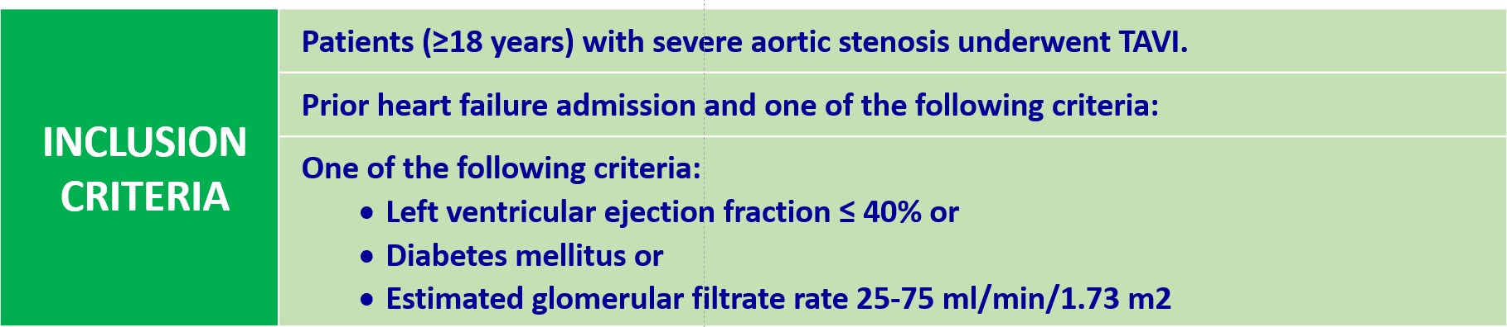
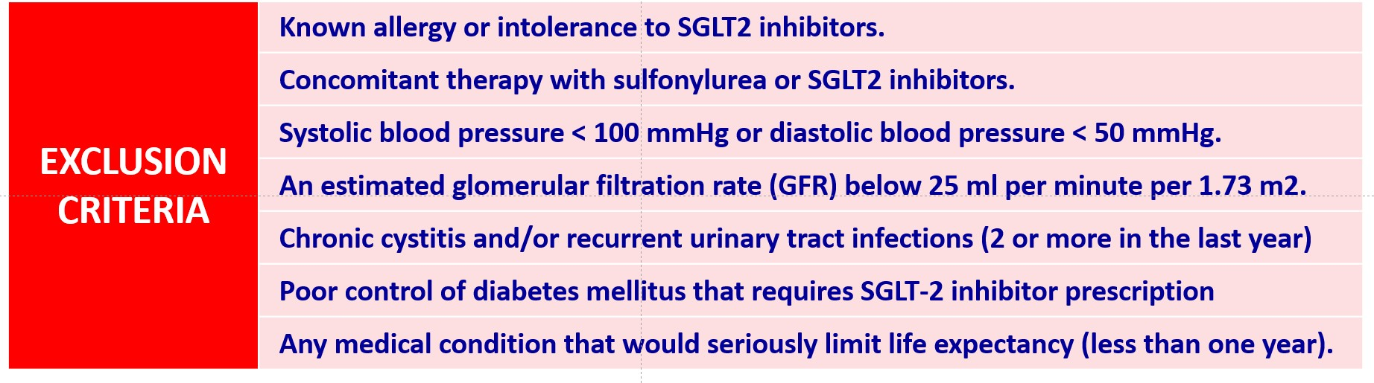
Inclusion/Exclusion Criteria
Sergio Raposeiras-Roubín, MD, PhD

Slide 8





Endpoints
PRIMARY
ENDPOINT
Composite of all-cause death or worsening HF
(defined as any hospitalization for HF or urgent HF visit requiring iv diuretics)
3 months
1 year
All-cause death
Hospitalization for HF and urgent HF visit requiring iv diuretics
Cardiovascular death
Composite of hospitalization for HF or cardiovascular death
SECONDARY ENDPOINTS
Telephone interviews Review of medical records
National vital status registries
Clinical outcomes were externally adjudicated by a clinical panel blinded to treatment
Sergio Raposeiras-Roubín, MD, PhD

Slide 9
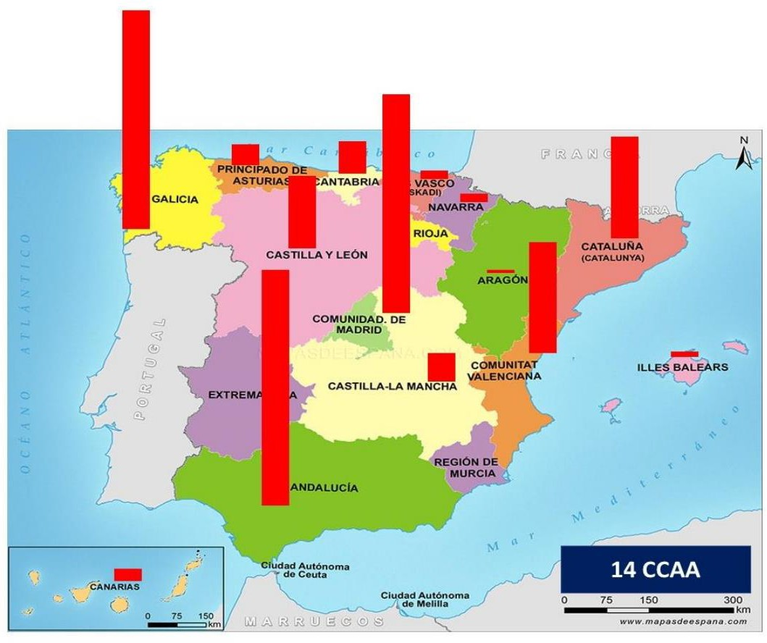
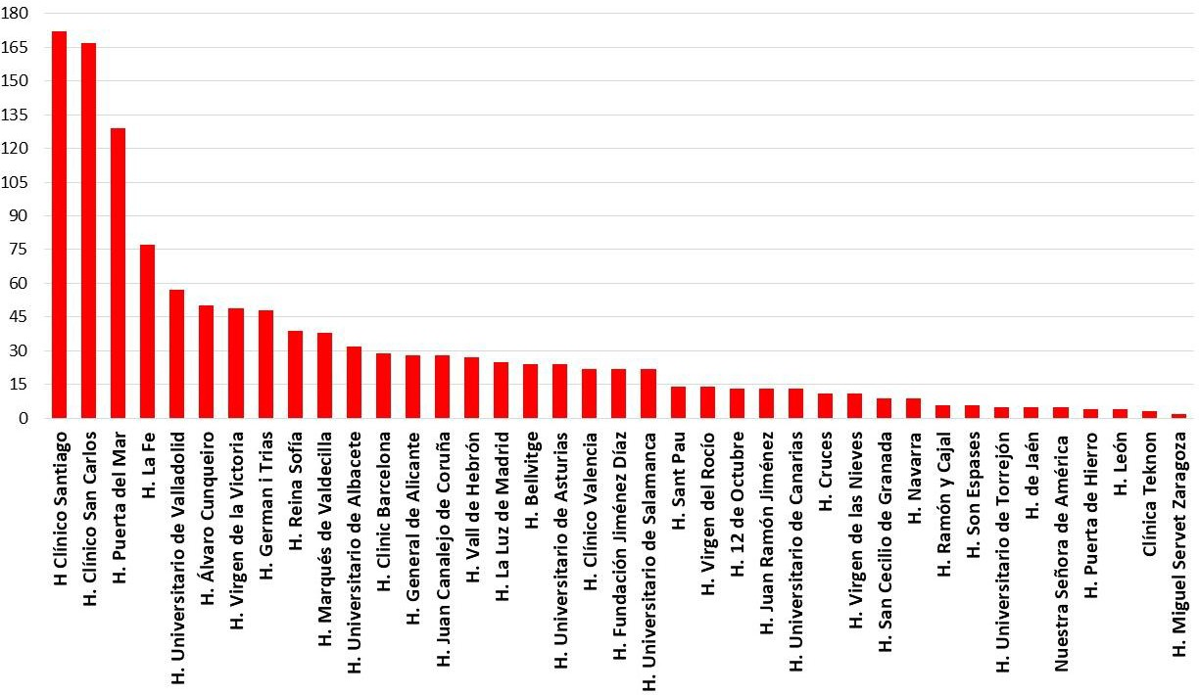
1,257
Study population
Multicenter: 39 centers across Spain
Recruitment by center
Number of patients
39 HOSPITALS
January 2021
December 2023
SPAIN
14 regions
Sergio Raposeiras-Roubín, MD, PhD

Slide 10
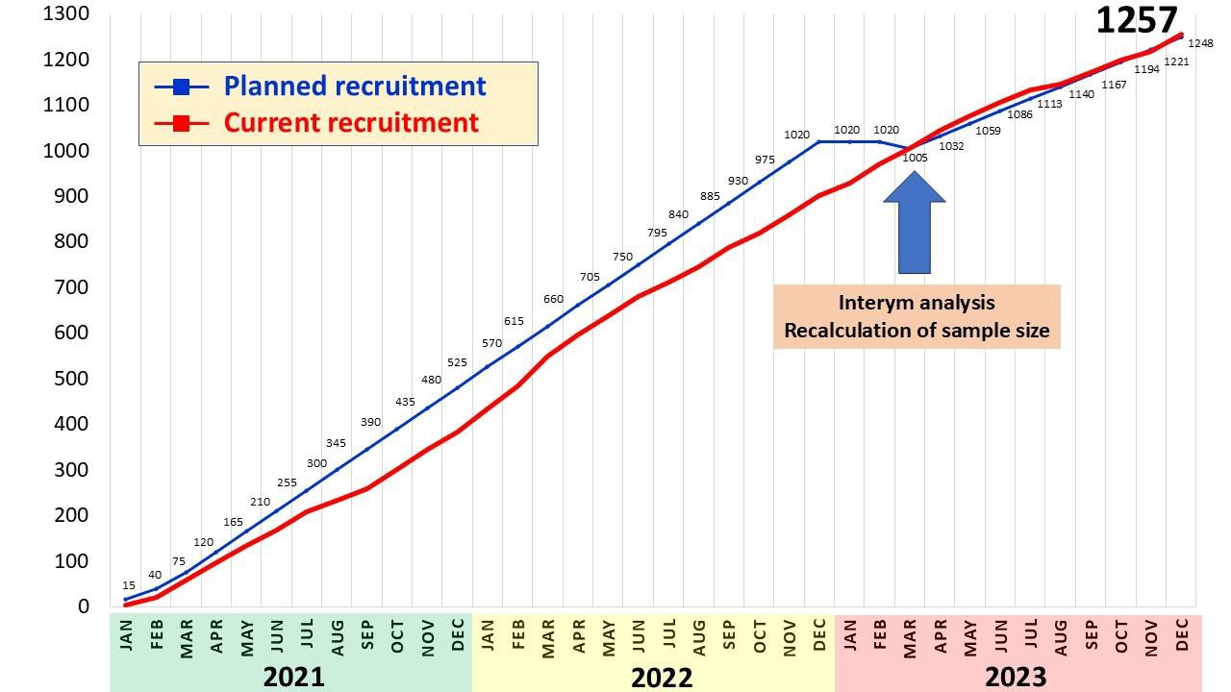


Recruitment
Recruitment rate
1,020
23%
1,257
CALCULATION OF SAMPLE SIZE
Anticipated event of primary composite outcome: 30% in control group
Dapagliflozin associated with 30% RRR (80% power) Estimated loss during follow-up of 5%
Sergio Raposeiras-Roubín, MD, PhD

Slide 11
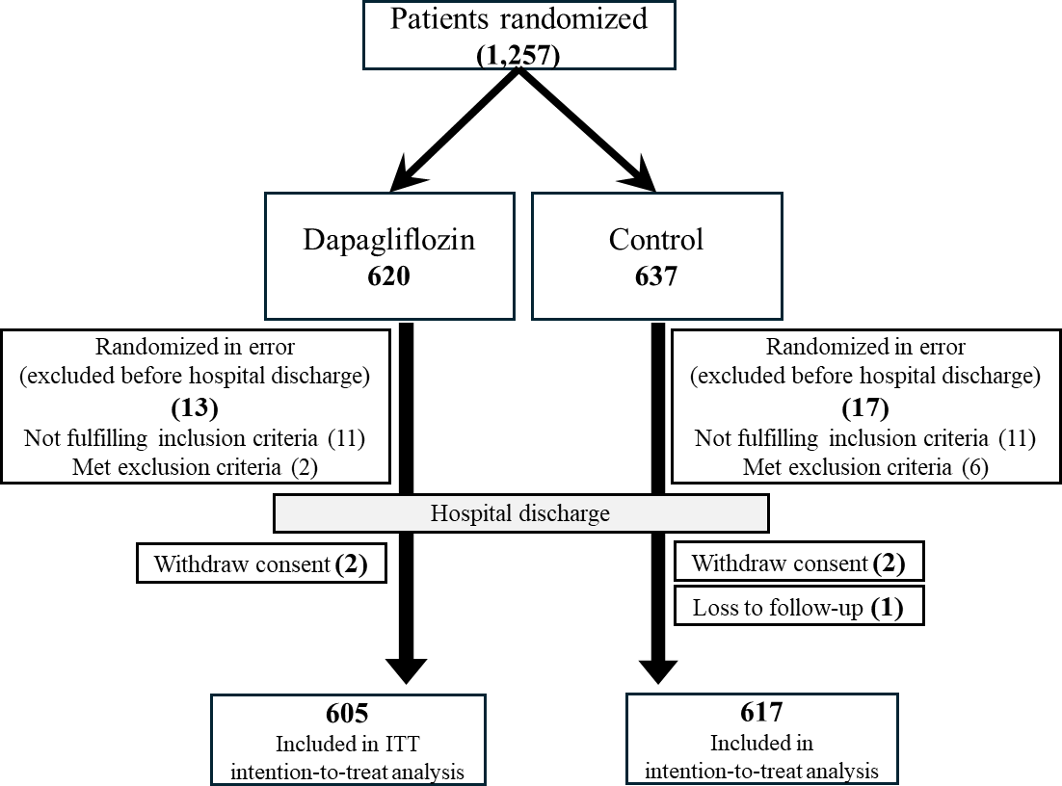
Patient flow
© Copyright 2025
Sergio Raposeiras-Roubín, MD, PhD

Slide 12
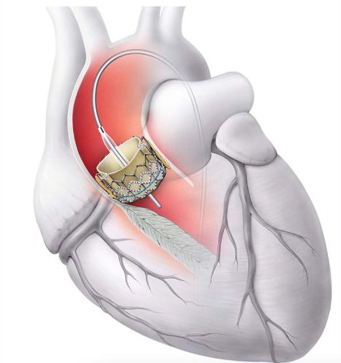
Randomization and cross-overs
Total crossover rate = 12%
103
(17%)
Dapagliflozin
N=605
Crossovers
Stopping treatment with dapagliflozin during the follow-up
2 days (1-4)
No Dapagliflozin N=617
43
(7%)
Crossovers
RANDOMIZATION
Initiation of STGL-2 inhibitors for reasons other than HF
Sergio Raposeiras-Roubín, MD, PhD

Slide 13
Baseline Characteristics
Characteristic | Dapagliflozin Group (N = 605) | Control Group (N = 618*)
Age — yr | 82.4±5.6 | 82.4±5.5
Female sex — no. (%) | 299 (49.4) | 305 (49.4)
Diabetes mellitus type 2 — no. (%) | 264 (43.6) | 273 (44.2)
Hypertension — no. (%) | 518 (85.6) | 519 (84.0)
Coronary artery disease — no. (%) | 237 (39.2) | 197 (31.9)
Previous myocardial infarction — no. (%) | 51 (8.4) | 52 (8.4)
Prior stroke — no. (%) | 61 (10.1) | 69 (11.2)
Peripheral artery disease — no. (%) | 51 (8.4) | 43 (7.0)
Atrial fibrillation — no. (%) | 250 (41.3) | 274 (44.3)
Estimated GFR — ml/min/1.73 m2 | 56.0±16.4 | 56.4±16.3
Left ventricular ejection fraction — % | 54.9±12.3 | 54.8±12.1
New-onset bundle branch block — no. (%) | 151 (32.0) | 146 (32.6)
Pacemaker implantation — no. (%) | 105 (19.3) | 103 (19.0)
Post-TAVI aortic regurgitation grade 3+ — no. (%) | 27 (4.5) | 37 (6.0)
* 1 patient was lost to follow-up
Sergio Raposeiras-Roubín, MD, PhD

Slide 14
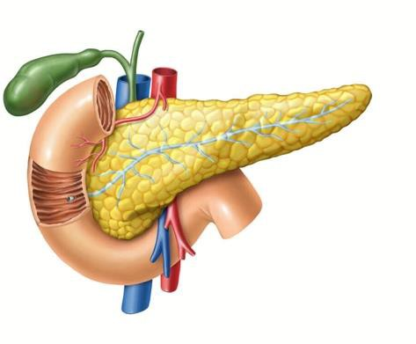
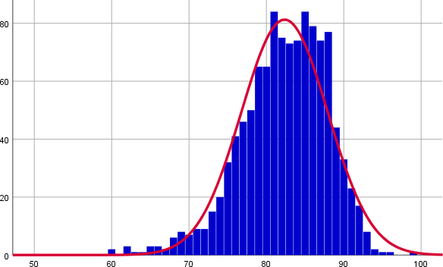


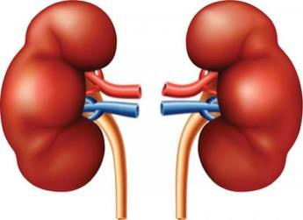
43,9%
(n=537)
Baseline Characteristics
49.4% women
82,4 ± 5,5 years
Median 83 years (IQR 79-86)
Diabetes
17%
(n=212)
LVEF ≤ 40%
Frequency
From 60 to 99 years
88,6%
(n=1,084)
Age (years)
7,4% ≥ 90 y
CKD-EPI 25-75
Sergio Raposeiras-Roubín, MD, PhD

Slide 15

RESULTS: Primary end-point (intention to treat analysis)
Control Group: 124 patients (20.1%)
Dapagliflozin Group: 91 patients (15.0%)
HR 0.72 (95% CI 0.55-0.95)
P=0.018
© Copyright 2025
Sergio Raposeiras-Roubín, MD, PhD

Slide 16
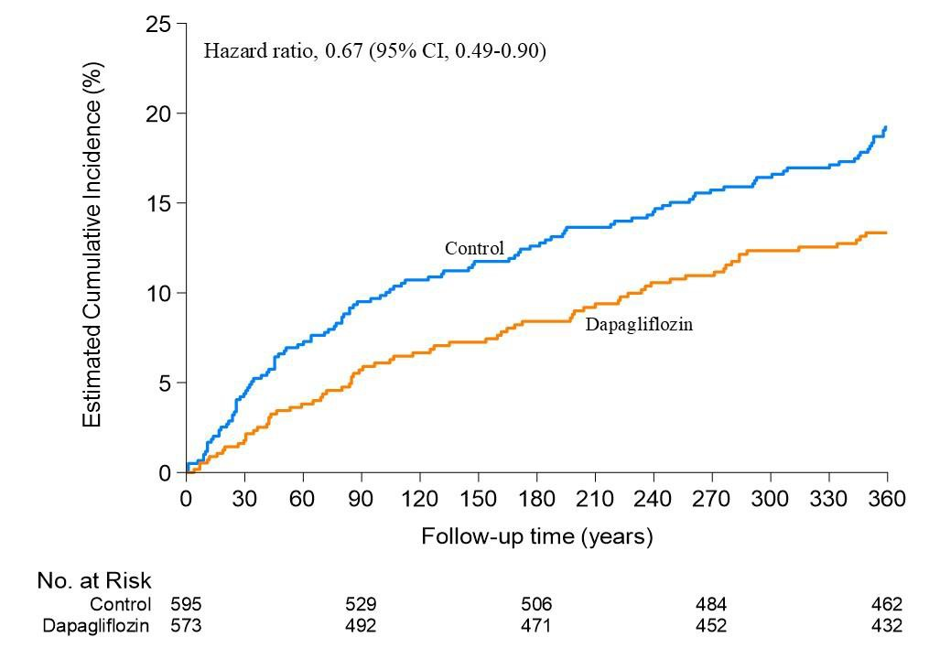
RESULTS: Primary end-point (per protocol analysis)
HR 0.67 (95% CI 0.49-0.90)
© Copyright 2025
Sergio Raposeiras-Roubín, MD, PhD

Slide 17
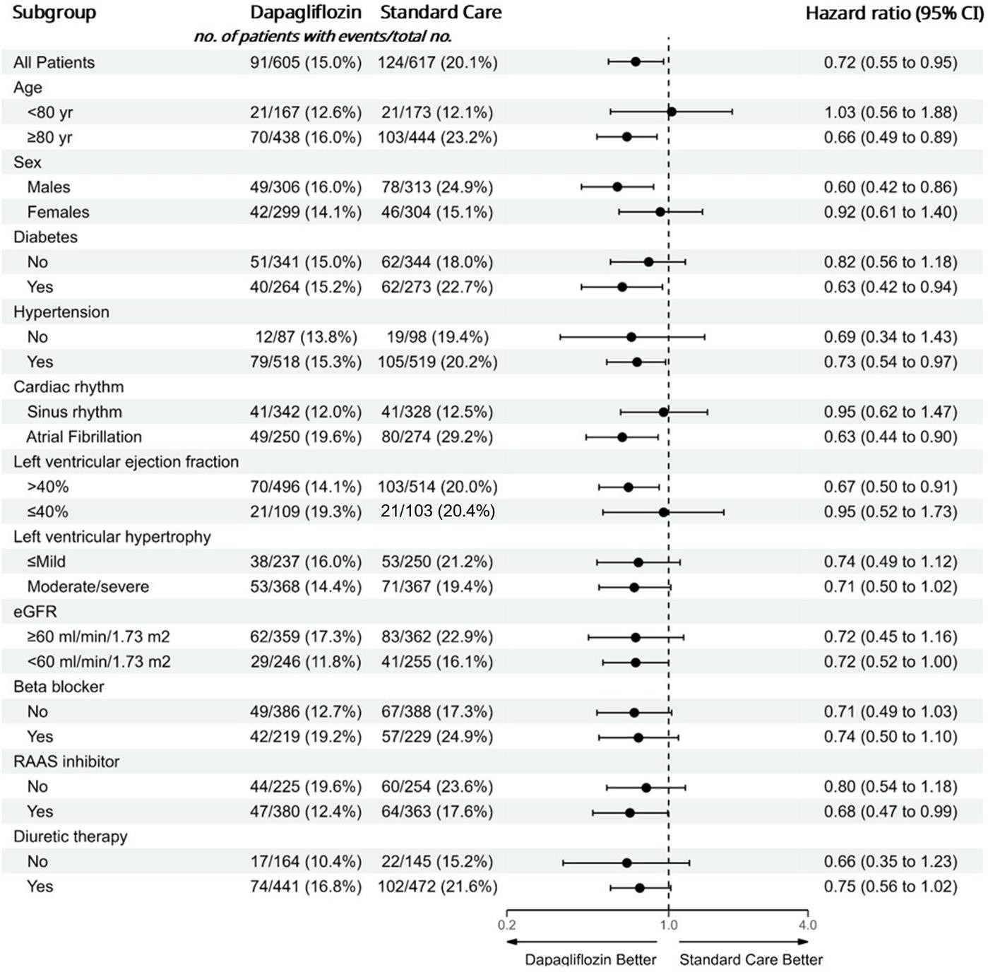
RESULTS: Subgroup analysis
The effect of dapagliflozin on the primary outcome also appeared consistent across prespecified subgroups
© Copyright 2025
Sergio Raposeiras-Roubín, MD, PhD

Slide 18
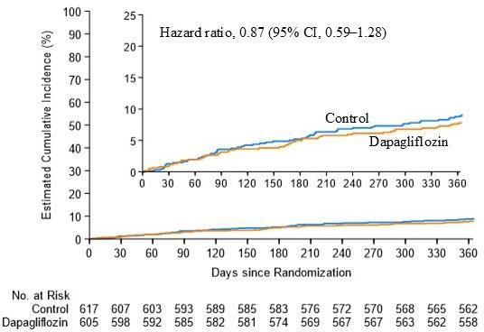
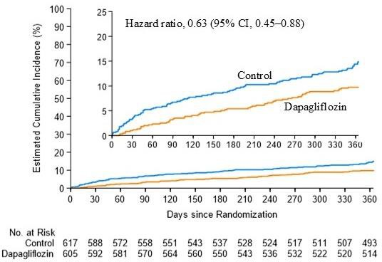
RESULTS: Secondary end-points
All-cause Death
Worsening HF
Control Group: 56 patients (9.1%)
Dapagliflozin Group: 47 patients (7.8%)
HR 0.87 (95% CI 0.59-1.28)
Control Group: 89 patients (14.4%)
Dapagliflozin Group: 57 patients (9.4%)
HR 0.63 (95% CI 0.45-0.88)
© Copyright 2025
Sergio Raposeiras-Roubín, MD, PhD

Slide 19

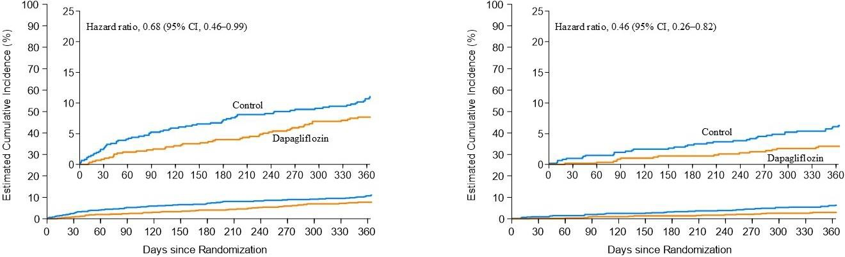

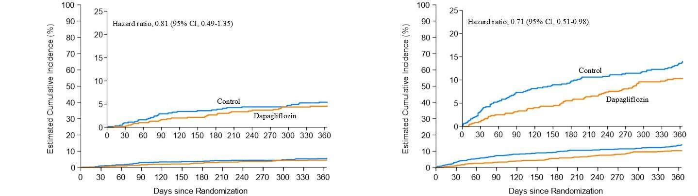
RESULTS: Secondary end-points
Hospitalization for HF
Urgent HF Visit
HR 0.68 (95% CI 0.46-0.99)
HR 0.46 (95% CI 0.26-0.82)
Cardiovascular Death
CV Death or Hospitalization for HF
HR 0.81 (95% CI 0.49-1.35)
HR 0.71 (95% CI 0.51-0.98)
© Copyright 2025
Sergio Raposeiras-Roubín, MD, PhD

Slide 20
RESULTS: Safety end-points
End Point | Dapagliflozin Group (N = 605) |  | Standard care Group (N = 617) |  | P-value
 | Value | Incidence | Value | Incidence
 |  | no. of events per 100 patient-yr |  | no. of events per 100 patient-yr
Genitourinary infections | 94 | 15.5 | 71 | 11.5 | 0.04
Genital infections | 11 | 1.8 | 3 | 0.5 | 0.03
Urinary infections | 83 | 13.7 | 68 | 11.0 | 0.15
Relevant urinary infections | 17 | 2.8 | 11 | 1.8 | 0.23
Bacteremia | 31 | 5.1 | 32 | 5.2 | 0.96
Hypotension | 40 | 6.6 | 22 | 3.6 | 0.01
Syncope | 22 | 3.6 | 13 | 2.1 | 0.11
Ketoacidosis | 0 | 0 | 0 | 0 | -
Major Hypoglycemia | 4 | 0.7 | 8 | 1.3 | 0.26
Necrotizing fasciitis | 0 | - | 0 | - | -
Non-traumatic amputation | 5 | 0.8 | 4 | 0.6 | 0.72
Cancer | 30 | 5 | 22 | 3.6 | 0.23
Sergio Raposeiras-Roubín, MD, PhD

Slide 21

CONCLUSION
Among elderly patients with aortic stenosis undergoing TAVI and at high risk for heart failure, dapagliflozin was safe and reduced the incidence of all-cause death or worsening heart failure compared to standard care
Sergio Raposeiras-Roubín, MD, PhD

Slide 22
Musical abstract
Dapa-Kuduro Song
Sergio Raposeiras-Roubín, MD, PhD

Slide 24





Acknowledgments
LIST OF INVESTIGATORS: Hospital Clínico Santiago: Diego López Otero, Xoan Carlos Sanmartín Pena, Javier López País, José Ramón Gonzalez Juanatey. Hospital Clínico San Carlos: Luis Nombela Franco, Gabriela Tirado, Carlos Real, Nieves Gonzalo López, Pablo Salinas Sanguino, Pilar Jiménez Quevedo, Antonio Fernández Ortiz. Hospital Puerta del Mar: Livia Gheorge, German Calle, Alejandro Gutierrez Barri. Hospital La Fe Valencia: Francisco Ten Morro, Elena Sánchez Lacuesta, Bernabé López Ledesma, Jorge Sanz-Sánchez. Hospital Universitario de Valladolid: Ignacio Amat Santos, Carlos Baladrón Zorita, José Raúl Delgado Arana, Alejandro Barrero, Sandra Santos, Esther Sanz Patiño, Javier Gómez- Herrero, Clara Fernandez-Cordón, Mario García Gómez, Marcelo Rodriguez, Akash Jain. Hospital Álvaro Cunqueiro: Sergio Raposeiras Roubín, Pablo Domínguez-Erquicia, Rodrigo Estévez-Loureiro, Lucía Riobóo Lestón, Ana Ledo, Antonio De Miguel, Saleta Fernández, Víctor Jiménez Díaz, Berenice Caneiro Queija, Alberto Ortiz, Guillermo Bastos, Rocío González Ferreiro, Inmaculada González Bermúdez, Juan Ocampo Míguez, Rafael Cobas Paz, Andrea Lizancos, Francisco Calvo. Hospital Virgen de la Victoria: Antonio Jesús Muñoz García, Erika Muños García, Juan H Alonso Briales, Javier Alcaide. Hospital German Trias i Pujol: Victoria Vilalta del Olmo, Eduard Fernandez Nofrerias, Xavier Carrillo Suares, Edgar Fadeuilhe Grau. Hospital Reina Sofía: Manuel Pan Álvarez, Soledad Ojeda, Javier Suarez de Lezo, Jorge Perea, Francisco J. Hidalgo. Hospital Marqués de Valdecilla: José María De la Torre, Gabriela Veiga Fernández. Hospital Universitario de Albacete: Juan Gabriel Córdoba Soriano, Jesús Jiménez Mazuecos, Arsenio Gallardo López. Hospital Clinic Barcelona: Ander Regueiro, Endaitz Estebanez, Pedro Cepas. Hospital General de Alicante: Pascual Bordes Siscar, Juan Miguel Ruiz Nodar, Miriam Sandín Rollán, Juan Quiles, Raquel Ajo Ferrer, María Ajo Ferrer, Marta Herrero, Vicente Mainar, José Valencia Martín, Javier Pineda Rocamora, Fernando J. Torres Mezcua, Teresa Lozano Palencia. Hospital Juan Canalejo de Coruña: Jorge Salgado Fernández, Xacobe Flores Ríos, Elizabet Méndez Eirín, María Soto Núñez.Hospital Vall de Hebrón: Bruno García, Ignacio Ferreira, Aitor Uribarri, Ricardo Palma. Hospital La Luz de Madrid: Roberto Martín Reyes, Jorge Palazuelos Molinero, Daniele Gemma, Ana Lucía Rivero Monteagudo. Hospital Bellvitge: Rafael Romaguera, Josep Comin Colet, Joan A. Gomez-Hospital. Hospital Universitario de Asturias: Cesar Morís, Pablo Avanzas, Ana Ayesta. Hospital Clínico Valencia: Sergio García Blas, Juan Sanchis Forés, Julio Núñez Villota, Gema Miñana Escriva, Ernesto Valero Picher, Jesskika González D´Gregorio, Agustín Fernández Cisnal, Clara Bonanad Lozano. Hospital
Thanks to all patients and DapaTAVI family
†DapaTAVI Colaborators: Pablo Domínguez-Erquicia, María Melendo-Viu, María Cespón- Fernández, Rodrigo Estévez-Loureiro, Javier López-Pais, José Ramón González-Juanatey, Gabriela Tirado, Alejandro Gutierrez-Barri, Jorge Sanz-Sánchez, Javier Gómez-Herrero, Erika Muñoz García, Xavier Carrillo Suares, Manuel Pan-Álvarez, Gabriela Veiga-Fernández, Jesús Jiménez Mazuecos, Juan Miguel Ruiz Nodar, Xacobe Flores Rios, Ignacio Ferreira, Jorge Palazuelos Molinero, Pablo Avanzas, Juan Sanchís, Antonio Piñeiro Lozano, Javier Moreiras, Lluis Asmarats Serra, Manuel Villa Gil-Ortega, Fernando Sarnago Cebada, José Francisco Díaz Fernández, Geoffrey Yanes Bowden, Roberto Blanco Mata, María Molina Jiménez, Manuel López Pérez, Raul Ramallal Martínez, Luis Manuel Domínguez Rodríguez, Antonio Morcuende González, Juan Ruiz-García, Rosa Fernández Olmo, Marta Cobo, María López Benito, José Antonio Diarte de Miguel, Juan Carlos SanMartín Pena, Diana Pereiro Montes, Carlos Real, Nieves Gonzalo López, Pablo Salinas Sanguino, Pilar Jiménez Quevedo, Antonio Fernández Ortiz, German Calle, Bernabé López Ledesma, Francisco Ten Morro, Elena Sánchez Lacuesta, Clara Fernandez-Cordón, Mario García Gómez, Marcelo Rodriguez, Akash Jain, Lucía Riobóo Lestón, Ana Ledo, Antonio De Miguel, Saleta Fernández, Víctor Jiménez Díaz, Berenice Caneiro Queija, Alberto Ortiz, Guillermo Bastos, Juan Ocampo Míguez, Andrea Lizancos, Francisco Calvo, Juan H Alonso Briales, Javier Alcaide, Edgar Fadeuilhe Grau, Eduard Fernandez Nofrerias, Javier Suarez de Lezo, Jorge Perea, Francisco J. Hidalgo, Arsenio Gallardo López, Vicente Mainar, José Valencia Martín, Javier Pineda Rocamora, Fernando J. Torres Mezcua, Juan Manuel Quiles Granado, Teresa Lozano Palencia, Miriam Sandín Rollán, Juan Quiles, Raquel Ajo Ferrer, María Ajo Ferrer, Marta Herrero, Elizabet Méndez Eirín, María Soto Núñez, Aitor Uribarri, Ricardo Palma, Daniele Gemma, Ana Lucía Rivero Monteagudo, Ana Ayesta, Clara Bonanad Lozano, Paqui Esteve Claramunt, Regina Blanco del Burgo, Daznia Bompart, Gema Miñana Escriva, Ernesto Valero Picher; Jesskika González D´Gregorio, Agustín Fernández Cisnal, Luis Nieto Roca, Sandra Gómez Talavera, Felipe Navarro del Amo, Antonio Piñero, Paloma Ávila, José A. Esteban-Chapel, José Tuñón, María López Álvarez, Alba Vega-Viyuela, Pablo Antúnez-Muíños, Sergio López-Tejero, Rocio Parrilla Linares, Alba Abril Molina, Elena Jiménez Xarrié, Antonio Delgado Ariza, Carlos Millán Rodríguez, Belén de la Fuente Perdomo, Maria Abellas, Guillermo Sanchez Elvira, Pablo Bazal Chacon, Raul Millán Segovia, Marcos Pascual Sastre, Jaume Maristany Daudert, Angeles Gelines Garcia Fernandez, Miguel Puentes Chiachío, Jesús Marchal Martínez, Felipe Fernández Vázquez, Armando Pérez de Prado, María Cruz Ferrer Gracia, Ana García-Álvarez, Pablo García-Pavía, Noemí Escalera.
Universitario Fundación Jiménez Díaz: Borja Ibáñez, Sandra Gómez-Talavera, Juan A Franco-Peláez, Felipe Navarro del Amo, Antonio Piñeiro, Paloma Avila, José A. Esteban-Chapel, María López Álvarez, Alba Vega-Viyuela, José Tuñón.Hospital Universitario de Salamanca: Ignacio Cruz, Javier Moreiras, Pablo Antúnez-Muíños, Sergio López-Tejero.Hospital Sant Pau: Dabit Arzamendi, Lluis Asmarats. Hospital Virgen del Rocío: Manuel Villa Gil-Ortega, Nieves Romero Rodríguez, Alba Abril Molina, Elena Jiménez Xarrié, Antonio Delgado Ariza, Carlos Millán Rodríguez, Belén de la Fuente Perdomo. Hospital 12 de Octubre: Fernando Sarnago Cebada, Agustín Albarrán, Felipe Díez-del Hoyo. Hospital Juan Ramón Jiménez: José Francisco Díaz Fernández, Santiago Camacho Freire. Hospital Universitario de Canarias: Francisco Bosa Ojeda, Geoffrey Yanes Bowden, Belén de la Fuente Perdomo. Hospital Cruces: Roberto Mata, Juan Carlos Astorga Burgo. Hospital Virgen de las Nieves: Eduardo Molina Navarro, Rocio Parrilla Linares, María Molina Jiménez, Teresa Bretones. Hospital San Cecilio de Granada: Juan Caballero Borrego, Manuel López Pérez. Hospital Navarra: Valeriano Ruiz Quevedo, Raul Ramallal Martínez, Guillermo Sanchez Elvira, Pablo Bazal Chacon, Raul Millán Segovia. Hospital Ramón y Cajal: Ángel Sánchez Recalde, María Abellás, Luis Manuel Domínguez Rodríguez. Hospital Son Espases: Vicente Peral Disdier, Antonio Morcuende González, Raul Millán Segovia, Marcos Pascual Sastre, Jaume Maristany Daudert. Hospital Universitario de Torrejón: Eduardo Alegría-Barrero. Hospital de Jaén: Javier Torres-Llergo, Rosa Fernández Olmo, Miguel Puentes Chiachío, Jesús Marchal Martínez. Hospital Nuestra Señora de América: Gisela Feltés. Hospital Puerta de Hierro: Jose Antonio Fernández Díaz, Marta Cobo. Hospital León: Carlos Cuellas, María López Benito, Felipe Fernández Vázquez, Armando Pérez de Prado, María Cruz Ferrer, María Thiscal, Angeles Gelines Garcia Fernandez. Clínica Teknon: Gustavo David Jimenez Britez. Hospital Miguel Servet Zaragoza: Juan Sánchez-Rubio Lezcano, José Antonio Diarte de Miguel, María Cruz Ferrer Gracia
SOCIEDAD GALLEGA DE CARDIOLOGÍA
Sergio Raposeiras-Roubín, MD, PhD

Slide 25


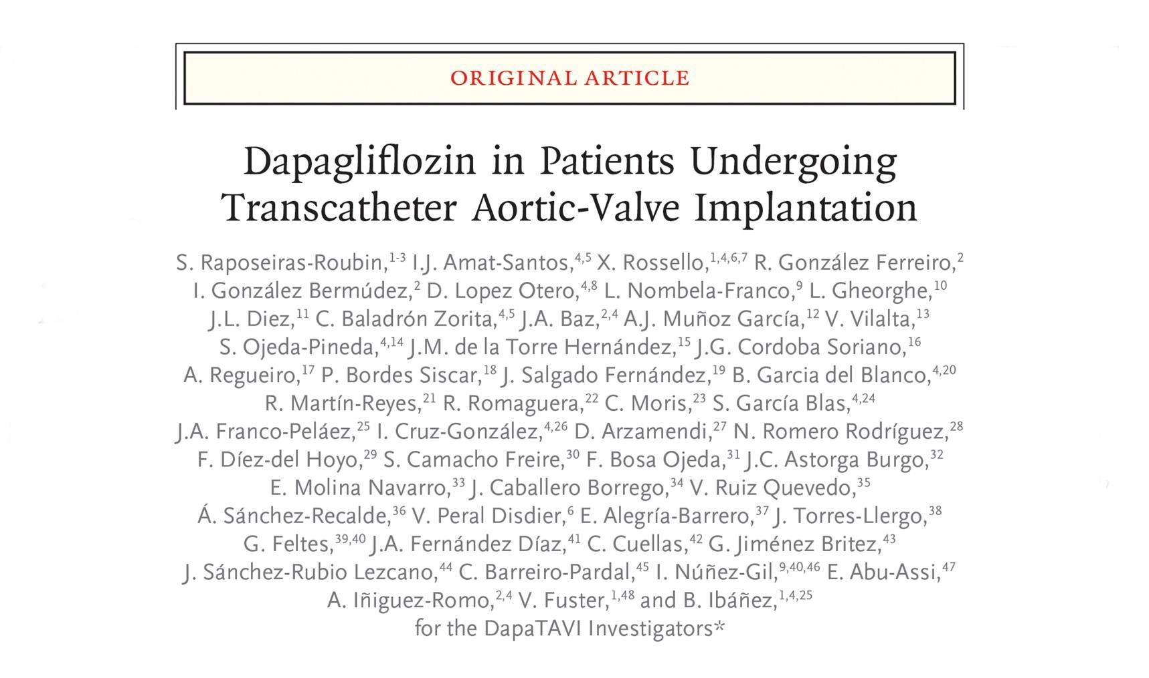

Publication
Sergio Raposeiras-Roubín, MD, PhD

