Slide 1


No benefit - but harm of No-touch Vein Grafts in Coronary Artery Bypass Surgery
A Nordic, multicentre, randomized, registry-based clinical trial on no-touch vein grafts in coronary surgery (SWEDEGRAFT)
Funded by the Swedish research council and the Swedish heart and lung foundation Stefan James, Professor Cardiology Uppsala University Hospital Sweden
31/08/2024

Slide 2
Declaration of interest
- I have nothing to declare
• •
ESC Congress 2024 London & Online

Slide 3
Conclusions
In this multicenter, registry-based, randomized trial (R-RCT) of patients undergoing non-emergent CABG, the no-touch vein technique was not better than the conventional technique regarding vein graft failure or clinical outcomes after up to four years.
No-touch vein harvest was associated with an increased rate of early leg wound complications and residual wound symptoms.
Our trial does not support the routine use of the no-touch harvesting technique compared to the standard technique of vein handling.

Slide 4
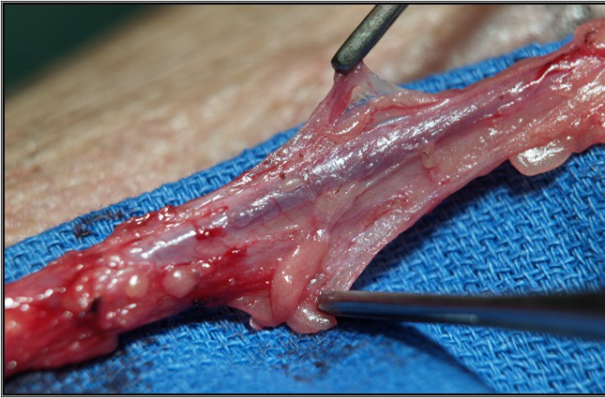

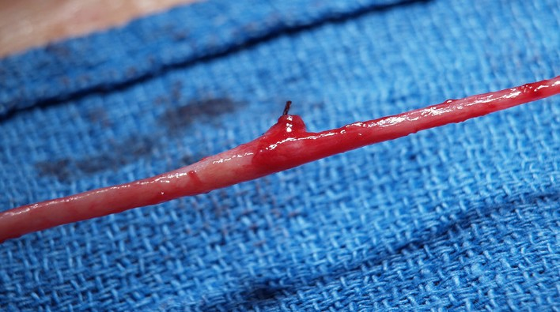
Rationale for the SWEDEGRAFT trial
Coronary Artery Bypass Graft (CABG) is the most common
cardiac surgical procedure with >600,000 operations
No touch
Vein harvesting with a pedicle of surrounding tissue and without vein graft distension
performed every year worldwide
Randomized clinical trials have indicated that saphenous vein graft harvesting using the no-touch technique improves graft patency compared with the conventional open skeletonized technique.
Conventional
Vein skeletonized and stripped of all adventitial tissue and distended prior to implantation.
No-touch vein harvesting should be considered when an open technique is used | IIa | B
Hypothesis: no-touch vein grafts are superior to conventionally harvested veins with respect to
mid-term patency and long-term clinical outcomes.

Slide 5











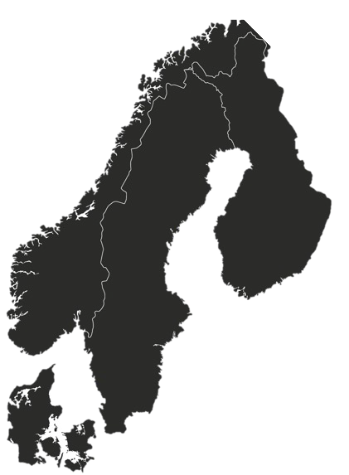



Registry based Randomised Trial design
Inclusion criteria (n=900)
Accepted for first time nonemergent isolated CABG
Age < 80 years
Need for at least one vein graft
No-touch SVG
Randomization
2 years
Telephone
SAQ-7
Computed tomography angiography (CTA)
3 months
Telephone
Conventional SVG
Data collected as part of routine clinical care Long term
8 centers
Western Denmark Heart Registry
1 center
No patients were lost to clinical follow-up

Slide 6


Primary endpoint
CTA was performed at mean duration from randomization of 3.5 (SD 0.4) years
Vein graft failure
Secondary endpoint
No significant difference in the composite of MACE (death, myocardial infarction or repeat revascularization) at a mean of 4.4 (SD 1.3) years
 | Patients with |  | Patients with
Variabel | events (%) | KM (%) | events (%) | KM (%) | HR (95% CI) | P-value
MACE | 57 (12.6) | 7.27 | 44 (9.9) | 4.93 | 1.30 (0.87–1.93) | 0.195

Slide 7
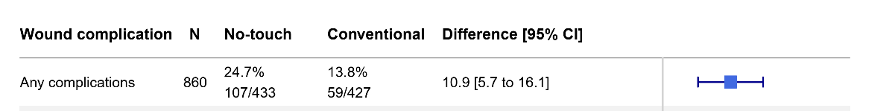
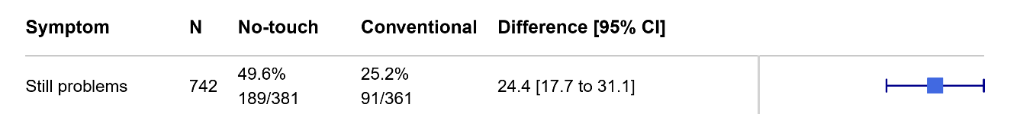
Leg wound complications
More leg wound complications at 3 months in patients randomized to the no-touch technique.
More remaining leg wound symptoms two years after surgery in patients randomized to the no-touch technique.

Slide 8
Thank you!
Executive Committee
Trial Statistician
Stefan Thelin, Uppsala University, Sweden - Coordinating investigator Ivy Susanne Modrau, Århus, Denmark
Olov Duvernoy, Uppsala University, Sweden
Anders Jeppsson, University of Gothenburg, Sweden Ulrik Sartipy, Karolinska Institutet, Sweden
Mats Dreifaldt, Örebro University, Sweden
Stefan James, Uppsala University, Sweden - Study chair
Karin Jensevik Eriksson, Uppsala University hospital
Uppsala Clinical Research Center, UCR
Susanne Heller (Senior Project Leader) Stefano Caramuta, (Lead Data Manager), Ida Björkgren (Publications Manager),
Maria Eriksson-Svensson (Executive director).
Site Investigators
Magnus Dalén, Karolinska University Hospital Anders Ericsson, Blekinge Hospital
Örjan Friberg, Örebro University hospital
Anders Holmgren, University Hospital of Umeå Per Hostrup Nielsen, Aarhus University hospital Henrik Hultkvist, Linköping University Hospital
Shahab Nozohoor, Skåne University Hospital, Lund Sigurdur Ragnarsson, Skåne University Hospital, Lund Lisa Ternström, Sahlgrenska University Hospital
Per Vikholm, Uppsala University hospital
Coronary CTA assessors
Olov Duvernoy, Uppsala University hospital Mats Lidén, Örebro University hospital
Raquel Themudo, Karolinska University Hospital
Funding bodies
Swedish Research Council
The Swedish Heart Lung Foundation
Regulatory sponsor
Dept. of Surgical Sciences, Uppsala University
National quality registries
Western Denmark Heart Registry
All participating patients

