Slide 1





Impact of coronary microvascular dysfunction on patient-reported outcomes in patients undergoing PCI
Frédéric BOUISSET, MD
on behalf of PPG Global investigators

Slide 2


Potential conflicts of interest
Speaker's name: Frédéric Bouisset
☑ I have the following potential conflicts of interest to report
Receipt of honoraria or consultation fees - Abbott
Receipt of honoraria or consultation fees - Boston Scientific
Receipt of honoraria or consultation fees - Shockwave Medical
Receipt of honoraria or consultation fees - GE Healthcare
Receipt of honoraria or consultation fees - Elixir Medical
europcr.com

Slide 3

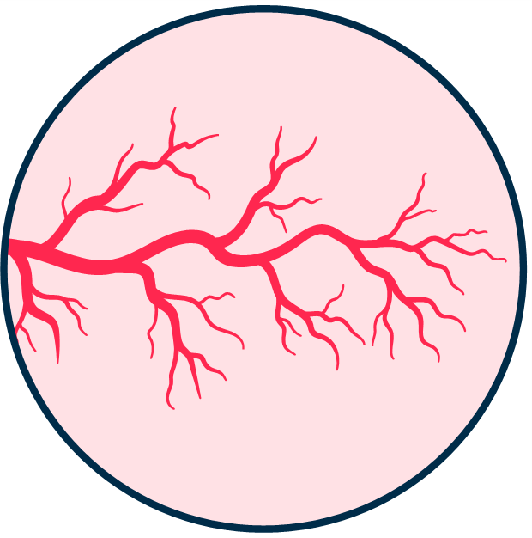
Background
1 in 4 patients after angiographically ‘successful’ PCI has residual angina
Coronary Microvascular dysfunction (CMD) has been proposed as one of the underlying mechanisms
Grodzinsky et al. Circ Cardiovasc Qual Outcomes. 2017 Sep;10(9) Collet et al JACC Cardiovasc Interv 2023 Oct 9;16(19)
europcr.com

Slide 4

Objective
To elucidate the mechanisms of residual angina after PCI by comprehensively assessing the (epicardial and microvascular) coronary circulation
europcr.com

Slide 5
Methods

Slide 6




Methods: PPG Global (n = 25 sites)
Karolinska Instituet, Stockholm
Gifu Medical
Aichi Medical
^{Aalborg}Center, Gifu
Center, Gifu
Aarhus University
Showa University, Showa
St Francis Righospitalet Hospital, NY
^{Stan}S^{fo}t.^{r}T^{d}homas’ Hospital
Radboud University, Nijmegen Catherina Ziekenhuis, Eindhoven
UnivLeornsditoyn, California
OLV_{M}-A_{e}a_{m}ls_{o}t,_{rial}
Belgium
^{Hermann T}U^{e}n^{x}ivªe^{s}rsity of Lausanne
University of
Medical Center, Houston
Tzanck Clinic, Nice
Monash Sidney
Ferrara University, Ferrara
La Princessa, Madrid
Cardiovascular Center
Policlinico Gemelli,
Rome
San Carlos, Madrid
North America Europe
Asia
europcr.com

Slide 7

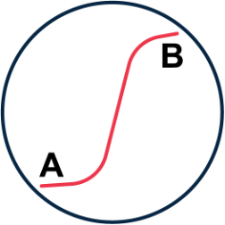
Methods: Population
At least one hemodynamically significant lesion
CAD pattern characterized as focal or diffuse
(FFR ≤ 0.80) intended to be treated with PCI
Determined by Pullback Pressure Gradient (PPG)
europcr.com

Slide 8
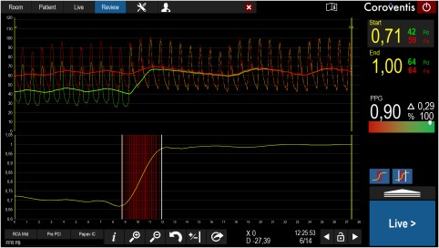
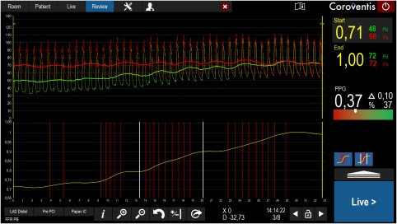
Pullback Pressure Gradient
High PPG = Focal disease
Low PPG = Diffuse disease
europcr.com

Slide 9


Methods: Microvascular function
Microvascular
Patient-reported
Assessment with Bolus
outcomes
thermodilution
CMD defined Microvascular Resistance
Seattle Angina Questionnaire (SAQ-7) at baseline and 1-year follow-up.
Reserve MRR < 3
europcr.com

Slide 10
Results

Slide 11
Study Flowchart
1004 patients with significant lesions (FFR ≤ 0.80) and intention to perform PCI
746 patients excluded for lack of microvascular assessment
6 patients were excluded for inadequate pressure tracing quality
242 patients with adequate quality bolus thermodilution pre-PCI
20 patients treated with OMT 6 patients treated with CABG
216 patients treated by PCI
europcr.com

Slide 12
Population characteristics
Variables | All patients (n=242) | CMD (n=86) | Normal microvascular function (n=156) | p-value
Age, mean ± SD | 68.2 ± 10.1 | 70.4 ± 9.7 | 67 ± 10.1 | 0.012
Male, n (%) | 177 (73.1) | 56 (65.1) | 121 (77.6) | 0.052
BMI, mean ± SD | 27.43 ± 14.44 | 27.52 ± 16.82 | 27.38 ± 13.01 | 0.943
Dyslipidemia, n (%) | 178 (73.6) | 62 (72.1) | 116 (74.4) | 0.818
Hypertension, n (%) | 174 (71.9) | 72 (83.7) | 102 (65.4) | 0.004
Diabetes, n (%) | 83 (34.3) | 37 (43.0) | 46 (29.5) | 0.048
Active Tobacco, n(%) | 41 (16.9) | 12 (14.0) | 29 (18.6) | 0.459
Prior MI, n (%) | 45 (18.6) | 15 (17.4) | 30 (19.2) | 0.865
PAD, n (%) | 11 (4.5) | 4 (4.7) | 7 (4.5) | 1.000
Clinical presentation |  |  |  | 0.069
Non-STEMI | 13 (5.4) | 7 (8.1) | 6 (3.8)
Chronic coronary Syndrome | 215 (88.8) | 71 (82.6) | 144 (92.3)
Unstable angina | 14 (5.8) | 8 (9.3) | 6 (3.8)
Creatinine clearance, mean±SD | 73.80 ± 26.80 | 72.74 ± 28.20 | 74.38 ± 26.07 | 0.651
LVEF, mean±SD | 58.41 ± 10.22 | 58.30 ± 11.79 | 58.48 ± 9.27 | 0.895
europcr.com

Slide 13
Population characteristics
Variables | All patients (n=242) | CMD (n=86) | Normal microvascular function (n=156) | p-value
Age, mean ± SD | 68.2 ± 10.1 | 70.4 ± 9.7 | 67 ± 10.1 | 0.012
Male, n (%) | 177 (73.1) | 56 (65.1) | 121 (77.6) | 0.052
BMI, mean ± SD | 27.43 ± 14.44 | 27.52 ± 16.82 | 27.38 ± 13.01 | 0.943
Dyslipidemia, n (%) | 178 (73.6) | 62 (72.1) | 116 (74.4) | 0.818
Hypertension, n (%) | 174 (71.9) | 72 (83.7) | 102 (65.4) | 0.004
Diabetes, n (%) | 83 (34.3) | 37 (43.0) | 46 (29.5) | 0.048
Active Tobacco, n(%) | 41 (16.9) | 12 (14.0) | 29 (18.6) | 0.459
Prior MI, n (%) | 45 (18.6) | 15 (17.4) | 30 (19.2) | 0.865
PAD, n (%) | 11 (4.5) | 4 (4.7) | 7 (4.5) | 1.000
Clinical presentation |  |  |  | 0.069
Non-STEMI | 13 (5.4) | 7 (8.1) | 6 (3.8)
Chronic coronary Syndrome | 215 (88.8) | 71 (82.6) | 144 (92.3)
Unstable angina | 14 (5.8) | 8 (9.3) | 6 (3.8)
Creatinine clearance, mean±SD | 73.80 ± 26.80 | 72.74 ± 28.20 | 74.38 ± 26.07 | 0.651
LVEF, mean±SD | 58.41 ± 10.22 | 58.30 ± 11.79 | 58.48 ± 9.27 | 0.895
europcr.com

Slide 14
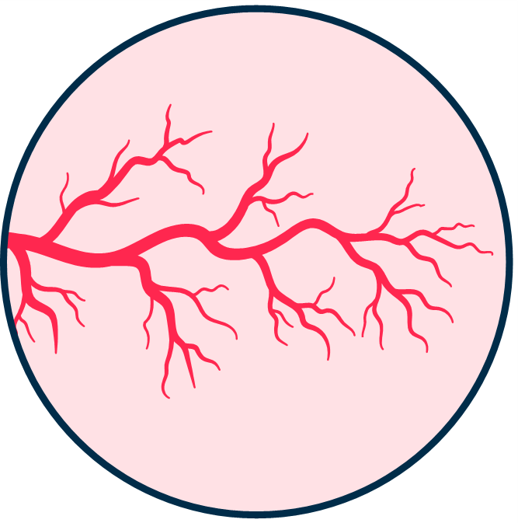
CMD and CAD patterns
Is there a relationship between CAD patterns and CMD presence?
europcr.com

Slide 15
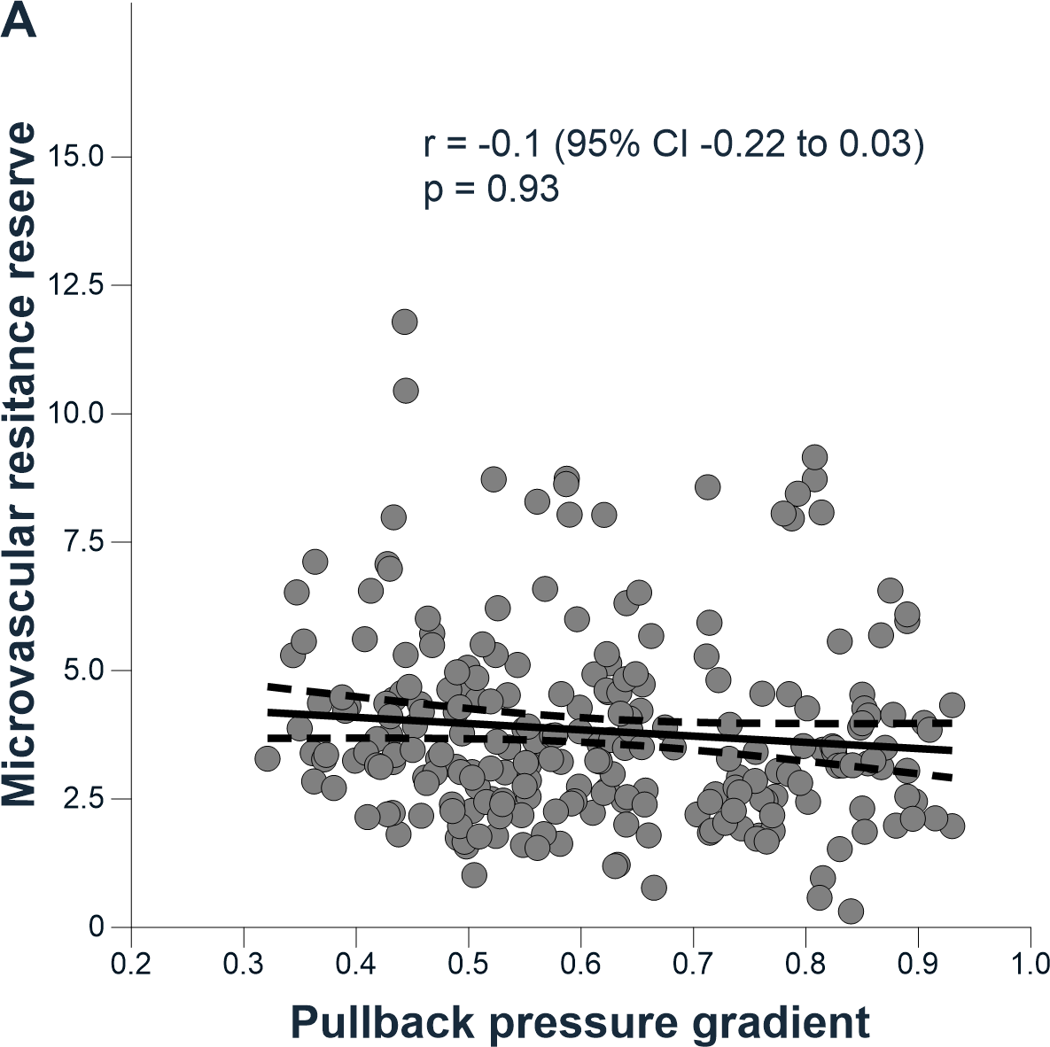
CMD and CAD pattern
No significant correlation between MRR and CAD pattern (PPG)
r=-0.1 95% CI [-0.22; 0.03]
p=0.93
europcr.com

Slide 16
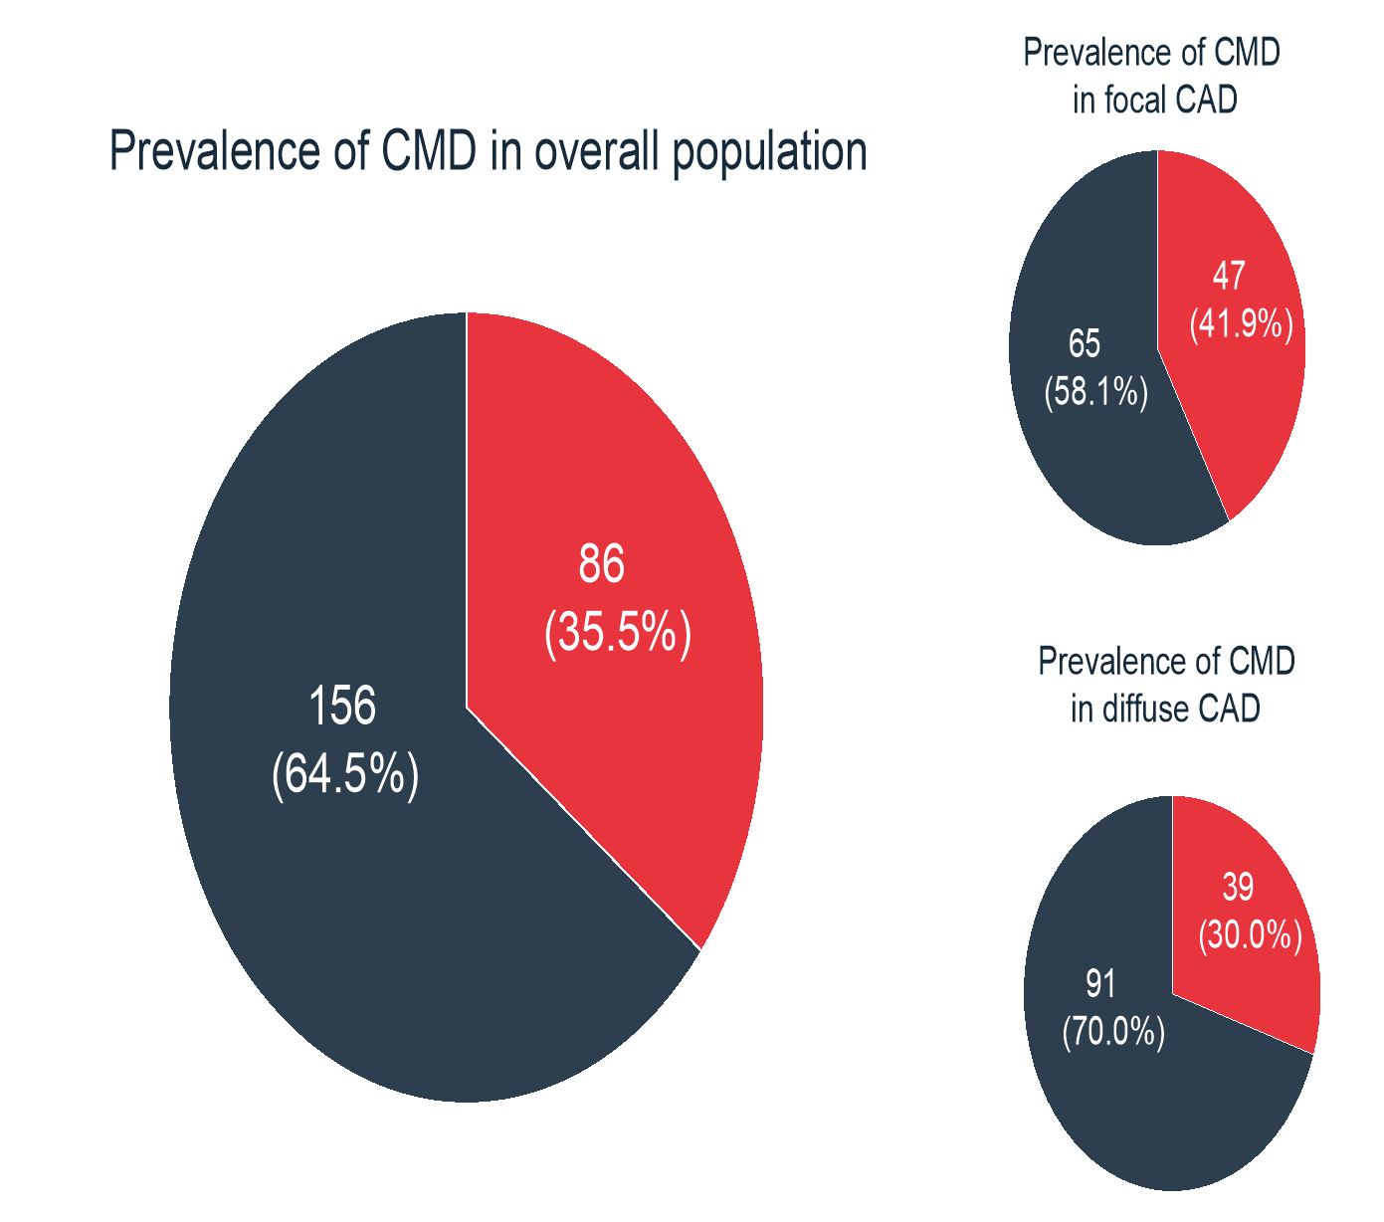
CMD: Similar prevalence in focal and diffuse disease
Focal disease
CMD prevalence (all patients)
P=0.07
Diffuse disease
CMD
Non-CMD
europcr.com

Slide 17

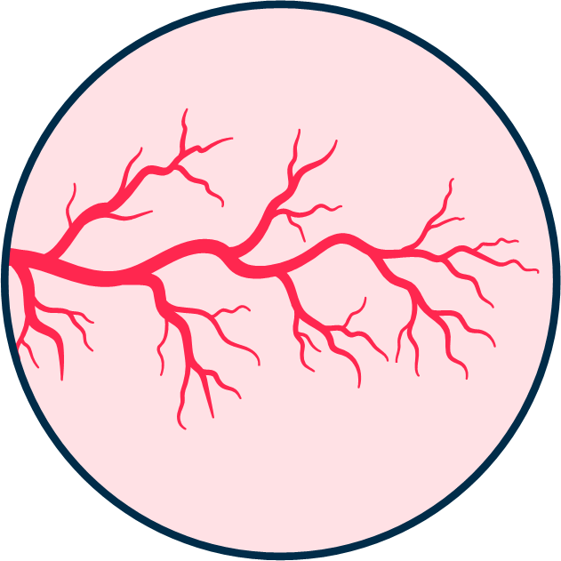
Microvascular function and residual angina
Is there a relation between residual angina and underlying CMD?
europcr.com

Slide 18
Angina and CMD
Variable | All (n=242) | CMD (n=86) | Non CMD (n=156) | p-value
Baseline
Physical limitation | 75.58 ± 28.3 | 69.51 ± 32.4 | 78.79 ± 25.41 | 0.016
Angina Frequency | 77.64 ± 23.08 | 73.49 ± 24.96 | 79.94 ± 21.72 | 0.037
Quality of Life | 52.07 ± 29.38 | 48.98 ± 30.63 | 53.77 ± 28.63 | 0.226
Summary Score | 68.35 ± 22.22 | 63.93 ± 24.45 | 70.69 ± 20.64 | 0.026
12-month Follow up
Physical limitation | 88.19 ± 22.62 | 85.88 ± 22.59 | 89.4 ± 22.62 | 0.285
Angina Frequency | 94.58 ± 12.57 | 93.75 ± 14.26 | 95.03 ± 11.55 | 0.464
Quality of Life | 83.89 ± 22.35 | 82.81 ± 22.88 | 84.48 ± 22.11 | 0.593
Summary Score | 88.7 ± 16.07 | 86.9 ± 17.3 | 89.64 ± 15.38 | 0.243
europcr.com

Slide 19
Angina and CMD
Variable | All (n=242) | CMD (n=86) | Non CMD (n=156) | p-value
Baseline
Physical limitation
75.58 ± 28.3
69.51 ± 32.4
78.79 ± 25.41
0.016
Angina Frequency
77.64 ± 23.08
73.49 ± 24.96
79.94 ± 21.72
0.037
Quality of Life
52.07 ± 29.38
48.98 ± 30.63
53.77 ± 28.63
0.226
Summary Score
68.35 ± 22.22
63.93 ± 24.45
70.69 ± 20.64
0.026
12-month Follow up
Physical limitation 88.19 ± 22.62 85.88 ± 22.59 89.4 ± 22.62 0.285
Angina Frequency 94.58 ± 12.57 93.75 ± 14.26 95.03 ± 11.55 0.464
Quality of Life 83.89 ± 22.35 82.81 ± 22.88 84.48 ± 22.11 0.593
Summary Score 88.7 ± 16.07 86.9 ± 17.3 89.64 ± 15.38 0.243
europcr.com

Slide 20
Residual angina and CMD
Variable | All (n=242) | CMD (n=86) | Non CMD (n=156) | p-value
Baseline
Physical limitation 75.58 ± 28.3 69.51 ± 32.4 78.79 ± 25.41 0.016
Angina Frequency 77.64 ± 23.08 73.49 ± 24.96 79.94 ± 21.72 0.037
Quality of Life 52.07 ± 29.38 48.98 ± 30.63 53.77 ± 28.63 0.226
Summary Score 68.35 ± 22.22 63.93 ± 24.45 70.69 ± 20.64 0.026
12-month Follow up
Physical limitation
88.19 ± 22.62
85.88 ± 22.59
89.4 ± 22.62
0.285
Angina Frequency
94.58 ± 12.57
93.75 ± 14.26
95.03 ± 11.55
0.464
Quality of Life
83.89 ± 22.35
82.81 ± 22.88
84.48 ± 22.11
0.593
Summary Score
88.7 ± 16.07
86.9 ± 17.3
89.64 ± 15.38
0.243
europcr.com

Slide 21


Microvascular function and PRO
Does the CAD pattern matter?
europcr.com

Slide 22
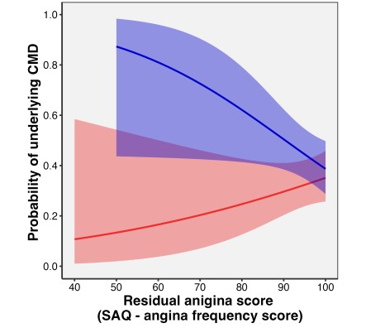
Microvascular function and SAQ7
^{p}interaction ^{= 0.02}
Probability of CMD and Residual angina stratified by CAD Patterns
Focal
Diffuse
europcr.com

Slide 23
Conclusion

Slide 24
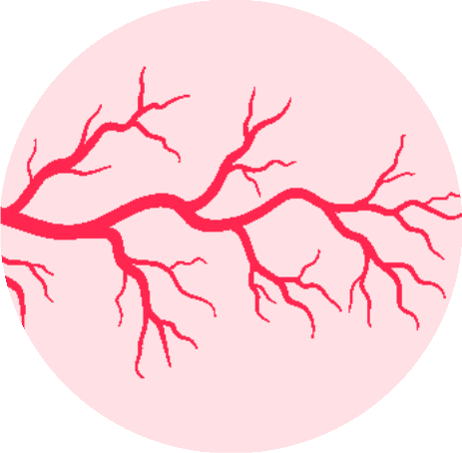
Take Home Messages
CMD was equally prevalent in focal and diffuse disease
Patients presenting CMD have a higher
Underlying CMD is associated with
symptom burden at
residual angina only
baseline
in focal CAD
europcr.com

Slide 25

pcronline.com

Slide 26
Back-up slides

Slide 27
Procedural characteristics
Variables | All patients (n=248) | CMD (n=88) | Normal microvascular function (n=160) | p-value
FFR pre-PCI | 0.70 ± 0.10 | 0.71 ± 0.08 | 0.69 ± 0.11 | 0.151
FFR post-PCI | 0.87 ± 0.06 | 0.87 ± 0.06 | 0.87 ± 0.06 | 0.876
Delta FFR | 0.18 ± 0.12 | 0.16 ± 0.10 | 0.19 ± 0.13 | 0.150
CAD pattern |  |  |  | 0.08
Focal, n (%) | 117 (47.2) | 48 (54.5) | 69 (43.1)
Diffuse, n (%) | 131 (52.8) | 40 (45.5) | 91 (56.9)
Treatment, n (%) |  |  |  | 0.032
CABG | 6 (2.4) | 0 (0.0) | 6 (3.8)
OMT | 22 (8.9) | 4 (4.5) | 18 (11.2)
PCI | 220 (88.7) | 84 (95.5) | 136 (85.0)
europcr.com

Slide 28
Procedural characteristics
Variables | All patients (n=248) | CMD (n=88) | Normal microvascular function (n=160) | p-value
Target vessel, n (%) |  |  |  | 0.018
LAD | 202 (81.5) | 64 (72.7) | 138 (86.2)
LCX | 16 (6.5) | 10 (11.4) | 6 (3.8)
RCA | 30 (12.1) | 14 (15.9) | 16 (10.0)
Pre-PCI Diameter Stenosis, mean ± SD | 48.63 ± 13.84 | 50.94 ± 12.24 | 47.31 ± 14.55 | 0.049
Pre-PCI Lesion Length, mean ± SD | 19.88 ± 12.52 | 21.66 ± 14.09 | 18.87 ± 11.46 | 0.095
Post-PCI Diameter Stenosis, mean ± SD | 0.17 ± 16.94 | 1.51 ± 17.85 | -0.64 ± 16.39 | 0.375
Post-PCI Lesion Length, mean ± SD | 28.68 ± 14.35 | 29.64 ± 16.88 | 28.10 ± 12.62 | 0.453
Total stent length, mean ± SD | 29.92 ± 16.03 | 30.95 ± 17.96 | 29.28 ± 14.73 | 0.454
Mean stent diameter, mean ± SD | 3.05 ± 0.43 | 2.95 ± 0.41 | 3.11 ± 0.43 | 0.007
Number of stent, mean ± SD | 1.20 ± 0.47 | 1.25 ± 0.56 | 1.16 ± 0.41 | 0.185
europcr.com

Slide 29
Procedural characteristics
Variables | All patients (n=248) | CMD (n=88) | Normal microvascular function (n=160) | p-value
Target vessel, n (%) |  |  |  | 0.018
LAD | 202 (81.5) | 64 (72.7) | 138 (86.2)
LCX | 16 (6.5) | 10 (11.4) | 6 (3.8)
RCA | 30 (12.1) | 14 (15.9) | 16 (10.0)
Pre-PCI Diameter Stenosis, mean ± SD | 48.63 ± 13.84 | 50.94 ± 12.24 | 47.31 ± 14.55 | 0.049
Pre-PCI Lesion Length, mean ± SD | 19.88 ± 12.52 | 21.66 ± 14.09 | 18.87 ± 11.46 | 0.095
Post-PCI Diameter Stenosis, mean ± SD | 0.17 ± 16.94 | 1.51 ± 17.85 | -0.64 ± 16.39 | 0.375
Post-PCI Lesion Length, mean ± SD | 28.68 ± 14.35 | 29.64 ± 16.88 | 28.10 ± 12.62 | 0.453
Total stent length, mean ± SD | 29.92 ± 16.03 | 30.95 ± 17.96 | 29.28 ± 14.73 | 0.454
Mean stent diameter, mean ± SD | 3.05 ± 0.43 | 2.95 ± 0.41 | 3.11 ± 0.43 | 0.007
Number of stent, mean ± SD | 1.20 ± 0.47 | 1.25 ± 0.56 | 1.16 ± 0.41 | 0.185
europcr.com

Slide 30

Microvascular function and SAQ7
Focal CAD population treated by PCI
Variable | All (n=109) | CMD (n=47) | Non-CMD (n=62) | p-value
Baseline
Physical limitation | 70.13 ± 29.85 | 63.7 ± 32.66 | 74.8 ± 26.95 | 0.057
Angina Frequency | 75.14 ± 22.34 | 70.64 ± 23.44 | 78.55 ± 21.03 | 0.067
Quality of Life | 46.9 ± 28.17 | 45.21 ± 30.46 | 48.19 ± 26.48 | 0.588
Summary Score | 64.35 ± 22.37 | 60.46 ± 24.73 | 67.18 ± 20.23 | 0.126
12-month Follow up
Physical limitation | 86.9 ± 23.47 | 81.81 ± 25.51 | 90.62 ± 21.32 | 0.067
Angina Frequency | 95.3 ± 9.79 | 92.95 ± 12.68 | 97.14 ± 6.24 | 0.033
Quality of Life | 84.38 ± 21.27 | 78.69 ± 25.37 | 88.84 ± 16.29 | 0.017
Summary Score | 88.78 ± 15.44 | 84.1 ± 18.89 | 92.2 ± 11.33 | 0.01
europcr.com

Slide 31
Microvascular function and SAQ7
Focal CAD population treated by PCI
Variable | All (n=242) | CMD (n=86) | Non CMD (n=156) | p-value
Baseline
Physical limitation 70.13 ± 29.85 63.7 ± 32.66 74.8 ± 26.95 0.057
Angina Frequency 75.14 ± 22.34 70.64 ± 23.44 78.55 ± 21.03 0.067
Quality of Life 46.9 ± 28.17 45.21 ± 30.46 48.19 ± 26.48 0.588
Summary Score 64.35 ± 22.37 60.46 ± 24.73 67.18 ± 20.23 0.126
12-month Follow up
Physical limitation | 86.9 ± 23.47 | 81.81 ± 25.51 | 90.62 ± 21.32 | 0.067
Angina Frequency | 95.3 ± 9.79 | 92.95 ± 12.68 | 97.14 ± 6.24 | 0.033
Quality of Life | 84.38 ± 21.27 | 78.69 ± 25.37 | 88.84 ± 16.29 | 0.017
Summary Score | 88.78 ± 15.44 | 84.1 ± 18.89 | 92.2 ± 11.33 | 0.01
europcr.com

Slide 32
Microvascular function and SAQ7
Diffuse CAD population treated by PCI
Variable | All (n=107) | CMD (n=36) | Non CMD (n=71) | p-value
Baseline
Physical limitation | 78.49 ± 27.71 | 77.45 ± 30.89 | 78.99 ± 26.24 | 0.792
Angina Frequency | 80.84 ± 21.94 | 79.72 ± 23.84 | 81.41 ± 21.06 | 0.709
Quality of Life | 55.49 ± 29.9 | 52.78 ± 31.35 | 56.87 ± 29.26 | 0.506
Summary Score | 71.14 ± 22.28 | 69.1 ± 24.3 | 72.13 ± 21.34 | 0.519
12-month Follow up
Physical limitation | 88.48 ± 23.86 | 91.52 ± 17.07 | 87.09 ± 26.41 | 0.419
Angina Frequency | 94.85 ± 12.54 | 96.97 ± 7.28 | 93.82 ± 14.35 | 0.239
Quality of Life | 83.79 ± 23.42 | 88.64 ± 16.93 | 81.43 ± 25.78 | 0.148
Summary Score | 88.71 ± 17.13 | 91.82 ± 10.97 | 87.28 ± 19.22 | 0.248
europcr.com

Slide 33
Microvascular function and SAQ7
Diffuse CAD population treated by PCI
Variable | All (n=107) | CMD (n=36) | Non CMD (n=71) | p-value
Baseline
Physical limitation 78.49 ± 27.71 77.45 ± 30.89 78.99 ± 26.24 0.792
Angina Frequency 80.84 ± 21.94 79.72 ± 23.84 81.41 ± 21.06 0.709
Quality of Life 55.49 ± 29.9 52.78 ± 31.35 56.87 ± 29.26 0.506
Summary Score 71.14 ± 22.28 69.1 ± 24.3 72.13 ± 21.34 0.519
12-month Follow up
Physical limitation | 88.48 ± 23.86 | 91.52 ± 17.07 | 87.09 ± 26.41 | 0.419
Angina Frequency | 94.85 ± 12.54 | 96.97 ± 7.28 | 93.82 ± 14.35 | 0.239
Quality of Life | 83.79 ± 23.42 | 88.64 ± 16.93 | 81.43 ± 25.78 | 0.148
Summary Score | 88.71 ± 17.13 | 91.82 ± 10.97 | 87.28 ± 19.22 | 0.248
europcr.com

Slide 34
pcronline.com

