Slide 1
Transcatheter repair or surgery in atrial functional mitral regurgitation
A subgroup analysis of the MATTERHORN trial
Stephan Baldus, MD
University Hospital Cologne, Cologne, Germany

Slide 2
Background
Functional mitral regurgitation is prevalent, prognostically relevant and can be treated by surgical repair/replacement or transcatheter edge to edge therapy
In MATTERHORN, we randomized 208 patients to TEER vs surgery:
Non-inferiority for efficacy in the TEER group
Signifcant better safety profile in TEER vs surgery

Slide 3
Atrial Mitral regurgitation (AFMR)
Is a recently defined subgroup of functional MR
Driven by atrial enlargement (AF / diastolic heart failure)
Optimal treatment is unclear
-> here, we analyzed the outcome of patients with AFMR in MATTERHORN

Slide 4
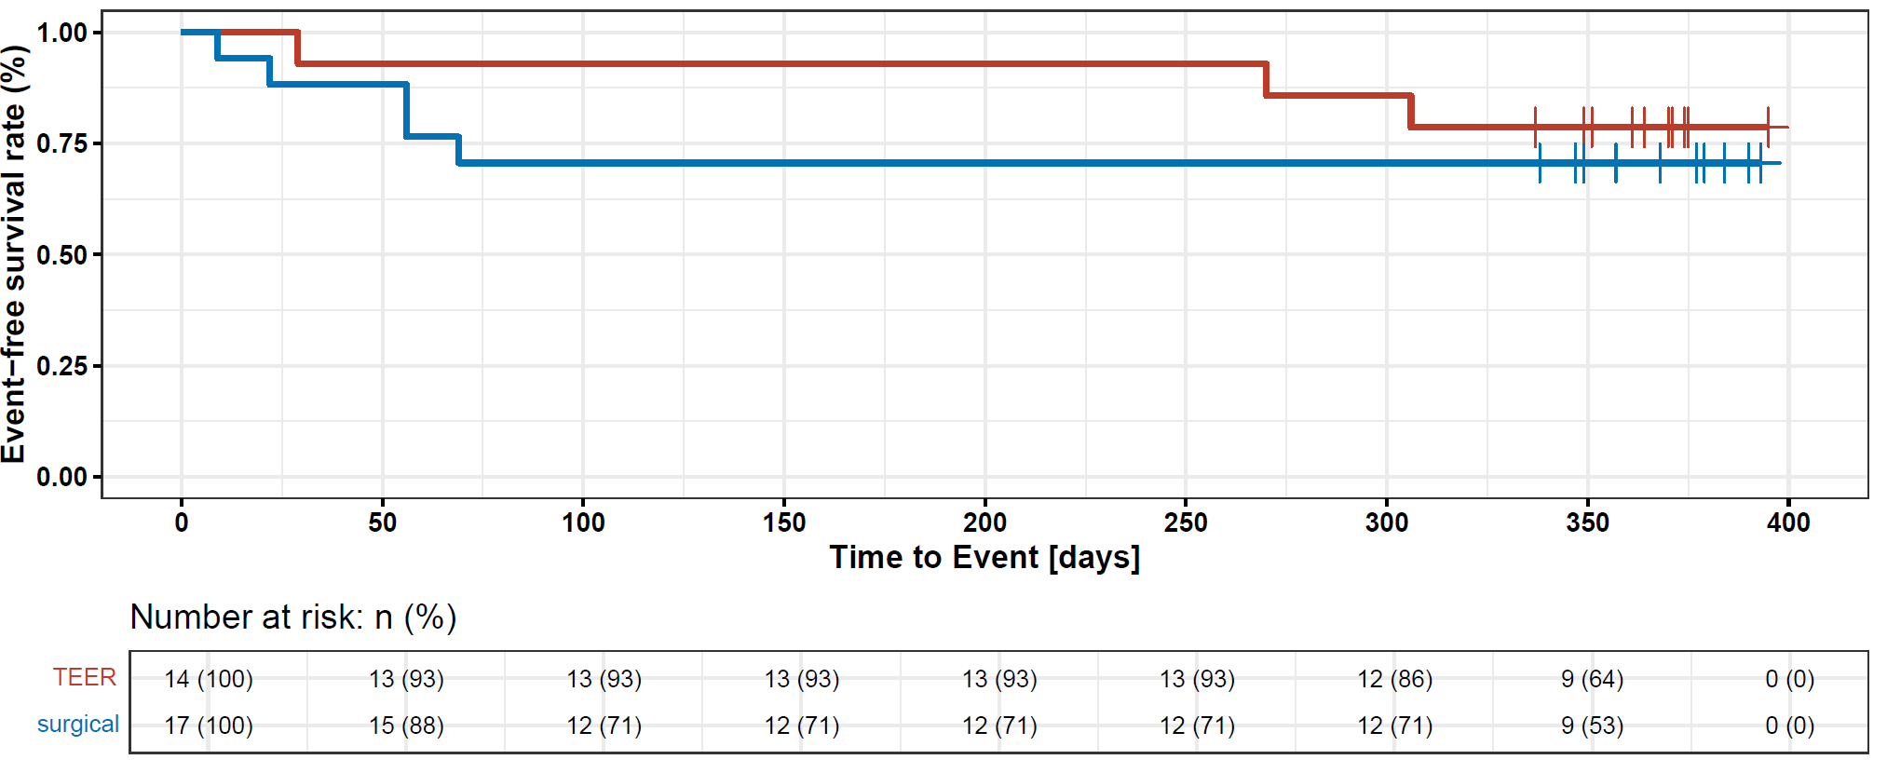
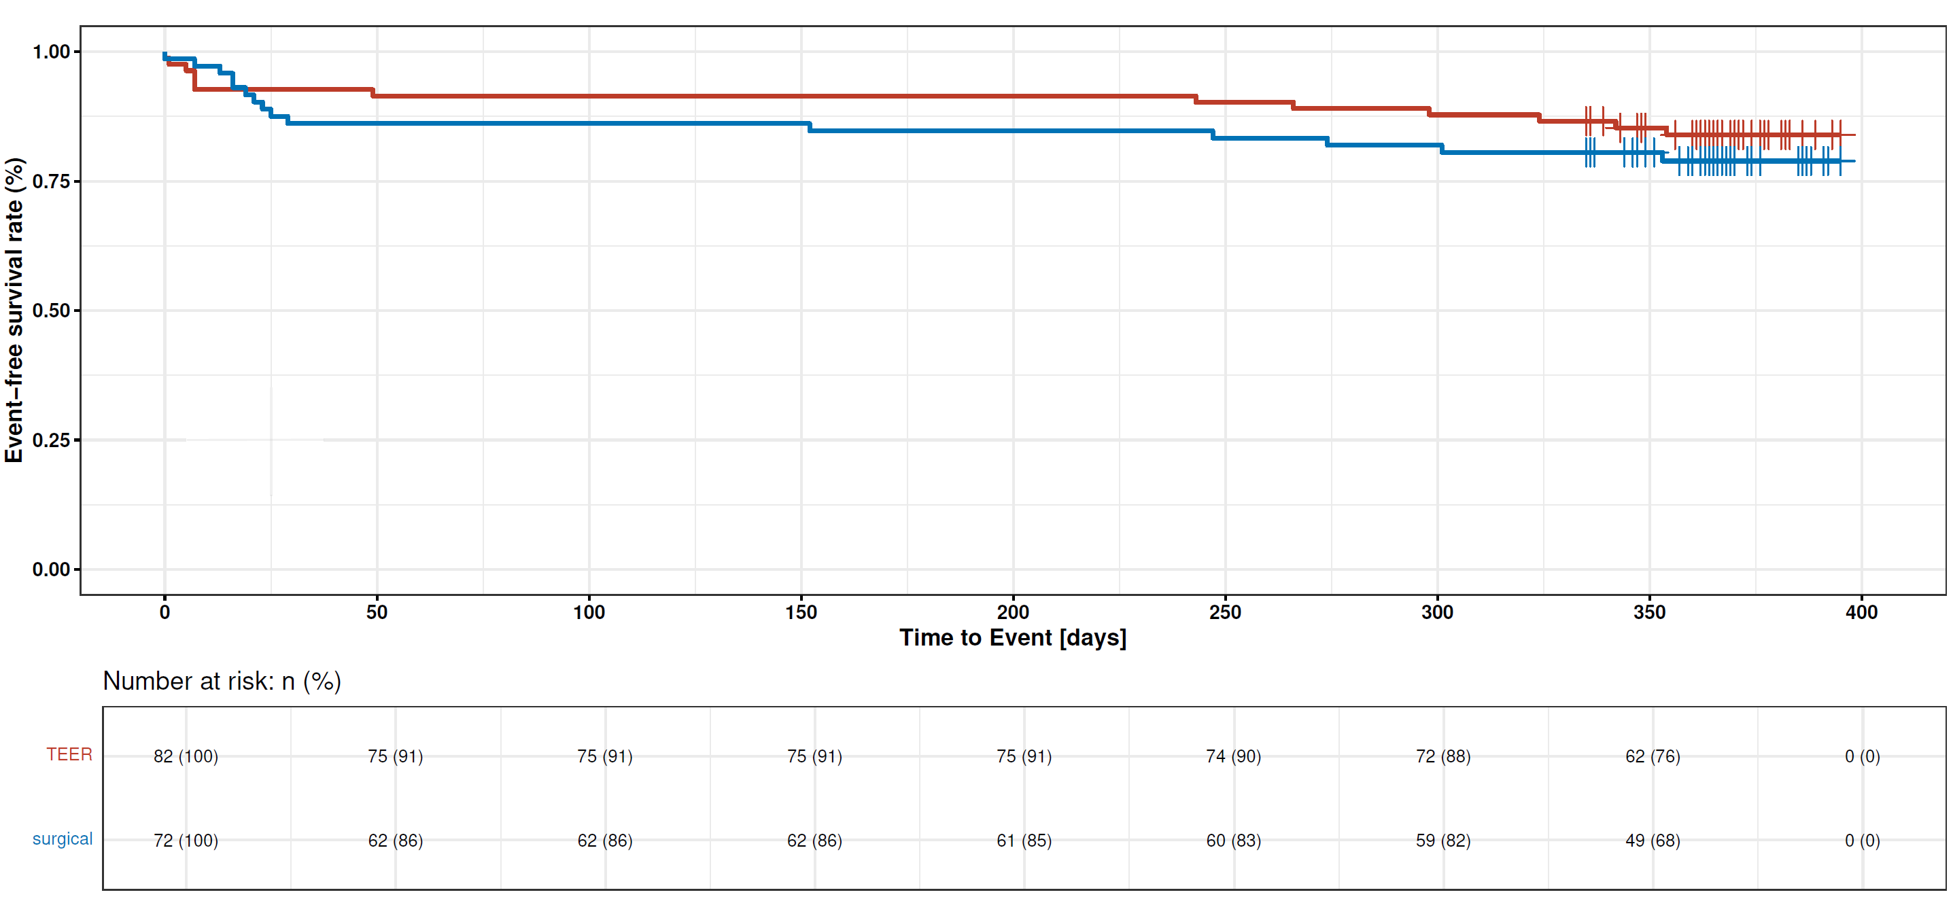
Results
Primary efficacy endpoint @ 1 year
all-cause death, HF hospitalization, MV reintervention, LVAD, stroke
aFMR
vFMR
P=0.058 for non-inferiority
P<0.001 for non-inferiority

Slide 5
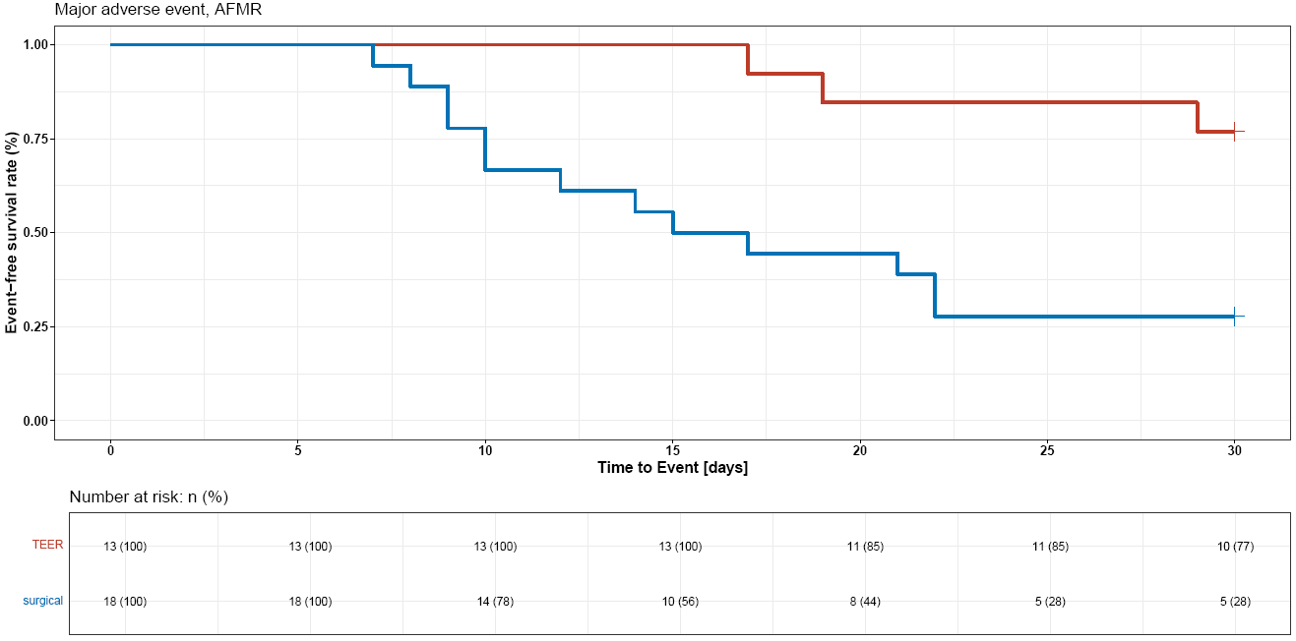
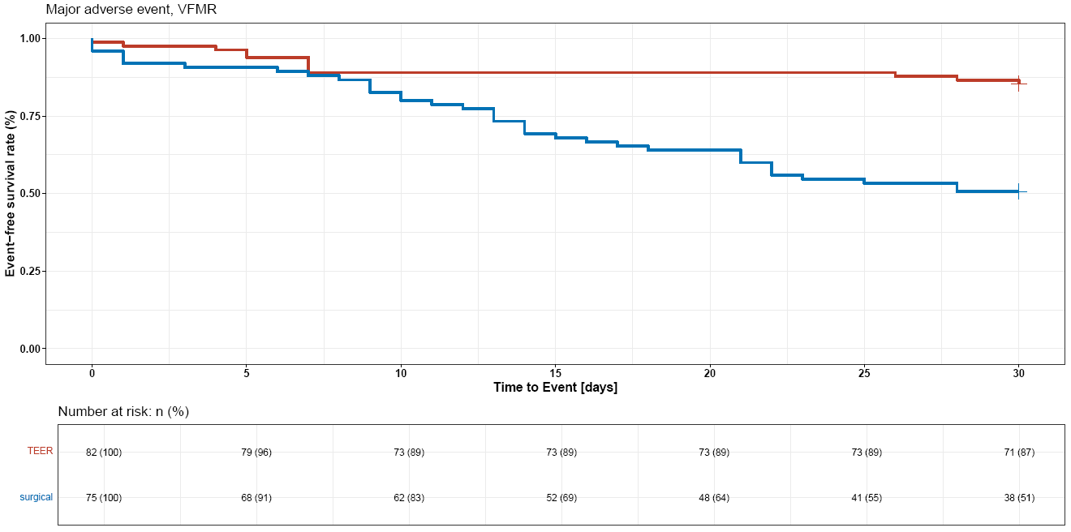
Matterhorn – subgroup analysis „aFMR“
Safety endpoint @ 30 days
death, MI, bleeding, stroke, rehospitalization, reintervention, new-onset AF
aFMR
vFMR
P=0.002 for superiority
P<0.001 for superiority

Slide 6
Summary
The results of this subgroup analysis follow the findings of the entire cohort:
Lower event rates for the primary endpoint in both subgroups for TEER vs MV surgery
Favorable safety profile for TEER in both subgroups

