Slide 1





Acute Valve Syndrome and its Association with Health Care Cost and Resources Utilization During and After Aortic Valve Replacement
Genereux et al.

Slide 2

Potential conflicts of interest
Speaker's name: Philippe Genereux
☑ I have the following potential conflicts of interest to report
Receipt of grants / research supports - Edwards Lifesciences
Receipt of honoraria or consultation fees - Edwards Lifesciences
Receipt of honoraria or consultation fees - Other
Receipt of grants / research supports - Other
Receipt of honoraria or consultation fees - Haemonetics
Receipt of honoraria or consultation fees - Other
europcr.com

Slide 3
Why This Study
A novel classification related to clinical presentation before aortic valve replacement (AVR) has been recently described and categorized patients into 3 groups:
  Asymptomatic or stable valve syndrome (SVS),
  Mildly symptomatic or progressive valve syndrome (PVS; such as New York Heart Association [NYHA] class II), or
  Acute valve syndrome (AVS; such as NYHA class III-IV, heart failure hospitalization [HFH], syncope, or cardiac arrest). ^{1,2}
AVS was associated with a 3-fold increase in mortality and a 4-fold increase in risk of HFH 2 years post-AVR compared with those presenting with no symptoms.¹
However, these findings have not been confirmed by other studies, and the economic impact associated with the mode of clinical presentation before AVR has never been reported.
1.
2.
Genereux P, Pellika P, Lindman B, Pibarot P, Garcia S, Acute Valve Syndrome in Aortic Stenosis. Structural Heart. 2024.
europcr.com
Genereux P, Schwartz A, Oldemeyer JB, Pibarot P, Cohen DJ, Blanke P, Lindman BR, Babaliaros V, Fearon WF, Daniels DV, et al. Transcatheter Aortic-Valve Replacement for Asymptomatic Severe Aortic Stenosis. N Engl J Med. 2024.

Slide 4
Study Objective
To study the association between clinical presentation before AVR, and clinical and economic outcomes during and after AVR hospitalization.
europcr.com

Slide 5
What Did We Do
Study Population:
From the Optum Market Clarity (Claims) Database in USA, patients ≥ 18 years of
age with AS who received AVR were included in the study sample
Categories of interest:
Patients were categorized into 3 different categories based on their mode of clinical presentation 12 months before AVR.
Patients were categorized as either SVS, PVS, and AVS based on coding claims to mirror the original classification as described by Genereux et al. 2024.
1. Genereux P, Pellika P, Lindman B, Pibarot P, Garcia S, Acute Valve Syndrome in Aortic Stenosis. Structural Heart. 2024.
europcr.com
2. Genereux P, Schwartz A, Oldemeyer JB, Pibarot P, Cohen DJ, Blanke P, Lindman BR, Babaliaros V, Fearon WF, Daniels DV, et al. Transcatheter Aortic-Valve Replacement for Asymptomatic Severe Aortic Stenosis. N Engl J Med. 2024.

Slide 6
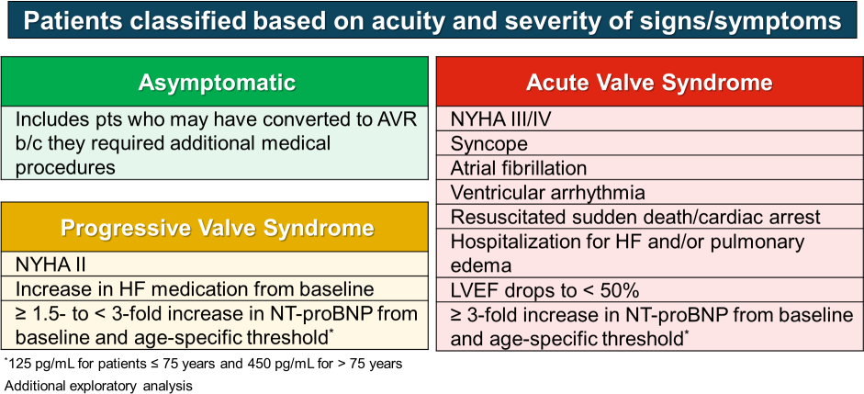
Clinical Presentation Before AVR
Adapted from Généreux et al. N Engl J Med 2024;382(2):111-119.
europcr.com

Slide 7








Index Procedure and 1-year Follow-up Outcomes
Clinical Outcomes
Death
Heart Failure (HF) Hospitalization
Death or HF Hospitalization
Stroke or transient ischemic attack (TIA)
Healthcare Cost and Utilization
Total Cost
(AVR + 1-year healthcare costs)
AVR Length of Stay All-cause Hospitalization
(Rate)
HF Hospitalization
(Rate)
europcr.com

Slide 8

Study Cohort: Clinical Presentation Before AVR
24,075 patients undergoing AVR for Aortic Stenosis in the United States
SVS
N=270 (1.1%)
PVS
N=10,195 (42.3%)
AVS
N=13,610 (56.5%)
europcr.com

Slide 9
Baseline Characteristics by Severity of Presentation before AVR (n= 24,075)
 | SVS | PVS | AVS | P-value
n | 270 (1.1%) | 10,195 (42.3%) | 13,610 (56.5%)
Age, y | 65.9 ± 13.5 | 70.1 ± 11.7 | 72 ± 11.7 | <0.001
Female sex | 84 (31.1%) | 4,007 (39.3%) | 5,280 (38.8%) | 0.022
Caucasian | 247 (91.5%) | 9,425 (92.4%) | 12,245 (90%) | <0.001
Hypertension | 187 (69.3%) | 8,976 (88%) | 12,700 (93.3%) | <0.001
Diabetes | 67 (24.8%) | 3,902 (38.3%) | 6,269 (46.1%) | <0.001
Atrial fibrillation/flutter | 35 (13%) | 1,902 (18.7%) | 6,708 (49.3%) | <0.001
Stroke/TIA | 15 (5.6%) | 847 (8.3%) | 1,886 (13.9%) | <0.001
ESRD or CKD on dialysis | 0 (0%) | 128 (1.3%) | 730 (5.4%) | <0.001
COPD with O₂ dependence | 0 (0%) | 116 (1.1%) | 724 (5.3%) | <0.001
Prior PCI | 7 (2.6%) | 641 (6.3%) | 1,692 (12.4%) | <0.001
Prior CABG | 31 (11.5%) | 1,721 (16.9%) | 1,575 (11.6%) | <0.001
Elixhauser score | 6.5 ± 2.7 | 8.1 ± 2.8 | 10.1 ± 3.3 | <0.001
Frailty score | 9.4 ± 5.6 | 12 ± 8 | 18.9 ± 12.2 | <0.001
TAVR | 115 (42.6%) | 5,035 (49.4%) | 8,333 (61.2%) | <0.001
europcr.com

Slide 10
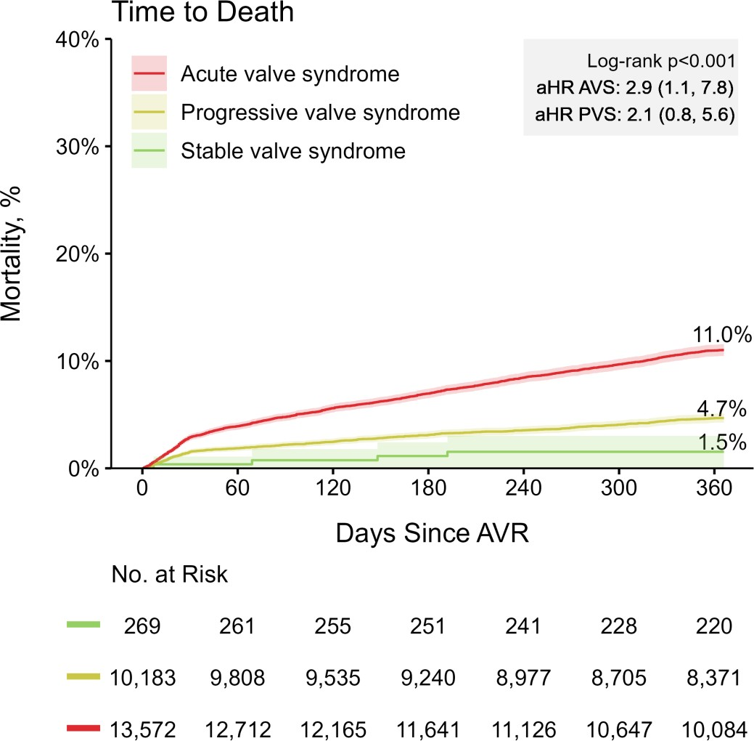
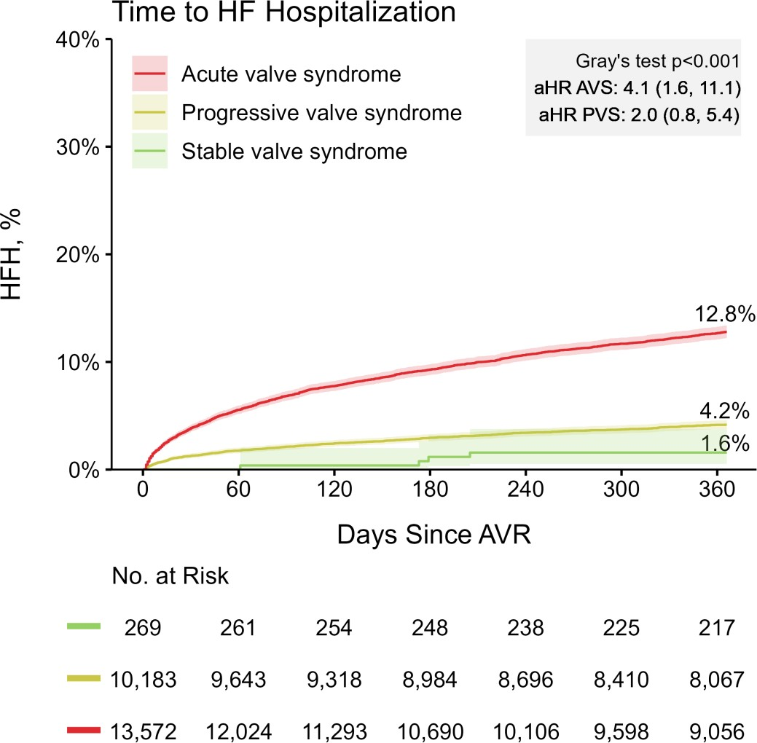
Acute Valve Syndrome is Associated with Increased Risk of Death and HF Hospitalization Post-AVR
AVS PVS SVS
AVS PVS SVS
HF Hospitalization
Death
europcr.com

Slide 11
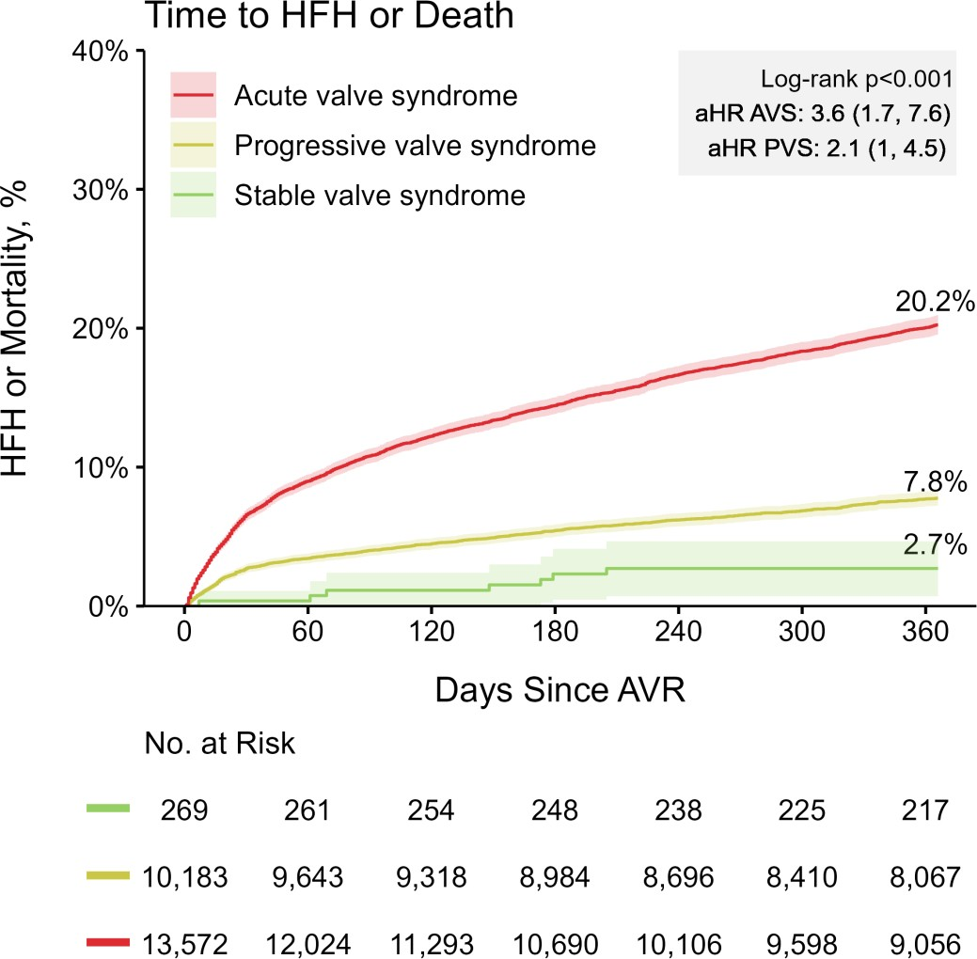
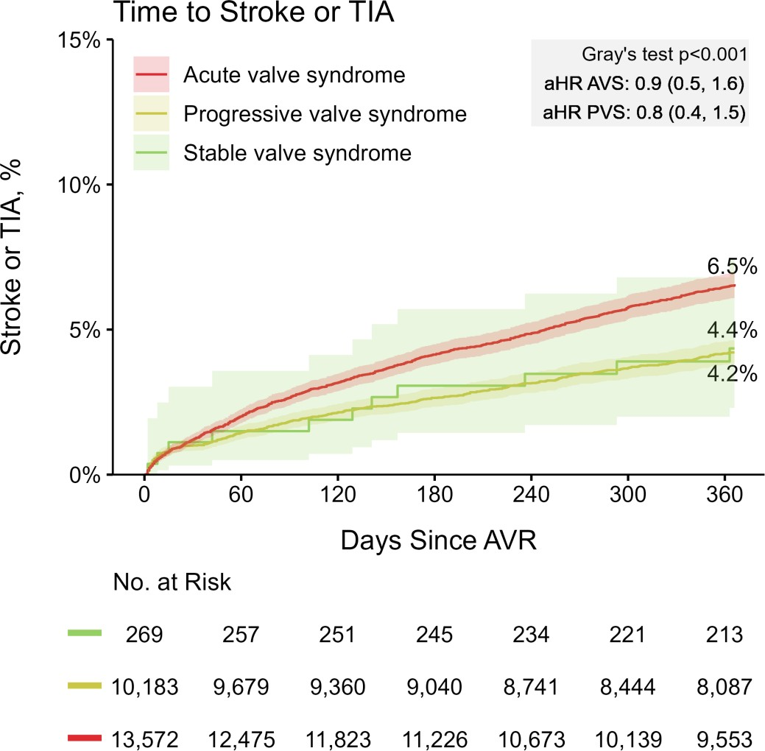
Acute Valve Syndrome is Associated with Increased Risk of Death or HF Hospitalization, and Higher Stroke Risk Post-AVR
AVS PVS
SVS
AVS PVS
SVS
HF Hospitalization or Death
Stroke or TIA
europcr.com

Slide 12
Healthcare Cost and Utilization by Clinical Presentation before AVR
Total Costs
(AVR + 1-year follow-up)
AVR Length of Stay
Hospitalizations during the 1-year follow-up
HF Hospitalizations during the 1-year follow-up
$200,000
$180,000
$160,000
$140,000
$120,000
$100,000
$80,000
$60,000
$40,000
$20,000
$0
↑ 19%
↑ 25%
1.5
↑ 56%
P<0.001
0.5
P<0.001
10
9
8
7
6
5
4
3
2
1
0
↑ 33%
P<0.001
P<0.001
1.25
↑ 29%
0.46
0.4
$36,267
$27,410
↑ 13%
2.2
1
P= 0.019
P= 0.013
0.24
0.3
0.8
0.75
↑ 386%
0.2
P<0.001
0.5
↑ 117%
0.147
0.1
P= 0.018
0.25
0.045
0
0
SVS
PVS
AVS
SVS
PVS
AVS
SVS
PVS
AVS
SVS
PVS
AVS
AVS and PVS before AVR are associated with higher total costs, increased LOS, higher all-cause and HF hospitalizations post AVR.
europcr.com

Slide 13
Total Healthcare Cost Up to 1 year after AVR Across Clinical Presentation
 | ∆ = $36,267
∆ = $27,410
$173,719 ^{$182,57}
6
$146,309
SVS
PVS
_{AVS} AVS
PVS
europcr.com
Total Healthcare cost includes cost of AVR + 1-year follow-up

Slide 14



Conclusions
Acute valve syndrome (AVS) was the most frequent mode of presentation before AVR
Compared with patients undergoing AVR while presenting with SVS (asymptomatic):
AVS was associated with a significantly higher risk of death and HF hospitalization
AVS and PVS were associated with significantly higher healthcare costs and resource use 1-year after AVR
europcr.com

Slide 15

Clinical Implications
Given worse clinical and economic outcomes associated with intervention performed after symptom onset, AVR before symptoms develop is the preferred strategy to improve outcomes and reduce healthcare cost in patients with AS.
europcr.com

Slide 16

pcronline.com

