Slide 1
Impact of Intravascular Imaging Guidance on PCI of Severely Calcified Lesions: The ECLIPSE Trial
Gregg W. Stone MD
on behalf of Akiko Mehara, Philippe Genereux, Ajay J. Kirtane and the ECLIPSE investigators
3/30/2025 1

Slide 2
Background
Few studies have examined whether intravascular imaging (IVI) guidance during PCI of severely calcified lesions improves clinical outcomes
The recent class 1A guideline from the ESC for IVI use to guide PCI of complex lesions does not explicitly include calcified lesions*
We therefore examined outcomes from the ECLIPSE trial in which 2005 pts with severely calcified coronary lesions were randomized at 104 US sites to vessel preparation with orbital atherectomy (OA) vs. balloon angioplasty (BA) prior to DES**
IVI guidance was allowed either in a formal OCT substudy of consecutive randomized pts (OCT only) or at operator discretion (OCT or IVUS)
3/30/2025 2
*Vrints C et al. EHJ 2024. On-line; **Kirtane AJ et al. Lancet 2025. On-line.

Slide 3
Patient Flow
2005 patients undergoing PCI of ≥1 severely calcified lesion
Randomized to OA before DES (n=1008) Randomized to BA before DES (n=997)
IVI guidance (n=627; 62.2%)
Angiography guidance alone (n=381; 37.8%)
IVI guidance (n=619; 62.1%)
Angiography guidance alone (n=378; 37.9%)
OCT guidance (n=408)
In the OCT substudy (n=276)
Not in the OCT substudy (n=132) IVUS guidance (n=258)
Both OCT and IVUS guidance (n=39)
OCT guidance (n=411)
In the OCT substudy (n=279)
Not in the OCT substudy (n=132) IVUS guidance (n=255)
Both OCT and IVUS guidance (n=47)
All patients, pooled IVI guidance (n=1246 [62.1%])
- OCT guidance (n=819 [40.8%])
- In the OCT substudy (n=555)
- Not in the OCT substudy (n=264)
IVUS guidance (n=513 [25.6%])
Both OCT and IVUS guidance (n=86; [4.3%])
All patients, pooled Angiography guidance alone (n=759 [37.9%])
Primary clinical endpoint: 1-year TVF
3/30/2025 3

Slide 4
Baseline Clinical/Lab Characteristics
Patient level | Intravascular imaging guidance (n=1246) | Angiographic guidance alone (N=759) | P-value
Age (years) | 70.0 [64.0, 75.0] | 71.0 [64.0, 77.0] | 0.16
Sex, male | 933 (74.9%) | 531 (70.0%) | 0.02
Body mass index (kg/m²) | 29.1 [25.6, 33.3] | 29.7 [25.9, 33.4] | 0.17
Diabetes mellitus | 536 (43.0%) | 345 (45.5%) | 0.29
Smoking, current (within 1 month) | 139 (11.2%) | 115 (15.2%) | 0.01
History of chronic kidney disease | 265 (21.3%) | 214 (28.2%) | 0.0004
History of hypercholesterolemia | 1102/1245 (88.5%) | 653/758 (86.1%) | 0.12
History of hypertension | 1117 (89.6%) | 693 (91.3%) | 0.22
Prior myocardial infarction | 333 (26.7%) | 201 (26.5%) | 0.90
Prior stroke/TIA | 127 (10.2%) | 73 (9.6%) | 0.68
Prior PCI | 550 (44.1%) | 356 (46.9%) | 0.23
Prior CABG | 118 (9.5%) | 83 (10.9%) | 0.29
Clinical presentation |  |  | 0.01
Recent MI or biomarker positive ACS | 238 (19.1%) | 180 (23.7%)
Stable angina or biomarker negative ACS | 1008 (80.9%) | 579 (76.3%)
eGFR, mL/min/1.73mm² | 71.3 [55.8, 84.2] | 65.3 [49.2, 81.0] | <0.0001
Hemoglobin, g/dL | 13.4 [12.1, 14.5] | 13.3 [11.8, 14.6] | 0.40
3/30/2025 4

Slide 5
Baseline Core Lab Angiography
Target lesions | Intravascular imaging guidance (n=1378) | Angiographic guidance alone (N=844) | P-value
Calcification, severe | 1335 (96.9%) | 821 (97.4%) | 0.50
Target lesion vessel |  |  | 0.03
Right coronary artery | 340 (24.7%) | 247 (29.3%)
Left main artery | 10 (0.7%) | 11 (1.3%)
Left anterior descending artery | 860 (62.4%) | 489 (57.9%)
Circumflex artery | 168 (12.2%) | 97 (11.5%)
Bifurcation/trifurcation | 445/1376 (32.3%) | 247/842 (29.3%) | 0.14
Bend, degrees | 20.0 [10.0, 30.0] | 20.0 [10.0, 32.0] | 0.29
Thrombus | 7/1375 (0.5%) | 4/841 (0.5%) | 0.91
Lesion length, mm | 27.9 [18.5, 37.5] | 23.5 [15.6, 33.1] | <0.0001
Calcification length, mm | 39.6 [27.9, 53.4] | 37.0 [26.9, 51.9] | 0.08
Reference vessel diameter, mm | 2.95 [2.67, 3.30] | 2.86 [2.55, 3.19] | <0.0001
Minimal lumen diameter, mm | 0.95 [0.70, 1.19] | 0.94 [0.68, 1.19] | 0.87
Diameter stenosis, % | 67.5 [59.0, 75.6] | 66.5 [57.7, 75.2] | 0.06
3/30/2025 5

Slide 6
Procedural Data I
Patient level | Intravascular imaging guidance (n=1246) | Angiographic guidance alone (N=759) | P-value
Number of target lesions treated | 1.0 [1.0, 1.0] | 1.0 [1.0, 1.0] | 0.53
Number of target vessels treated | 1.0 [1.0, 1.0] | 1.0 [1.0, 1.0] | 0.98
Non-target vessels treated | 150 (12.0%) | 93 (12.3%) | 0.89
Hemodynamic support | 5 (0.4%) | 10 (1.3%) | 0.02
Temporary pacemaker | 33 (2.6%) | 31 (4.1%) | 0.08
Guide extension catheter used | 281 (22.6%) | 157 (20.7%) | 0.33
Buddy wire used | 89 (7.1%) | 53 (7.0%) | 0.89
Number of wires used | 2.5 ± 1.5 | 2.3 ± 1.4 | 0.003
Microcatheter or OTW balloon used for support | 407 (32.7%) | 182 (24.0%) | <0.0001
Total contrast volume, mL | 160 [120, 220] | 140 [97, 200] | <0.0001
Total fluoroscopy time, minutes | 20.6 [13.9, 29.5] | 16.6 [11.5, 25.0] | <0.0001
Radiation dose, mGy | 1276 [741, 2049] | 1256 [679, 2198] | 0.92
Total procedure time (minutes) | 66.0 [47.0, 90.0] | 50.0 [35.0, 72.0] | <0.0001
3/30/2025 6

Slide 7
Procedural Data II
Target lesions | Intravascular imaging guidance (n=1549) | Angiographic guidance alone (N=943) | P-value
OA device used | 751 (48.5%) | 460 (48.8%) | 0.94
Number of OA passes | 4.0 ± 2.3 | 3.4 ± 1.8 | <0.0001
Total OA pass time, seconds | 94.8 ± 64.2 | 80.3 ± 55.0 | 0.002
Number of pre-dilation balloons | 1.9 ± 1.7 | 1.5 ± 1.3 | <0.0001
Cutting, scoring, or specialty balloon used | 284/1549 (18.3%) | 57/943 (6.0%) | <0.0001
Stent(s) implanted | 1535 (99.1%) | 926 (98.2%) | 0.06
Drug-eluting stents | 1532/1534 (99.9%) | 924/925 (99.9%) | 1.0
Number of stents implanted | 1.3 ± 0.6 | 1.2 ± 0.6 | <0.0001
Total stent length, mm | 33.0 [23.0, 48.0] | 28.0 [20.0, 38.0] | <0.0001
Maximum device diameter, mm | 3.6 ± 0.6 | 3.3 ± 0.5 | <0.0001
Post-stent dilatation done | 1426 (92.1%) | 803 (85.2%) | <0.0001
Maximum pressure, atm. | 19.0 ± 3.7 | 18.8 ± 3.5 | 0.21
Crossover to an alternative treatment* | 52/1549 (3.4%) | 38/943 (4.0%) | 0.23
3/30/2025 7

Slide 8
Final Post-Stent Core Lab Angiography
Target lesions | Intravascular imaging guidance (n=1378) | Angiographic guidance alone (N=844) | P-value
Reference vessel diameter, mm | 2.90 [2.57, 3.26] | 2.81 [2.53, 3.10] | 0.0001
Acute gain, mm
In-stent | 1.71 [1.42, 2.03] | 1.63 [1.36, 1.93] | <0.0001
In-segment | 1.47 [1.16, 1.82] | 1.38 [1.10, 1.71] | <0.0001
Minimal lumen diameter, mm
In-stent | 2.66 [2.41, 2.99] | 2.58 [2.33, 2.88] | <0.0001
In-segment | 2.43 [2.15, 2.74] | 2.35 [2.09, 2.63] | <0.0001
Diameter stenosis, %
In-stent | 6.9 [1.8, 13.2] | 7.0 [2.3, 13.7] | 0.31
In-segment | 15.4 [10.9, 21.2] | 15.8 [10.8, 21.2] | 0.03
Final morphology | N=1366 | N=833
TIMI 3 flow | 1349 (98.8%) | 820 (98.4%) | 0.54
Dissection, any | 19 (1.4%) | 11 (1.3%) | 0.92
Perforation, any | 5 (0.4%) | 6 (0.7%) | 0.26
Type I | 2 (0.1%) | 2 (0.2%) | -
Type II | 2 (0.1%) | 2 (0.2%) | -
Type III | 1 (0.1%) | 2 (0.2%) | -
Side branch treated | 84/440 (19.1%) | 51/242 (21.1%) | 0.55
3/30/2025 8

Slide 9
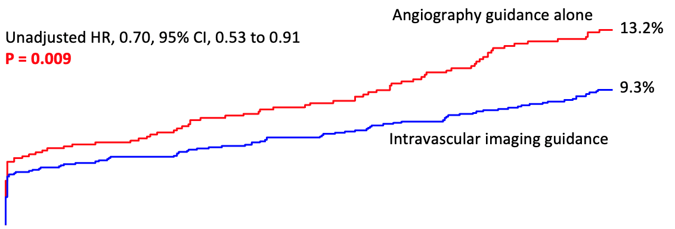
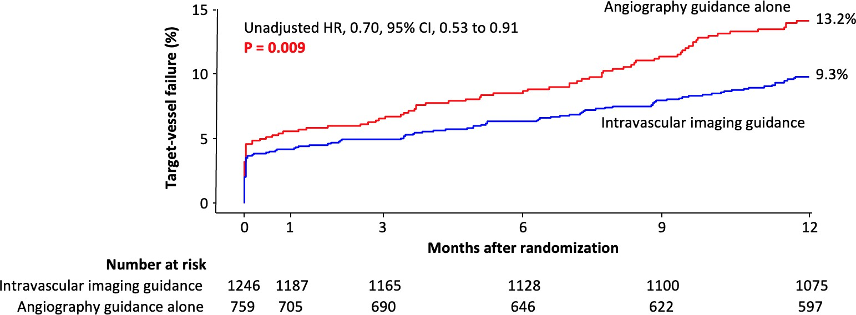
Target Vessel Failure at 1-Year
Unadjusted HR 0.70, 95% CI, 0.53-0.91
P = 0.009
Adjusted HR 0.74, 95% CI, 0.56-0.97; P = 0.03
Adjusted for IVI vs. angiography guidance, baseline clinical variables (age, sex, diabetes, current smoker, prior PCI, prior CABG, prior MI, h/o PVD, eGFR, hemodialysis, and presentation with ACS), baseline core laboratory angiographic variables (# lesions treated, any LM or LAD treated, smallest RVD, smallest MLD, and max calcium length),
and randomization to OA vs. BA, using inverse propensity score weighting with a robust variance estimator
3/30/2025 9

Slide 10
Adverse Events at 1-Year
 | Intravascular imaging guidance (n=1246) | Angiographic guidance alone (N=759) | Unadjusted Risk difference, % (95% CI) | Unadjusted Hazard ratio (95% CI) | P-value
Target-vessel failure | 114 (9.3%) | 96 (13.2%) | -3.9 (-6.8, -0.9) | 0.70 (0.53, 0.91) | 0.009
Cardiac death | 32 (2.7%) | 33 (4.6%) | -1.9 (-3.7, -0.2) | 0.57 (0.35, 0.92) | 0.02
TV-MI | 60 (4.9%) | 38 (5.1%) | -0.2 (-2.2, 1.7) | 0.95 (0.63, 1.42) | 0.80
ID-TVR | 42 (3.5%) | 39 (5.6%) | -2.1 (-4.1, -0.1) | 0.62 0.40, 0.96) | 0.03
Secondary endpoints
All-cause death | 55 (4.5%) | 59 (8.1%) | -3.6 (-5.9, -1.3) | 0.55 (0.38, 0.79) | 0.001
All MI | 92 (7.5%) | 62 (8.5%) | -1.0 (-3.5, 1.5) | 0.88 (0.64, 1.22) | 0.45
Procedural MI | 46 (3.7%) | 29 (3.8%) | -0.1 (-1.9, 1.6) | 0.96 (0.60, 1.53) | 0.87
Non-procedural MI | 47 (3.9%) | 34 (4.8%) | -0.9 (-2.8, 1.0) | 0.81 (0.52, 1.26) | 0.35
Non-TV-MI | 33 (2.7%) | 26 (3.6%) | -0.9 (-2.6, 0.7) | 0.75 (0.45, 1.25) | 0.27
ID-TLR | 32 (2.7%) | 32 (4.6%) | -1.9 (-3.7, -0.1) | 0.58 (0.36, 0.95) | 0.03
Stent thrombosis, def or prob | 5 (0.4%) | 10 (1.3%) | -0.9 (-1.8, -0.0) | 0.30 (0.10, 0.88) | 0.03
3/30/2025 10

Slide 11
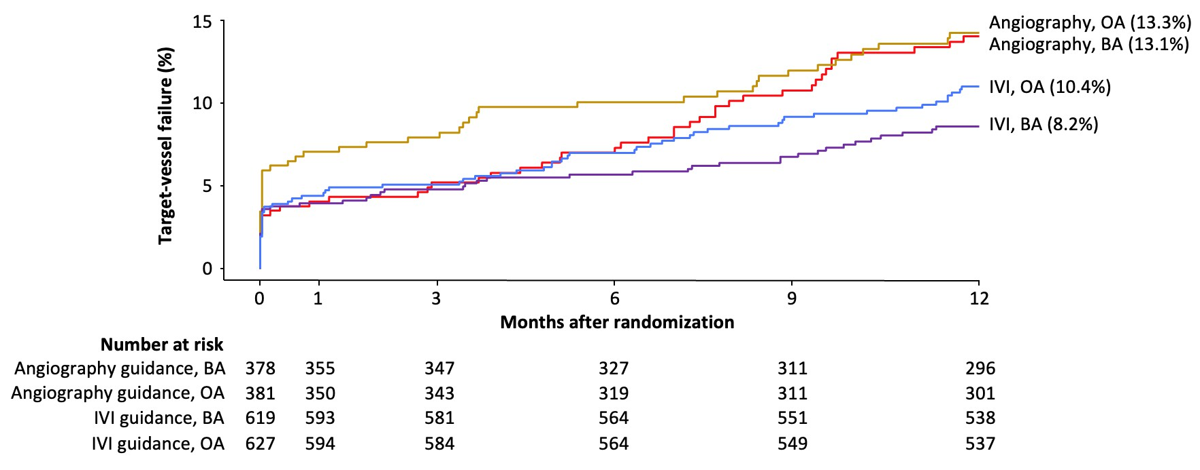
Target Vessel Failure at 1-Year
OA: IVI guidance vs. angiography guidance alone - HR, 0.76, 95% CI, 0.53 to 1.11 CBA: IVI guidance vs. angiography guidance alone - HR, 0.62, 95% CI, 0.42 to 0.93 IVI guidance: OA vs. BA - HR, 1.27, 95% CI, 0.88 to 1.84
Angiography guidance alone: OA vs. BA - HR, 1.04, 95% CI, 0.70 to 1.56
P
= 0.48
interaction
3/30/2025 11

Slide 12
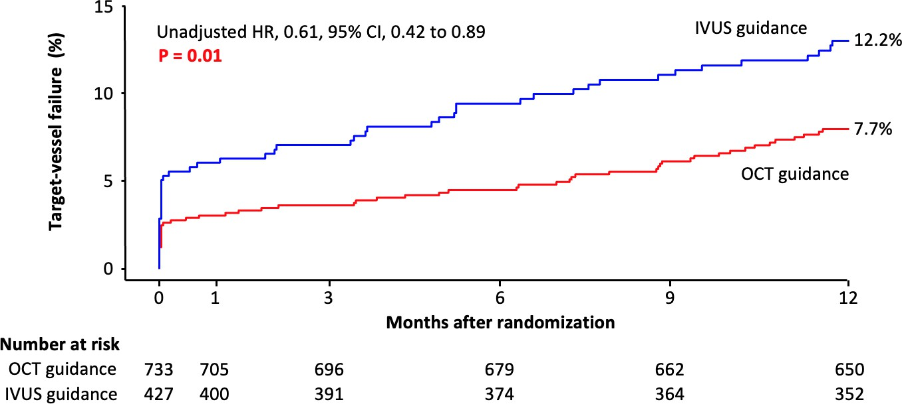
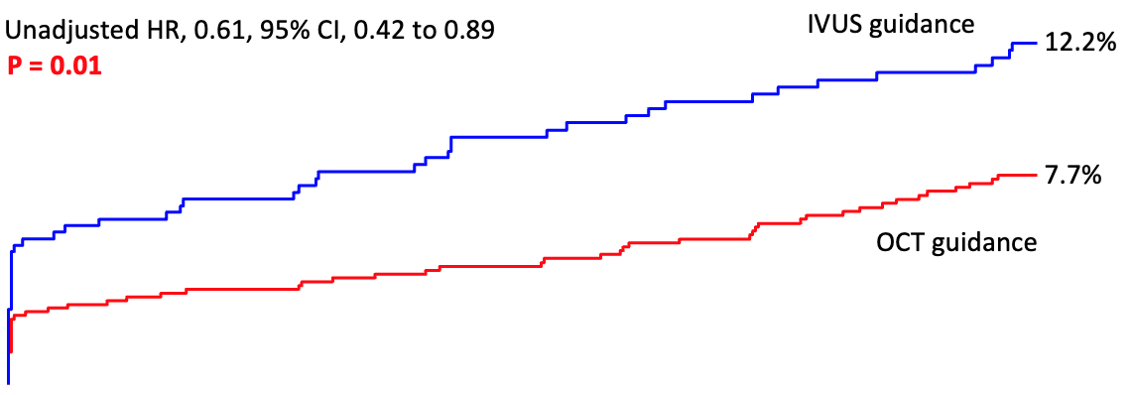
Target Vessel Failure at 1-Year: OCT vs. IVUS
Unadjusted HR 0.61, 95% CI, 0.42-0.89
P = 0.01
Adjusted HR 0.78, 95% CI, 0.52-1.18; P = 0.24
Adjusted for baseline clinical variables (age, sex, diabetes, current smoker, prior PCI, prior CABG, prior MI, h/o PVD, eGFR, hemodialysis, and presentation with ACS), baseline core laboratory angiographic variables (# lesions treated, any LM or LAD treated, smallest RVD, smallest MLD, and max calcium length),
and randomization to OA vs. BA, using inverse propensity score weighting with a robust variance estimator
3/30/2025 12

Slide 13
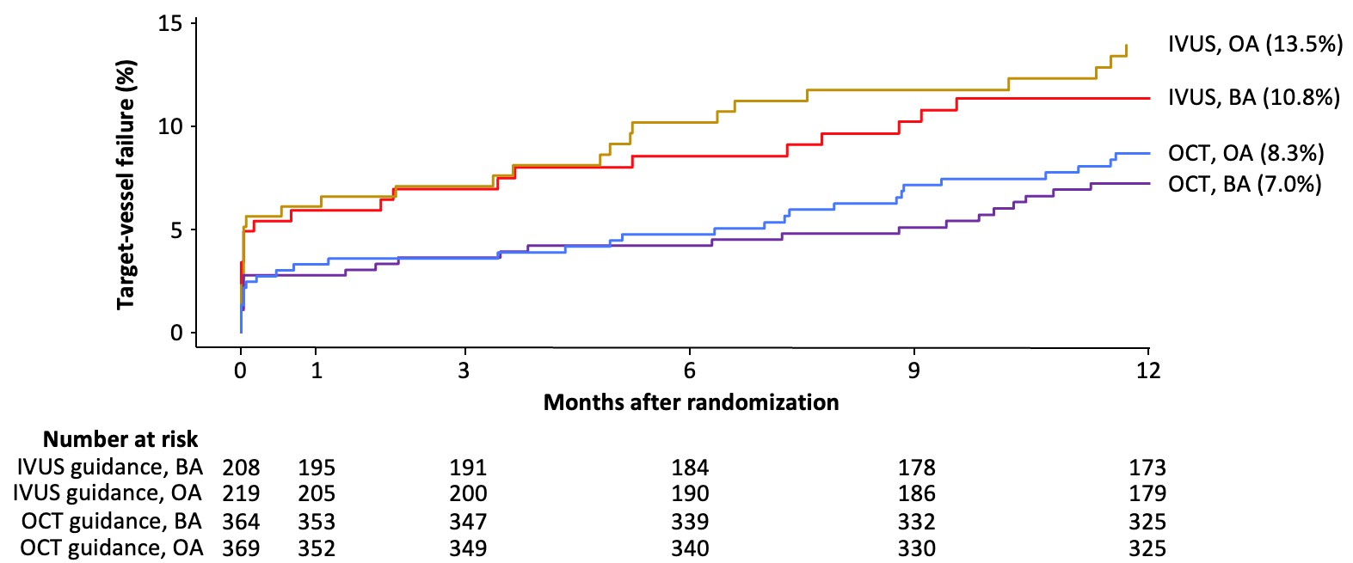
Target Vessel Failure at 1-Year: OCT vs. IVUS
OA: OCT guidance vs. IVUS guidance - HR, 0.59, 95% CI, 0.36 to 0.99 BA: OCT guidance vs. IVUS guidance - HR, 0.63, 95% CI, 0.35 to 1.11 OCT guidance: OA vs. BA - HR, 1.19, 95% CI, 0.70 to 2.03
IVUS guidance: OA vs. BA - HR, 1.26, 95% CI, 0.72 to 2.19
P
= 0.89
interaction
3/30/2025 13

Slide 14
Limitations
Given the non-randomized nature of the present analysis, residual confounding cannot be excluded
Operators in ECLIPSE were not instructed how to use IVI nor were provided imaging goals for optimization
The present study was not designed to determine how IVI guidance improves outcomes compared with angiography guidance alone in calcified lesions
The OCT vs. IVUS comparison was under-powered to detect differences in outcomes between the imaging modalities
Longer-term follow-up is necessary to determine if the benefits of IVI guidance observed at 1 year increase over time
3/30/2025 14

Slide 15
Conclusions
In the large-scale ECLIPSE trial of vessel preparation strategies in severely calcified lesions prior to DES implantation:
IVI guidance during PCI was associated with a 26% reduction in the 1-year risk of TVF compared with angiography guidance alone, with consistent results in patients treated with OA and BA
A lower rate of TVF was observed with OCT guidance compared with IVUS guidance although this difference was no longer significant after adjustment for differences in baseline clinical and angiographic characteristics between the groups
These data support the routine use of IVI guidance during PCI of severely calcified lesions
3/30/2025 15

