Slide 1


Randomized clinical trial shows a novel point-of-care heart attack test leads to shorter Emergency Department stays for some patients
Funding: The study was financed by grants from the Western Norway Regional Health Authority; grant number: F-10440 and F-12852. I.V.L Thulin has a Ph.D. grant from the Western Norway Regional Health Authority (grant number: F-13074). The Atellica VTLi analyzers and reagent costs were covered by Siemens Healthineers. The sponsor had no influence on the analyzing or interpretation of the data, nor on the writing of the manuscript.
Conflicts of interest: K.M.A. has served on advisory board for Roche Diagnostics, Siemens Healthineers and SpinChip, consultant honoraria form CardiNor, lecturing honorarium from Siemens Healthineers, Roche Diagnostics, Mindray and Snibe Diagnostics and research grants from Siemens Healthineers and Roche Diagnostics, she is Associate Editor of Clinical Biochemistry and Chair of the IFCC Committee of Clinical Application of Cardiac Bio-markers.
Professor Kristin M Aakre, MD, PhD 1st September 2024

Slide 2
Conclusion
Implementing POC (bedside) hs-cTnI testing in the Emergency Department with a 0/1-hour diagnostic algorithm led to modest reductions in Emergency Department length of stay
The effect were more marked in patients with a heart attack and in patients who were seen by a clinician within 1 hour of arrival
Safety was comparable to central laboratory testing

Slide 3





























The Problem

Slide 4
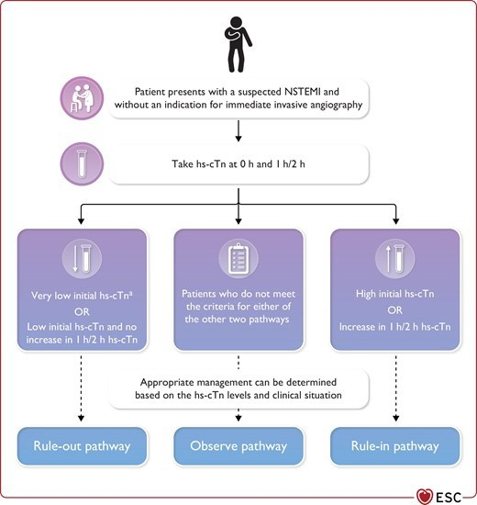

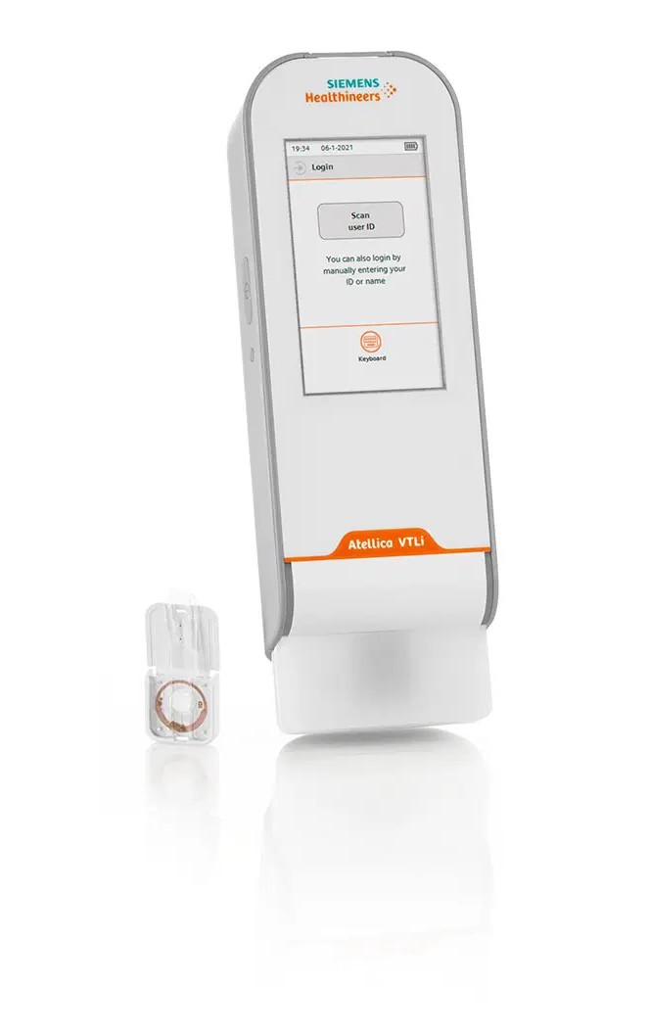
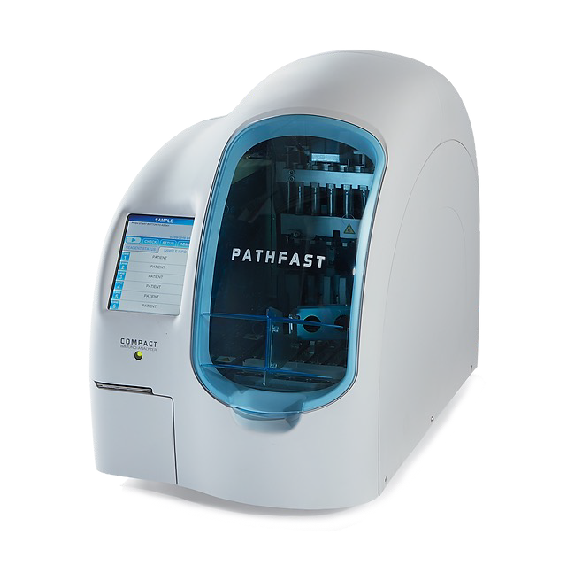
Potential Solutions
Accelerated diagnostic protocols
Point-of-care hs-cTn assays?

Slide 5

Study design
1614 patients with symptoms suggestive of ACS
Randomized to the Point-of-care group n=806
Randomized to the Standard group n=808
Excluded patients n= 78
Excluded patients n= 42
Final analysis
Point-of-care group n=728
Final analysis Standard group n=766

Slide 6




Primary Results: Overall 6 Minute Difference in the Median Length of Stay in the Emergency Department
Patients seen by physician within 60 minutes
Minutes in the ED
Difference
15 minutes
p<0.001
Point of care Standard
147
162
Patients with AMI
Minutes in the ED
Difference
43 minutes
p= 0.005
Point of care Standard
137
180

Slide 7
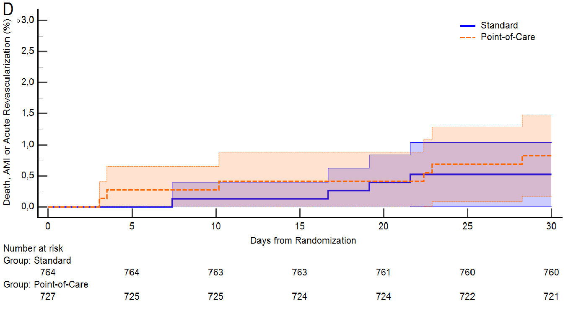
Safety Outcomes: The 30 days prevalence of heart attack, death and acute revascularization after discharge was < 1%
OR: 1.6 (0.4-5.6)
p-value: 0.48

Slide 8
Key Takeaways
Bedside hs-cTnI testing is efficient and safe
  can reduce length of stay in the Emergency Department
  has comparable safety to centralized hs-cTnT testing when applied in an Emergency Department 0/1h accelerated diagnostic protocol
Efficiency benefits from bedside hs-cTnI testing are dependent on local logistics and workflow

