Slide 1





Incidence, Evolution, and Impact of Cardiac Damage in Asymptomatic Severe Aortic Stenosis:
Results from the EARLY TAVR trial
Drs. Philippe Généreux, Brian Lindman, Allan Schwartz,
Philippe Pibarot, and Martin B. Leon
on behalf of the EARLY TAVR Investigators

Slide 2

Potential conflicts of interest
Speaker's name: Dr Philippe Généreux
☑ I have the following potential conflicts of interest to report
Financial Relationship
Consulting Fees
Company
Abbott Vascular, Abiomed, Edwards Lifesciences, Haemonetics, Pi- Cardia, Puzzle Medical Inc., Saranas, Shockwave Medical, Teleflex Incorporated, 4C Medical
Principal Investigator
EARLY TAVR trial, PROGRESS trial, ECLIPSE trial, 4C Feasibility trial
Equity
Puzzle Medical Inc., Pi-Cardia, Saranas
europcr.com

Slide 3
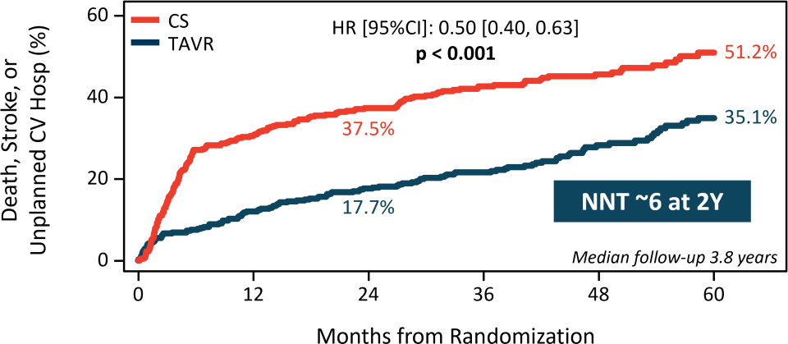
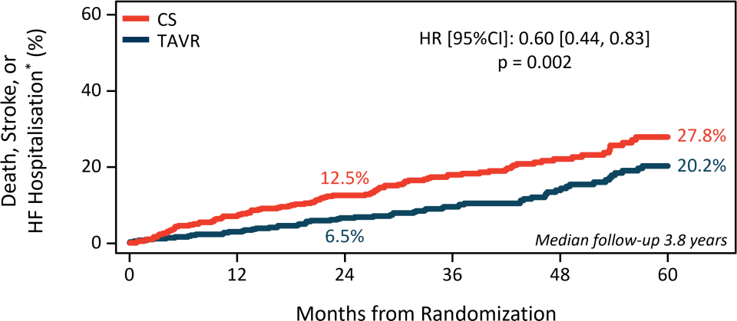
Why this study?
For patients with severe aortic stenosis (AS) and no symptoms, the EARLY TAVR trial demonstrated superiority of a strategy of early transcatheter aortic valve replacement (TAVR) compared to clinical surveillance with regards to the primary endpoint of death, stroke, and unplanned cardiovascular hospitalisation as well as death, stroke and hospitalisation for heart failure¹
Months from Randomisation
Months from Randomisation
¹Généreux et al., N Engl J Med 2025. europcr.com

Slide 4
Why this study?
For patients with severe aortic stenosis (AS) and no symptoms, the EARLY TAVR trial demonstrated superiority of a strategy of early transcatheter aortic valve replacement (TAVR) compared to clinical surveillance with regards to the primary endpoint of death, stroke, and unplanned cardiovascular hospitalisation as well as death, stroke and hospitalisation for heart failure¹
Prior studies have shown that the extent of cardiac damage is associated with
worse outcomes in patients with AS²⁻³
The impact of early intervention on progression of cardiac damage in patients with asymptomatic, severe AS has never been studied in the context of a randomised trial
¹Généreux et al., N Engl J Med 2025. ²Généreux et al., Eur Heart J. 2017. ³Abdelfattahet al., JACC Adv. 2024.europcr.com

Slide 5





EARLY TAVR trial
Prospective, multicenter RCT evaluating patients with asymptomatic,
severe AS aged ≥ 65 years w/ an STS score ≤ 10% and LVEF ≥ 50%
Asymptomatic Status
Confirmed by negative treadmill stress test
Randomisation 1:1
Transfemoral-TAVR
(SAPIEN 3 or SAPIEN 3 Ultra THV)
Clinical Surveillance
PRIMARY ENDPOINT
Non-hierarchical composite of all-cause death, any stroke,
or unplanned CV hospitalization at a minimum follow-up of 2 years
europcr.com

Slide 6


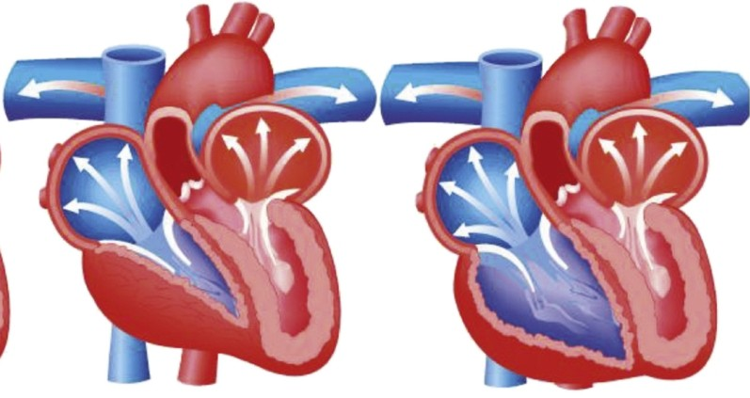






Staging of Cardiac Damage
Left heart damage Right heart damage
Stage/Criteria | 0 | 1 | 2 | 3 | 4
 | No cardiac damage | LV Damage | LA or Mitral Damage | Pulmonary Vasculature or Tricuspid Damage | RV Damage
Echocardiogram |  | Increased LV Mass Index >115 g/m² (Male) > 95 g/m² (Female) | LA Volume Index >35 mL/m² | Systolic Pulmonary Hypertension >60 mmHg | Moderate – Severe RV Dysfunction
 |  | E/e’>14 | Moderate – Severe Mitral Regurgitation | Moderate – Severe Tricuspid Regurgitation
 |  | LVEF < 50% | Atrial Fibrillation
Généreux et al., Eur Heart J. 2017. europcr.com

Slide 7




Cardiac Damage Data Availability
EARLY TAVR Trial
Randomisation 1:1 (N=901)
Transfemoral-TAVR (N=455)
(SAPIEN 3 or SAPIEN 3 Ultra THV)
Clinical Surveillance (N=446)
(388 pts converted to delayed AVR)
Missingness of Baseline AS Staging Components
TAPSE | 31/901 (3.4%)
Tricuspid regurgitation | 26/901 (2.9%)
PA systolic pressure | 250/901 (27.7%)
Mitral regurgitation | 18/901 (2.0%)
Atrial fibrillation | 1/901 (0.1%)
Left atrial volume index | 15/901 (1.7%)
LVEF | 6/901 (0.7%)
E/e’ ratio | 56/901 (6.2%)
LV mass index | 19/901 (2.1%)
Echocardiography Data Available Baseline Analysis (N=631: 70.0%)
Echocardiography Data Available 2-year Analysis (N=538: 59.7%)
europcr.com

Slide 8

Stage of Cardiac Damage at Baseline
Left heart damage Right heart damage
Stage | Stage 0 | Stage 1 | Stage 2 | Stage 3/4
Total | 14.4% | 19.6% | 62.2% | 3.8%
europcr.com

Slide 9
Stage of Cardiac Damage at Baseline
Left heart damage Right heart damage
Stage | Stage 0 | Stage 1 | Stage 2 | Stage 3/4 | P-value
Total | 14.4% | 19.6% | 62.2% | 3.8%
TAVR | 10.9% | 22.3% | 62.7% | 4.1% | 0.39
CS | 18.2% | 16.7% | 61.6% | 3.5%
>85% of patients with asymptomatic, severe AS enrolled in the EARLY TAVR trial had existing cardiac damage at baseline
P value is for difference in cardiac damage between Early TAVR and CS, using a Wilcoxon Rank Sum test in a paired analysis. europcr.com

Slide 10
Death, Stroke, or Unplanned CV Hospitalisation (ITT)
60
Stage 3/4 Stage 2
Stage 1
Stage 0
Log-rank p=0.06
Median follow-up 3.8 years
Death, Stroke, Unplanned
CV Hospitalisation* (%)
46.7
44.5
37.4
40
26.1
20
0
0
12
24 36 48
Months from Randomisation
60
No. at Risk
Stage 3/4 | 25 | 16 | 13 | 10 | 6 | 5
Stage 2 | 390 | 301 | 271 | 199 | 101 | 54
Stage 1 | 112 | 91 | 81 | 62 | 36 | 24
Stage 0 | 104 | 82 | 79 | 60 | 32 | 19 | europcr.com

Slide 11
Death, Stroke, or HF Hospitalisation (ITT)
60
Stage 3/4 Stage 2
Stage 1
Stage 0
Death, Stroke, or
HF Hospitalisation* (%)
Log-rank p=0.01
Median follow-up 3.8 years
40
32.6
26.4
23.7
20
11.7
0
0
12
24 36 48
Months from Randomisation
60
No. at Risk
Stage 3/4 | 25 | 20 | 16 | 13 | 9 | 7
Stage 2 | 390 | 367 | 347 | 260 | 140 | 83
Stage 1 | 112 | 105 | 98 | 74 | 42 | 27
Stage 0 | 104 | 100 | 98 | 75 | 39 | 25 | europcr.com

Slide 12
Treatment Effect by Baseline Cardiac Damage
Consistent benefits of the early TAVR strategy across all stages of cardiac damage
Endpoint
Death, Stroke or Unplanned CV Hospitalisation
Stage 0
Stage 1
Stage 2 Stage 3/4
Death, Stroke or Heart Failure Hospitalisation
Stage 0
Stage 1
Stage 2 Stage 3/4
Death, Stroke, Unplanned CV Hosp.
or Intervention with Advanced Signs/Symptoms
Stage 0
Stage 1
Stage 2 Stage 3/4
Hazard Ratio [95% CI]
P-value
0.68
0.46 [0.19, 1.09]
0.34 [0.17, 0.68]
0.49 [0.35, 0.69]
0.32 [0.09, 1.11]
0.13
0.20 [0.03, 1.66]
0.26 [0.10, 0.69]
0.75 [0.47, 1.20]
0.39 [0.09, 1.63]
0.63
0.44 [0.20, 1.00]
0.30 [0.15, 0.59]
0.48 [0.35, 0.67]
0.47 [0.13, 1.65]
0.1
1
2 3
CS Better
TAVR Better
europcr.com

Slide 13
Death, Stroke, or Unplanned CV Hospitalisation
Consistent benefits of the early TAVR strategy across all stages of cardiac damage
Death, Stroke, or
Unplanned CV Hosp. (%)
Death, Stroke, or
Unplanned CV Hosp (%)
CS TAVR
80 Stage 0 (N=104)
Log-rank p=0.07 Log-rank p=0.001
80 Stage 1 (N=112)
52.0
40
40
32.0
18.5
25.8
0
0
0
0
12 24
36 48 60
12 24 36 48 60
Months from Randomisation
Months from Randomisation
Death, Stroke, or
Unplanned CV Hosp. (%)
80
Stage 2 (N=390) Log-rank p<0.001
Death, Stroke, or
Unplanned CV Hosp. (%)
80
Log-rank p=0.06
63.6
Stage 3/4 (N=25)
52.6
40.1
40
40
29.3
0
0
0
12 24 36 48 60
Months from Randomisation
0
12 24 36 48 60
Months from Randomisation
Exploratory analysis
europcr.com

Slide 14
Timing of Conversion to AVR in the CS Arm*
100
Stage 3/4 Stage 2
Stage 1
Stage 0
Log-rank p=0.98
Conversion to AVR (%)
72.4
67.9
66.5
64.9
50
Median (Q1, Q3) time to conversion Stage 3/4 6.1 (1.8, 10.5) months
Stage 2
Stage 1
Stage 0
Total
12 18
12.1 (4.7, 21.4) months
12.5 (5.8, 16.8) months
10.1 (5.7, 25.5) months
11.3 (5.0, 21.2) months
0
0
6
24
Months from Randomisation
No. at Risk
Stage 3/4 | 11 | 6 | 4 | 3 | 3
Stage 2 | 199 | 147 | 111 | 78 | 61
Stage 1 | 49 | 38 | 29 | 15 | 13
Stage 0 | 58 | 43 | 26 | 20 | 19 *312 pts converted within 2 years. europcr.com

Slide 15
Clinical Presentation at Time of Conversion
Patients classified based on acuity and severity of signs/symptoms
Asymptomatic
Acute Valve Syndrome
NYHA III/IV
Syncope
Atrial fibrillation
Ventricular arrhythmia
Resuscitated sudden death/cardiac arrest
Hospitalization for HF and/or pulmonary edema
LVEF drops to < 50%
≥ 3-fold increase in NT-proBNP from baseline and age-specific threshold*
Includes pts who may have converted to AVR b/c
they required additional medical procedures
Progressive Valve Syndrome
NYHA II
Increase in HF medication from baseline
≥ 1.5- to < 3-fold increase in NT-proBNP from baseline and age-specific threshold*
*125 pg/mL for patients ≤ 75 years and 450 pg/mL for > 75 years
Additional exploratory analysis
Adapted from Généreux et al. N Engl J Med 2024 and Généreux et al. Struct Heart 2024. europcr.com

Slide 16







Clinical Presentation at Time of Conversion*
1/3 of patients in Stage 0 converted to AVR with acute valve syndrome
p=0.27
100%
90%
80%
70%
60%
50%
40%
30%
20%
10%
0%
0.0
0.0
1.7
0.0
No symptoms
Progressive valve syndrome
Acute valve syndrome
66.7
63.4
56.3
50.0
33.3
36.6
42.0
50.0
Stage 0
Stage 1 Stage 2 Stage 3/4
P-value is from Jonckheere-Terpstra test. *388 pts in total had converted at most recent follow-up.
europcr.com

Slide 17


Evolution of Damage: Early TAVR vs Clinical Surveillance
At 2-year follow-up Early TAVR (N=220)
Improved*
24.1%
Stayed the same 61.8%
Worsened* 14.1%
p=0.01
Clinical Surveillance (N=198)
Improved* 17.7%
Stayed the same 58.6%
Worsened*
23.7%
The Early TAVR patients were more likely to improve their stage of cardiac damage compared to the CS patients who were more likely to worsen their stage of cardiac damage
P value is for difference in cardiac damage between Early TAVR and CS, using a Wilcoxon Rank Sum test in a paired analysis. *Improved or Worsened >= 1 stage of cardiac damage from baseline. europcr.com

Slide 18

Evolution of Damage: Clinical Surveillance with or w/o AVR
At 2-year follow-up
Early TAVR (N=220)
Improved*
24.1%
Stayed the same 61.8%
Worsened*
14.1%
Clinical Surveillance with AVR within 2 years† (N=133)
Improved*
21.1%
Stayed the same 55.6%
Worsened*
23.3%
p=0.02
Clinical Surveillance w/o AVR within 2 years (N=65)
Improved*
10.8%
Stayed the same 64.6%
Worsened*
24.6%
P value is for difference in cardiac damage between groups, using a Kruskal-Wallis test in a paired analysis. *Improved or Worsened >= 1 stage of cardiac damage from baseline. †312 pts in total converted within 2 years.
europcr.com

Slide 19

Conclusions and Implications
Among patients with asymptomatic, severe AS in the EARLY TAVR trial:
Cardiac damage was frequent, with >85% having cardiac damage at baseline
The extent of cardiac damage was associated with worse outcomes
The benefit of early TAVR was consistent across all stages of cardiac damage
At 2-year follow-up, patients who received early TAVR were more likely to show improvement in their stage of cardiac damage, whereas those in the clinical surveillance group more often experienced a worsening of cardiac damage
These findings support a strategy of early referral and prompt TAVR before symptoms develop for patients with severe AS to prevent worsening of cardiac damage
europcr.com

Slide 20

pcronline.com

