Slide 1





Randomised Comparison of Lithotripsy vs. Conventional Preparation in Severely Calcified Coronary Lesions (BALI)
An investigator-initiated multinational trial
Andreas T. Kristensen, MD For the BALI trial investigators

Slide 2

Potential conflicts of interest
BALI Trial
NCT04253171
Speaker's name: Andreas Torp Kristensen
This investigator-initiated trial was supported by Abbott Vascular and Shockwave Medical.
europcr.com

Slide 3
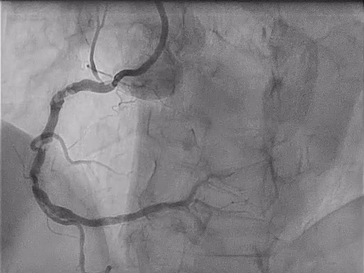

pcronline.com

Slide 4
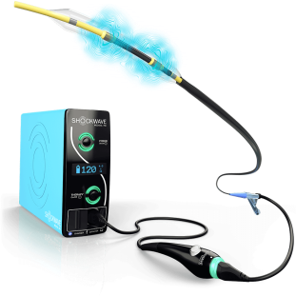
Why this study?
BALI Trial
NCT04253171
Intravascular lithotripsy (IVL)
Rapid uptake
Promising observational results
Not supported by randomized evidence
Hypothesis: Lithotripsy was superior to conventional preparation

Slide 5
Methods
BALI Trial
NCT04253171
Inclusion criteria
Severe angiographic calcification (Mintz et al. 1995) Chronic or acute coronary syndrome
Evidence of ischemia
Exclusion criteria
STEMI CTO
LVEF <35%
eGFR <30

Slide 6
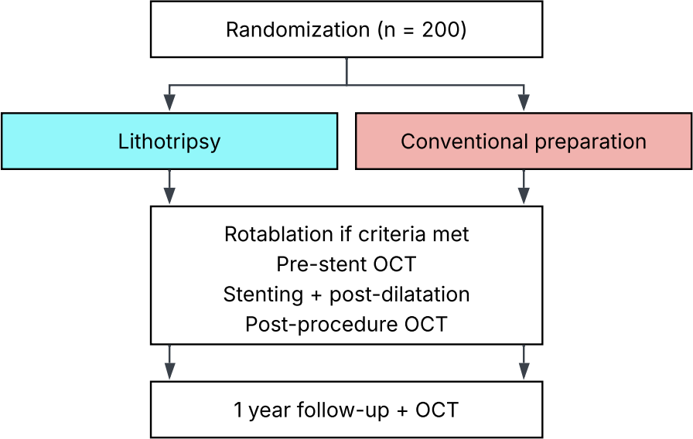
Methods
BALI Trial
NCT04253171

Slide 7
Primary endpoint
BALI Trial
NCT04253171
A composite of
Procedural failure
  No or failed stent delivery
  OCT-assessed residual area stenosis ≥20%
Target vessel failure at 1 year
  Myocardial infarction
  Clinically driven revascularization
  Cardiac death
Assumed 15% points difference (25% in control arm, 80% β) → 200 patients
Predefined statistical analysis plan with blinded adjudication of clinical endpoints Blinded core laboratory OCT analyses and adjudication of OCT endpoints

Slide 8
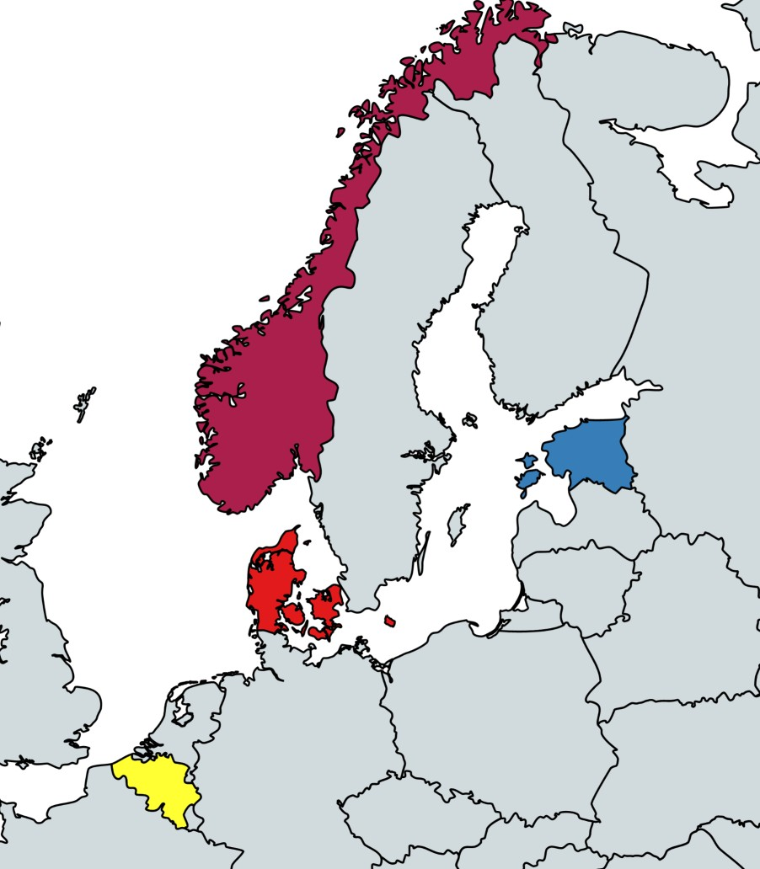
Trial sites
Primary investigator
BALI Trial
NCT04253171
Niels Thue Olsen
Copenhagen University Hospital Rigshospitalet, Denmark
Principal investigators Evald Høj Christiansen Henning Kelbæk Thomas Engstrøm Karsten Veien
Bent Raungaard Ola Kleveland Johan Bennett Peep Laanmets
Aarhus University Hospital, Denmark
St. Olavs Hospital
Zealand University Hospital, Denmark
Copenhagen University Hospital Rigshospitalet, Denmark
North-Estonia Medical Centre
Odense University Hospital, Denmark
Aalborg University Hospital, Denmark
St. Olavs Hospital, Norway
University Hospitals Leuven Belgium
UZ Leuven
Aarhus Hospital Roskilde Hospital Rigshospitalet Gentofte Hospital Odense Hospital Aalborg Hospital
North-Estonia Medical Center, Estonia
europcr.com

Slide 9
Baseline characteristics
BALI Trial
NCT04253171
 | Lithotripsy (n = 99) | Conventional (n = 101)
Age | 75 ± 8 | 74 ± 7
Female sex | 21% | 26%
NYHA class ≥2 | 49% | 43%
CCS class ≥2 | 74% | 79%
LVEF | 55 ± 8 | 54 ± 8
Chronic coronary syndrome | 81% | 74%
Medical history
Diabetes mellitus | 32% | 30%
Hypertension | 81% | 68%
Smoking | 60% | 68%
Prior MI | 18% | 19%
Prior PCI/CABG | 37% | 44%

Slide 10
Lesion characteristics
BALI Trial
NCT04253171
 | Lithotripsy (n = 99) | Conventional (n = 101)
Lesion location
LMCA | 1% | 0%
LAD | 56% | 57%
CX | 3% | 7%
RCA | 40% | 36%
Severe calcification (core lab.) | 98% | 95%
Ostial | 22% | 24%
Tortuous | 24% | 16%
Diffuse disease | 27% | 23%

Slide 11
Procedural characteristics
BALI Trial
NCT04253171
 | Lithotripsy (n = 99) | Conventional (n = 101)
Lesion preparation
Lithotripsy balloon | 100% | 2%
Non-compliant balloon | 69% | 82%
Cutting or scoring balloon | 12% | 57%
Super high-pressure balloon | 1% | 3%
Largest balloon diameter, mm | 3.5 ± 0.4 | 3.3 ± 0.5
Balloon pressure, atm | 15.3 ± 4.3 | 18.1 ± 4.5
Rotational atherectomy | 31% | 42%
Stent implantation
No. of stents 1.7 ± 0.8 1.7 ± 0.7

Slide 12
Procedural characteristics
BALI Trial
NCT04253171
 | Lithotripsy (n = 99) | Conventional (n = 101)
Lesion preparation
Lithotripsy balloon | 100% | 2%
Non-compliant balloon | 69% | 82%
Cutting or scoring balloon | 12% | 57%
Super high-pressure balloon | 1% | 3%
Largest balloon diameter, mm | 3.5 ± 0.4 | 3.3 ± 0.5
Balloon pressure, atm | 15.3 ± 4.3 | 18.1 ± 4.5
Rotational atherectomy | 31% | 42%
Stent implantation
No. of stents | 1.7 ± 0.8 | 1.7 ± 0.7
Total length, mm | 50.1 ± 23.3 | 46.3 ± 21.7
Post-dilatation
Largest balloon diameter, mm | 4.3 ± 0.7 | 4.0 ± 0.6
Balloon pressure, atm | 16.9 ± 5.1 | 18.2 ± 4.7

Slide 13
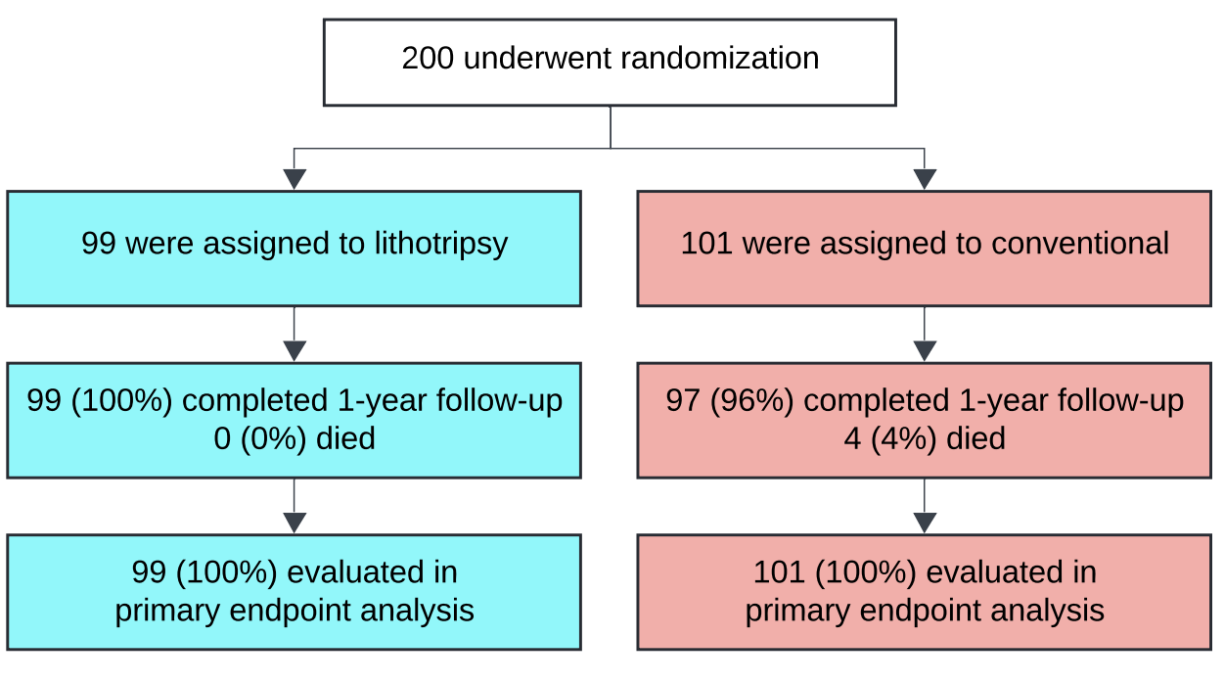
Trial flowchart
BALI Trial
NCT04253171

Slide 14
Primary endpoint result
BALI Trial
NCT04253171
Myocardial infarction 3.0% 5.9% 0.51 (0.07-2.10) -
Clinically driven revasc. 4.0% 5.0% 0.82 (0.18-3.32) -

Slide 15
Primary endpoint result
BALI Trial
NCT04253171
 | Lithotripsy (n = 99) | Conventional (n = 101) | Relative risk p
Primary endpoint | 35/99 (35.4%) | 52/101 (51.5%) | 0.69 (0.48-0.97) 0.02
Failed or no stent delivery | 1.0% | 0.0% | - -
Residual area stenosis ≥20% (OCT) | 32.3% | 44.6% | 0.73 (0.49-1.04) -
Target vessel failure at 1 year | 4.0% | 10.9% | 0.37 (0.07-1.09) -
Cardiac death 0.0% 1.0% - -
Myocardial infarction 3.0% 5.9% 0.51 (0.07-2.10) -
Clinically driven revasc. 4.0% 5.0% 0.82 (0.18-3.32) -

Slide 16
Procedural complications
BALI Trial
NCT04253171
 | Lithotripsy (n = 99) | Conventional (n = 101) | Relative risk p
Myocardial infarction | 0% | 5% | 0 (0.0-0.93) 0.07
Flow-limiting dissection | 6% | 4% | 1.53 (0.41-6.87) 0.72
Perforation* | 4% | 1% | 4.08 (0.56-102) 0.35
*A total of 5 perforations occurred, 2 were distal wire perforations (both in lithotripsy group)

Slide 17
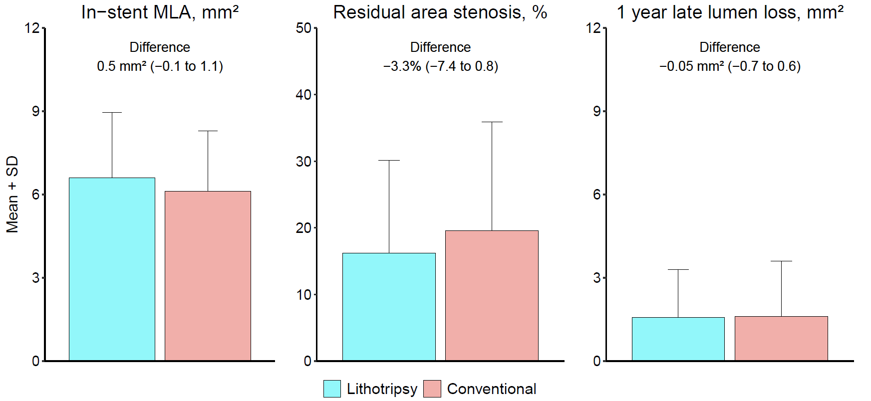
OCT results
BALI Trial
NCT04253171
europcr.com

Slide 18
Conclusion
BALI Trial
NCT04253171
In patients undergoing PCI for a severely calcified coronary lesion, the use of lithotripsy before stent implantation reduced the incidence of procedural failure or target vessel failure at 1 year, without an increased risk of adverse events.
andreas.torp.kristensen@regionh.dk

Slide 19
pcronline.com

