Slide 1

Overview:
SCAI Expert Consensus Statement on the Management of Patients With STEMI Referred for Primary PCI
Jacqueline E. Tamis-Holland, MD, FACC, FAHA, FSCAI Interventional Cardiologist
Institute Director Acute Coronary Care
Cleveland Clinic, Heart, Vascular and Thoracic Institute

Slide 3
Outline
Cath lab team readiness and initial assessment
Optimal techniques for angiography
Approach to PCI
  Managing thrombus
  Managing no-reflow
Intracoronary imaging
Emerging approaches to reduce infarct size
Special circumstances, Anatomical Subsets and Non-Atherosclerotic Causes
Future Directions

Slide 4
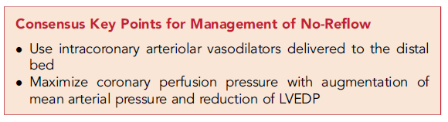
Consensus Key Points are “Key”

Slide 8
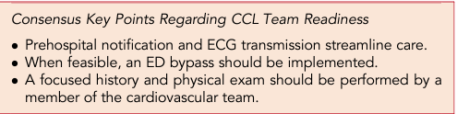
Key Consensus on Cath Lab Team Readiness

Slide 10
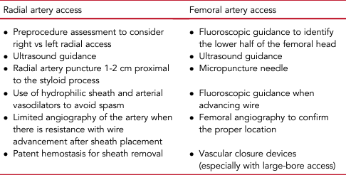
Best Practices for Optimal Arterial Access

Slide 11
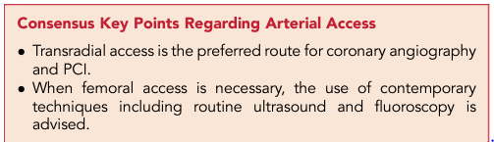
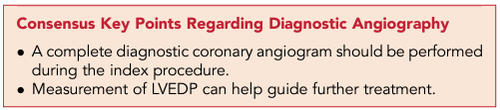
Key Consensus on “Performing Initial Diagnostic Assessment

Slide 14
Managing No Reflow
Prevention
  Aggressive antiplatelet therapies
  Arterial vasodilators
  Arterial vasodilators
  Arterial vasodilators

Slide 15
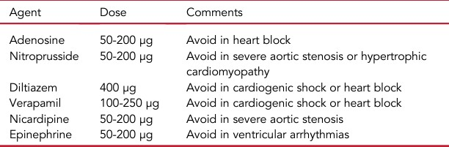
Suggested Dosing for Intra-Coronary Vasodilators

Slide 19
Additional Information
Special
Circumstances
Anatomical
Considerations
Non-Atherosclerotic
Causes of STEMI
Cardiogenic Shock
Post Lytic
Multi-vessel Disease
Coronary bypass graft
Stent thrombosis
Bifurcation disease
Calcification
Aneurysms/Ectasias
Epicardial vasospasm
SCAD
Thrombosis or
embolism
MINOCA

Slide 20
Additional Information
Special
Circumstances
Cardiogenic Shock
Post Lytic
Multi-vessel Disease
Coronary bypass graft
Stent thrombosis
Anatomical
Considerations
Non-Atherosclerotic
Causes of STEMI
Bifurcation disease
Calcification
Aneurysms/Ectasias
Epicardial vasospasm
SCAD
Thrombosis or
embolism
MINOCA

Slide 22
Additional Information
Special
Circumstances
Anatomical
Considerations
Bifurcation disease
Calcification
Aneurysms/Ectasias
Non-Atherosclerotic
Causes of STEMI
Cardiogenic Shock
Post Lytic
Multi-vessel Disease
Coronary bypass graft
Stent thrombosis
Epicardial vasospasm
SCAD
Thrombosis or
embolism
MINOCA

Slide 23
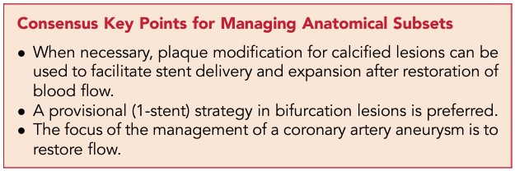
Key Consensus on Managing Anatomical Subsets

Slide 24
Additional Information
Special
Circumstances
Anatomical
Considerations
Non-Atherosclerotic
Causes of STEMI
Epicardial vasospasm
SCAD
Thrombosis or
embolism
MINOCA
Cardiogenic Shock
Post Lytic
Multi-vessel Disease
Coronary bypass graft
Stent thrombosis
Bifurcation disease
Calcification
Aneurysms/Ectasias

Slide 25
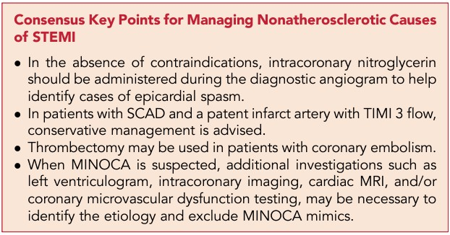
Key Consensus on Non-Atherosclerotic Causes of STEMI

Slide 26
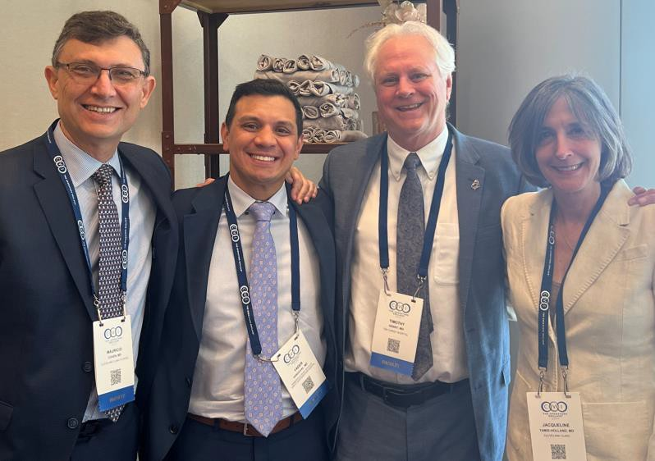
A BIG Thank You to all Co-Authors and to SCAI Leadership
Scott Firestone Chelsea Armah George Dangas Sunil Rao

