Slide 1
Novel AI to Assess Intracardiac Filling Pressure:
The Non-invasive SEISMocardiogram In Cardiovascular Monitoring for Heart Failure I (SEISMIC-HF I) Study
Liviu Klein, MD, MS | University of California, San Francisco
On behalf of the SEISMIC-HF I Investigators

Slide 2
DISCLOSURES
Dr. Klein is a consultant for Abbott, Cardiosense, Edwards and Medtronic.

Slide 3
Background
Remote hemodynamic-guided HF management using implanted PAP sensors has been shown to decrease the risk of HF hospitalizations and mortality ^{1,2}
Implanted PAP sensors, while offering valuable data, come with inherent risk of an invasive procedure, adverse events, and significant cost ³
Advances in non-invasive sensor technology and machine learning (ML) allow for novel approaches in estimating intracardiac pressures
We aimed to develop a ML algorithm to estimate PCWP non-invasively in a diverse population of HF patients, using a wearable sensor
Abraham WT et. al. Lancet. 2016;387:453-461.
Lindenfeld J et al. Lancet. 2021;398:991-1001.
Schmier JK et. al. Clin Cardiol. 2017;40:430-436.

Slide 4
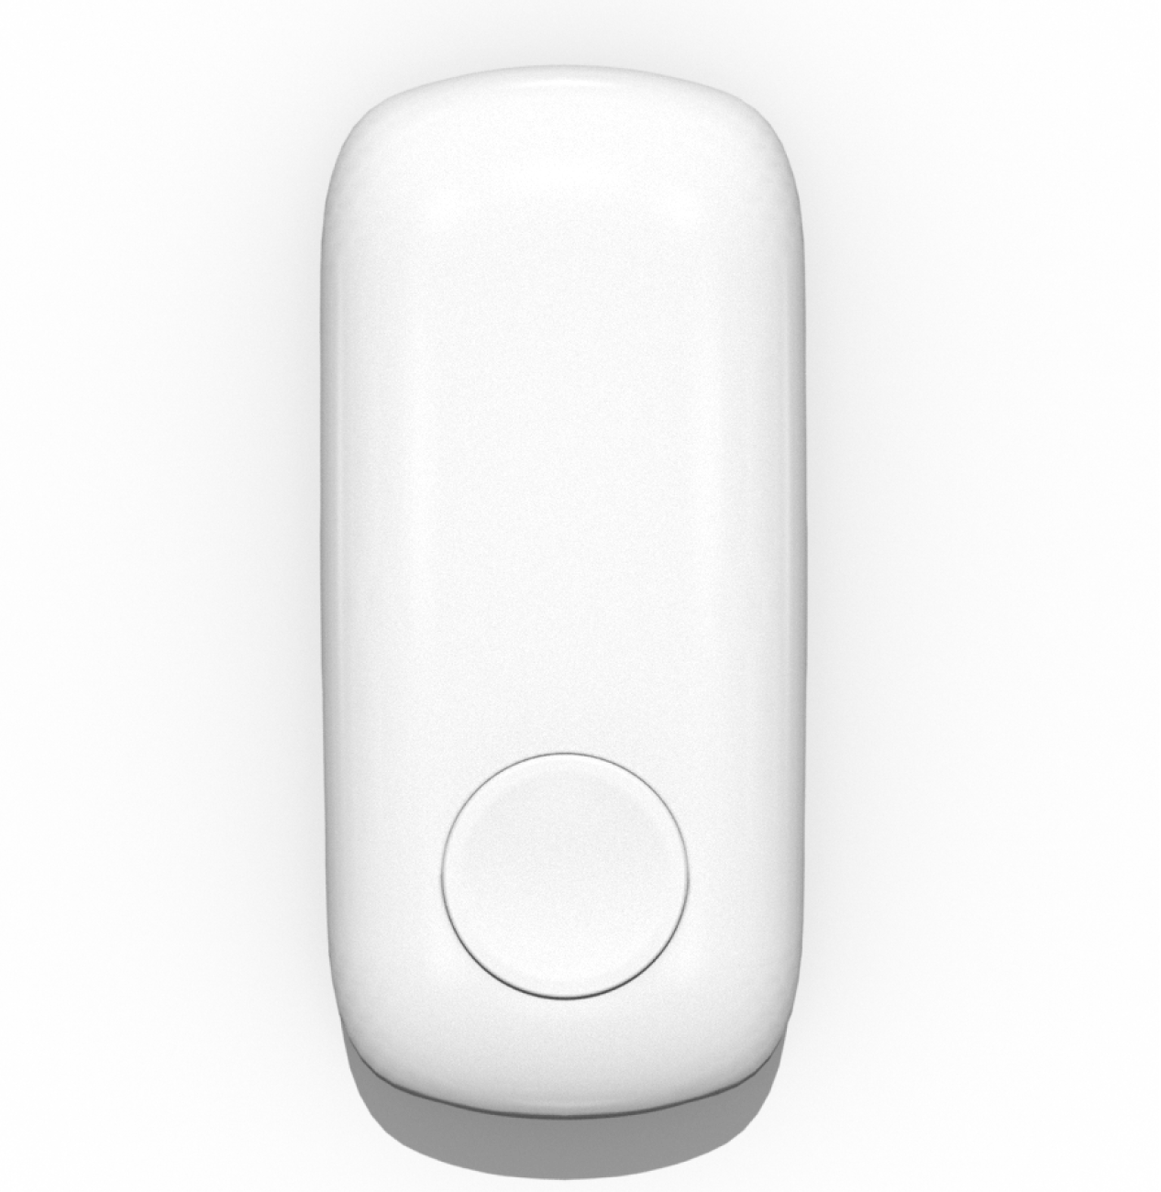
Hemodynamic-guided HF management via non-invasive PCWP estimation
CardioTag
Multi-modal wearable sensor for physiological signal capture
Cardiogenic Vibrations
Seismocardiogram (SCG)
Pulmonary Capillary Wedge Pressure Estimation and Congestion Classification
Optical Pulse Wave
Photoplethysmogram (PPG)
Signal Processing /
ML Pipeline
Electrical Rhythm
Electrocardiogram (ECG)
Incorporating SCG with traditional electrical and optical modalities enhances the AI’s accuracy assessing cardiac function
*CardioTag and Cardiosense Algorithms are investigational and have not been cleared or approved by the United States Food and Drug Administration (FDA).

Slide 5
SEISMIC-HF I: Eligibility
Key Inclusion Criteria
≥ 21 years of age
History of HF or suspected HF
Scheduled to undergo a RHC procedure per standard of care
Key Exclusion Criteria
Temporary or durable mechanical circulatory support
Mechanical ventilatory support
Known allergies to Ag/AgCl wet electrodes
Healing chest wall wounds
Hemodynamically unstable or otherwise inappropriate for participation

Slide 6
SEISMIC-HF I: Study Design
Objective | Develop a generalizable model for hemodynamic assessment using data from wearable sensors in HF patients
Primary Aim | Collect a large dataset of synchronously measured SCG, ECG, PPG (from CardioTag) and right heart catheterization (RHC) pressure tracings
Design | Prospective, multi-site, observational study
Recruitment | 943 participants scheduled to undergo a routine RHC at 15 US sites
Hemodynamic data | Hemodynamic data were reviewed by an independent blinded core lab
Analysis | Patients with HFrEF only

Slide 7
Patient Flow: HFrEF Cohort
HFrEF
(n=310)
Corrupted Data (n=34)
Annotated RHC (n=276)
RHC Data Quality Check Fail (n=13)
Sufficient PCWP Quality (n=263)
Automated CardioTag Data Quality Check Filtered (n=30)
Modeling Dataset (n=233)
Development (n=186)
Holdout Test (n=47)

Slide 8
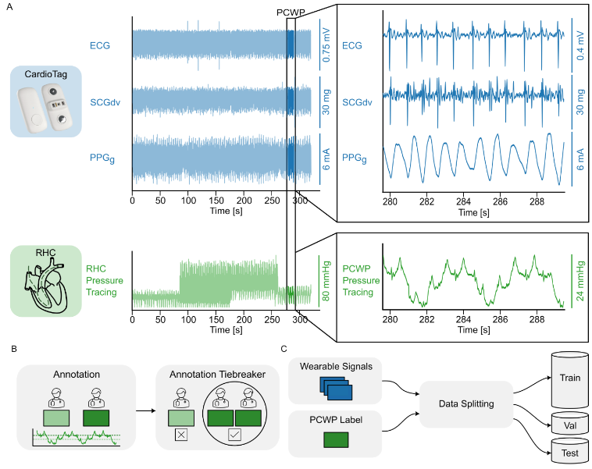
HFrEF PCWP Algorithm Development
Wearable Signals
PCWP Label
Data Splitting
Development
n = 186
Test
N = 47
CardioTag signals and RHC PCWP waveforms used to train the algorithms
Notes:
Andrew

Slide 9
Patient Characteristics
Diverse HF population providing a robust dataset for ML algorithms
Subject Characteristics | ​​HFrEF (≤ 40%)​ (n=310)
Age, y Mean (SD) > 65 years | 61.1 ± 13.4 137 (44%)
BMI | 31.4 ± 13.8
Sex Male Female | 193 (62%) 117 (38%)
Blood Pressure, mmHg Systolic / Diastolic, mean (SD) | 117.8 ± 19.4 / 73.5 ± 13.3
Race White Black or African American Asian Native Hawaiian or Other Pacific Islander American Indian or Alaska Native Other | 136 (44%) 122 (39%) 11 (4%) 7 (2%) 3 (1%) 31 (10%)
Ethnicity Hispanic / Latino Not Hispanic / Latino Not Reported | 23 (7%) 265 (85%) 22 (7%)
Clinical Characteristics and Symptoms | ​​HFrEF (≤ 40%) (n=310)
NYHA Functional Class
NYHA I | 8 (3%)
NYHA II | 72 (23%)
NYHA III | 177 (57%)
NYHA IV | 51 (16%)
Comorbidities
Hypertension | 259 (84%)
Prior myocardial Infarction | 100 (32%)
Coronary Artery Disease | 172 (55%)
Chronic Kidney Disease, Stage III-V | 142 (46%)
Hyperlipidemia | 221 (71%)
Chronic Obstructive Pulmonary Disease | 51 (16%)
Any Valve repair/ replacement | 34 (11%)

Slide 10
Medications and EF Data
High use of Guideline-Directed Medical Therapies
Medication | HFrEF (≤ 40%) (n=310)
Angiotensin-Converting Enzyme (ACE) Inhibitor | 23 (7%)
Angiotensin II Receptor Blocker (ARB) | 52 (17%)
Angiotensin Receptor Blocker/Neprilysin Inhibitor (ARNI) | 140 (45%)
Beta-blocker | 260 (84%)
Mineralocorticoid Receptor Antagonist (MRA) | 205 (66%)
Sodium-Glucose Cotransporter-2 (SGLT2) Inhibitor | 202 (65%)
Ivabradine | 7 (2%)
Loop Diuretics | 248 (80%)
Thiazide Diuretic | 20 (6%)
Vasodilators | 48 (15%)
LVEF (%)

Slide 11
Right Heart Catheterization Data
Hemodynamic Parameters (mean, SD) | HFrEF (≤ 40%) (n=310)
Right Atrial Pressure, mmHg | 8.9 ± 6.7
Right Ventricular Pressure, mmHg
Systolic | 43.9 ± 16.5
Diastolic | 4.8 ± 5.1
End Diastolic | 10.6 ± 6.7
Pulmonary Artery Pressure, mmHg
Systolic | 44.5 ± 16.9
Diastolic | 20.2 ± 9.3
Mean | 29.6 ± 11.8
Pulmonary Capillary Wedge Pressure, mmHg
A-wave | 20.2 ± 9.7
V-wave | 22.0 ± 11.6
Mean | 18.1 ± 9.4
Cardiac Output, L/min
Fick | 4.5 ± 1.4
Thermodilution | 4.1 ± 1.3
Cardiac Index L/min/m²
Fick | 2.2 ± 0.6
Thermodilution | 2.0 ± 0.6
PCWP (mmHg)
PAM (mmHg)

Slide 12
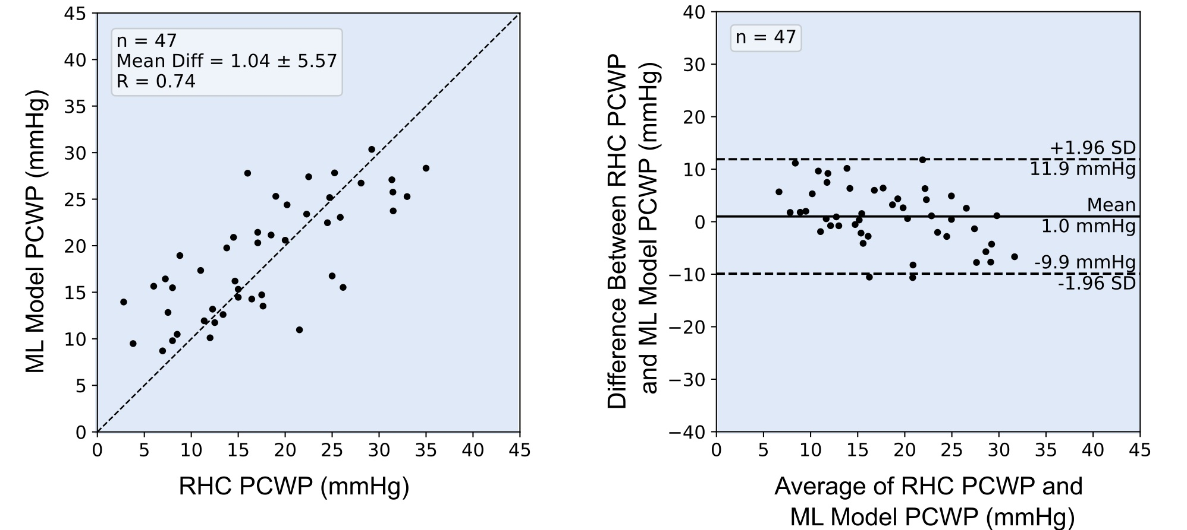
Holdout Set Model Performance
RHC vs ML Model
Bland-Altman

Slide 13
Subpopulation Analysis
 | Development |  |  |  | Holdout Test
 | N (%) | Bias (mmHg) | Precision (mmHg) |  | N (%) | Bias (mmHg) | Precision (mmHg)
Overall | 186 (100%) | 1.10 | 5.95 |  | 47 (100%) | 1.04 | 5.57
Sex
Female | 70 (38%) | 1.38 | 6.29 |  | 18 (38%) | 2.47 | 6.24
Male | 116 (62%) | 0.93 | 5.76 |  | 29 (62%) | 0.15 | 5.01
Race
White | 79 (42%) | 2.19 | 5.36 |  | 22 (47%) | 1.43 | 4.86
Black | 78 (42%) | 0.63 | 6.13 |  | 17 (36%) | 1.41 | 5.81
NYHA Class
III | 108 (58%) | 0.59 | 6.17 |  | 33 (70%) | 0.51 | 5.19
IV | 27 (15%) | 1.26 | 5.98 |  | 5 (11%) | 4.02 | 6.91
BMI
<25 | 84 (45%) | 2.76 | 6.07 |  | 12 .26%) | 2.6 | 6.28
25-35 | 59 (32%) | 1.01 | 5.01 |  | 30 (64%) | 0.34 | 5.48
>35 | 43 (23%) | -1.01 | 6.85 |  | 5 (11%) | 1.47 | 4.29

Slide 14
Subpopulation Analysis
 | Development |  |  |  | Holdout Test
 | N (%) | Bias (mmHg) | Precision (mmHg) |  | N (%) | Bias (mmHg) | Precision (mmHg)
Clinical Setting
Inpatient | 75 (40%) | 1.42 | 6.28 |  | 18 (38%) | -0.64 | 5.66
Outpatient | 111 (60%) | 0.88 | 5.74 |  | 29 (62%) | 2.08 | 5.34
Hypertension
Yes | 153 (82%) | 1.07 | 5.87 |  | 41 (87%) | 0.73 | 5.86
No | 33 (18%) | 1.26 | 6.39 |  | 6 (13%) | 3.11 | 2.17
Mitral Valve Regurgitation
None/Mild | 108 (58%) | 0.61 | 6.12 |  | 32 (68%) | 1.38 | 6.19
Moderate/Severe | 78 (42%) | 1.45 | 5.83 |  | 15 (32%) | 0.31 | 4.02
Pacemaker
Yes | 46 (25%) | 0.48 | 6.19 |  | 12 (26%) | 1.21 | 4.34
No | 140 (75%) | 1.3 | 5.88 |  | 35 (74%) | 0.98 | 5.98
Atrial Fibrillation
Yes | 68 (37%) | 1.07 | 5.92 |  | 14 (30%) | -1.08 | 6.18
No | 118 (63%) | 1.12 | 5.99 |  | 33 (70%) | 1.94 | 5.12

Slide 15
Limitations
Limited to clinical setting
Further work needed for remote hemodynamic data
Results focused on PCW pressures only
Further work needed in other hemodynamic measures (e.g., PAP)
Clinical outcomes validation (e.g., hospitalizations)
Algorithm trained only to HFrEF
Future work to expand train on HFpEF/ HFmrEF

Slide 16
Conclusions
SEISMIC-HF I successfully enrolled 310 diverse HFrEF patients => generalizable results
Developed ML model capable of estimating PCWP in HFrEF patients
Non-invasively measured waveforms using the CardioTag device
Algorithm performance for PCWP resulted an error of 1.04 ± 5.57 mmHg when compared to RHC measurements
LoA range was between -9.9 and 11.9 mmHg
Similar performance to FDA cleared implantable hemodynamic monitors
Results provide an important step towards enabling widespread hemodynamic-guided remote management of HF patients

Slide 17
THANK YOU

