Slide 1
Reversed Re-entry Technique
Mahmoud Abdelghany, MD, Yulanka Castro-Dominguez, MD, Qurat-Ul-Ain Jelani, MD, Carlos Mena, MD
Yale University School of Medicine

Slide 2
Mahmoud Abdelghany, MD
I have no relevant financial relationships

Slide 3
HPI
An 88-year-old male presented with lifestyle limiting claudications on the left leg
He had a failed endovascular revascularization attempt in an outside hospital

Slide 4
PMH
Coronary artery disease s/p CABG
Diabetes
Hypertension
Hyperlipidemia

Slide 9
How would you approach it?
Antegrade approach?
Retrograde approach?
Vascular surgery consult for bypass?

Slide 10
Antegrade Approach

Slide 12
Retrograde Approach

Slide 14
True Lumen
Subintimal

Slide 15
Now What?

Slide 18
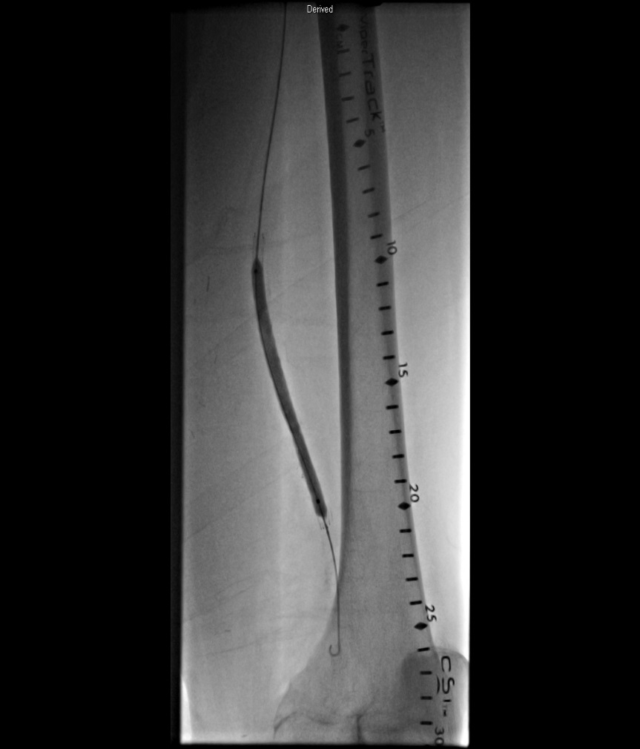

Slide 20
Take Home Message
Know your tools
Know your abilities and limitations
Think outside the box

