Slide 1
A Tale Of Two Cases Of In Stent Thrombosis (OCT guided management)
By
Dr. Adham Almowafy
Interventional cardioloy

Slide 2
Introduction
Stent thrombosis was defined and standardized by the academic research consortium (ARC) based on timing (Acute,Subacute,Late and very late)
Early stent thrombosis | 0 to 30 days after stent implantation
Acute stent thrombosis | 0 to 24 hours after stent implantation
Subacute stent thrombosis | >24 hours to 30 days after stent implantation
Late stent thrombosis | >30 days to 1 year after stent implantation
Very late stent thrombosis | >1 year after stent implantation

Slide 3
Causes of stent thrombosis
Stent Thrombosis: a Multifactorial Problem
Lesion
Long lesions
Small diameter
Multivessel
AMI
Diabetes
Bifurcations
Technical
Underexpansion
Incomplete wall apposition
Crush technique
Overlapping
Stent
Material
Polymer Matrix
Antirestenosis agent
Patient
Antiplatelet noncompliance
clopedogrel resistance
Adapted and modified from: Kereiakes D., et. al., Rev Cardiovasc Med. 2004;5(1):9-15.

Slide 4
Early stent thrombosis
As compared with late or very late stent thrombosis, early (Acute and Subcute)stent thrombosis emerged to occur independent of stent type and was more likely to be associated with mechanical factors such as malaposition, underexpansion and dissections.

Slide 5
Incomplete stent apposition (malapposition)
By definition, malapposition occurs when the distance between the stent and the vessel wall is greater than the sum of the strut thickness, polymer and minimal axial resolution of the OCT (20Mm). Starting from distance of 270 Mm and it is considered as a malaposition.
Incomplete stent apposition causes not early stent thrombosis, but emerged as important correlate of late or very late stent thrombosis.
The proportion of malapposed struts was significantly higher in lesion with stent thrombosis in recent OCT studies.

Slide 6
Malaposition in the setting of stent thrombosis
As the vessel contour can be depicted on the abluminal part of the struts, those struts are classified as malapposed.
Thrombus has fully occupied the space between struts and vessel suggesting that the struts are apposed. If vessel contour cannot be clearly visualized owing to the attenuating thrombus, the apposition status remains unclear.

Slide 7
Case #1
Male 58 y old.
NIDDM (type II)- 15 y ago.
HTN
EXSMOKER.
CABG SINCE (8 YEARS AGO)X2
LIMA------ LAD
SVG-------OM
Presented by NSTEMI and CAG revealed:
LM : Distal 80%, LAD: Prox. CTO, LCX: Prox. CTO, RCA: small non dominant.
LIMA to LAD: Patent.
SVG to OM show prox. 80% fixed by 1 DES (3X15 mm).

Slide 8
Case#1
After 8 hours patient develop ST segment elevation infero-lateral, killip IV.
Cathlab activated, IABP was inserted before angiography that showed : acute stent thrombosis of the stent in the proximal SVG to OM1.
OCT was done show in-stent thrombosis and malaposition.

Slide 9
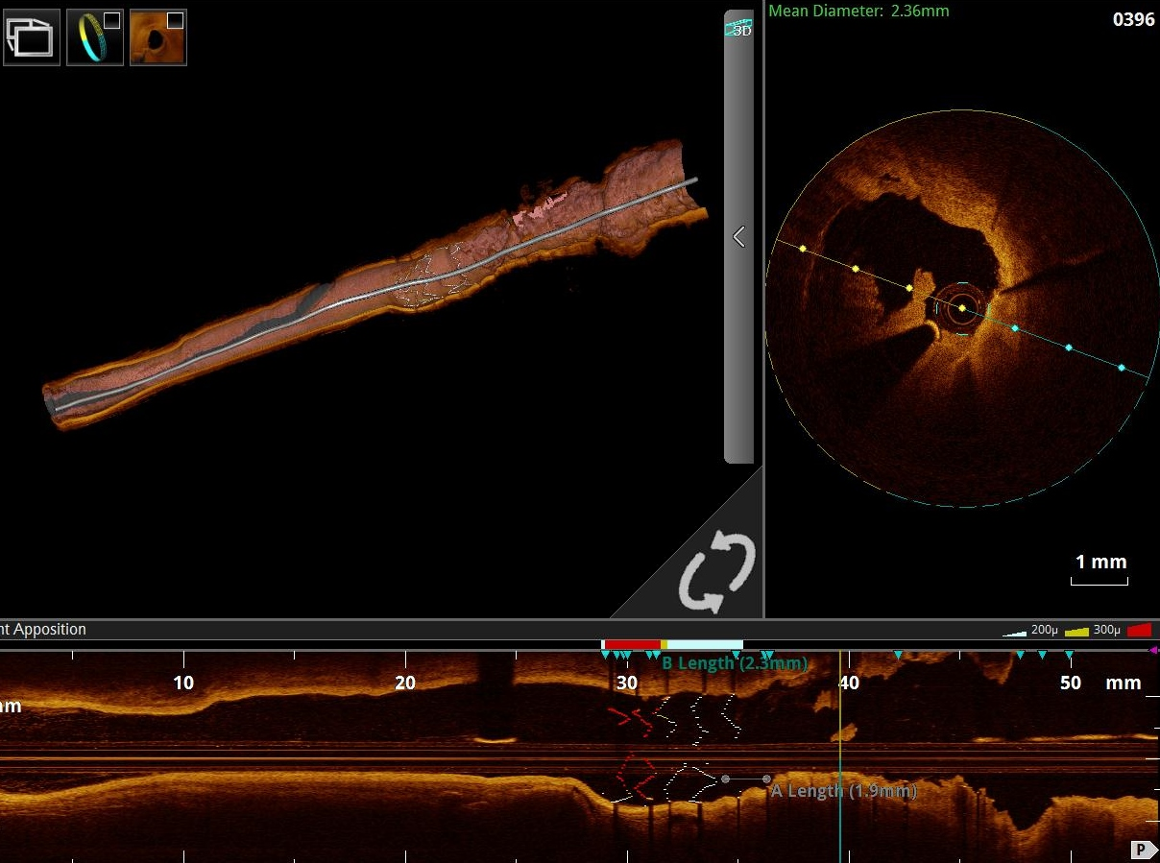
Case #1
SVG 1st obutuse marginal has acute stent thrombosis in Angiogram and using imaging technique “Ilumein Optis system “ (OCT St.Jude Medical/Abbott) 9

Slide 10
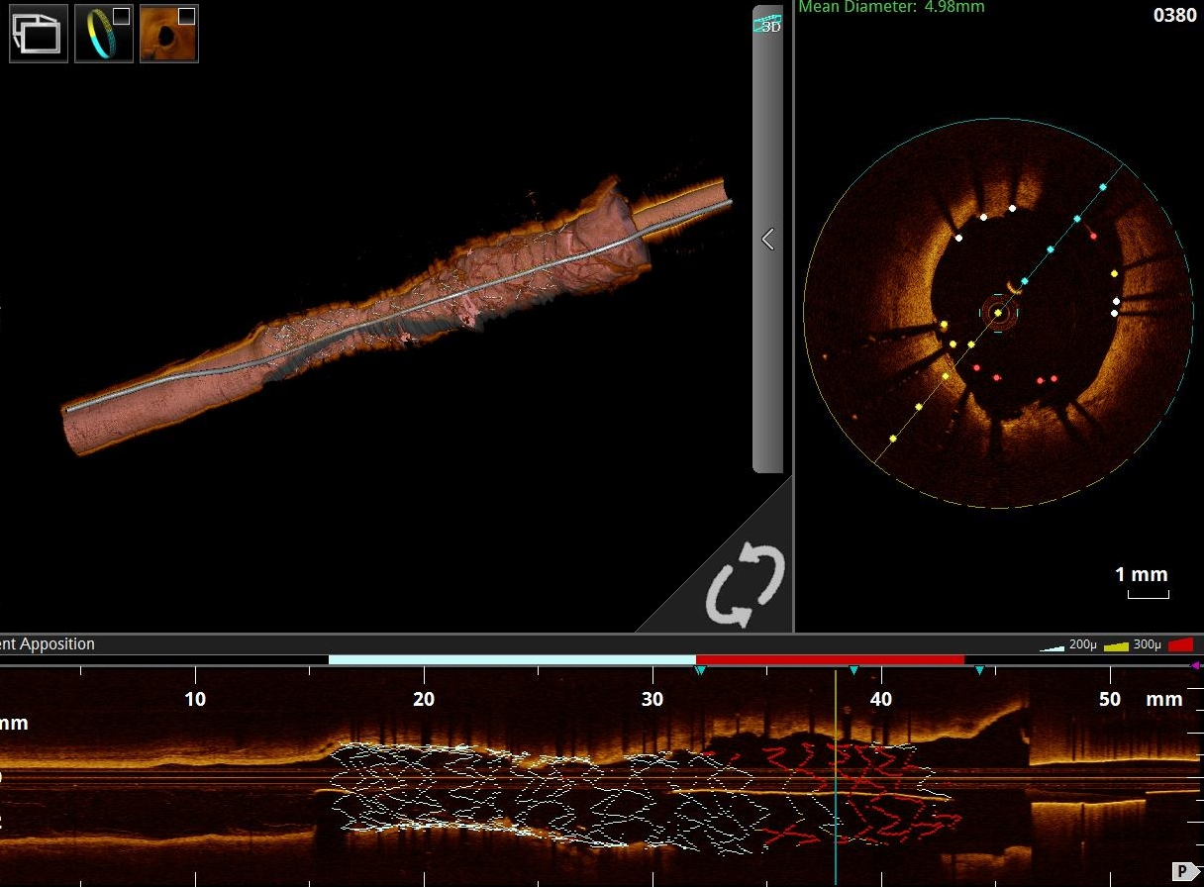
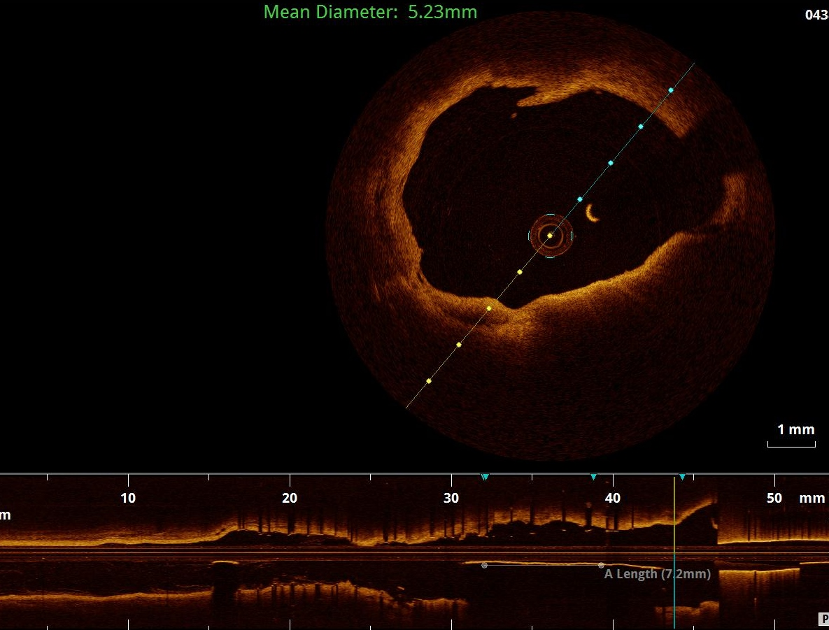
PCI was done with 1 DES (4.0x28 mm) inside the old stent, followed by post -dilatation with NC balloon(4.5x15mm), then 2nd run of OCT was done that showed again malaposition.

Slide 12
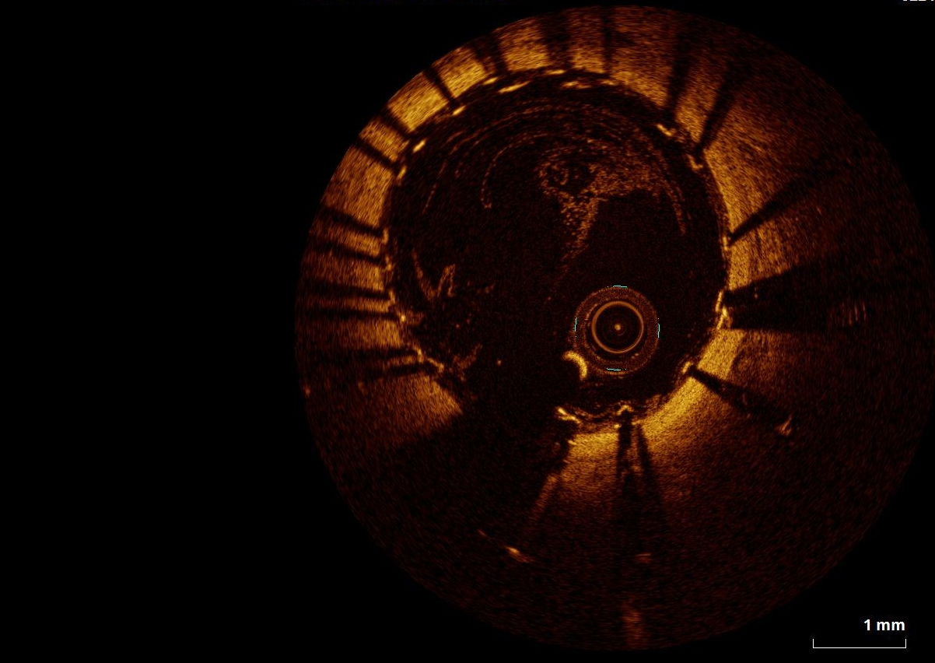
Then post-dilatation with bigger balloon (5x15mm), was used. then 3rd run of OCT was done showed well opposed fully expanded stent.

Slide 13
Case #2
54y old, male patient.
NIDDM (7y ago), HTN,DLP.
Presented with NSTEMI.
CAG was done which revealed:
LM: normal.
LAD: prox. 40%
LCX: prox. 70% fixed by 1 DES (2.5X28mm).
RCA: mid intraluminal thrombus causing subtotal occlusion fixed by 1DES(3.0x20 mm).
Dual antiplatelet (clopidogrel75mg & aspirin81mg) was prescribed.
After 3 days patient presented with inferior STEMI, cathlab activated and CAG revealed sub-acute stent thrombosis at RCA and LCX.

Slide 14
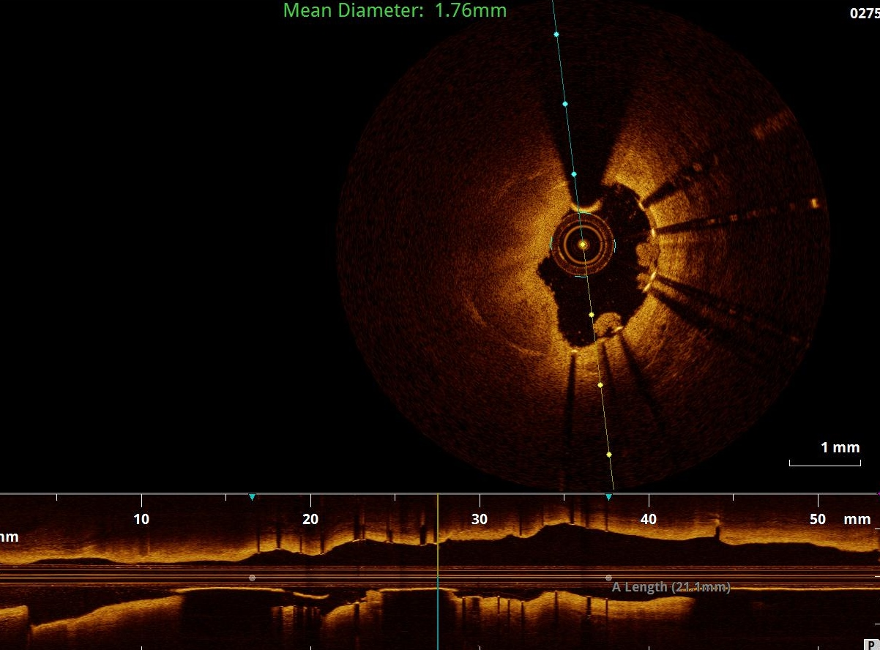
Case #2 OCT was done to RCA and LCX and showed well opposed well deployed stents in both arteries. That just treated with balloon dilatation.

Slide 15
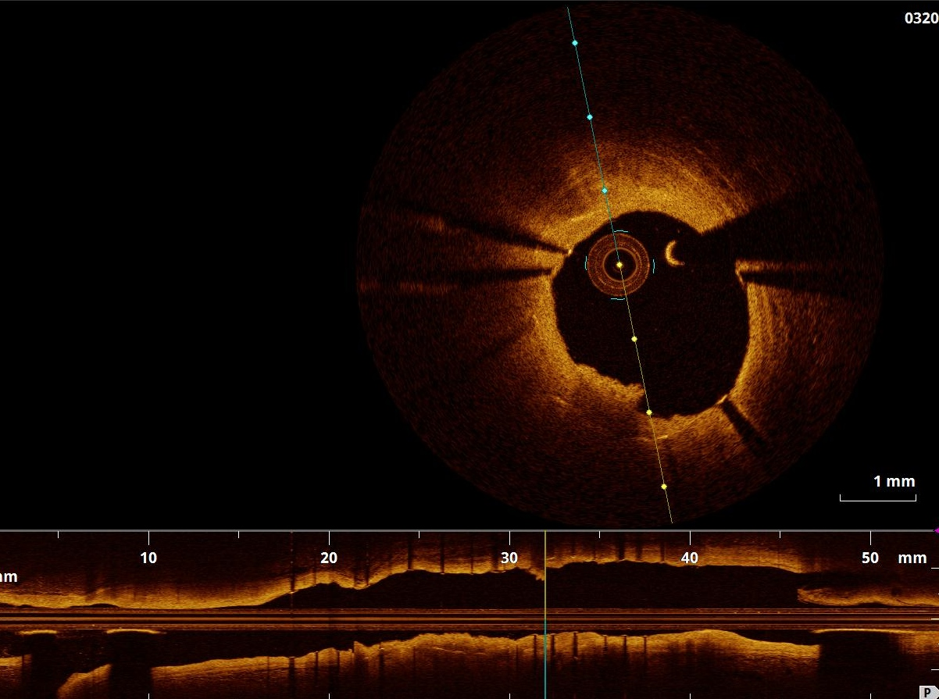
Final result for RCA

Slide 16
Pre-LCX

Slide 17
Final result with recommendation to change clopidogrel to tecagrelor.

Slide 18
OCT CLI-OPCI ACS substudy published
This substudy from the famous CLI-OPCI study explored the impact of post-PCI OCT findings in ACS Patients (n=507).
The study showed that suboptimal stenting is more common in ACS vs stable patients and is associated with adverse outcome.
In 1/3 of cases intrastent thrombus protrusion was observed
In 55% of cases suboptimal stenting (according to CLI-OPCI parameters in image) was detected by OCT

Slide 19
These outcomes indicate that OCT is useful to identify patients at increased risk, potentially requiring an adjusted/more aggressive treatment approach.

Slide 20
Take home messages
Stent thrombosis is devastating complication of PCI.
Incidence rates are reported from 0.5to1%. With mortality rates ranges from 25-40%.
Intravascular imaging should be used during PCI to ensure well expansion, good aposition and absence of significant edge dissection.
Intravascular imaging with IVUS or OCT can provide significant insight into underlying mechanisms causing stent thrombosis, and hence guide the management.
Clopidogrel resistance is an important cause of stent thrombosis, and should be diagnosed after exclusion of mechanical causes of stent thrombosis by imaging.

