Slide 1

Electronic Provider Notification to Facilitate the Recognition and Management of Severe AS
A Randomized Clinical Trial
Sammy Elmariah, MD, MPH, FACC
On behalf of the DETECT AS Investigators
Chief, Interventional Cardiology
Medical Director, Cardiac Catheterization Laboratory
Associate Professor, UCSF
@SammyElmariahMD

Slide 2
Disclosures
Within the past 24 months, I have had a financial interest, arrangement, or affiliation with the organizations listed below:
Financial Relationship
Consulting Fees
Research
Equity
Company
Edwards Lifesciences
Edwards Lifesciences, Medtronic, Abbott
Prospect Health

Slide 3
Background
Symptomatic severe aortic stenosis (SSAS) is associated with high morbidity and mortality.
Data have demonstrated significant undertreatment of SSAS with high associated mortality that disproportionately impacts women, the elderly, and racial/ethnic minority groups.¹
ACC and AHA established new performance and quality metrics, identifying %SSAS receiving AVR within 90 days as a key metric.²
AHA launched the Target: Aortic Stenosis program, a national quality initiative, to improve care and outcomes for patients with severe AS.³

Slide 4
Objective
To evaluate the efficacy of electronic provider notification (EPN) in improving rates of AVR for severe AS with 1 year of diagnostic transthoracic echocardiography (TTE).

Slide 5

Study Design
Pragmatic, single-blinded, randomized controlled trial and quality improvement initiative conducted within the multicenter MGH academic health system.
Enrollment occurred from March 2022 to November 2023, and follow-up was conducted through November 2024 to complete 1-year follow-up for all patients.
The study was an investigator-initiated study sponsored by Edwards Lifesciences. The authors are solely responsible for the design and conduct of the study, data analyses, or disclosure of data. Methods are further detailed in a previously published manuscript.
ClinicalTrials.gov identifier: NCT05230225

Slide 6
Inclusion & Exclusion Criteria
Providers were eligible if their patient was found to have an aortic valve area (AVA) of 1.0 cm² or less on TTE.
Patients with prior aortic valve replacement (bioprosthetic or mechanical valve) or without a cardiologist, primary care physician, or TTE-ordering provider affiliated with the Massachusetts General Brigham (MGB) network were excluded

Slide 7
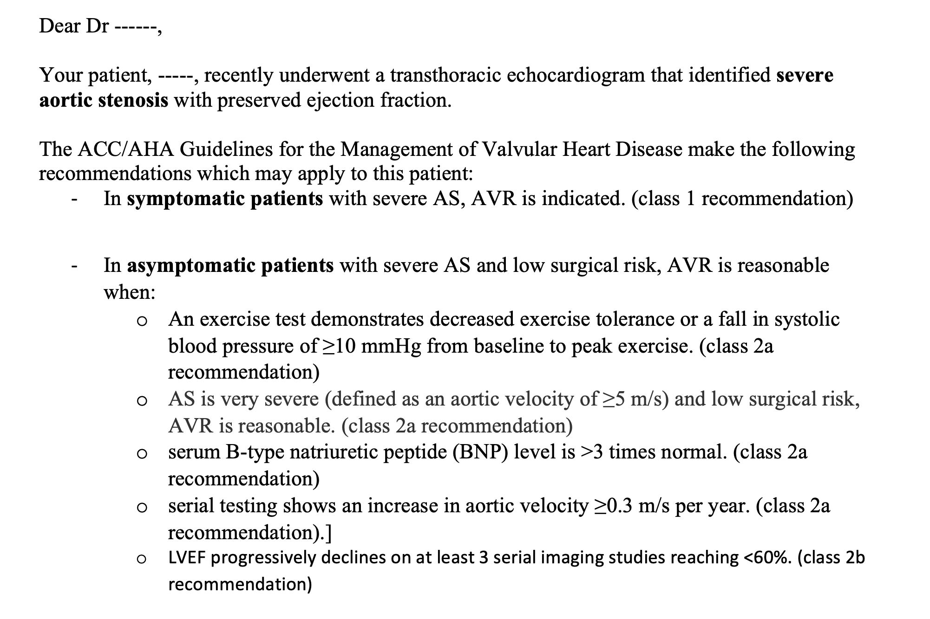
Electronic Provider Notification
Personalized EPN delivered via e-mail and EMR inbasket based on AS characteristics:
  High gradient with normal LVEF: mAVG ≥40 mmHg, LVEF ≥50%
  High gradient with low LVEF: mAVG ≥40 mmHg, LVEF <50%
  Low gradient with normal LVEF: mAVG <40 mmHg, LVEF ≥50%
  Low gradient with low LVEF: mAVG <40 mmHg, LVEF <50%

Slide 8
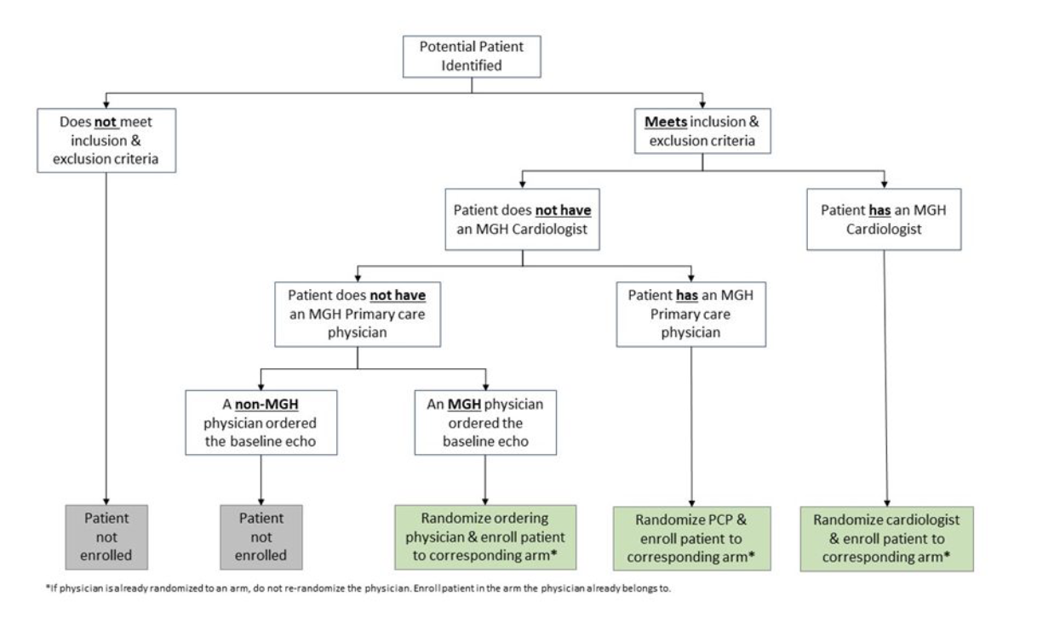
Hierarchical EPN Algorithm

Slide 9
Primary Endpoint
The proportion of patients with severe AS receiving AVR within 1-year of the index TTE

Slide 10
Secondary Endpoints
All-cause mortality
Heart failure hospitalization
Follow-up TTE utilization
Assignment of an International Classification of Diseases-10 (ICD-10) billing code indicative of AS
Specialist referral

Slide 11
Study Flow

Slide 12
Baseline Patient Characteristics
 | Notification n = 496 | Control n = 443
Age | 77.7 (10.5) | 76.9 (11.8)
Female | 248 (50%) | 189 (43%)
Caucasian | 450 (96%) | 412 (96%)
Hispanic ethnicity | 15 (3.2%) | 11 (2.6%)
Diabetes | 153 (31%) | 129 (29%)
Hypertension | 414 (83%) | 350 (79%)
Dyslipidemia | 382 (77%) | 310 (70%)
Atrial fibrillation | 184 (37%) | 149 (34%)
Prior cardiac surgery | 47 (9.5%) | 41 (9.3%)
Chronic kidney disease | 132 (27%) | 106 (24%)
End-stage renal disease | 17 (3.4%) | 19 (4.3%)
COPD | 55 (11%) | 46 (10%)
O2 dependence | 6 (1.2%) | 6 (1.4%)
Dementia | 16 (3.2%) | 7 (1.6%)
Cirrhosis | 17 (3.4%) | 18 (4.1%)
Metastatic cancer | 9 (1.8%) | 5 (1.1%)
Symptomatic | 305 (61%) | 241 (55%)
Provider Specialist
Valve specialist (IC or CTS) | 103 (21%) | 53 (12%)
Cardiologist (Non-Valve specialist) | 311 (63%) | 309 (70%)
Primary Care Physician | 68 (14%) | 49 (11%)
Other | 14 (2.8%) | 32 (7.2%)
Inpatient echocardiogram location | 151 (30%) | 127 (29%)

Slide 13
Baseline Echo Characteristics
 | Notification n = 496 | Control n = 443
AV Area² | 0.8 (0.2) | 0.9 (0.1)
AV Peak Gradient² | 59.8 (21.1) | 61.8 (21.0)
AV Mean Gradient | 35.2 (13.3) | 36.8 (19.4)
AV Mean Gradient Category
AV mean gradient <40 | 327 (66%) | 272 (61%)
AV mean gradient >=40 | 169 (34%) | 171 (39%)
LVEF | 61.7 (12.3) | 62.9 (11.6)
LVEF Category
LVEF <50% | 70 (14%) | 53 (12%)
LVEF >=50% | 426 (86%) | 389 (88%)

Slide 14
Primary Endpoint
60%
EPN
Usual Care
40%
Cumulative Incidence of AVR
20%
Gray's test p<0.001
0%
0
50
100
150
200
250
300
350
Number at Risk:
Days
EPN
496
403
338
298
274
255
235
216
Usual Care
443
362
322
287
267
254
242
227

Slide 15
Symptomatic Patients
EPN
60%
Usual Care
40%
Cumulative Incidence of AVR
20%
Gray's test p=0.001
0%
0
50
100
150
Days
200
250
300
350
Number at Risk
Notification
305
220
166
138
123
110
95
87
Control
241
177
146
120
110
100
91
87

Slide 16
Survival

Slide 17
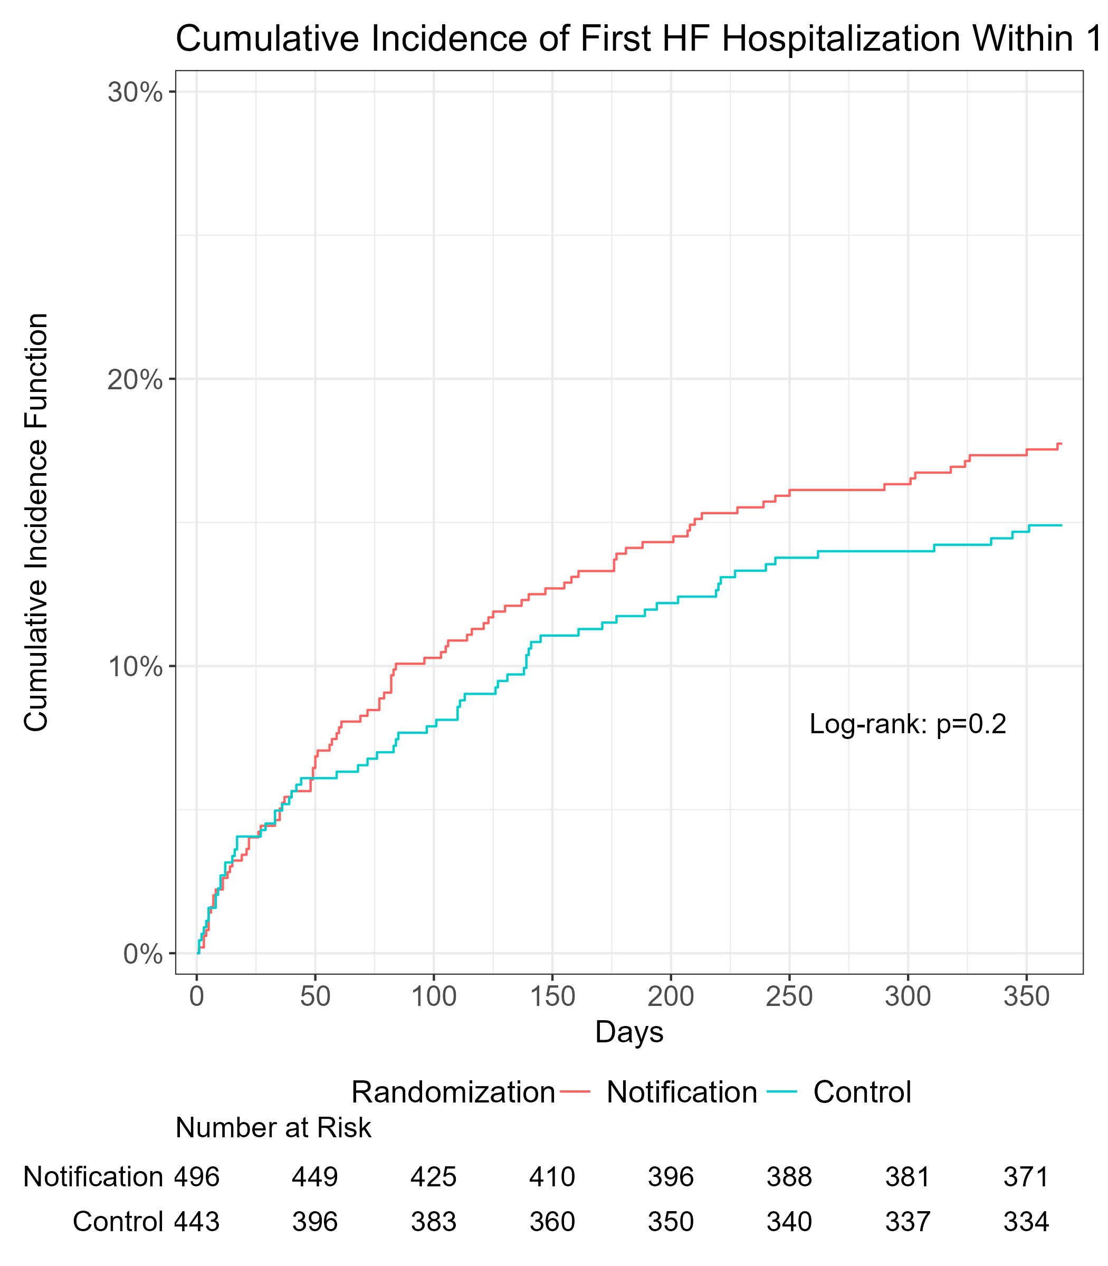
Secondary Endpoints
Heart Failure
ICD-10 Diagnosis

Slide 18
Evaluation & Referral
Among patients cared for by PCP or other, non-cardiac specialists, referral to cardiology services was more frequent with EPM that usual care (63.4 vs. 39.5%; p = 0.004).
Referral from cardiology to valve specialists (41.2 vs. 34.3%; p = 0.09).
Repeat TTE within 1-year of the index study also occurred more frequently with EPN (18.8 vs. 13.8%; p = 0.05).
Confirmatory Testing in Low-Gradient AS
 | Notification (n=327) | Control (n=272 | P value
Any confirmatory study | 134 (41%) | 85 (31.2%) | 0.02
Cardiac Cath | 8 (2.5%) | 6 (2.2%) | 1
Cardiac CT | 131 (40.1%) | 82 (30.1%) | 0.01
Dobutamine stress testing | 2 (0.6%) | 1 (0.4%) | 1
Patients with multiple confirmatory studies | 7 (2.1%) | 5 (1.8%) | 1

Slide 19
Subgroup Analyses

Slide 20
Subgroup Analyses
Subgroup
Patients
AVR rate
(Notification vs. Control)
Odds ratio
[95%CI]
P-Value
P-Value for
Interaction
Age, year
0.57
<65
110
53.8% vs. 50.0%
1.17 [0.55, 2.47]
0.69
65-80
444
53.9% vs. 42.6%
1.60 [0.96, 2.64]
0.07
>80
385
40.7% vs. 26.0%
2.00 [1.17, 3.41]
0.01
Sex
0.006
female
437
46.8% vs. 25.9%
2.78 [1.69, 4.57]
<.001
male
500
49.8% vs. 45.5%
1.16 [0.73, 1.83]
0.53
AV Mean Gradient
0.91
<40
599
34.3% vs. 22.4%
1.83 [1.21, 2.77]
0.004
>=40
340
75.1% vs. 60.8%
1.89 [1.03, 3.46]
0.04
LVEF
0.55
<50%
123
50.0% vs. 34.0%
1.94 [0.93, 4.06]
0.08
>=50%
815
47.9% vs. 37.8%
1.55 [1.05, 2.28]
0.03
Symptom Status
0.18
With Symptom
546
60.7% vs. 46.5%
1.77 [1.17, 2.65]
0.006
No symptom
392
28.3% vs. 26.4%
1.23 [0.71, 2.11]
0.46
Echo location
0.09
Inpatient
278
53.6% vs. 33.1%
2.49 [1.44, 4.31]
<.001
Outpatient
661
45.8% vs. 38.9%
1.27 [0.81, 1.99]
0.30
Provider Specialty
0.51
Cardiologist (Valve specialist)
156
71.8% vs. 56.6%
1.96 [0.98, 3.91]
0.06
Cardiologist (Non-Valve specialist)
620
44.1% vs. 38.5%
1.26 [0.85, 1.88]
0.25
Primary Care Physician
117
36.8% vs. 20.4%
2.27 [0.97, 5.31]
0.06
Other
46
21.4% vs. 18.8%
1.18 [0.25, 5.60]
0.83
-0.2
0.0
0.2
0.4
Usual Care Better
Notification Better

Slide 21
Exploratory Analysis
Within the subgroup of patients with mAVG<40 mmHg that underwent diagnostic testing confirming severe AS, 76.6% (49 of 64) in the EPN arm underwent AVR compared to 56.8% (24 of 44) with usual care (OR 4.37; 95% CI 0.96-19.96; p=0.06).
Confirmed severe AS defined by invasive hemodynamic assessment, dobutamine stress test, or aortic valve calcium score of ≥1200 Agatston units in women or ≥2000 Agatston units in men.

Slide 22
Limitations
Study results may not be generalizable to less integrated health systems or within community or private healthcare settings.
Providers may have become aware of the ongoing trial which may have influenced referral patterns and treatment decisions.
Racial and ethnic homogeneity limits our ability to evaluate impact of EPN on disparities.
Inclusion of asymptomatic and pseudo-severe AS patients biases study results towards the null and may lead to underestimation of EPN efficacy.

Slide 23
Conclusions
In the management of patients with aortic stenosis and AVA ≤ 1.0cm², EPN compared to usual care resulted in:
Higher rates of AVR
Prolonged survival-time through 1-year
Reduced disparities in AVR delivery across genders, age groups, and healthcare setting (inpatient vs. outpatient)
More frequent specialist referral and confirmatory diagnostic testing for severe AS

Slide 24
Clinical Implications
Electronic provider notifications are a simple scalable tool to raise awareness of critical echocardiographic findings of severe AS and to encourage its guideline-directed diagnosis, referral, and treatment of severe AS.

Slide 25
Thank you!

