Slide 1
The JenaValve Trilogy™ Heart Valve System in High Surgical Risk Patients with Symptomatic, Severe Aortic Regurgitation
2-year Outcomes From The ALIGN AR Trial
Torsten P. Vahl, MD
and Vinod H. Thourani, MD for the ALIGN-AR Investigators
The Trilogy THV System is for Investigational Use Only in the United States and is Limited by Federal (or United States) law for this use.

Slide 2
Disclosure of Relevant Financial Relationships
Within the prior 24 months, I have had a relevant financial relationship with a company producing, marketing, selling, re-selling, or distributing healthcare products used by or on patients:
Nature of Financial Relationship | Ineligible Company
Grant/Research Support | Edwards Lifesciences, Boston Scientific, Medtronic, JenaValve
Consultant Fees/Honoraria | 4C Medical, Abbott, Innovheart, Philips
Individual Stock(s)/Stock Options | None
Royalties/Patent Beneficiary | None
Executive Role/Ownership Interest | None
Other Financial Benefit | None
All Relevant Financial Relationships have been mitigated.
Faculty disclosure information can be found on the app

Slide 3
Purpose
Report 2-year outcomes from the ALIGN-AR pivotal trial evaluating TAVR with the Trilogy transcatheter heart valve (THV) amongst high surgical risk patients with symptomatic ≥3+ aortic regurgitation

Slide 4
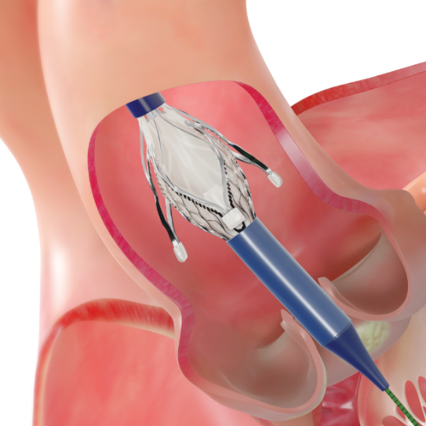
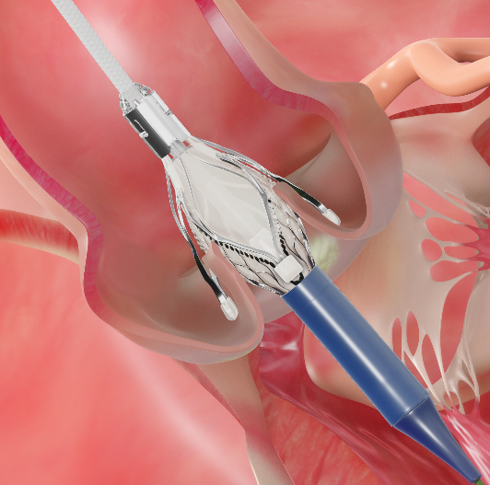
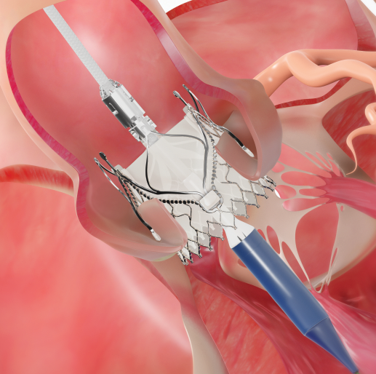
Trilogy Porcine Pericardial Valve
27-31F opening
Alignment
Positioning/Anchoring
Deployment
Aligns THV with native cusps
Locators “clip” onto native leaflets forming a natural seal and stable securement
Large open cells provide access to low coronaries
Flared sealing ring conforms to annulus

Slide 5
ALIGN AR Study Design
Multicenter, Non-blinded, Single Arm Evaluation of Patients with Symptomatic ≥3+ Aortic Regurgitation at High Risk for Surgery
Trilogy THV Implantation
Clinical Evaluation, Echocardiography, Functional and QoL Assessment at 30 Days, 6 Months, 1 Year and Annually up to 5 Years
30 Day Primary Safety Endpoint
1 Year Primary Efficacy Endpoint
Comparison with Prespecified Performance Goal

Slide 6
Consort Diagram
180 Patients Enrolled in ALIGN-AR
180 (100%) included in 1-year follow up
Lost to Follow-up (n=1)
Day 561
Withdrew (n=2)
Day 408
Day 440
Valve Explant for Endocarditis (n=1)
Day 380
176 (98%) Included in 2-year follow-up

Slide 7
Primary Efficacy Endpoint at 1 Year*
Enrolled Population
^{N=180}
25% prespecified non-inferiority margin
Rate 7.8%
Upper 1-sided 97.5% CI
12.3%
P <0.0001
Non-inferiority criteria met for primary efficacy endpoint
*All-cause mortality

Slide 8
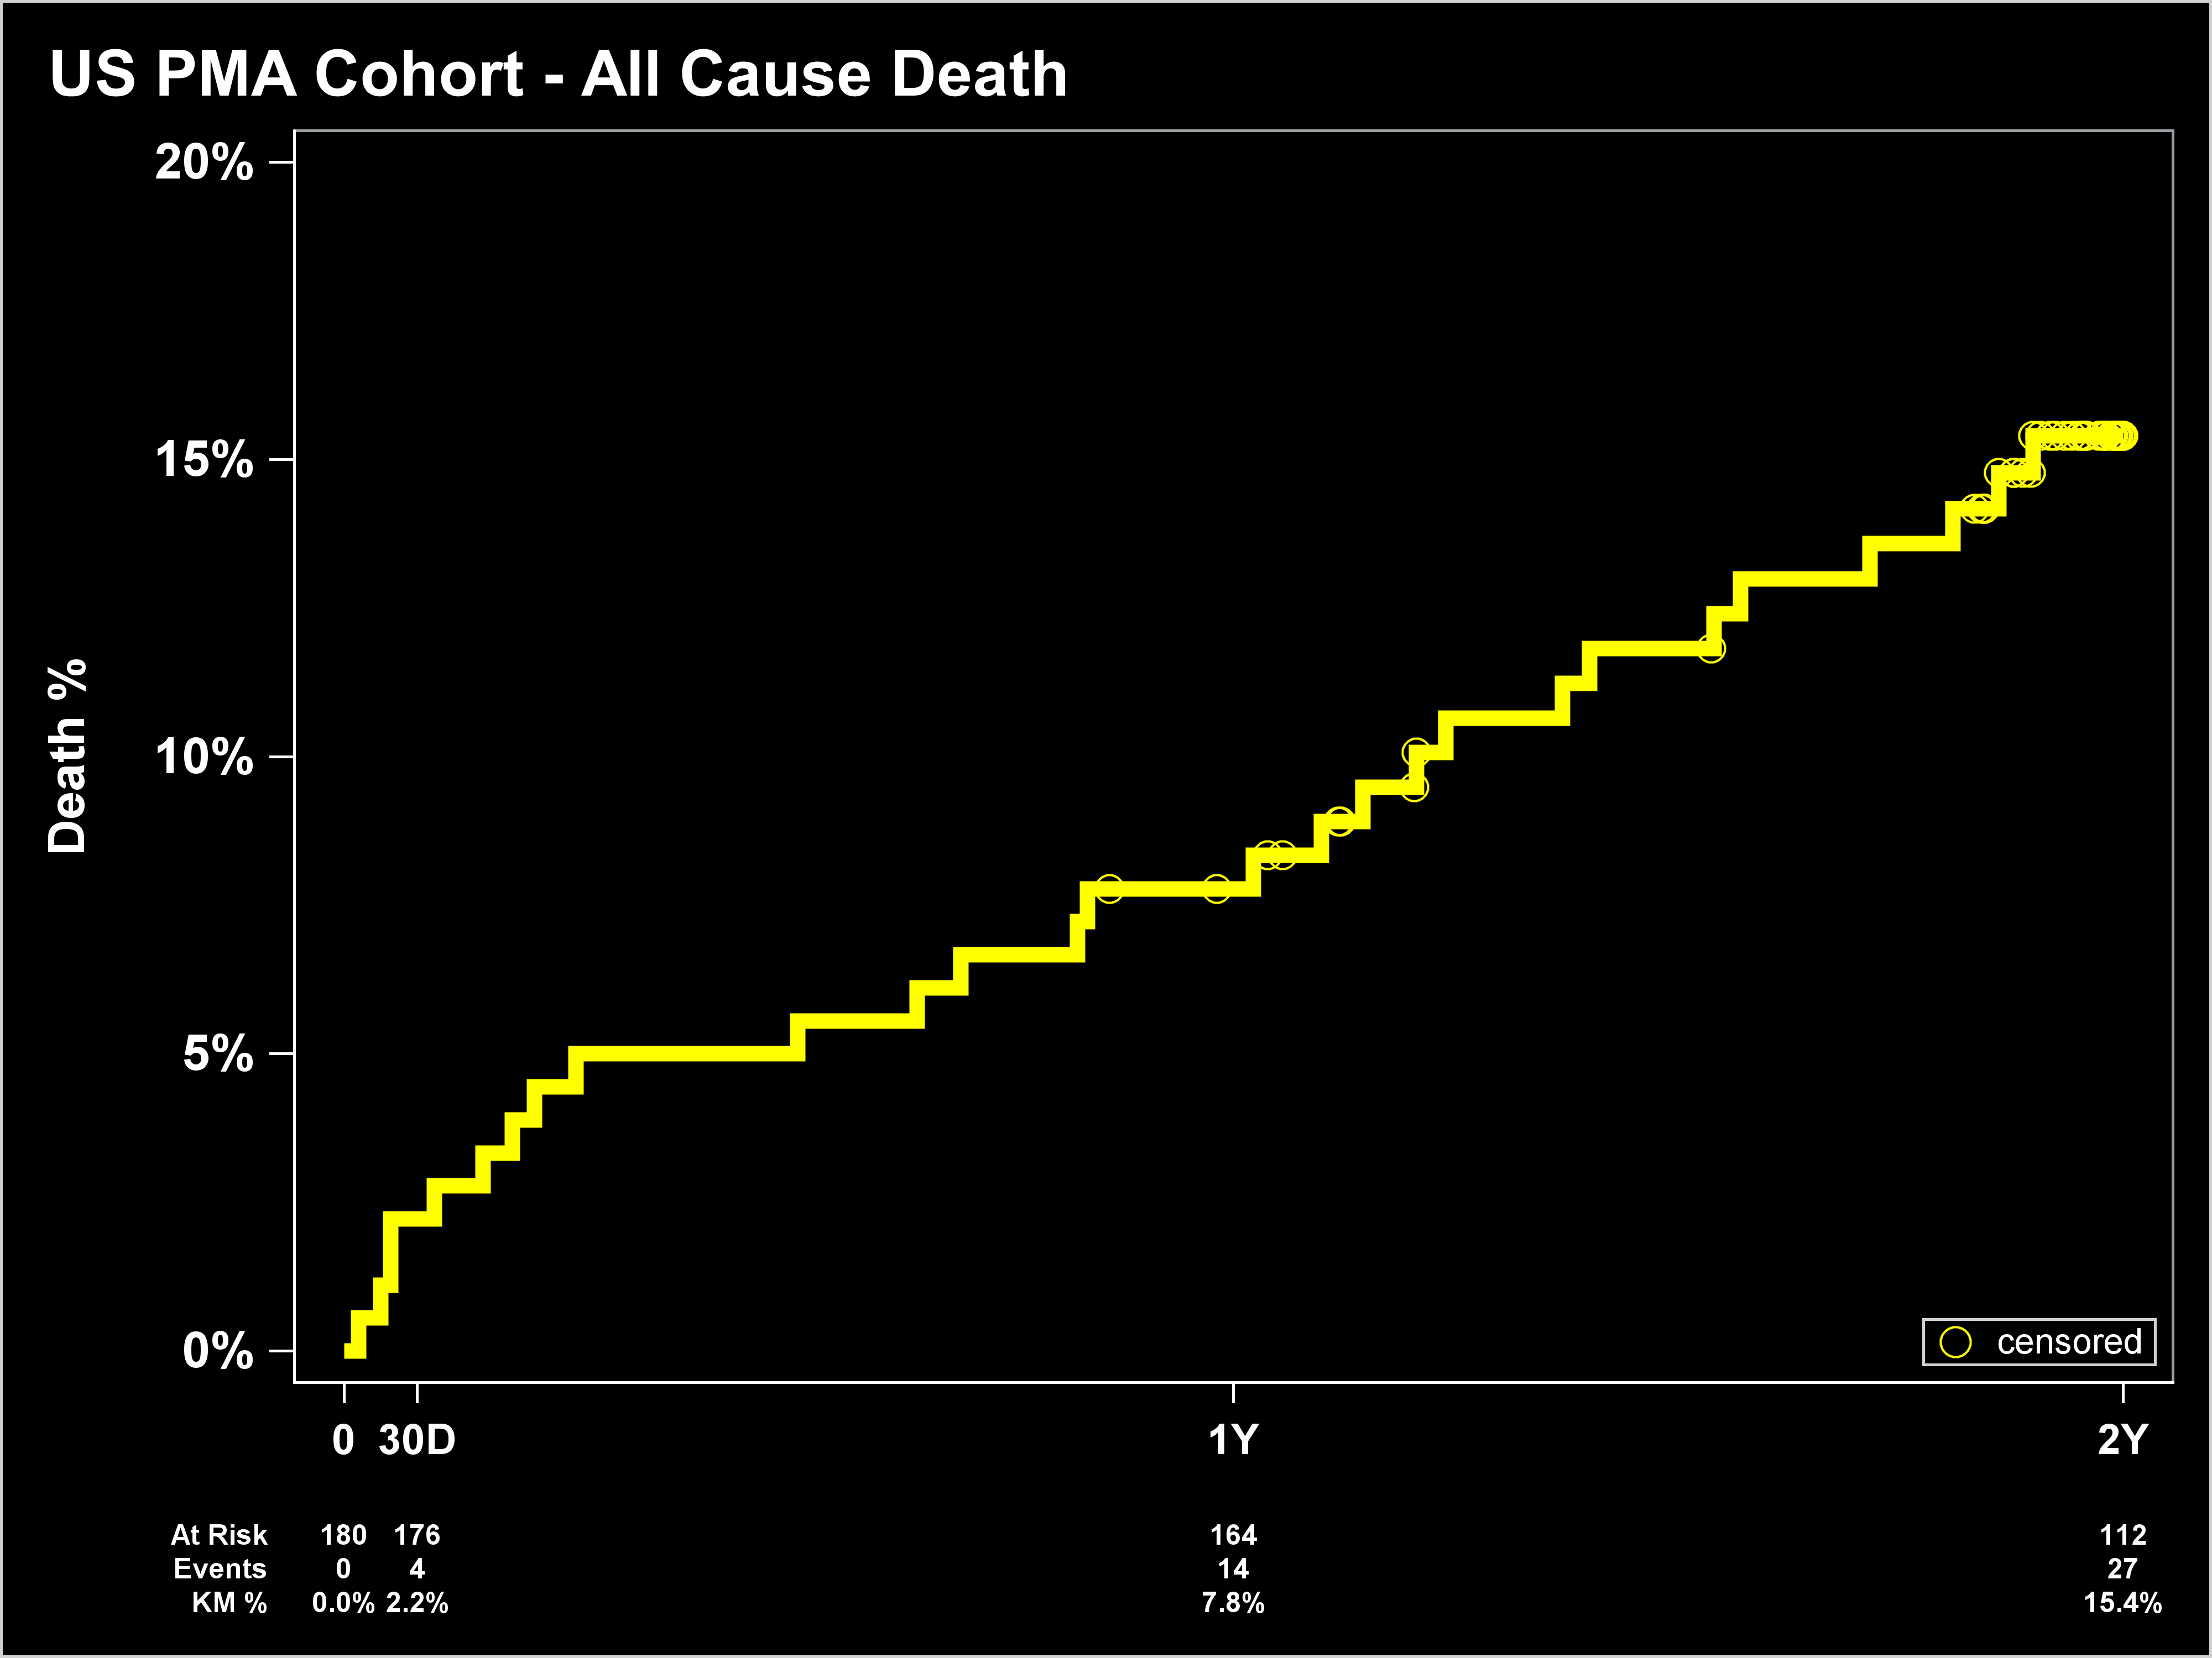
All-Cause Mortality at 2 Years
15.4%
All Cause Mortality %
7.8%
2.2%
Number at Risk
180
176
164
112
Number of Events
0
4
14
27

Slide 9
All-Cause Mortality at 2 Years
15.4%
All Cause Mortality %
7.8%
2.2%
Number at Risk
180
176
164
112
Number of Events
0
4
14
27

Slide 10
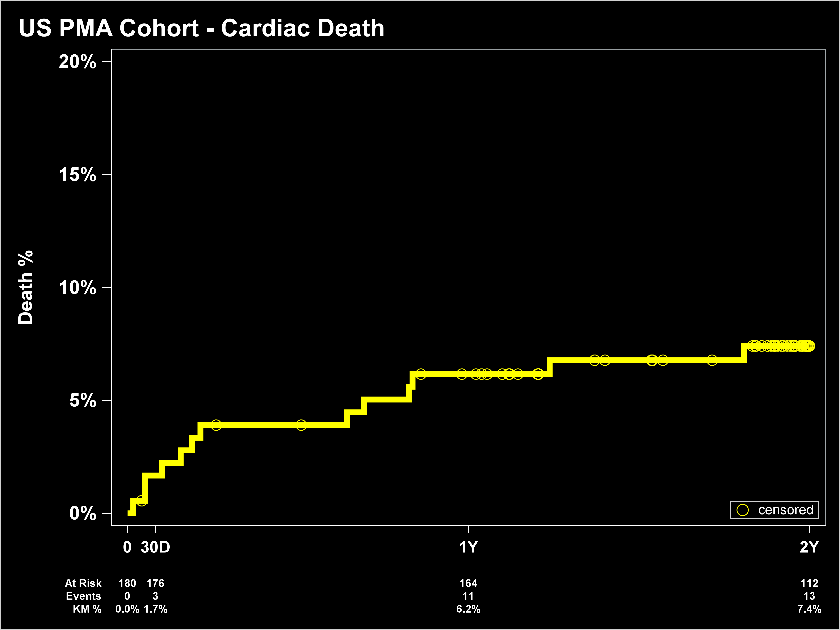
Cardiovascular Mortality at 2 Years
Cardiovascular Mortality %
7.4%
6.2%
1.7%
Number at Risk
180
176
164
112
Number of Events
0
3
11
13

Slide 11
Cardiovascular Mortality at 2 Years
Cardiovascular Mortality %
7.4%
6.2%
1.7%
Number at Risk
180
176
164
112
Number of Events
0
3
11
13

Slide 12
Hemodynamic Valve Performance
²

Slide 13
Paravalvular Regurgitation

Slide 14
NYHA Functional Class

Slide 15
The ALIGN AR Trial: 2 Year Follow-up Conclusions
Mortality was primarily noncardiac between 1 and 2 years in this population with numerous comorbidities
Hemodynamic valve performance was favorable beyond 1 year with average EOA >2.5 cm² and mean transvalvular gradient <5 mmHg and no cases of hemodynamic valve deterioration
The favorable LV remodeling findings observed by echocardiography at 1 year were sustained at 2 years
The improvements in NYHA functional class and KCCQ-OS observed at 1 year were preserved at 2 year follow-up

